Slide 1
General Assembly - DSI Capstone Project
“Securing Your Human”
(Proof of Concept)
Aaron Kim
Nov 23, 2016
Notes:
1. My capstone, though theoretical in nature, focused around practical implementation of the proposed solution using some data science.

Slide 2
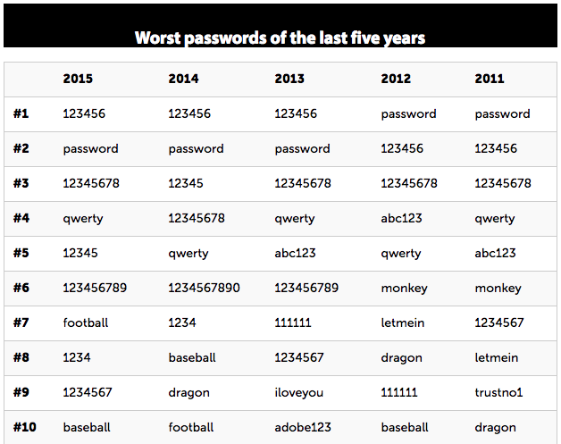
Introduction
Password compromise a constant security risk
Repeated password resets can lead to insecure reminders (post-its) or weak passwords (ie: password, 123456)
Source: http://www.computerworld.com/article/3024404/security/worst-most-common-passwords-for-the-last-5-years.html

Slide 3
Introduction
how can we minimize login failures / clicking on “forgot/reset password”?
Proposed solution:
adjust passwords based on user behavior

Slide 4
Project Objectives
Reduce/eliminate “forgot password” requests
Improve security by ”training” security to the user

Slide 5
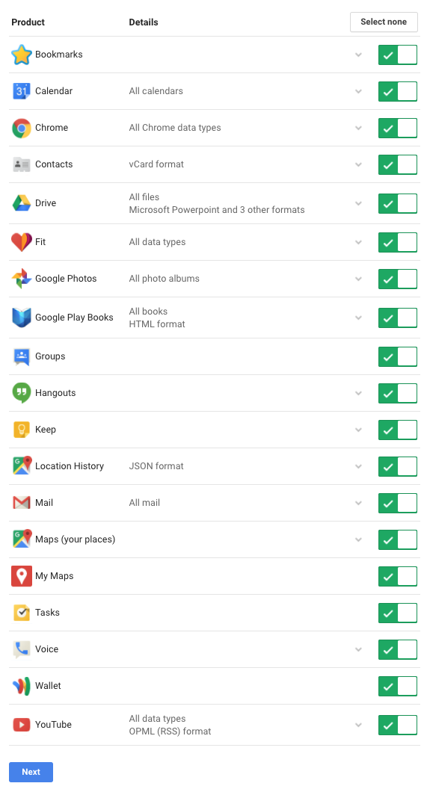
Data
Companies like google already aggregate a considerable amounts and dimensions of user data across their products/services
Notes:
What is something that we do every day? We move!

Slide 6
Data
For the scope of the proof-of-concept, focus on developing a challenge based on user location patterns.
Data collection through background location history via google maps app

Slide 7
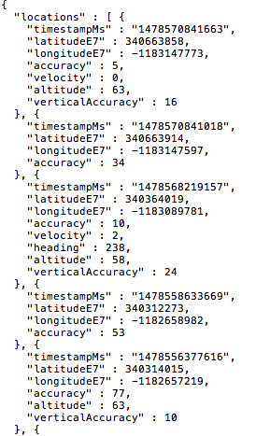
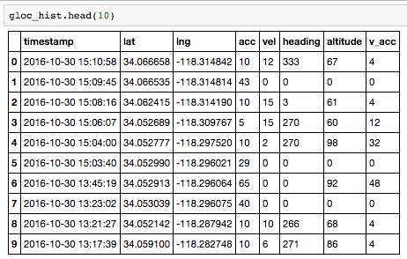
Data
Google maps locations data come prepared in JSON format
Notes:
How to approach making sense of this data?
Because we’re dealing with geospatial data, I figured an EDA approach around using methods and visualizations that were position sensitive would be the best approach.

Slide 8
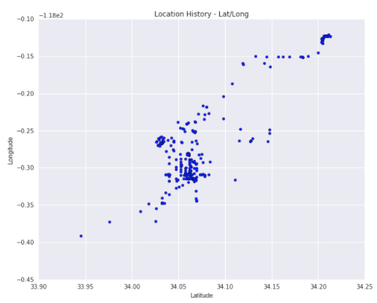
EDA
Plotting of coordinates reveals a general pattern of travel, but difficult to determine any possible points of interest (POI) from this visualization

Slide 9
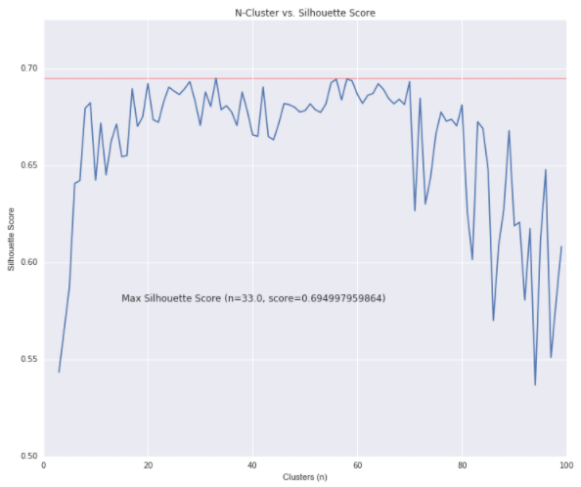
EDA
Use K-means on an estimated range of 2 to 100 possible POI
optimal number of clusters chosen at n=33 (based on silhouette score)
Notes:
Why silhouette score? The Silhouette Coefficient is a measure of how well samples are clustered with samples that are similar to themselves. (Sklearn documentation)

Slide 10
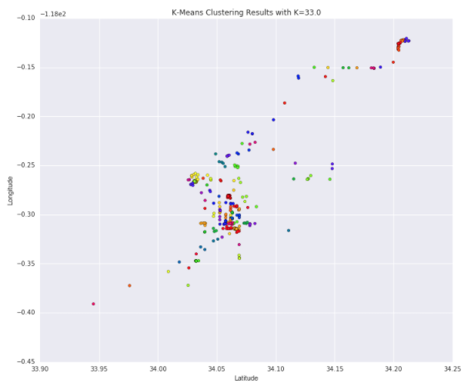
EDA
Grouping on n=33 results in a visualization that starts to show some possible hidden poi
Other options to improve clustering visualization?
Notes:
tsne - t-distributed Stochastic Neighbor Embedding.
Caveats?
TSNE –used as a representation of high-dimensional data. My data may or may not be considered high-dimension, but given it’s demonstrated ability to provide a better visualization alternative it’s worth also considering in EDA.
If data had higher dimensions, would consider using PCA first before TSNE.
Mainly computational reasons
Test for density – in future versions, should eventually try adding tests for datapoint density. In our case, we want dense data. If not dense, it would signify that the user is highly mobile thus the likelihood of successfully selecting a POI with HRP is reduced.

Slide 11
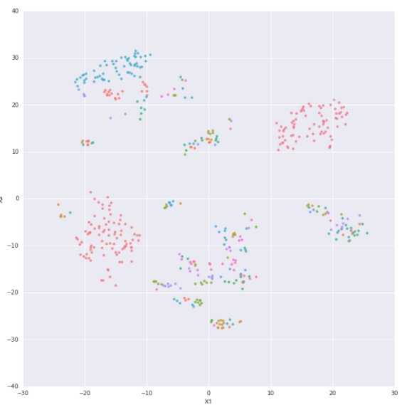
EDA
TSNE suggests existence of poi
user appears to frequent a few specific locations often
Notes:
Mention : Clusters may change with each run.

Slide 12
process
Procedurally identify poi (minimize need for human intervention/variable manipulation)
Identify features of poi for challenge extraction

Slide 13
process
POI features selected:
Number of datapoints (geolocation check-ins)
Statistical measures from .describe() method
Days visited (weekday vs weekend)
Weekday/Weekend only

Slide 14
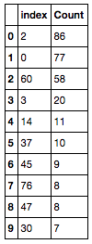
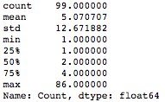

Poi selection
After assignment of poi id (based on cluster labels), group and order by count.
2. get distribution stats via the .describe() method, look for data points between 2~3 std deviations from the mean towards the max
3. selected poi ids considered significant (likely to be recalled correctly)
Notes:
2-3 std deviations -> 95% to 99.7% of data.
It may be possible that users who are highly mobile may not meet this threshold. User challenge-response trends (predictive indicator of whether the user will get location based challenge corrections correct) may override this threshold and bring down the restriction to 1 std deviation from the mean towards the max

Slide 15
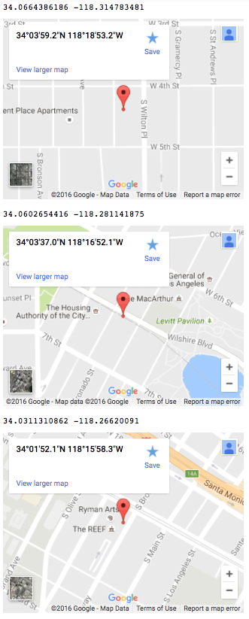
Poi selection
Visualization of geographical coordinates of the top three poi using google maps
Given that the location data is based on my own location history, I can verify that these locations are significant

Slide 16
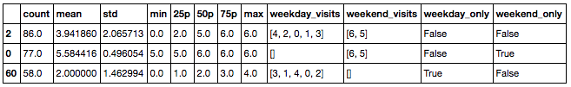
Poi selection
How do we narrow down our challenge from the set of significant poi?
DAYS LISTED IN
ORDER OF FREQUENCY
CHALLENGE GENERATOR
FEATURES OF INTEREST
SELECTOR
Notes:
Low std dev given pref -> low variance in datapoints suggests less movement in and around the location.

Slide 17
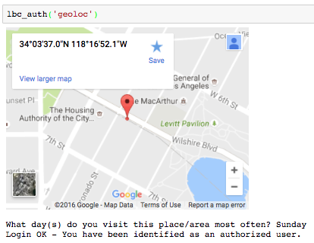
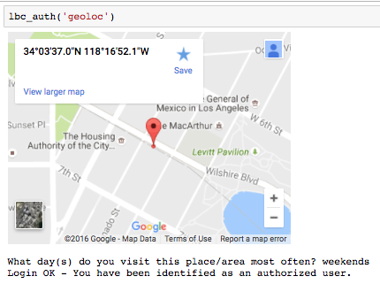
DEMO - Screenshot

Slide 18
Demo – wrap up
Can allow multiple answers
Challenge questions and responses are meaningful only to the user
Challenges will change depending on user behavior
Repeat failures will disqualify the question class (prevent brute force)

Slide 19
Thank You
Notes:
Final Thoughts – why clustering?
Based on the notion that humans are creatures of habit.

