Slide 1
NEUROCTI - A CUSTOM FINE-TUNED LLM FOR CTI
BENCHMARKING, SUCCESSES AND LESSONS LEARNED
Aaron Kaplan, Alexandre Dulaunoy, Jürgen Brandl, Paolo Di Prodi

Slide 2
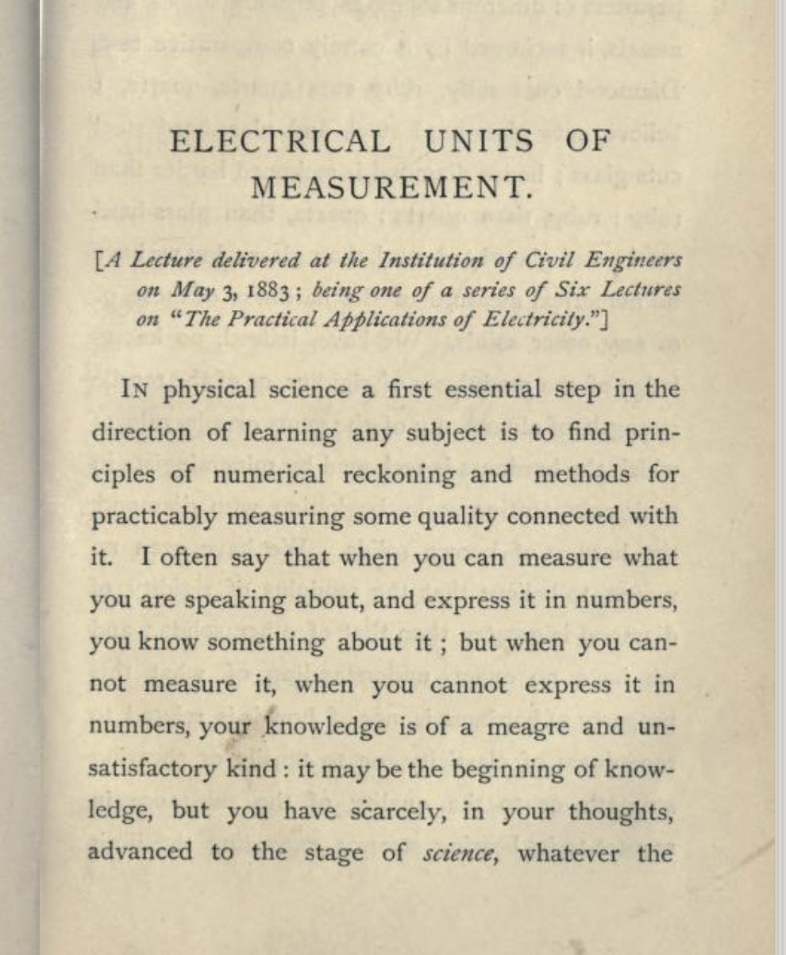
What you can’t measure, you can’t improve
Lord Kelvin
Notes:
Aaron

Slide 3
Intro speakers
Aaron Kaplan
Self-employed / EC-DIGIT-CSIRC
Previously 12 years @ CERT.at, Austria
Alexandre Dulaunoy
Leading CIRCL.lu
Makes and breaks stuff
Jürgen Brandl
senior cyber security analyst at the Federal Ministry of the Interior
Paolo di Prodi
Founder PRIAM.AI, previously senior data scientist at Microsoft and Fortinet.
+ lots of contributions from the FIRST AI SIG and benchmarking dataset sub-group (Jay Jacobs, Syra Marshall,…). Thank you!
Notes:
Aaron

Slide 4
Disclaimer
DISCLAIMER
Aaron
All errors are mine to keep
I present this here as a sole proprietor company under my own name
Alexandre Dulaunoy
CIRCL.lu
Jürgen Brandl
Opinions are my own
Paolo di Prodi
PRIAM.AI
Notes:
Aaron

Slide 5
Background
Intro AI SIG @ FIRST
Weekly meetings
Presentations and sharing of results
Join if you are interested: https://www.first.org/global/sigs/ai-security/ (please come and talk afterwards)
Idea of the AI Subgroup on Benchmarks
Notes:
Aaron

Slide 6
Constraints in typical CTI settings
Very often, we can not use ChatGPT/openai/anthropic/etc. via API
Data needs to stay internal
Local models FTW!
But: are they just as good?
Only a benchmark can tell!

Slide 7
Why do we need a benchmark for LLMs for CTI?
We identified 5 main uses cases:
UC 1: CTI analysists need to digest a lot of threat intel reports → Summarization
UC 2: Analysts might want to search (question-answering) on CTI reports → RAG
UC 3: Analysts would like to get the information out (“information extraction”) from CTI reports → NER
UC 4: Extracting MITRE TTPs from text reports → T-Codes mapping
UC 5: Extract relationships (“Threat Actor xyz is using Tool ABC to achieve 123”) → put into knowledge graph / STIX 2.x
Notes:
Aaron
We have many use-cases actually, but the main question always will be, … how well can we do it?

Slide 8
Core questions to evaluating AI in CTI
For uc in use-cases:
Can we do uc? (does it work with LLMs?)
Can we do it better than humans?
→ score against human
TPR , FPR, etc. metrics
When we have a FP (or FNs), can we detect it?
How do we need to integrate uc into our workflow? Where is the human-in-the-loop?
Notes:
Aaron

Slide 9
Re-cap presentation CTI Berlin
Notes:
Aaron

Slide 10
Notes:
Aaron

Slide 11
Related research & data
AnnoCTR
TRAM
MISP Galaxies
TRAM
CyNER
So far, all annotators that we found, were not ideal

Slide 12
CTI.tools workbench
Notes:
Jürgen

Slide 13
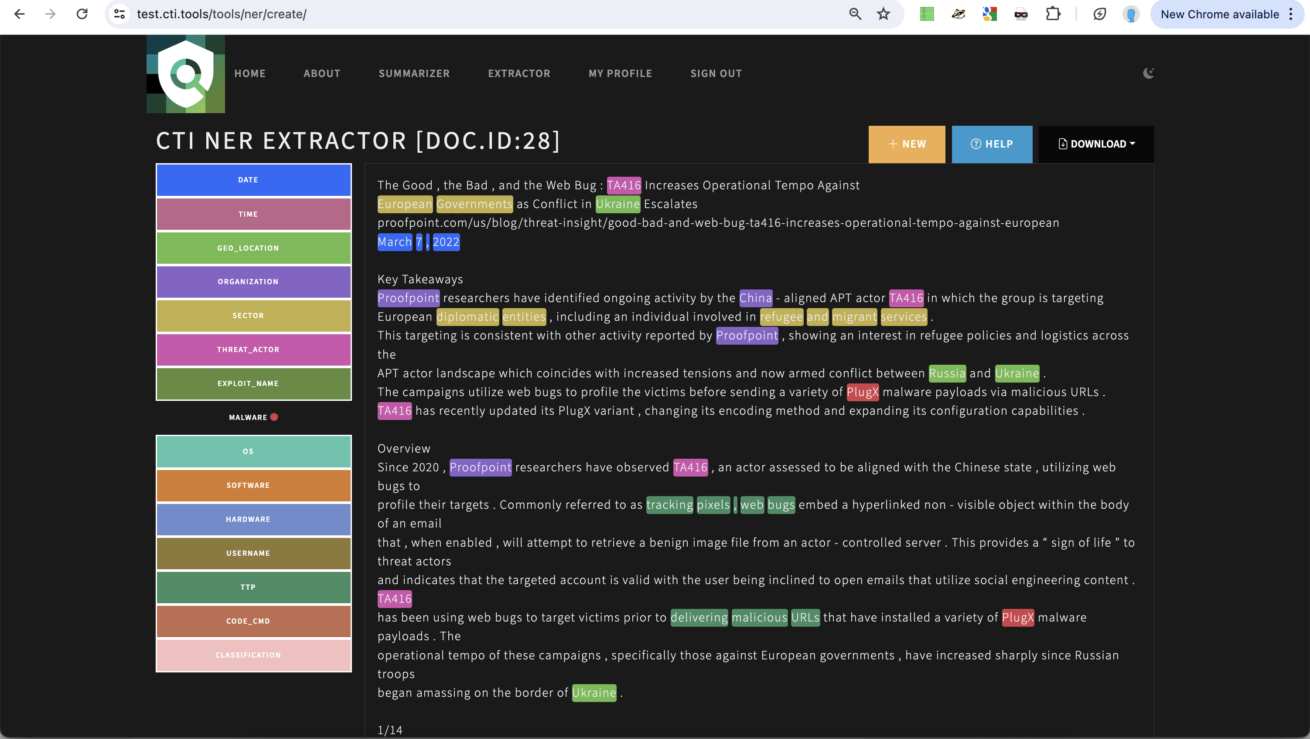
Notes:
Jürgen

Slide 14
CTI.tools - overview
Notes:
Jürgen

Slide 15
Live Demo
Notes:
Jürgen

Slide 16
Re-cap CTI.tools
It’s a workbench for annotation of CTI texts
It’s crowdsources (→ yes, we need YOU!)
The results are for everyone who participates
Helps create the benchmark as well as the training dataset
… leads to…
Notes:
Jürgen

Slide 17
NeuroCTI LLM
A custom LLM, fine-tuned on CTI texts
Notes:
Paolo

Slide 18
@Paolo… your slides and successes go here

Slide 19
Integration with MISP
Notes:
Alexandre

Slide 20
@Alex: your slides go here

Slide 21
Re-cap

Slide 22
What can the LLM do? Where do I get it?
…
Code: https://github.com/aaronkaplan/cti-llm
Help us with the annotations & get the LLM and training data faster !

Slide 23
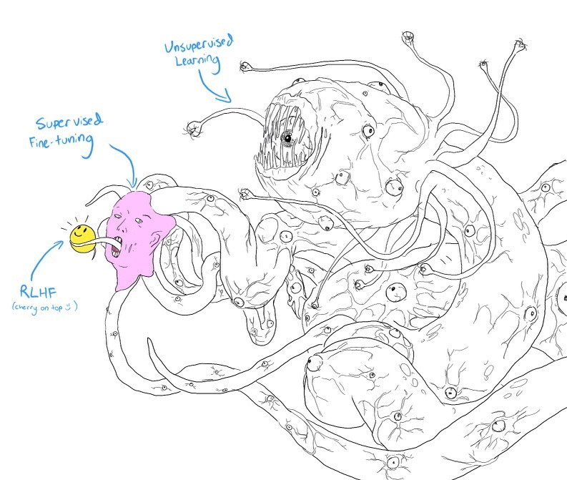
Challenges
Creating a good benchmark + training set is a monster
It’s hard
Confidence
Duplication
Naming Conventions and Aliases
Diverse sources of data – non uniform / no standard
Legal issues with releasing benchmark dataset

Slide 24
Your ideas?
Are you working on something similar? → let’s talk.
Join the AI SIG

Slide 25
Getting the code & data
https://github.com/aaronkaplan/cti-llm/

Slide 26
Let’s get in touch & thanks!
AI SIG subgroup on a benchmark dataset
https://www.first.org/global/sigs/ai-security/
https://github.com/aaronkaplan/cti-llm/
Help us with the annotations & get the LLM and training data faster !
Notes:
Aaron

