Slide 1
Appcelerator Titanium Alloy
Simple App, Step-By-Step

Slide 2
Getting Started
Follow Alloy download instruction
http://projects.appcelerator.com/alloy/docs/Alloy-bootstrap/index.html
https://github.com/appcelerator/alloy
Complete Project Source Code
https://github.com/aaronksaunders/SimpleAlloyPresentationApp

Slide 3
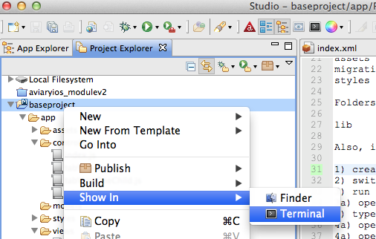
Create new project in TiStudio
Save Project
Open up terminal in project to add Alloy functionality

Slide 4
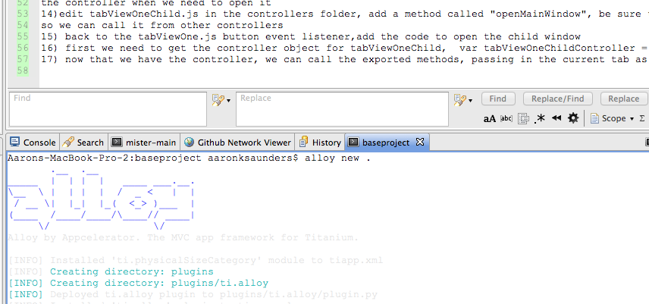
Create Alloy Project
In the terminal window you just created, type alloy new .
Output should look something like this

Slide 5

Modify index.js in controllers folder
Open app/controllers/index.js edit the file so it should look like this

Slide 6
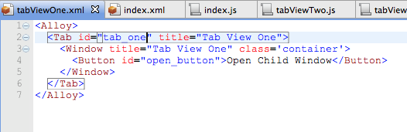
Create the Tabs for the TabGroup
Type alloy generate controller tabOneView
Open the file app/views/tabOneView.xml
Edit the file as follows

Slide 7
Tab creation, more details
We set an ids on objects so they can be accessed from controllers
We have a tab with a nested window and the button in the window

Slide 8
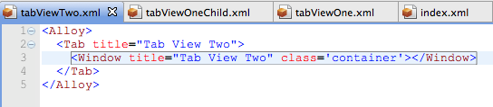
Tab creation, Tab View Two
Type alloy generate controller tabViewTwo
app/views/tabViewTwo.xml is very similar to tabViewOne.xml
We now have the tabs set up, lets create the tabGroup

Slide 9
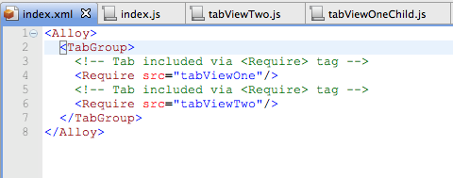
TabGroup Creation
Open app/views/index.xml
Add the TabGroup object and then nest the require statements using the controller file name for each tabView we created

Slide 10
TabGroup Creation, explanation
We are using <Require src=“”/> so we can modularize our code more efficiently.
The functionality for each components is separated into the specified controller file

Slide 11
Let’s See What We’ve Built
At this point you should be able to run you application and click through the two tabs and see the expected behavior
QUESTIONS

Slide 12
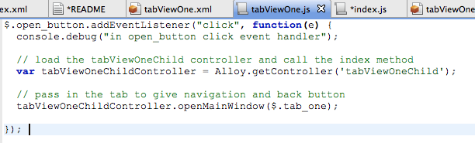
Navigating Between Windows
Open app/controllers/tabViewOne.js
Here we will add some action to what we have built to open a child window from app/views/tabViewOne.xml.

Slide 13
Navigating Between Windows
The $.open_button.eventListener will be called when the user clicks on “one_button”. The “$.” notation allows you to access your objects by id

Slide 14
Navigating Between Windows
Next we need to access the controller for the new window.
Alloy.getController(‘tabViewOneChild’); returns the controller object.

Slide 15
Creating new controller object
Type, alloy generate controller tabViewOneChild,
In this controller at app/controllers/tabViewOneChild.js we only need to open the view.
We pass in the tab object as a parameter for the function
To expose methods outside of controller we use exports

Slide 16
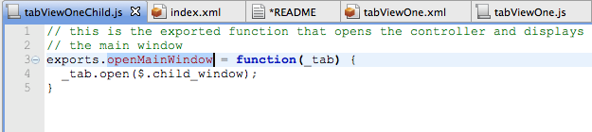
tabViewOneChild.js controller source
app/controllers/tabViewOneChild.js code should look like this when completed
We use the tab container to open the child window using the window id

Slide 17
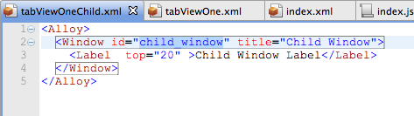
tabViewOneChild.xml view source
app/views/tabViewOneChild.xml code should look like this when completed
We simple window with label; the id is defined here so that the controller can access it.

Slide 18
Back to tabViewOne controller
Here we call the exported function we created in app/controllers/tabViewOneChild.js to open the window.
We have access to any and all exported objects from the controller

Slide 19
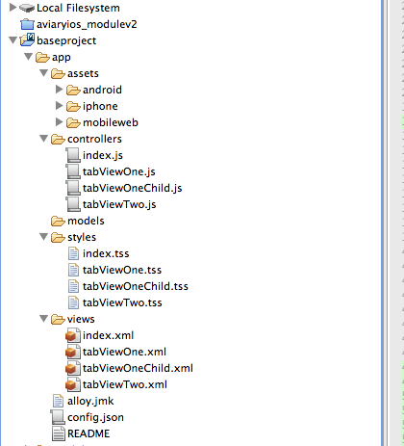
Final Directory Structure Should Look Like This

Slide 20
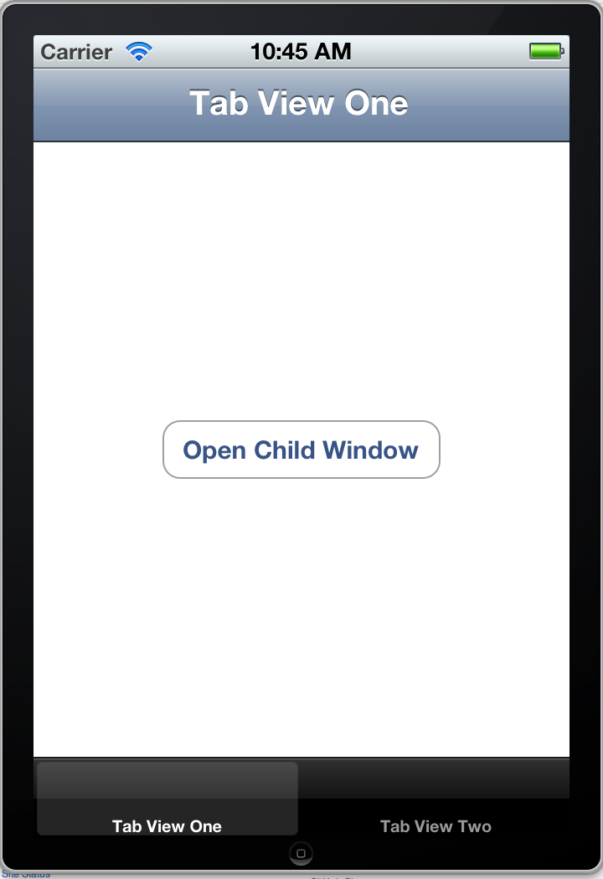
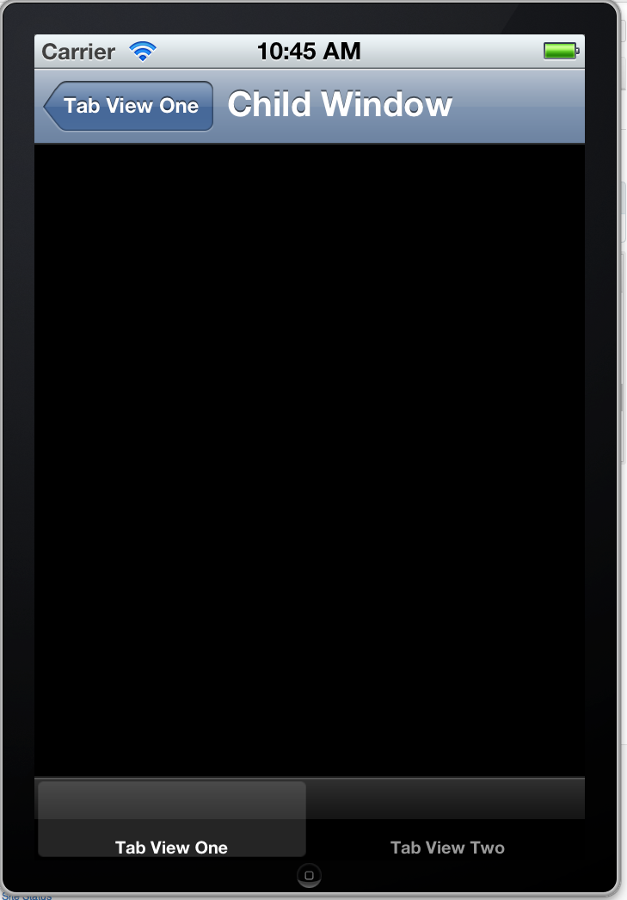
App Should Look Like This
A

Slide 21
More Information
Aaron K. Saunders
Clearly Innovative Inc
info@clearlyinnovative.com
@aaronksaunders
http://blog.clearlyinnovative.com
Project Source Code
https://github.com/aaronksaunders/SimpleAlloyPresentationApp

