Slide 1

Air Travel Final Presentation
By: Aaron Kuethe

Slide 2
Overview of the Issue at Hand
Perception of Flying
Public Concern & Fear
Media’s Role

Slide 3
Power of Three
Ethical Considerations
Data Analysis & Graphs
Summary of Results

Slide 4
Ethical Considerations
Open and Honest
01
Goal is to inform the audience on air travel safety and not specifically hurt another company
Clearly Label Data and Charts
02
Do not want to mislead the audience
State outliers in the data. Some examples:
03
2020 travel saw a decline due to COVID
2001 fatalities were due to terrorist attacks

Slide 5
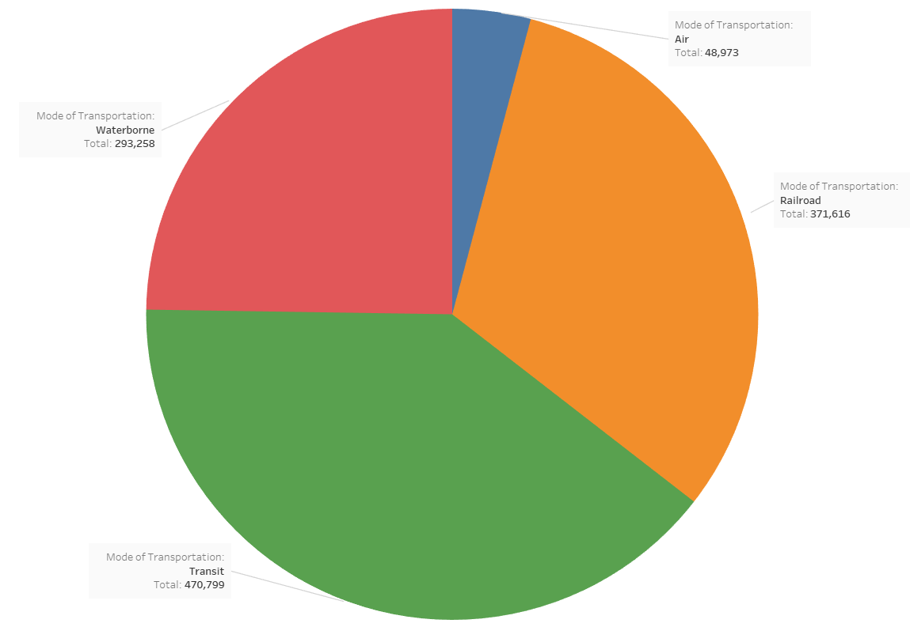
Accidents by Mode of Transportation from 1990-2016
This excludes motor vehicle accidents, as those account for most of all transportation accidents
Shows air travel has by far the fewest number of accidents

Slide 6
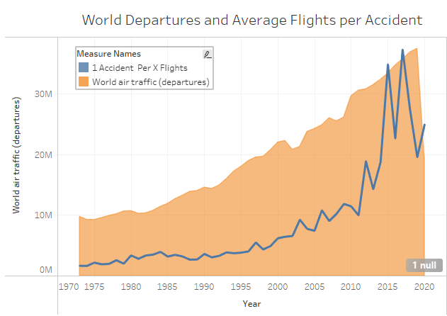
World Departures by Year
World departures are growing over time
The number of X flights per 1 accident is also growing
Proves flying is getting safer

Slide 7
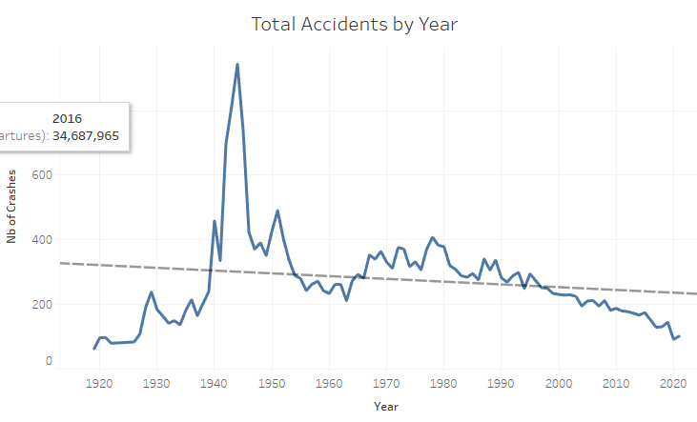
Total Accidents by Year
Flying started in the early 1900’s
With more flights came more accidents
With advances in technology and safety, total flying accidents are trending downwards as the number of flights have increased
Downward trend proves flying is continuing to become safer

Slide 8
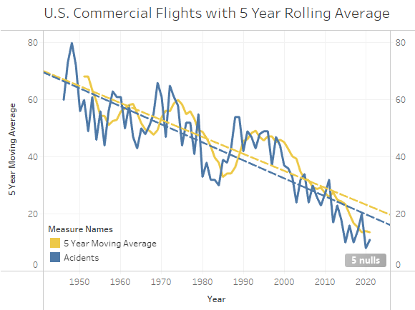
U.S. Commercial Flights Accidents
Accidents to U.S. commercial flights are trending down, as is the 5-year moving average
Again, we see flying is getting safer, specifically with U.S. commercial flights

Slide 9
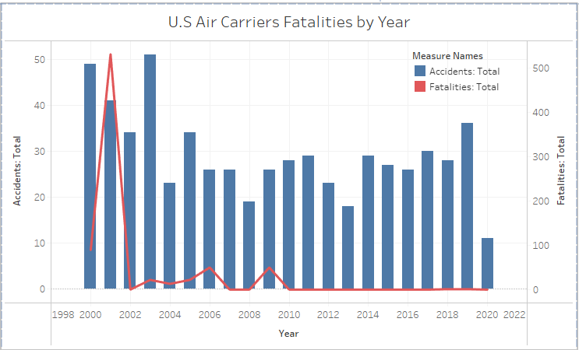
U.S. Air Carrier Fatalities by Year
Even on the accidents that do happen with U.S. air carriers, there are very few fatalities
The exception is the tragedy that happened in 2001

Slide 10
Summary of Results & Findings
Air travel is far safer than other modes of transportation
The number of flights continues to increase ever year, while the number of accidents and fatalities are trending downwards
The number of flights per 1 accident is increasing
Most airlines have become safer and decreased their fatality numbers, but not all…
The accidents of these airlines have garnered negative attention for air travel as a whole

Slide 11

Thank You!

