Slide 1

Heimdall
Inspec Results Viewer

Slide 2
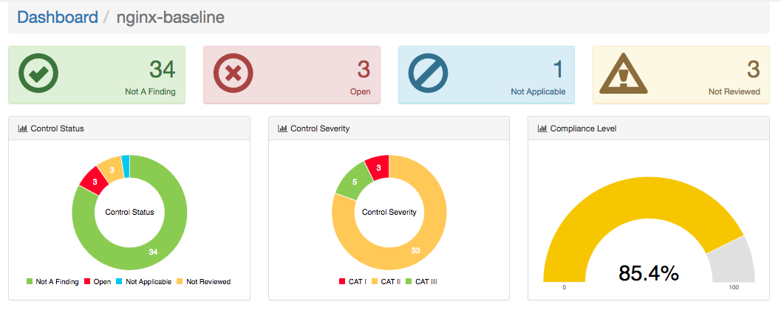
Graphs
Status Summary.

Slide 3
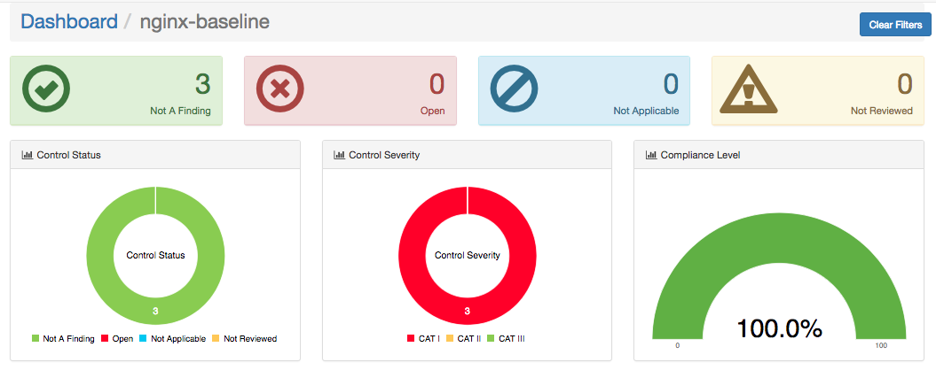
Graphs Continued.
Pie Charts can be used to filter controls.
View below is filtered to show only CAT I controls.

Slide 4
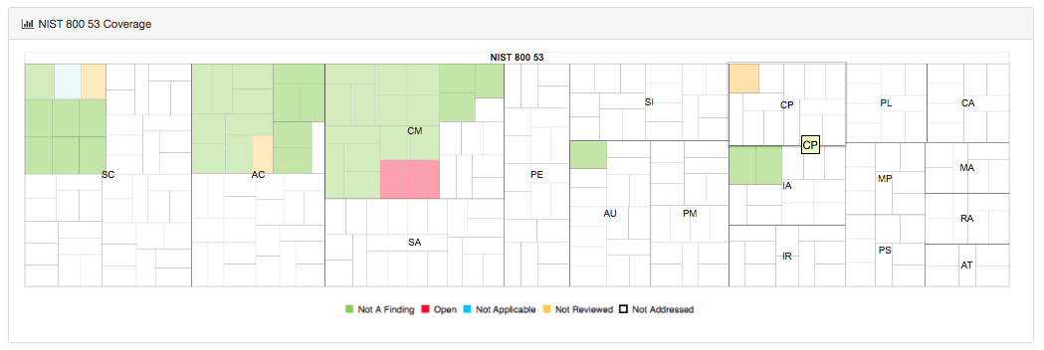
Graphs Continued.
NIST Coverage Treemap.
This visualization maps each control to their individual NIST family.
Controls are populated with appropriate colors to show its status.
Blank while cells indicate the NIST families not addressed by the profile.

Slide 5
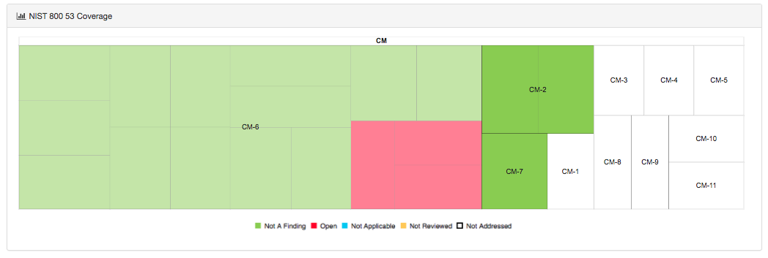
Graphs Continued.
NIST Coverage Treemap Continued.
Each NIST family can be clicked to drill down to sub families.
View below shows a drill down on NIST family Content Management(CM)

Slide 6
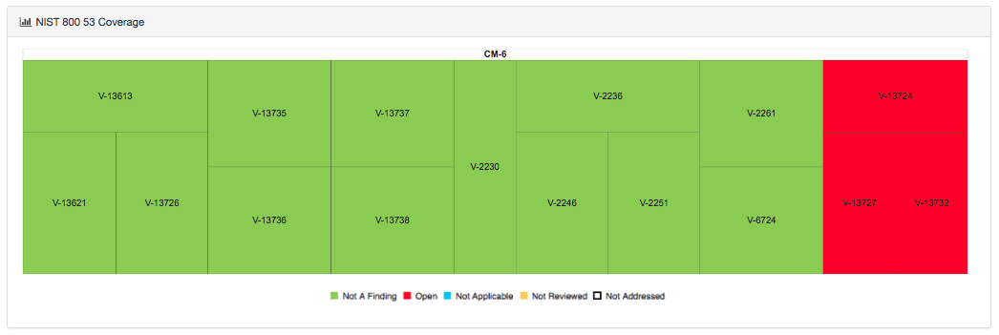
Graphs Continued.
NIST Coverage Treemap Continued.
Each sub family can be clicked to drill down to view associated controls.
View below shows a drill down on NIST sub family CM-6.

Slide 7
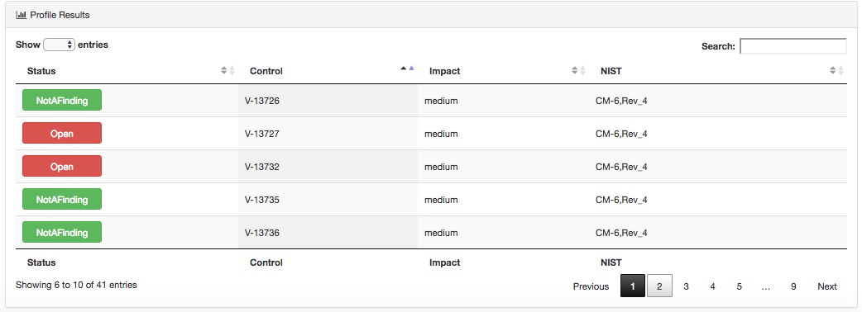
Graphs Continued.
Control Details Data Table.
Detailed View of the Controls is populated in a DataTable.

Slide 8
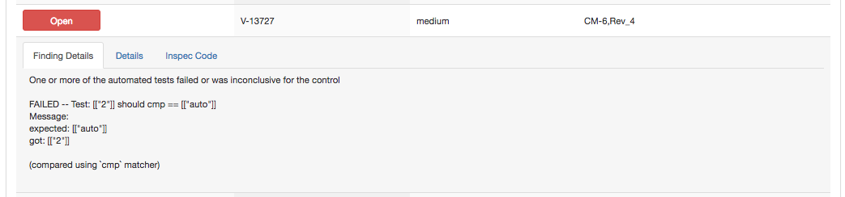
Graphs Continued.
Control Details Data Table Continued.
Each row can be click to see further details on the control.
Finding Details tab shows statues of individual tests within a control.

Slide 9
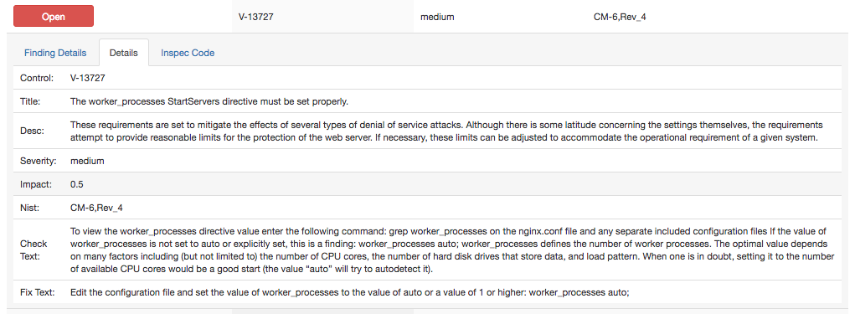
Graphs Continued.
Control Details Data Table Continued.
Details Tab shows metadata for the control.

Slide 10
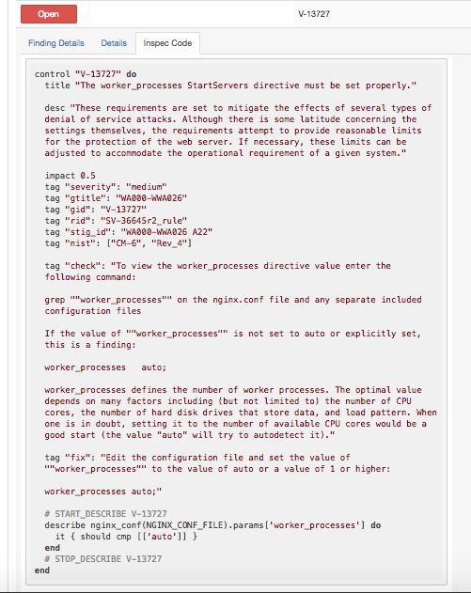
Graphs Continued.
Control Details Data Table Continued.
Inspec Code tab shows the actual InSpec code for the control.

