Slide 1
Project Trellis
Aaron, David, Angel, George, Maggie

Slide 2
ALAN PLEASE ADD DETAILS
ALAN PLEASE ADD DETAILS
ALAN PLEASE ADD DETAILS
ALAN PLEASE ADD DETAILS
ALAN PLEASE ADD DETAILS
ALAN PLEASE ADD DETAILS
ALAN PLEASE ADD DETAILS
ALAN PLEASE ADD DETAILS
ALAN STANDS FOR MAGGIE

Slide 3
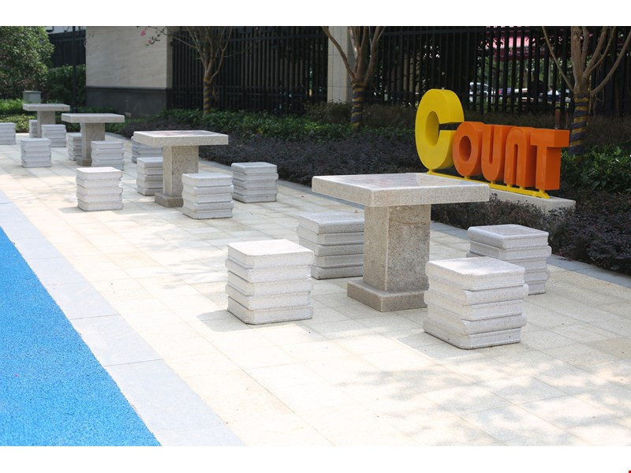
Where will Our Trellis be?

Slide 4
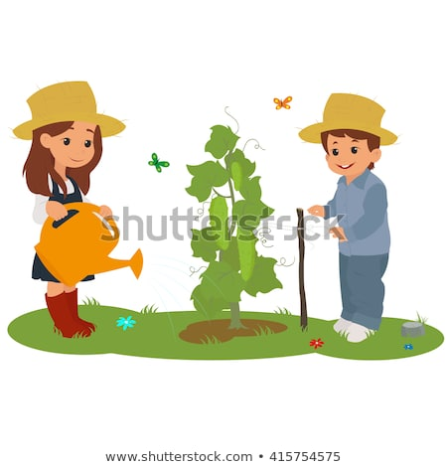
What will it be used for?

Slide 5
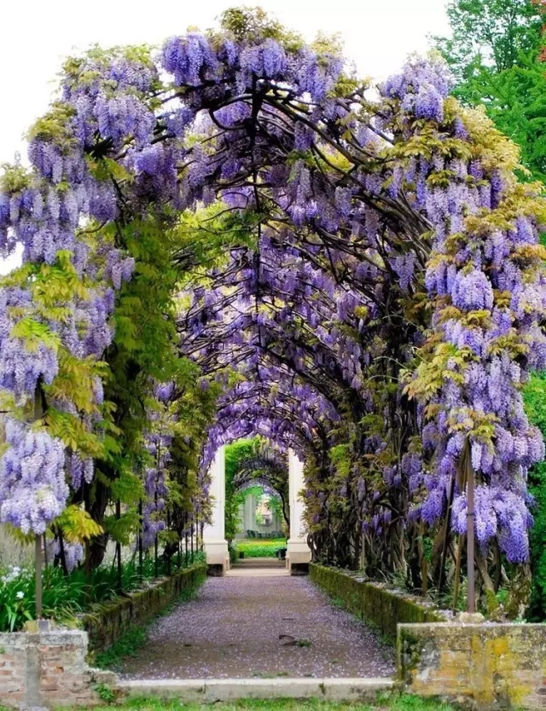
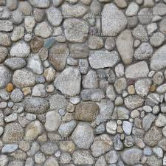
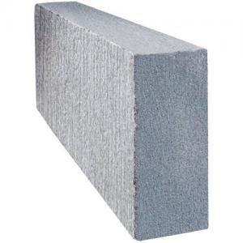
What Materials Will we Use?
cobblestone and concrete and plants

Slide 6
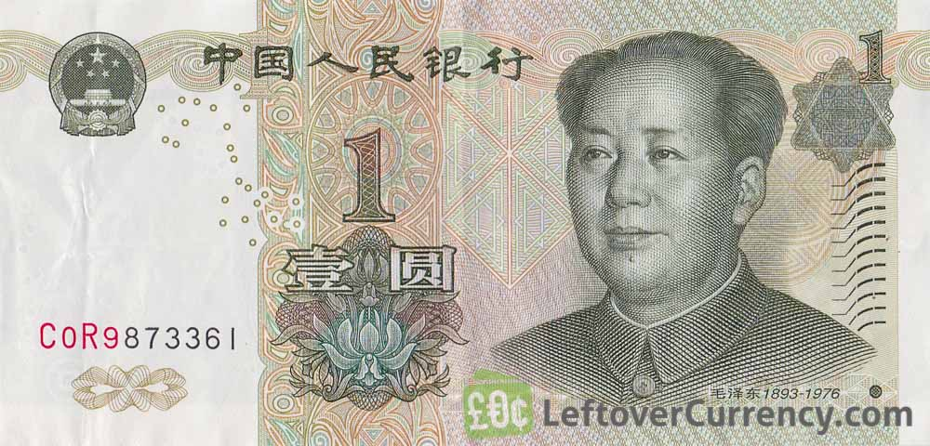
How much will it cost?
≤10000

Slide 7
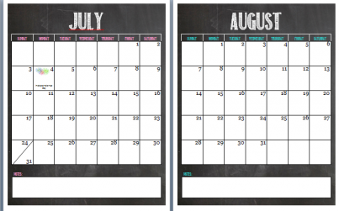
How long will it take? （？）孙
开始
结束

Slide 8
How will we make sure our structure is safe?
水泥柱
3.5m
鹅卵石中有水泥柱支撑，有坚固的铁地基，还有植物支撑

Slide 9
ALAN PLEASE ADD DETAILS
ALAN PLEASE ADD DETAILS
ALAN PLEASE ADD DETAILS
ALAN PLEASE ADD DETAILS
ALAN PLEASE ADD DETAILS
ALAN PLEASE ADD DETAILS
ALAN PLEASE ADD DETAILS
ALAN PLEASE ADD DETAILS
ALAN STANDS FOR MAGGIE

