Slide 1
Project Trellis
Aaron, David, Angel, George, Maggie

Slide 2
ALAN PLEASE ADD DETAILS
ALAN PLEASE ADD DETAILS
ALAN PLEASE ADD DETAILS
ALAN PLEASE ADD DETAILS
ALAN PLEASE ADD DETAILS
ALAN PLEASE ADD DETAILS
ALAN PLEASE ADD DETAILS
ALAN PLEASE ADD DETAILS
ALAN STANDS FOR MAGGIE

Slide 3
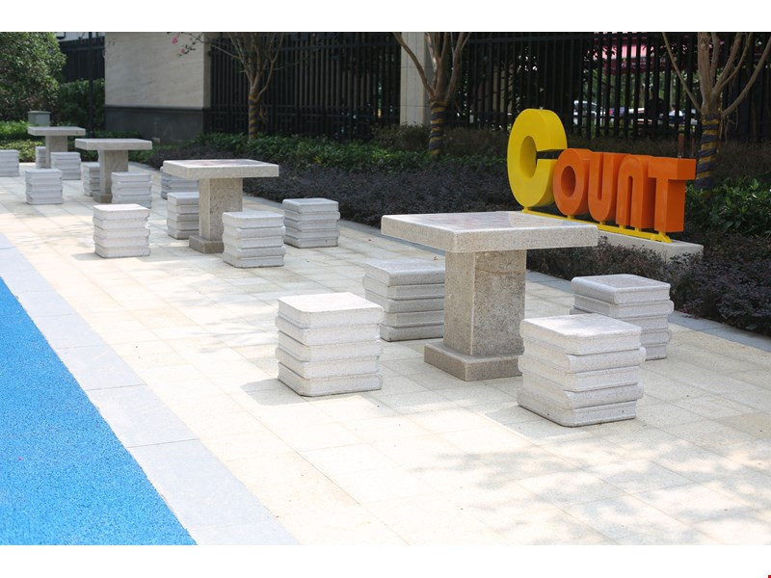
Where will Our Trellis be?

Slide 4

What will it be used for?

Slide 5
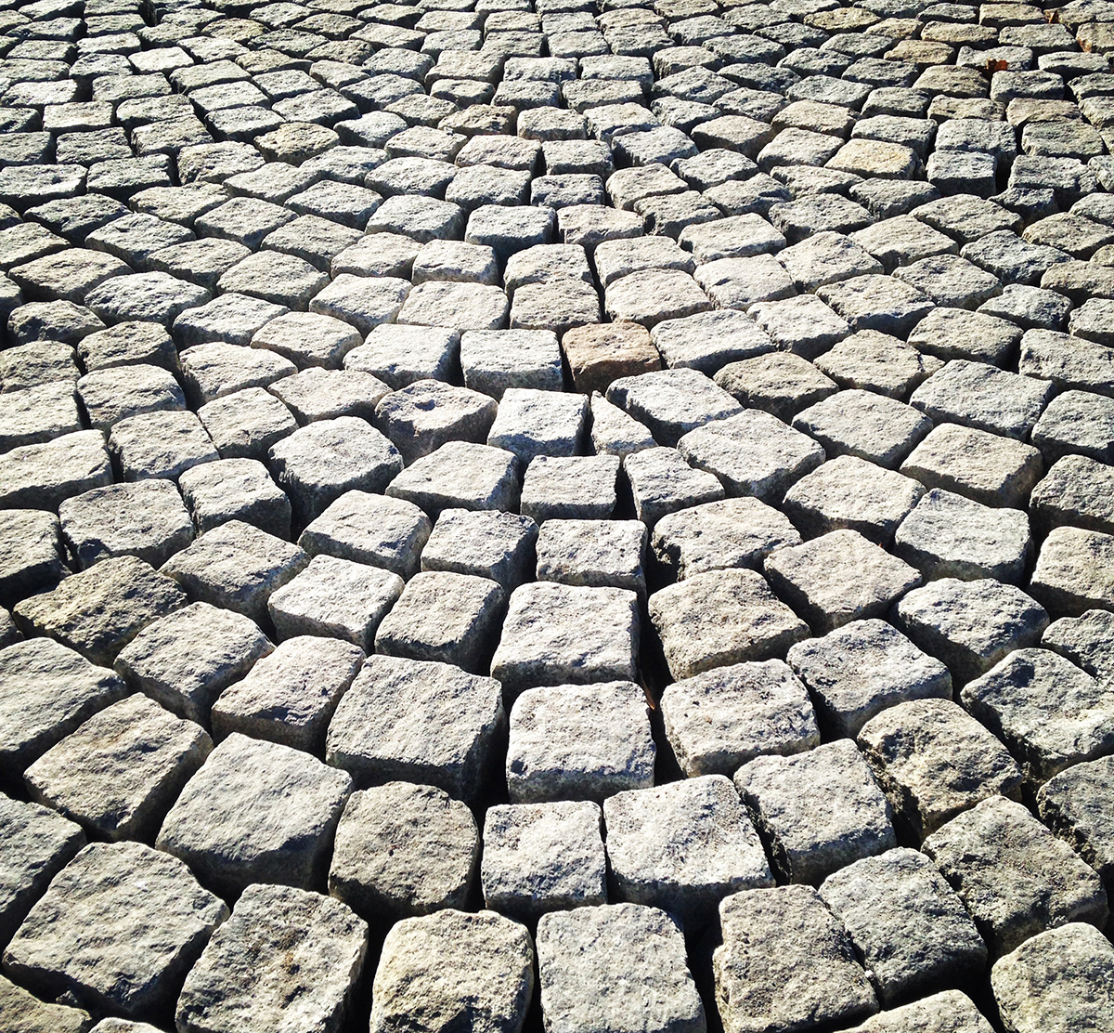
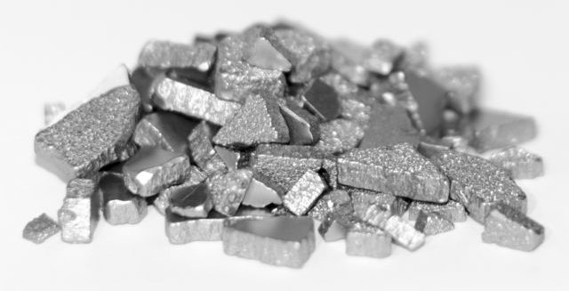

What Materials Will we Use?
(Maggie please choose one cobblestone
Image.)

Slide 6
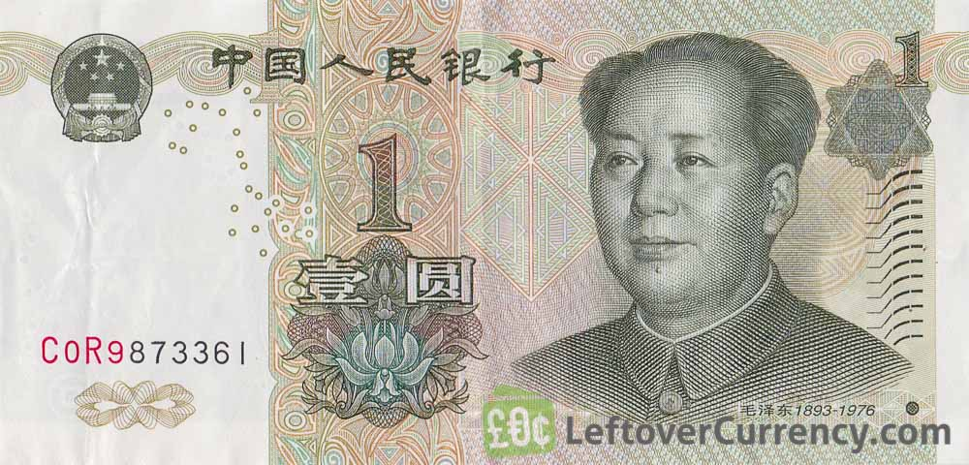
How much will it cost?
≤10000

Slide 7
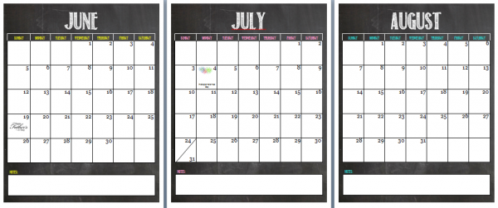
How long will it take?

Slide 8
How will we make sure our structure is safe?
3.5m

Slide 9
ALAN PLEASE ADD DETAILS
ALAN PLEASE ADD DETAILS
ALAN PLEASE ADD DETAILS
ALAN PLEASE ADD DETAILS
ALAN PLEASE ADD DETAILS
ALAN PLEASE ADD DETAILS
ALAN PLEASE ADD DETAILS
ALAN PLEASE ADD DETAILS
ALAN STANDS FOR MAGGIE

