Slide 1
CS 479 Project 2
Phi Do, Aaron King
dop@sonoma.edu, kingaa@sonoma.edu

Slide 2
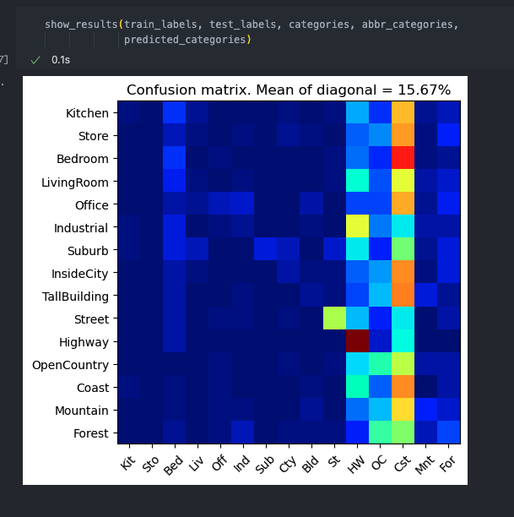
Part 1: Your confusion matrix, together with the accuracy for Part 1 with the standard param set (image_size = 16, k = 3)

Slide 3
Part 1: Experiments: change image size and k individually using the following values, and report the accuracy (when tuning one param, keep the other as the standard (16 x 16, 3)):
ie. when you’re tuning image size, keep k at 3, when changing k, keep image size as 16x16
image size:
8 x 8: 17.07%
16 x 16: 15.67%
32 x 32: 15.33%
k:
1: 17.73%
3: 15.67%
5: 16.47%
10: 16.20%
15: 15.73%

Slide 4
Part 1: Reflection: when tuning the parameters, what have you observed about the processing time and accuracy? What do you think might lead to this observation?
Image Size: The change in image size showed that the confusion matrix was more accurate with a smaller image. I imagine this might be due to how much data is being compressed/disregarded in the cv2.resize function (specifically the high frequency data). There is a parameter that will change how the image is interpolated when resizing, which could also have an effect on the accuracy of the kNN classifier. I believe that as the image gets larger, it is “overfitting” the training data which leads to a lower accuracy. This could also be the issue with the image being too small, but it then is “underfitting” which would lead to not enough information.
k Value: The accuracy varies a few percentages between every iteration. We received the highest percentage of accuracy with k = 1 which I believe is due to the fact that we are only comparing to one neighbor in that instance versus when looking at multiple neighbors. Because the classifier is finding these neighbors based on distance I believe that the image with a zero mean will create a more accurate model due to taking the norm of each point. The accuracy increases at k = 1, decreases at k = 3, increases again at k = 5 and finally decreases again as k increases. As k increases there are more points to pull data from, so the line of best fit becomes less and less accurate.

Slide 5
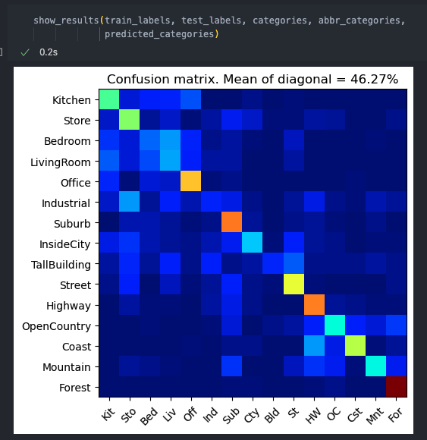
Part 2: Your best confusion matrix, together with the accuracy for Part 2. Also report your param settings to get this result.
<Plot here>
Param settings:
Vocab_size: 50
stride (build_vocab): 20 => 10
step_size(get_bags_of_sifts): 10
max_iter (k-means): 100
k (kNN): 3 => 20

Slide 6
Part 2: Reflection: when experimenting with the value k in kNN, what have you observed? Compare this performance difference with the k value experiment in Part 1, what can you tell from this?
When k in kNN increases it leads to more accurate results until we hit a certain peak. There is a value where the best accuracy is achieved. Then any value higher than that k value will likely be the same or slightly below in accuracy. Our “sweet spot” value was near 20 for k kNN. The difference of percentages between values in k is proportional to closeness to the “sweet spot”. So the difference between k = 1 and k = 3 was a difference of 17.73% and 15.67% while the difference between k = 20 and k = 18 is 46.27% and 45.47% respectively. I’m unsure if there is any real basis for this when the Bag of Words model is so much more complex and accurate; but it would seem that the further from the peak of accuracy for k (k = 1 and k = 20) the more chances that our nearest neighbor algorithm can create boundaries that will generalize too much, causing lower accuracy.

Slide 7
Reflection on Tiny Image Representation vs. Bag of Words with SIFT features
Why do you think that the tiny image representation gives a much worse accuracy than bag of words? As such, why is Bag of Words better in this case?
Bag of Words uses a more robust image representation by utilizing the concept of visual words, clustering with k-means and classifying with our earlier implementation of kNN. We are able to build a vocabulary of visual words which our SIFT features are able to train against. Our SIFT features also able to cluster relative to their identified centroid. Our centroids are our visual word vocabulary. The biggest thing that helps give us achieve higher accuracy is likely our ability to cluster with k-means and how we use kNN on our visual vocabulary. The tiny image representation can have tons of generalizations when it comes to how the model classifies the images. It is especially dependent on the nearest neighbors that are calculated because that is the only metric that is deciding what label the image is being assigned to. The amount of high frequency data that is being lost when resizing the images.

Slide 8
Conclusion: briefly discuss what you have learned from this project.
We have explored the differences between two combinations of features/classifiers. By implementing the Tiny Image Representation, Bag of Sift features and each of their respective nearest neighbor classifier we have been able to dive more into the inner workings of image manipulation. We are able to see how those images are interpreted through classifiers, their respective categorizations and some of the specific parameters required to achieve more accurate models. We have learned how to create models that can train from and test data. These models can classify images into categories based on features (SIFT descriptors) found from within the image. This is considered a vital introduction to computer vision and will surely help prepare us for understanding more complex classifiers and algorithms.

Slide 9
Extra Credit
<Discuss what extra credit you did and analyze it. Include images of results as well >

