Slide 1
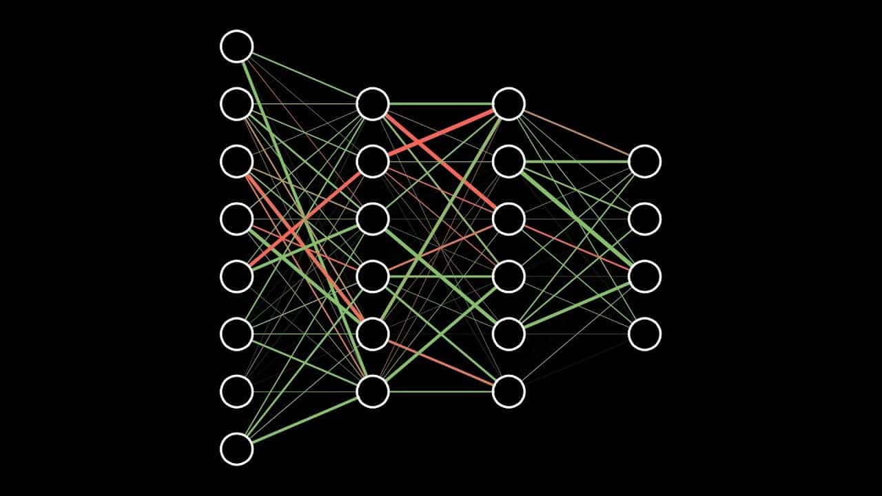
Deep Learning Workshop
Neural Networks and Friends
Instructor: Aaron Low
HELP University, Faculty of Computing and Digital Technology

Slide 2
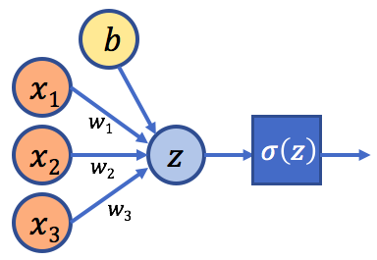
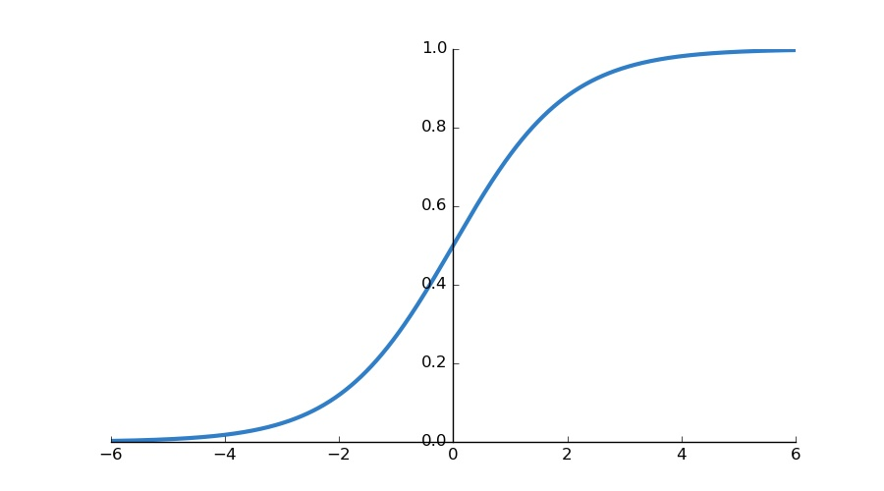
Logistic Regression
$$σ\left(z\right)=\frac{1}{1+e^{−z}}$$
x: input data
b: bias
w: weights
$σ:$ activation function
$$P(y=1|x)$$
$$z=w_{1}x_{1}+w_{2}x_{2}+w_{3}x_{3}+b$$
Logistic Regression from https://medium.com/@melodious/understanding-deep-neural-networks-from-first-principles-logistic-regression-bd2f01c9e263

Slide 3
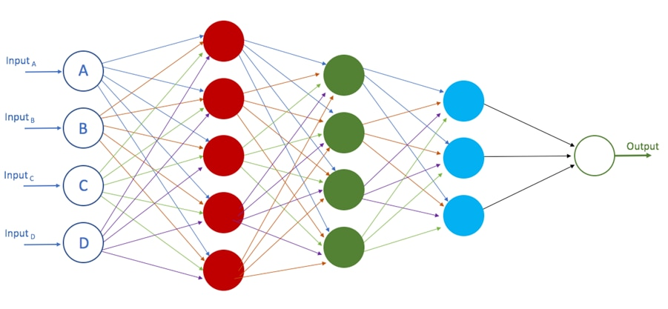
Neural Network
Hidden Layer 1
Input Layer
Hidden Layer 2
Hidden Layer 3
Output Layer
Deep Neural Network from https://developer.oracle.com/databases/neural-network-machine-learning.html

Slide 4
Neural Network
Neural Network GIF from https://www.youtube.com/channel/UCYO_jab_esuFRV4b17AJtAw

Slide 5
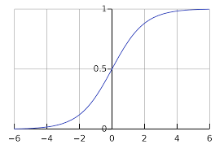
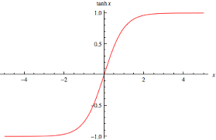
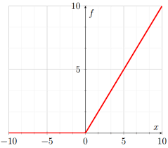
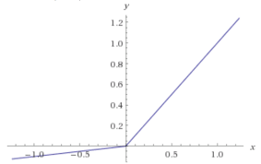


Activation Functions
Sigmoid(z) = $\frac{1}{1+e^{−z}}$
Tanh(z) = $\frac{e^{z}−e^{−z}}{e^{z}+e^{−z}}$
x₁
x₂
z
a(z)
ReLU(z) = max(0, z)
Leaky_ReLU(z) = max(0.1z, z)
x₃

Slide 6
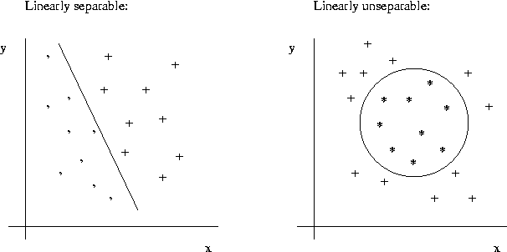
Why Activation Functions?
Specifically we want non-linear activation functions
To allow our model to learn non-linear mappings
Most input-output mappings we would like to learn are non-linear
Linearly separable
Linearly unseparable
* The activation function should also be differentiable

Slide 7
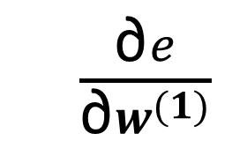

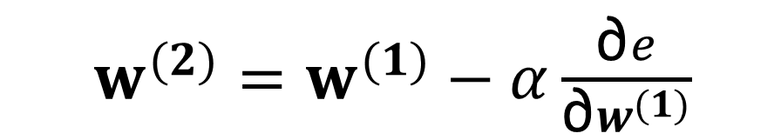
How do we train the model?
w⁽¹⁾
x
Model
ŷ
1. Forward pass to obtain prediction
2. Calculate error using cost function, J
3. Use backpropagation to calculate gradient
4. Update weights using an optimization algorithm (typically a variant of gradient descent)
$$e = J(w)$$
$\frac{\text{∂}e}{\text{∂}w^{(1)}}$
$w^{(2)}=w^{(1)}−α\frac{\text{∂}e}{\text{∂}w^{(1)}}$

Slide 8
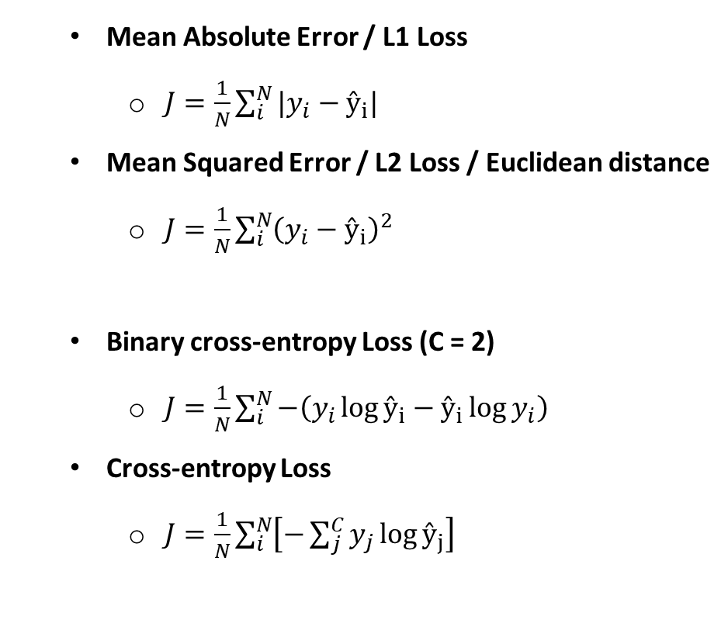
Types of Cost Function
Mean Absolute Error / L1 Loss
$J=\frac{1}{N}\sum_{i}^{N}{|y_{i}−ŷ_{i}| }$
Mean Squared Error / L2 Loss / Euclidean distance
$J=\frac{1}{N}\sum_{i}^{N}{{\left(y_{i}−ŷ_{i}\right)}^{2}}$
Binary cross-entropy Loss (C = 2)
$J=\frac{1}{N}\sum_{i}^{N}{−\left(y_{i}\log{ŷ_{i}}−ŷ_{i}\log{y_{i}}\right)}$
Cross-entropy Loss
$J=\frac{1}{N}\sum_{i}^{N}{\left[−\sum_{j}^{C}{y_{j}\log{ŷ_{j}}}\right]}$
Typically used in regression
Typically used in classification
* There are many types of cost functions that are possible depending on what you want your model to learn

Slide 9






Backpropagation
Used to calculate error gradient with respect to the model weights
Calculate using chain rule
Forward propagation
$$a= 5$$
$$b=3$$
$$v=a+u$$
$$J=3v$$
$$u=bc$$
$$c=2$$
Backward propagation
Computation graph as shown in by Andrew Ng in his deeplearning.ai course

Slide 10
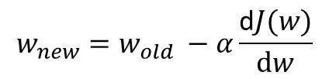

Gradient Descent
Method to optimize our model and find our optimal weights
We want to find the weights, w that minimize our cost function, J(w)
Currently, there are many variants to improve standard gradient descent
J(w)
$$w_{new}=w_{old} −α\frac{\text{d}J(w)}{\text{d}w}$$
Initial weight, w
$\frac{\text{d}J(w)}{\text{d}w}$
Global minimum
w

Slide 11

Evaluating your Model
Identify how well the model performs
Identify how well the model generalizes to unseen data samples
Quantitative analysis
Use performance metrics
Qualitative analysis
Useful for visual based output

Slide 12
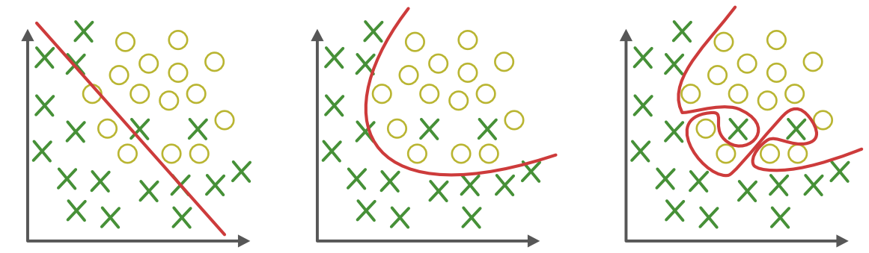
Underfitting and Overfitting
Understanding the model’s ability to generalize to unseen data
High bias
High variance
Underfitting
Good fit
Overfitting
Graphs from https://towardsdatascience.com/underfitting-and-overfitting-in-machine-learning-and-how-to-deal-with-it-6fe4a8a49dbf

Slide 13
Underfitting and Overfitting
Optimal
Cost, J(w)
Underfitting
Overfitting
Validation loss
High bias
High variance
Training loss
Epoch
How do we deal with this? - Regularization

Slide 14
Underfitting and Overfitting
We would like to reduce bias and variance
Reducing bias (Prevent underfitting)
Increase size of network
Train longer
Reducing variance (Prevent overfitting)
Add more training data
Regularization

Slide 15
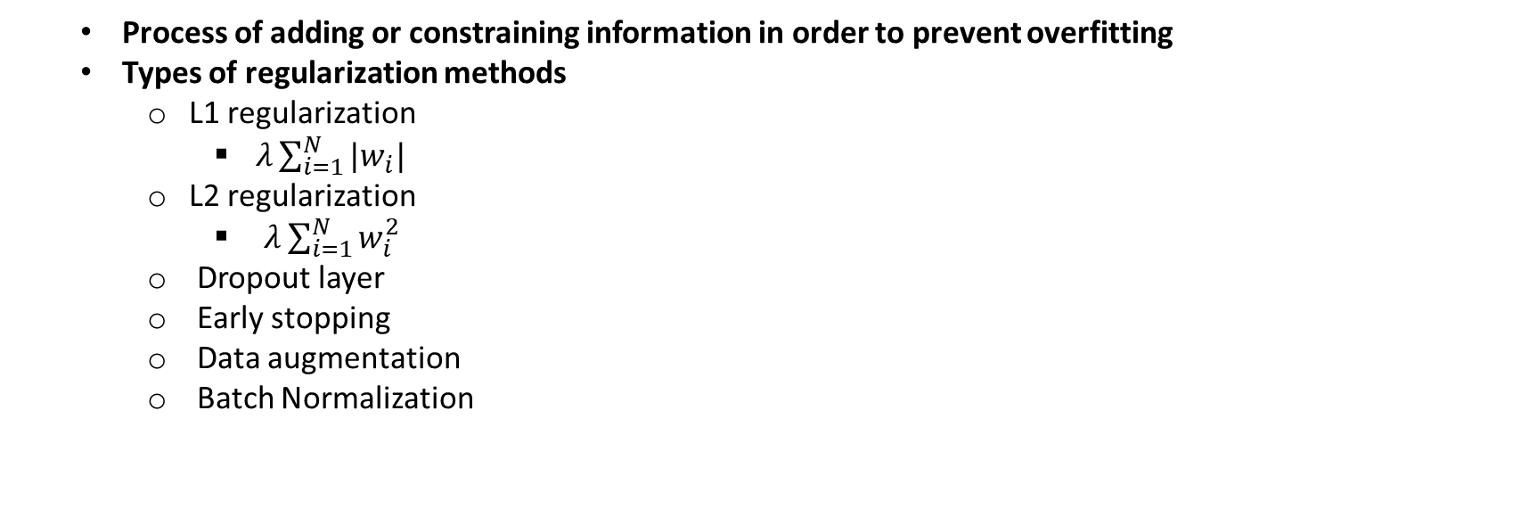
Multi-class Classification
Regularization
Process of adding or constraining information in order to prevent overfitting
Types of regularization methods
L1 regularization
$λ\sum_{i=1}^{N}{|w_{i}|}$
L2 regularization
$λ\sum_{i=1}^{N}{w_{i}^{2}}$
Dropout layer
Early stopping
Data augmentation
Batch Normalization
add to cost function
add to cost function

Slide 16
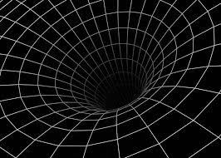
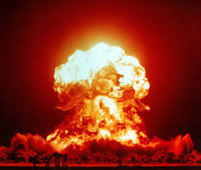



Multi-class Classification
Vanishing/Exploding Gradients
As neural network becomes deeper, gradient propagation can result in gradients becoming vanishing-ly small or exploding-ly large
How to deal with this?
Gradient Clipping
Weight Initialization
Weight Regularization
Change number of layers, batch size
$$x_{1}$$
…
$$y$$
$$x_{2}$$
…

Slide 17
Questions?

