Slide 1
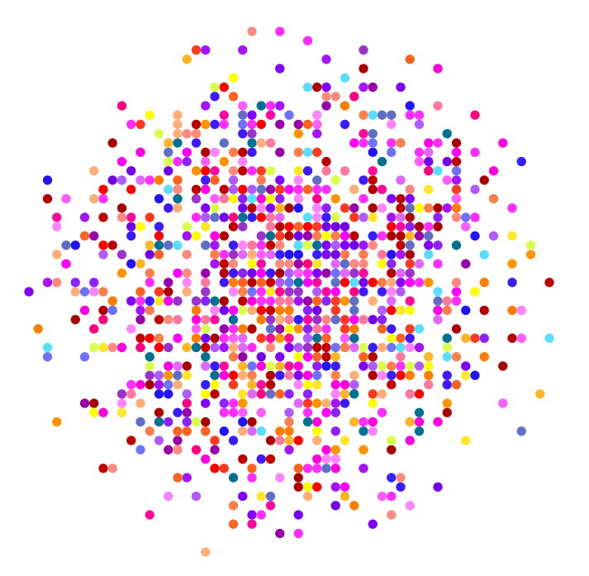
Alex Brown PAN July 25, 2019

Slide 2
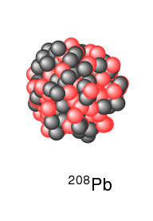
What is a nucleus made of ?

Slide 3
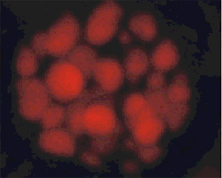

Slide 4
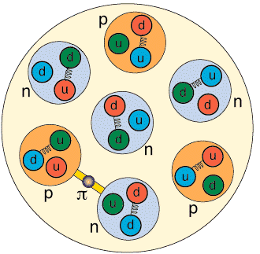

Slide 5
What is a nucleus made of ? ²⁰⁸Pb has
82 protons (Z is the atomic number for Pb)
126 neutrons (N is the number of neutrons)
208 nucleons (A = Z + N is the mass number)

Slide 6
We will pass around a windows folder call “Nucleus"
Put this on your windows desktop.
This folder contains:
codes folder for the programs
results-density folder for outputs of nuclear densities
results-levels folder for outputs of single-particle levels
cleanup.bat deletes all outputs
run-nucleus runs the program
chart-levels.html the nuclear chart on the web
questions.pdf your homework

Slide 7
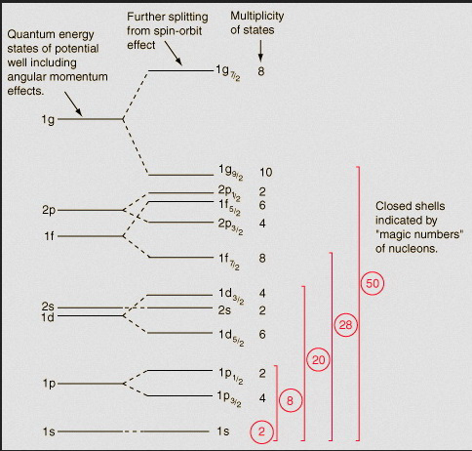
Nucleons move in quantum “orbits” similar to the electrons in an atom
These have quantized (fixed) energies, and orbital angular momentum l
s l=0
p l=1
d l=2
f l=3
g l=4
h l=5
i l=6
j l=7
k l=8
…

Slide 8
The nucleus can rotate in quantized units of Plank’s constant (h) divided by 2π. This is called the “angular momentum” or “spin”
The proton and neutron have internal angular momentum of ½
The orbital motion contributes l
The total angular momentum for one proton (or neutron) in a nucleus is
j = l + ½ ( all l )
j = l - ½ ( l > 0)

Slide 10
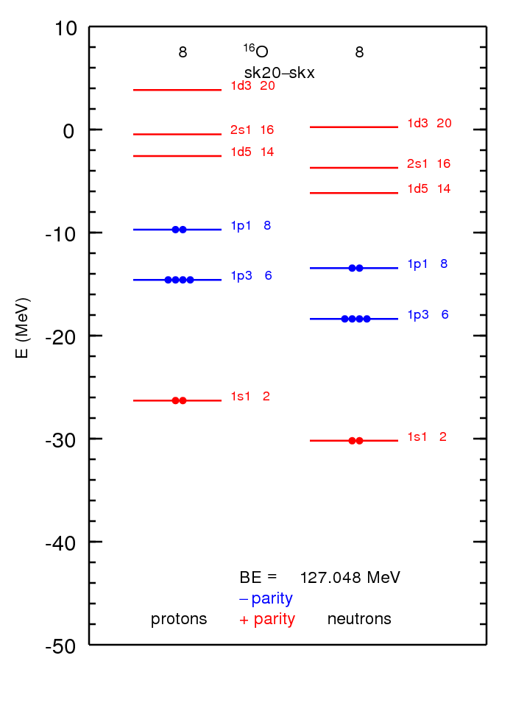
Output in results-levels folder
for ¹⁶O with 8 protons and 8 neutrons.
Each single-particle state is labeled by n l 2j N
n radial quantum number
l orbital angular momentum
j total angular momentum
l + ½ ( all l )
l – ½ ( l > 0 )
The Pauli principle allows at most 2j+1 protons (or neutrons)
in each state (the multiplicity)
N = summed total allowed by Pauli
in lowest energy configuration

Slide 11
What is a magic number?
The total number of protons (or neutrons) obtained when the highest orbital is completely filled.
There is a relatively large gap between the highest completely filled orbital and the next empty orbital.
There is analogy with atomic properties where the magic numbers correspond to the atomic number of the Nobel gas (inert) elements: Helium (2), Neon (10), Argon (18), Krypton (36) , Xeon (54) and Radon (86)

Slide 12
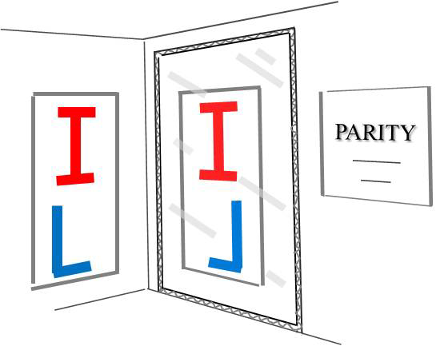
Each energy state has a “parity” that is related to how its wavefunction looks in a mirror.
even l have positive parity +
odd l have negative parity -
The total parity is the product of those for all filled states
So nuclei with even numbers of protons and neutrons have + parity

Slide 13
For nuclei with even numbers of protons and neutrons all of these angular momenta add up to J = 0
(e.g. pairs of particles with j pointing in opposite directions)
So ¹⁶O has total spin-parity J = 0⁺ .

Slide 14
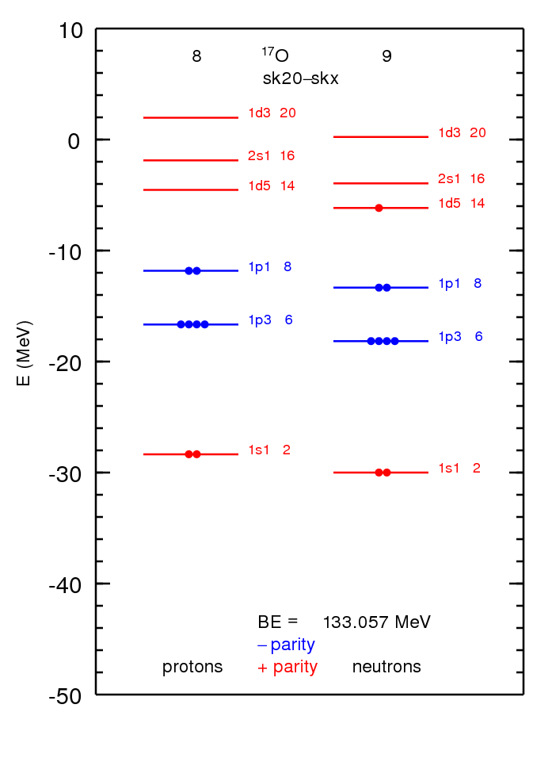
The total spin and parity for a nucleus with an odd number of protons (or neutrons) is determined by that of the last (valence) state that is filled.
In this example of ¹⁷O the total spin-parity is 5/2⁺

Slide 15
Each state has a wavefunction that tells us the probability of finding a proton (or neutron) at some position in space.
The wavefunction probability for a given state times the number of protons (neutrons) in that state is called the proton (neutron) density.
This is what determines the size of the nucleus.
A model that uses these densities to calculate the states of nuclei is called
an Energy Density Functional (EDF) theory.

Slide 16
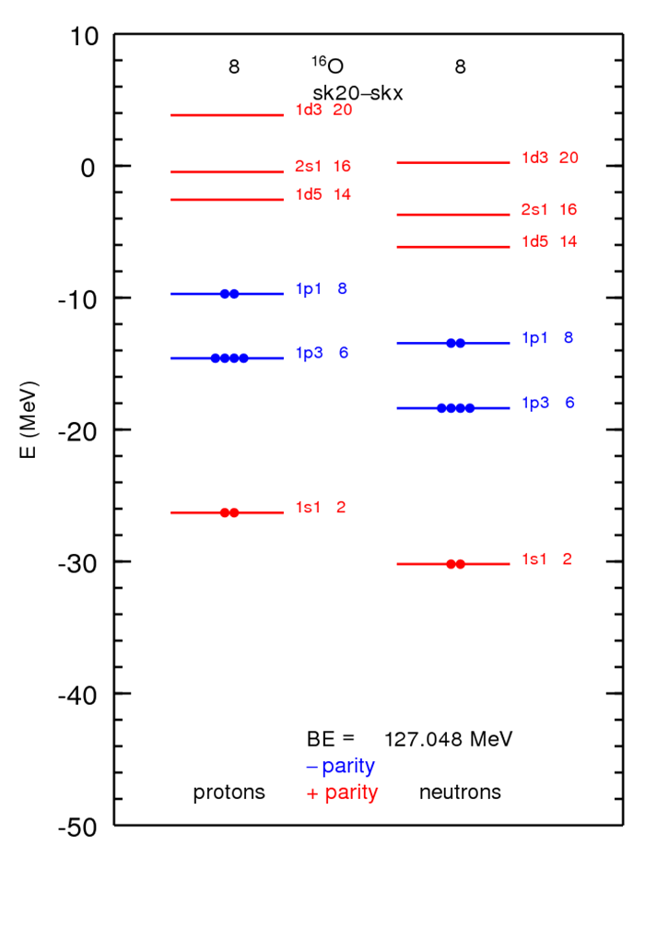
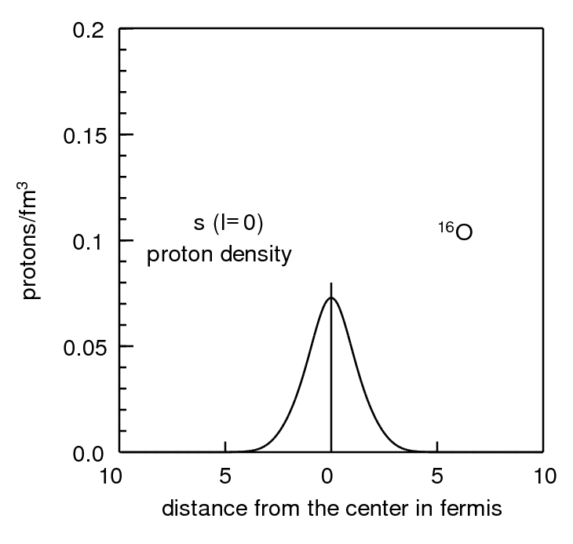

Slide 17

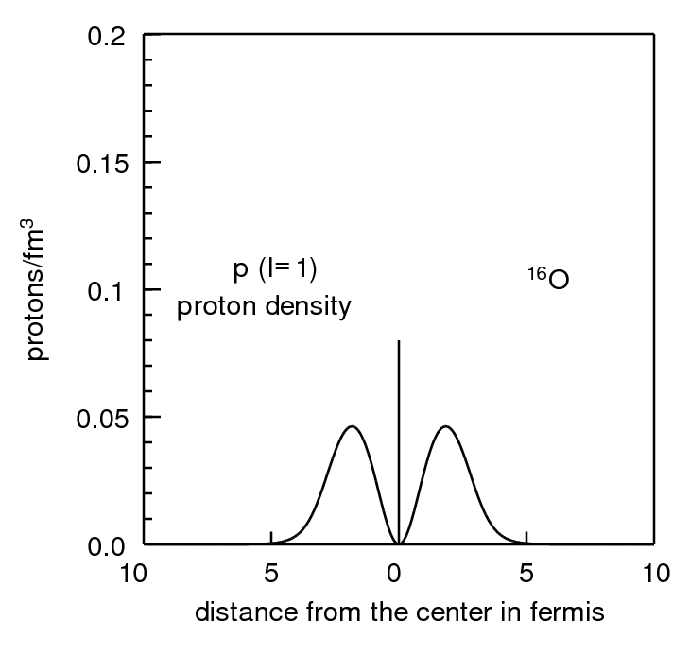

Slide 18
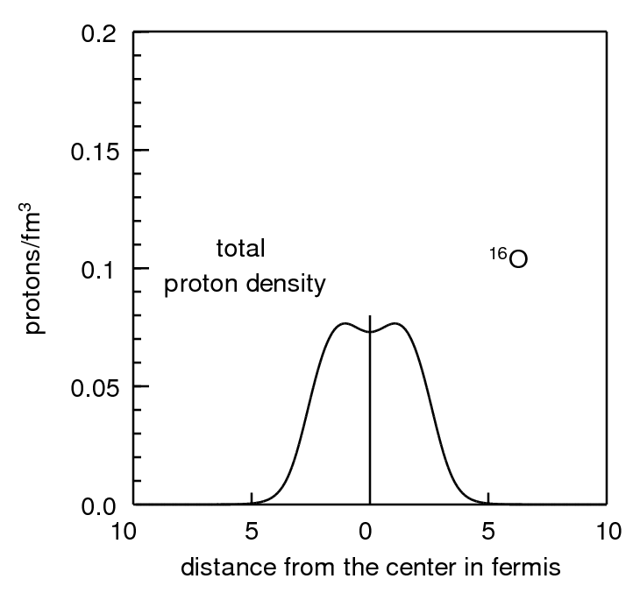

Slide 19
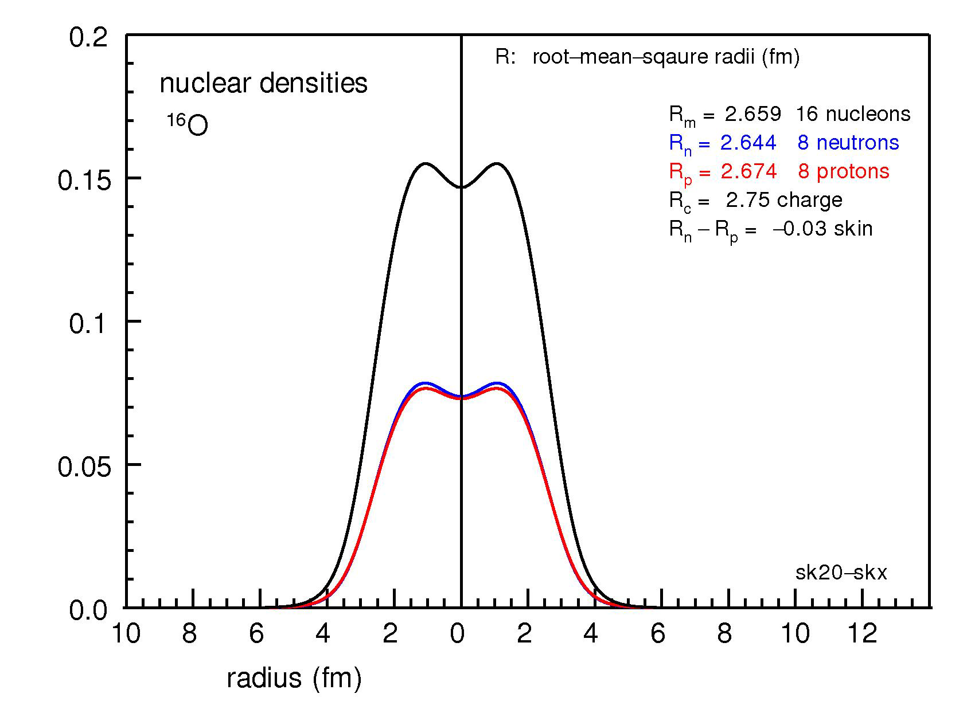
Output in results-density folder

Slide 20
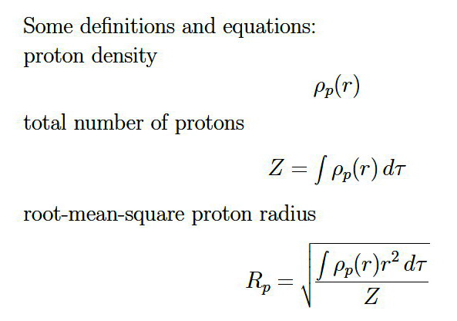
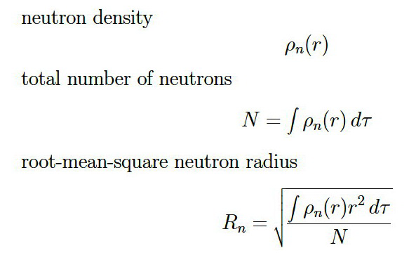
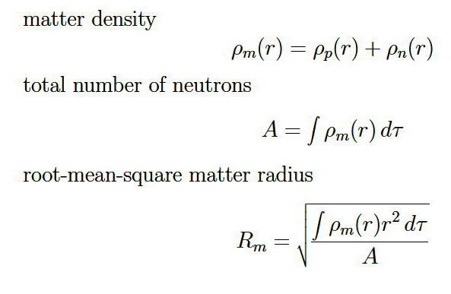
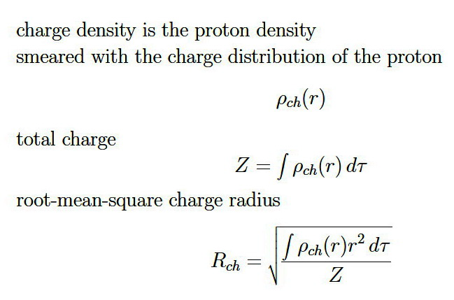
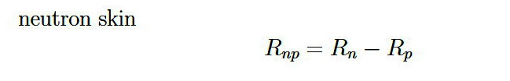

Slide 21
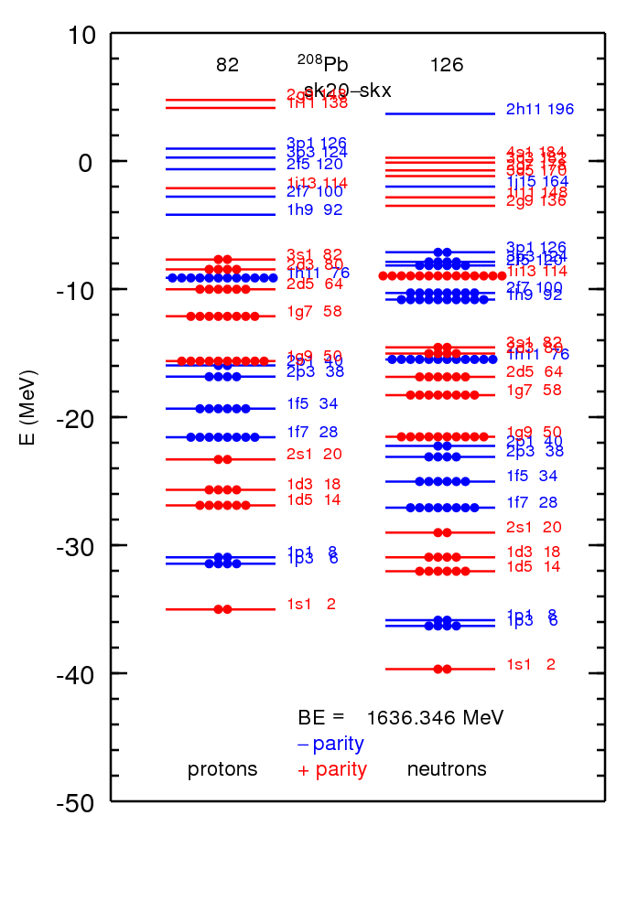
s l=0
p l=1
d l=2
f l=3
g l=4
h l=5
i l=6
j l=7
k l=8
…

Slide 22
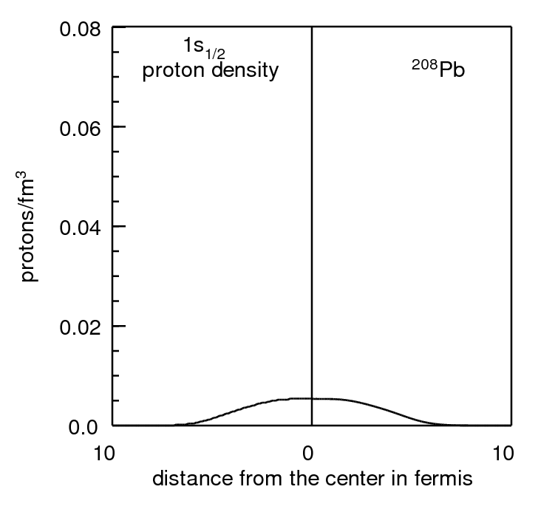

Slide 23
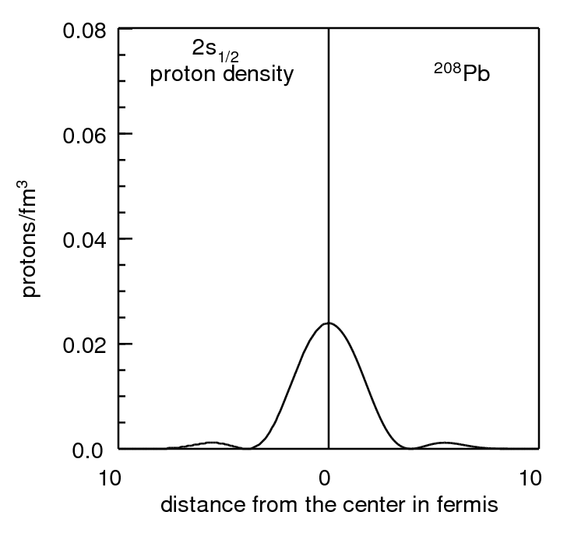

Slide 24
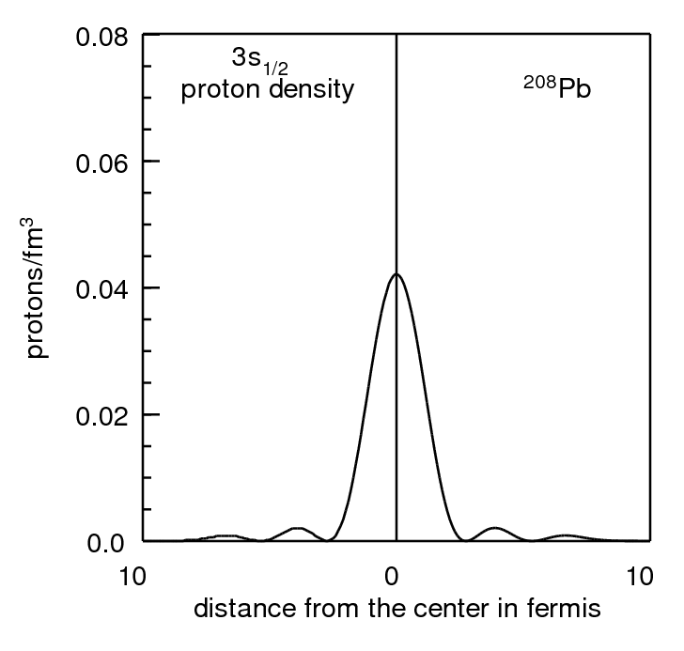

Slide 25
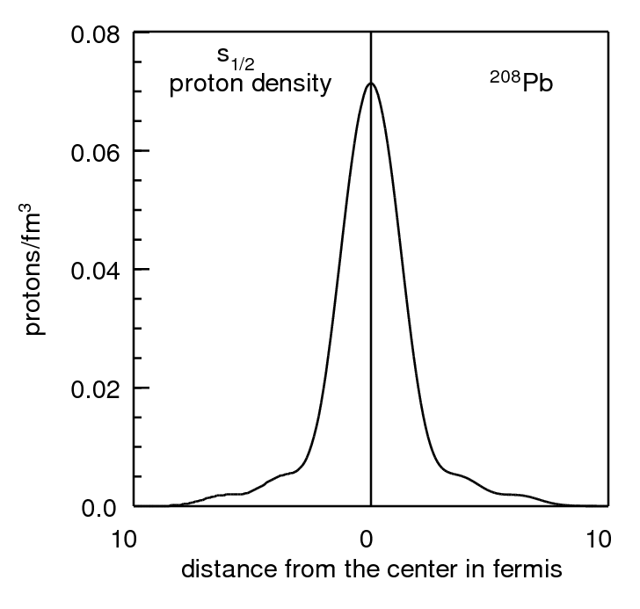

Slide 26
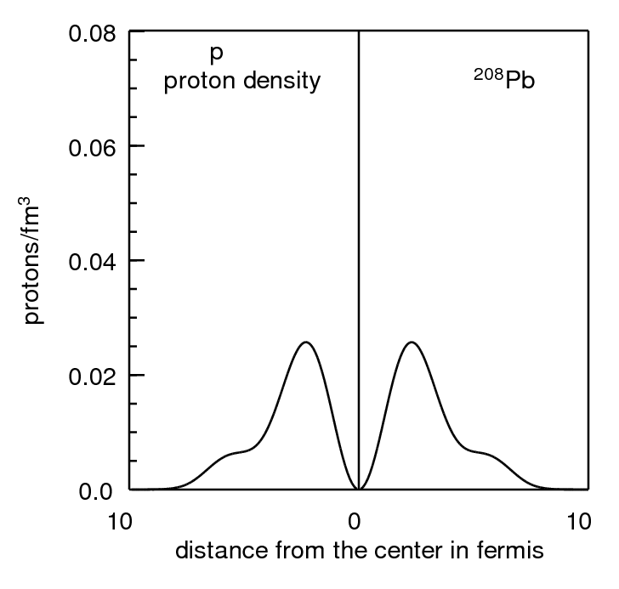

Slide 27
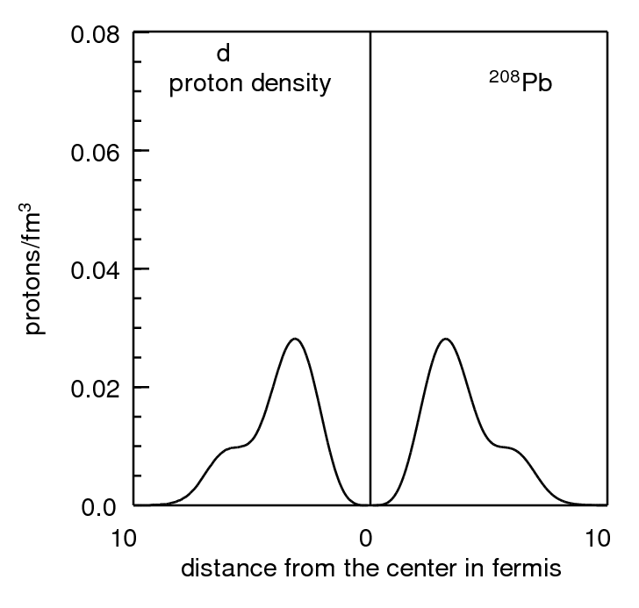

Slide 28
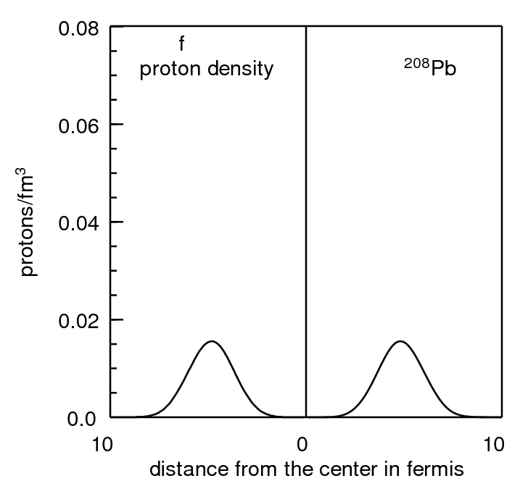

Slide 29
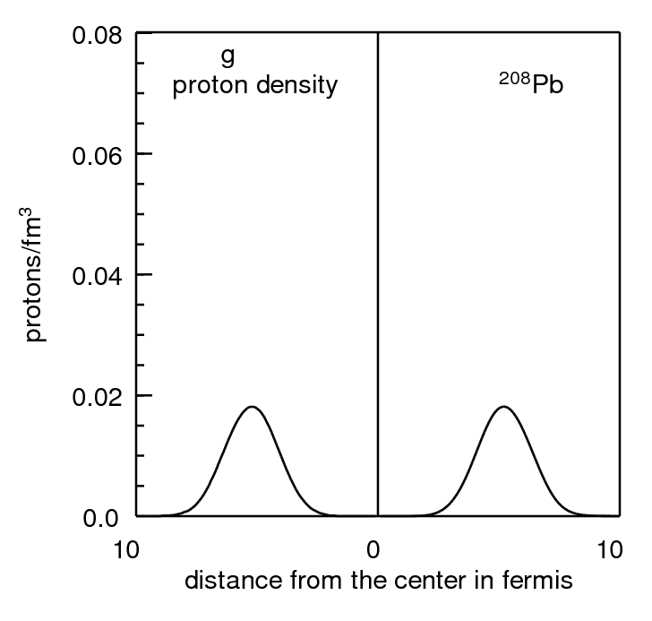

Slide 30
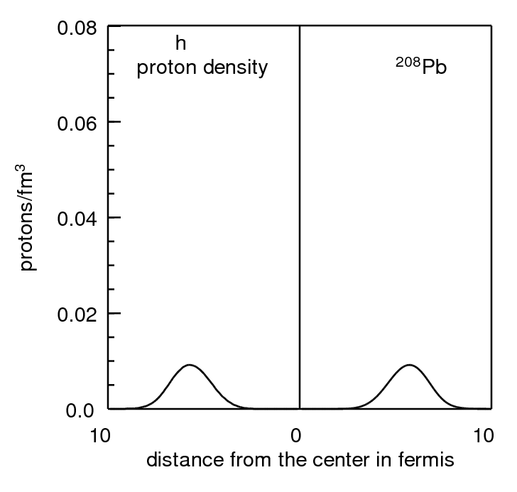

Slide 31
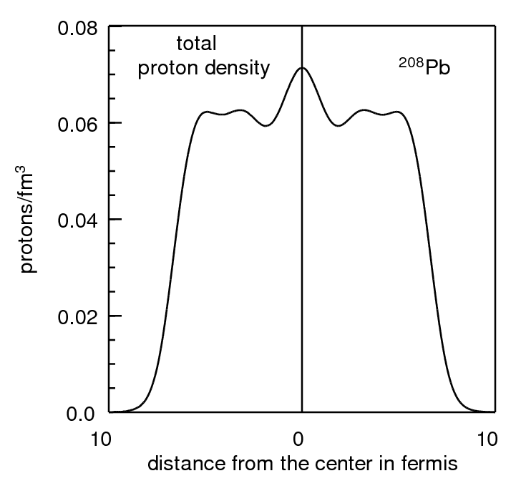

Slide 32
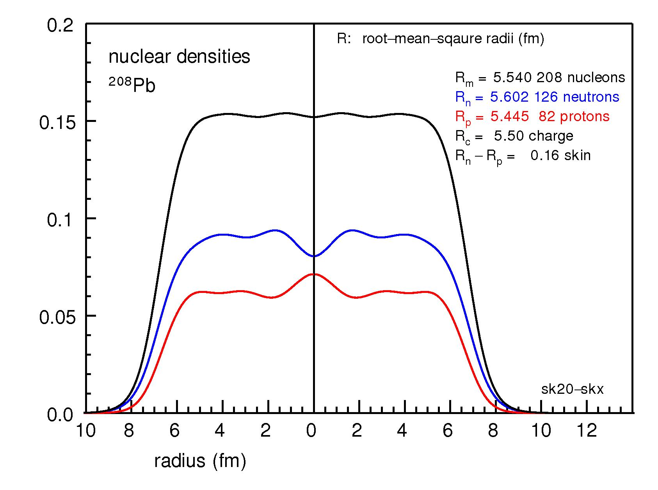

Slide 33
Fermi energy (e_{F})
= highest filled energy
e_{Fp} = -7.9 MeV for protons
e_{Fn} = -7.4 MeV for neutrons
If e_{Fp} and e_{Fn} are about the same (as in this case) the nucleus is stable to beta decay

Slide 34
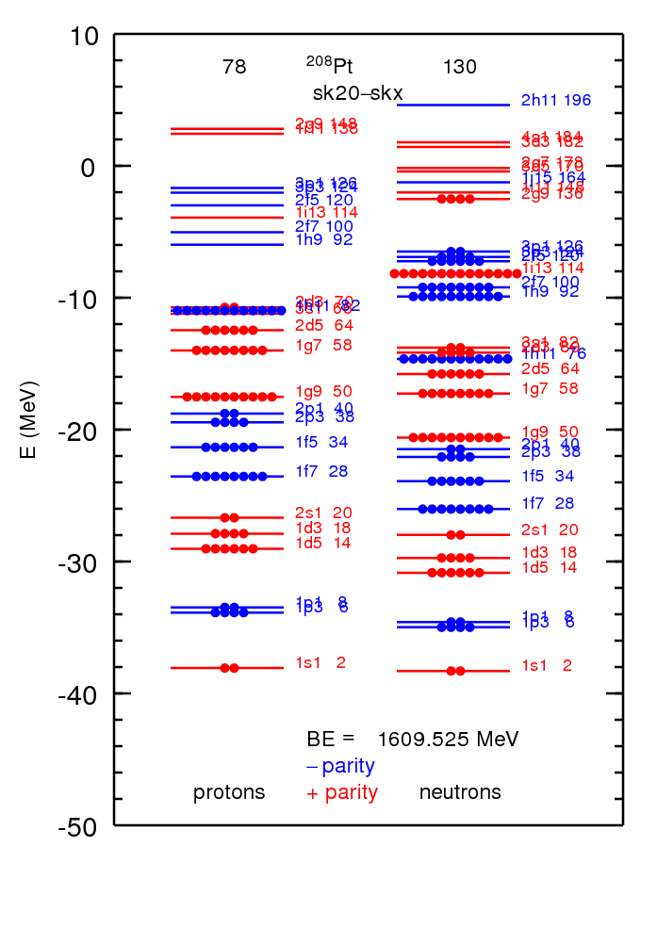
e_{Fp} = - 11.0 MeV for protons
e_{Fn} = - 2.1 MeV for neutrons
If e_{Fp} < e_{Fn} (as in this case) the nucleus beta minus decays
n goes into p + electron + neutrino

Slide 35
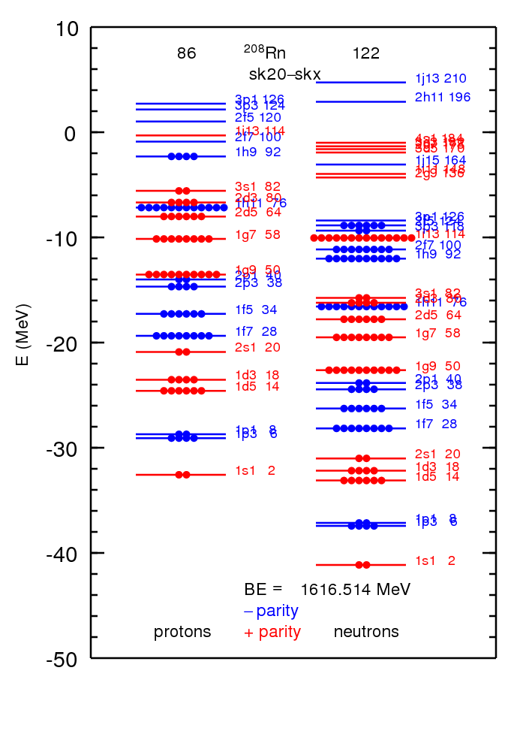
e_{Fp} = - 2.1 MeV for protons
e_{Fn} = - 9.0 MeV for neutrons
If e_{Fp} > e_{Fn} (as in this case) the nucleus beta plus decays
p goes into n + positron + neutrino

Slide 36
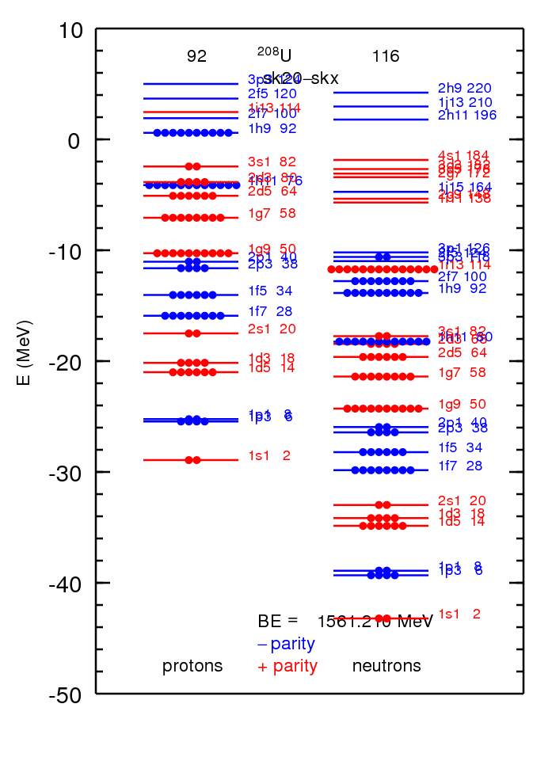
e_{Fp} = 0.1 MeV for protons
e_{Fn} = - 10.0 MeV for neutrons
If e_{Fp} > 0 (as in this case) the nucleus proton decays
this means a proton comes out
this nucleus is beyond the
proton drip line

Slide 37
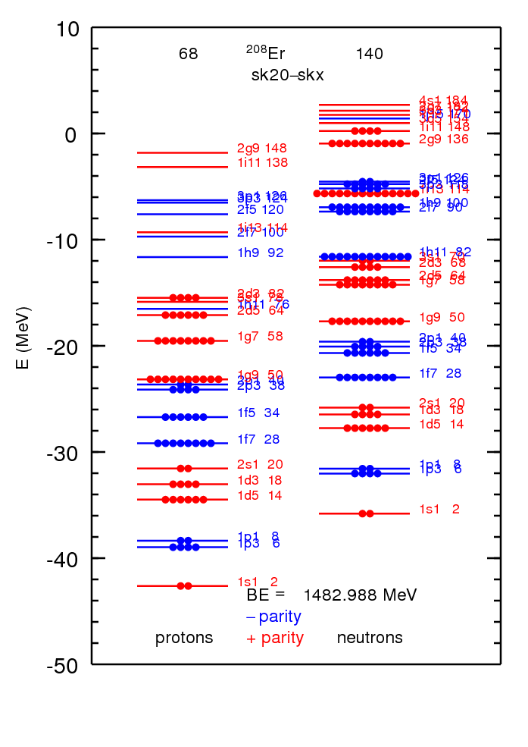
e_{Fp} = - 15.5 MeV for protons
e_{Fn} = 0.1 MeV for neutrons
If e_{Fn} > 0 (as in this case) the nucleus neutron decays
this means a neutron comes out
this nucleus is beyond the
neutron drip line

Slide 38
Energy Density Functional (EDF) theory some references
https://en.wikipedia.org/wiki/Density_functional_theory
P. Hohenberg and W. Kohn, "Inhomogeneous Electron Gas". Physical Review 136, B864 (1964).
W. Kohn and L. J. Sham, "Self-Consistent Equations Including Exchange and Correlation Effects“ Physical Review 140, A1133 (1965).
W. Kohn, Nobel Prize in chemistry in 1998

Slide 39
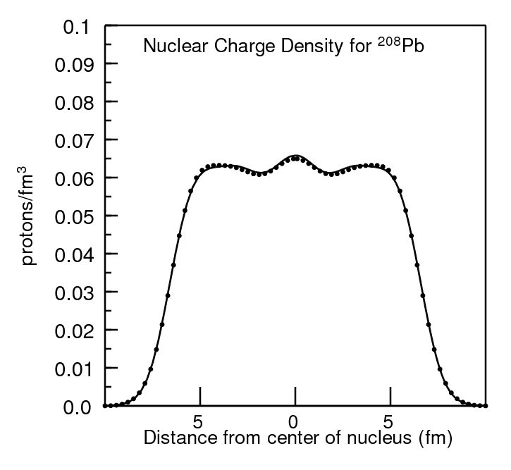

Slide 40
