Slide 1
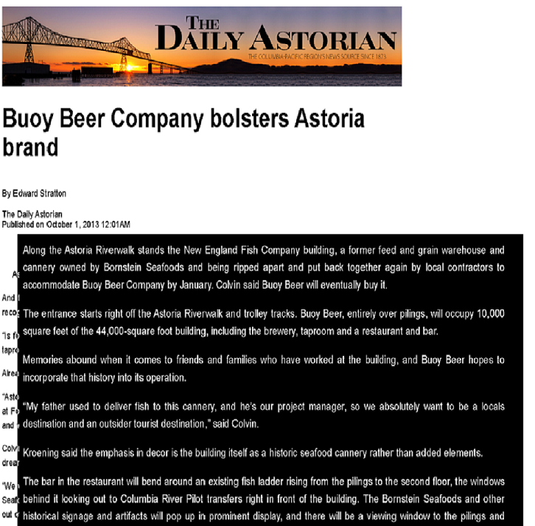
Motivation
Economic geography (Speir 2013, Black and Henderson 2003)
Commerical fishing activity tends to cluster due
locational (mostly exogenous) advantage like availability of wild fish stocks and
Returns to scale in things like provision of fishing related infrastructure
When conditions (ecological, economic, regulatory) disadvantage certain communities those communities can:
Look for ways traditional industries can remain competitive
Look for new industries better suited to current local comparative advantage or new ways to leverage locational advantage
Public Finance
If local public funds are used to subsidize the fishing industry it’s usually a good idea to try an evaluate those expenditures relative to some credible counterfactural investment.
What can other CA port communities learn?
Since communities all along CA’s coastline are talking about forming CQFs, it would be nice to know if there are lessons from MBCQF/MBFT that might apply state or region-wide.

Slide 2
Study
31 interviews
6 questionnaires targeted 6 groups within the fishing communities
Quota fund directors/quota managers
Quota fund board members
Commercial groundfish fishermen
Fishing related businesses
Civic Leaders
Community members from other communities considering QF formation (Santa Barbara, Fort Bragg, Half Moon Bay, Ilwaco)
Questions intended to elicit specifics rather than perceptions

Slide 3
Groups
Fishermen
Questions focused on impacts of the quota fund on operations: innovation, investments, lease rates, opinion on QF operations
Directors and Quota Managers
Questions focused on operational specifics and governance. Two big themes
How are allocation decisions made when there is shortage
How are the various goals (generating local landings, being financially solvent, encouraging new entrants, research to expand harvesting possibilities) prioritized
Board Members
Questions focused on
what do they consider to be the most important goals?
How do they engage the larger community
Civic Leaders
Questions focused on extent to which larger community is involved/engaged with the QFs and specific of how municipal governments lend support to commercial fishing and QFs.
Local Business Owners
Questions focused on whether they have notice any specific impacts to their business because of QF operations.
Additionally, all groups were asked perspectives on:
Greatest contributions of commercial fishing to their city/region in the past 5 years
Importance of QFs to their area
Specific ways the QFs benefit the community at large

Slide 4
Some key Questions: Fishermen
Have you been able to get sufficient quota?
How do CQF lease rates compare to open market rates? Do you feel the CQF considers your individual cost of operations when setting up a QP lease rate?
What are the top 3 advantages that participation has afforded your business?

Slide 5
Key Questions: Board Members/Civic Leaders
What, in your opinion, are the top five accomplishments of the organization?
What were the major factors motivating your community to form a quota fund?
What is your understanding of the city’s/community-at-large involvement in the QFs?
What are the optimal number and types of vessels to be operating in your community?
Can you provide up to 3 examples of induced innovation (fishing techniques, business models, financing) that fishermen have adopted since inception of the CQFs?

Slide 6
Key Questions: Directors/Quota Managers
What is your understanding of the city’s/community-at-large involvement in the formation of the QF?
What is your understanding of the city’s/community-at-large ongoing level of support for the QF?
How much quota have you been able to lease? What type of return on leases has the QF experienced?
What are the defining characteristics of a successful quota fund fisherman
From your perspective, what is the optimal number of vessels to be operating in your areas. What is the optimal make up of vessel types?
When demand for quota lease exceeds supply, how are allocation decisions made?
How does the QF balance the need to be cash flow positive with the desire to lease locally? i.e. under what circumstances would the QF lease to a highly profitable out-of-area vessel (willing to pay market lease rates) instead of to a local vessel with a lower willingness (ability) to pay?

Slide 7
Innovation, the power of the collective
Particularly among board members it was pretty popular to tell us how MBFT/MBCQF created a ‘framework’ for innovative thinking and how the benefit of the QFs are that the collective is better suited to taking risks and developing new strategies than individual fishermen. It deserves some emphasis that these responses were very light on examples of actual investments or innovations driven by the QFs.
Almost all respondents told us the same story of the lone MBCQF trawler who is
pursuing high value strategies like shallow sets that produce some live thornyheads (live shortspine thornyheads can get $5/lbs EVV versus $0.33/lbs round or dressed)
Making increased use of direct-to-market (online sales) and farmers markets to get higher return on catch.
It is worth noting here that most respondents agree that these innovations are likely individual specific (i.e. would have occurred with or without the QF) but that they give an example of the types of things the QF could promote with other fishermen.
MBFT has tried to ease the heavy of observer costs for its local fishermen by paying to train local observers (a frequently cited constraint on California groundfish fishermen is that they have to pay travel cost for observers who are most often located around Astoria…MBFT has experimented with trying to keep a local observer in order to decreased costs for it’s vessels).

Slide 8
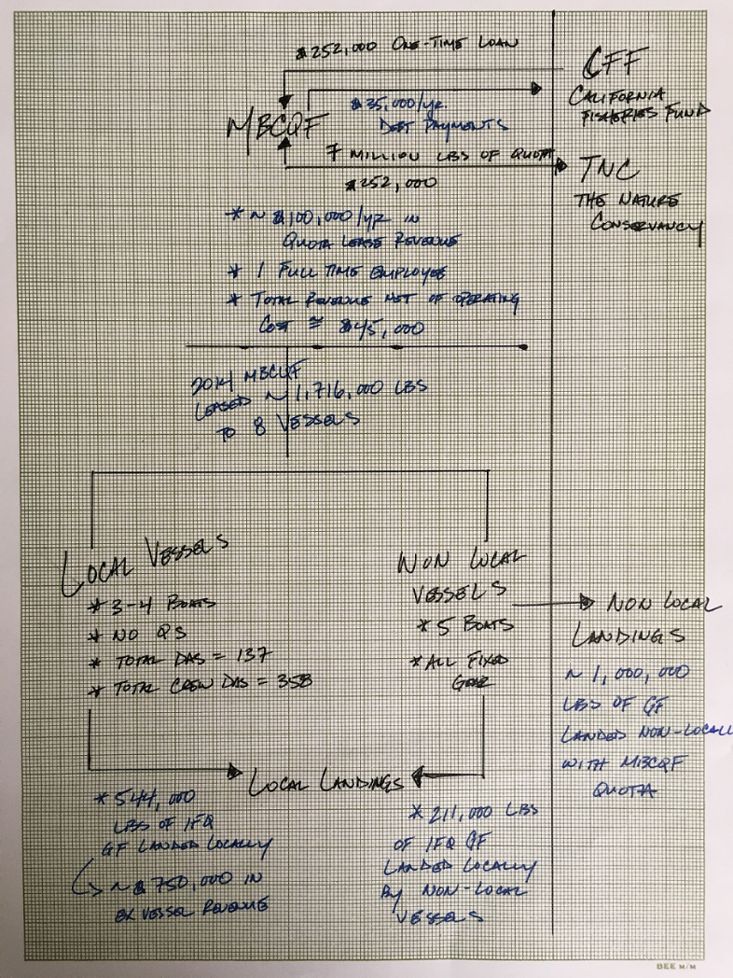
Basic facts/observations
QS portfolio valued ~$1.9 million
Species shares map to ~7 million lbs of groundfish
2014-2015 operations supported 3-4 local vessels with no QS of their own
Generated ~ 1.3 million lbs of IFQ groundfish landings in Morro Bay for 2014-15 combined.
~990,000 from local vessels
~350,000 non-local
Charged an average lease price of $0.06/lbs.

Slide 9
Local Services Sector (MBCQF)
~ 0.75 FTE
Non Local Financing (CFF)
Important Flows (2014 Snapshot)
~ $30,000
~ 500,000 lbs QP
~ 1 million lbs QP
Local Harvesting Sector
137 Captain Days = 0.55 FTE
358 Crew Days = 1.4 FTE
Non Local Harvesting Sector
??
~ 211,000 lbs
~ 500,000 lbs IFQ groundfish
~ 700,000 lbs IFQ groundfish
Local Receiving Sector
??
Non Local Receiving Sector
??

Slide 10
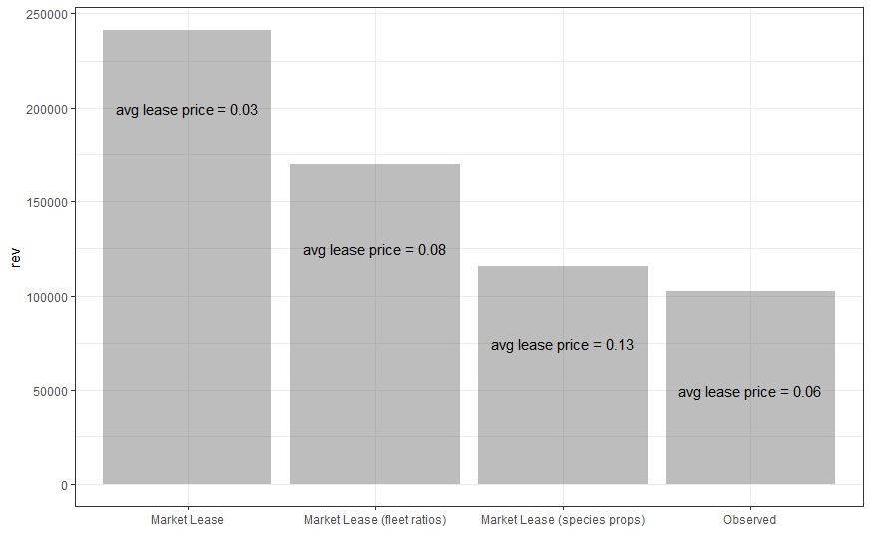

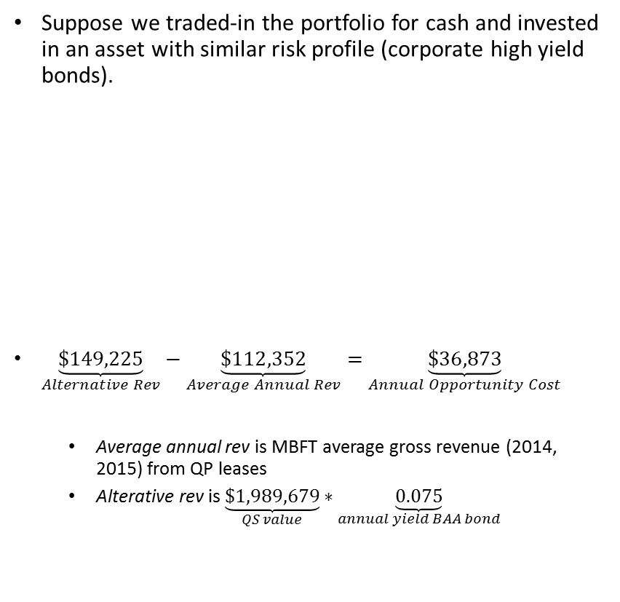
Opportunity Cost
‘Community’ Premium
Suppose we traded-in the portfolio for cash and invested in an asset with similar risk profile (corporate high yield bonds).
$\underset{Alternative Rev}{\underbrace{\$149,225}}−\underset{Average Annual Rev}{\underbrace{\$112,352}}=\underset{Annual Opportunity Cost}{\underbrace{\$36,873}}$
Average annual rev is MBFT average gross revenue (2014, 2015) from QP leases
Alterative rev is $\underset{QS value}{\underbrace{\$1,989,679}}∗\underset{annual yield BAA bond}{\underbrace{0.075}}$
Observed: $\frac{MBCQF Total Lease Rev}{MBCQF Total QP Lease}$
Market Lease: assume all QP leased at market rate
Market Lease (fleet ratio): $R=\sum_{i}{w_{i}p_{i}}; w_{i}=\frac{fleet harvest_{i}}{sector allocation_{i}}$
Market Lease (species prop): $R=\sum_{i}{w_{i}p_{i}},; w_{i}=\frac{Morro Bay Landings_{i}}{Morro Bay total IFQ Landings}$

Slide 11
Fleet Balance Sheet
Local vessel own no QS…lease 100% of landings
Landings and revenue for Morro Bay ‘local’ vessels only
Captain/boat share includes observer travel cost

Slide 12
Observations
Sentiment
A key buyer indicated he had invested in GF offloading capacity in Monterey but was ‘scrambling’ to find guys to supply him…’we can sell dover and other trawl species as well.’
The city of Monterey invested $200,000 in quota and pays $10,000/year for operating costs.
2016 IFQ groundfish landings at Monterey/Moss Landing totalled 19,801 lbs. (all sablefish). The upper bound on revenue this could generate would be around $22000…that leaves a lot of quota leased out of the area or not leased.
I find this really interesting…I mean if we are going to square these facts with the sentiment that the community is ‘really trying to make this work’, we have to accept either a coordination failure of epic proportions or some exaggeration.
There was a disconnect between interview responses and what respondents wanted to see reflected in the report….the interviews asked pretty specific questions so there was limited scope for flowery B.S. answers….but when board members in particular saw the responses in the final report they were uncomfortable with the lack of jargon and prose in the report.

Slide 13
some language that board members wanted inserted into the report:
Responses from this group also pointed out that pooling of quota (in a quota fund) with the benefits of staff (Executive Directors) and a board, enables fishing communities to engage in more creative and long-term thinking than individual fishermen and that in the reality of the new ITQ system, quota is being bought and sold and through quota funds, some quota is being captured and will be held locally. Respondents from this group also stressed that their organizations were still working on strategic planning and capacity building and making excellent progress.

Slide 14
Margaert: Overall, It seems to paint a picture that focuses on economic challenges without enough emphasis on the benefits and innovation potential offered by pooling capacity and quota in the QFs. I think the capacity brought into the situation by the QFs allows for some creative thinking and engagement with other groups that you don't have if you are a fisherman alone. Agreed it is challenging, but why can't we focus on some of the value add that we have been bringing to the discussion (part time observer; Fish 2.0; MREP leader, etc.)? This report overlooks a major accomplishment of the QFs - the real challenge is that Quota holders are selling their quota and the good news is that our groups are able to capture some of the quota before it leaves. That has been a key part of our work but it is not mentioned (the real threat of loss of quota that we are seeing). Ideally, this report would distinguish the challenges of the IFQ program to individuals vs the benefits provided by an aggregation of quota and capacity in a Fund with staff. I feel the report is rather simplistic in that regard. EXCELLENT COMMENTS,.CONSIDERING SHE IS PART OF GROUP 2, WE MOVED THESE COMMENTS TO THE BOARD MEMBERS AND ADVISORS SECTION. This should reflect that our Trust is still working on our capacity and strategic planning, so this is a bit premature.

Slide 15
In your opinion is there any evidence that MBCQF/MBFT has made financing (for fishermen) easier to obtain?

Slide 16
Online bullshit buzzword corpus:
http://ngenworks.com/culture/250-buzzwords-we-love-to-hate/
https://www.amazon.com/Dictionary-Corporate-Bullshit-Lexicon-Enraging/dp/0767920740
http://www.atrixnet.com/bs-generator.html

Slide 17
References
Black, D. and V. Henderson. 2003. Urban evolution in the USA. Journal of Economic Geography v.3: 343-372
Clark, S.J. and J.C. Stabler. 1991. Gibrat’s Law and the growth of Canadian cities. Urban Studies v.28: 635-639
Davis, D.R. and D.E. Weinstein. 2002. Bones, bombs, and break points: The geography of economic activity. American Economic Review v.92: 1269-1289
Speir, C.L. 2013. The geographic distribution of commercial fishing: Locational fundamentals versus increasing returns. Agricultural and Applied Economics Association, Joint Annual Meeting.
Martin, R. and P. Sunley. 2006. Path dependence and regional economic evolution. Journal of economic geography, v.6(4): 395-437
Simmie, J. and R. Martin. 2010. The economic resilience of region: towards an evolutionary approach. Cambridge journal of regions, economy and society. V.3(1): 27-43
Dawley, S. 2013. Creating new paths? Offshore wind, policy activism, and peripheral region development. Economic Geography, v. 90(1): 91-112.

Slide 18
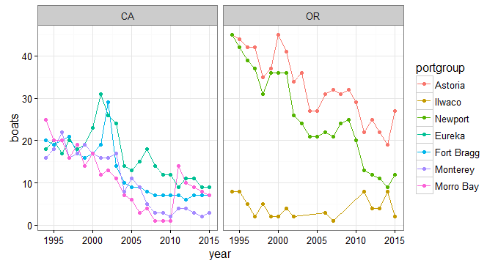

Slide 19
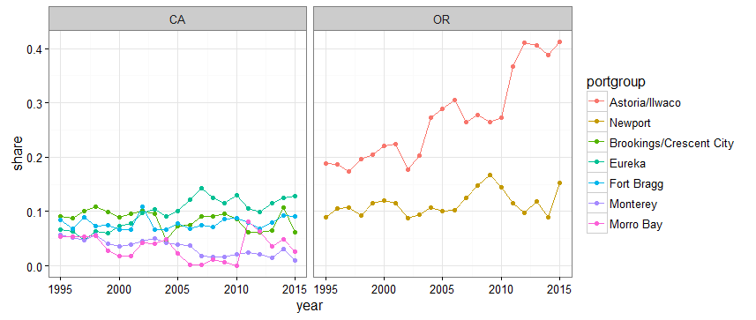

Slide 20
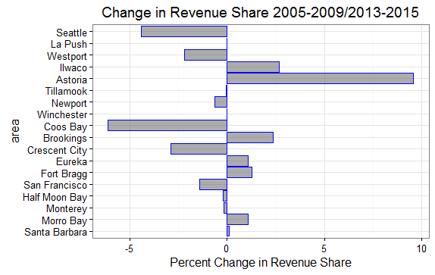

Slide 21
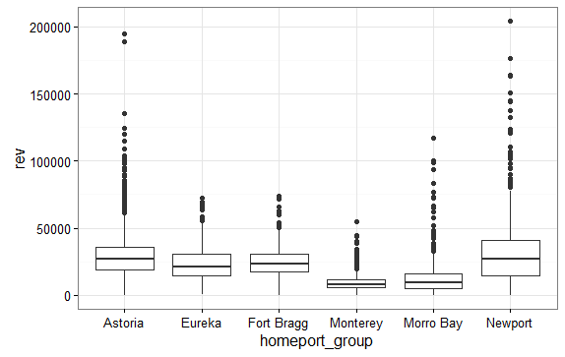
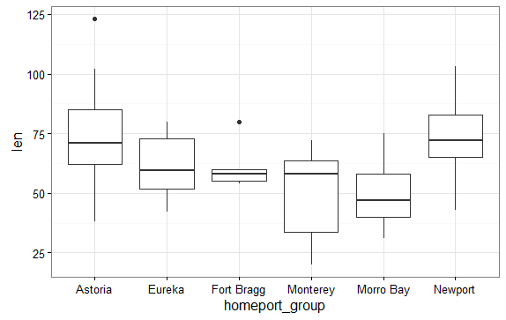

Slide 22
