Slide 1
Gadget YFT model Spatial assessment modelling workshop
William Butler (MFRI)
BJARKI ÞÓR ELVARSSON (MFRI)
VALERIO BARTOLINO (SLU)
ALFONSO PÉREZ RODRÍGUEZ (IEO)

Slide 2
Gadget overview
Age and length-based ecosystem simulator and stock assessment tool
Multi-fleets, multi-stocks and multi-areas
Examples of spatial Gadget models:
Two area cod model with migrations between North and South of Iceland (https://raunvisindastofnun.hi.is/sites/raunvisindastofnun.hi.is/files/rh-03-2011.pdf)
Bormicon model (the precursor to Gadget) https://www.hafogvatn.is/static/research/files/fjolrit-058.pdf
Multi-species, multi-area Barents sea study
https://www.sciencedirect.com/science/article/pii/S0967064508003950

Slide 3
Introducing Gadget 3
Written by Jamie Lentin (https://shuttlethread.com) and Bjarki Þór Elvarsson
Models written in R and use TMB to build objective function
Improvements over Gadget2:
Automated differentiation
adreports, random effects
Highly customisable
The objective function is mobile
Can be used with R optimisers
Current status

Slide 4
Modelling process
Data imported into an MFDB database
Initial ´out-of-the-box’ model run with G3
Growth, maturity, initial abundances, and recruitment all estimated
Configure model set up
Which parameter should be fixed?
How closely should we follow the operation model?
Fit and diagnose models for one area without tagging data

Slide 5
Model structure
Stock processes
Initial conditions: equilibrium
Maturity: length-based
Ageing: annual
Growth: Linf fixed, K averaged across seasons
Natural mortality: age-dependent (averaged over seasons)
Renewal: free-parameter per quarter
Fleets
7 fleets
6 dome-shaped
1 logistic (longline)
1 survey fleet (taking selectivity of the longline)

Slide 6
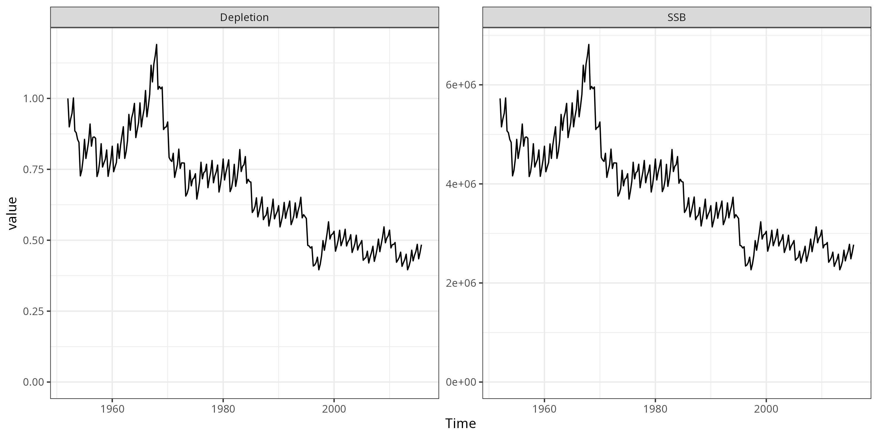
1A Biomass and depletion

Slide 7
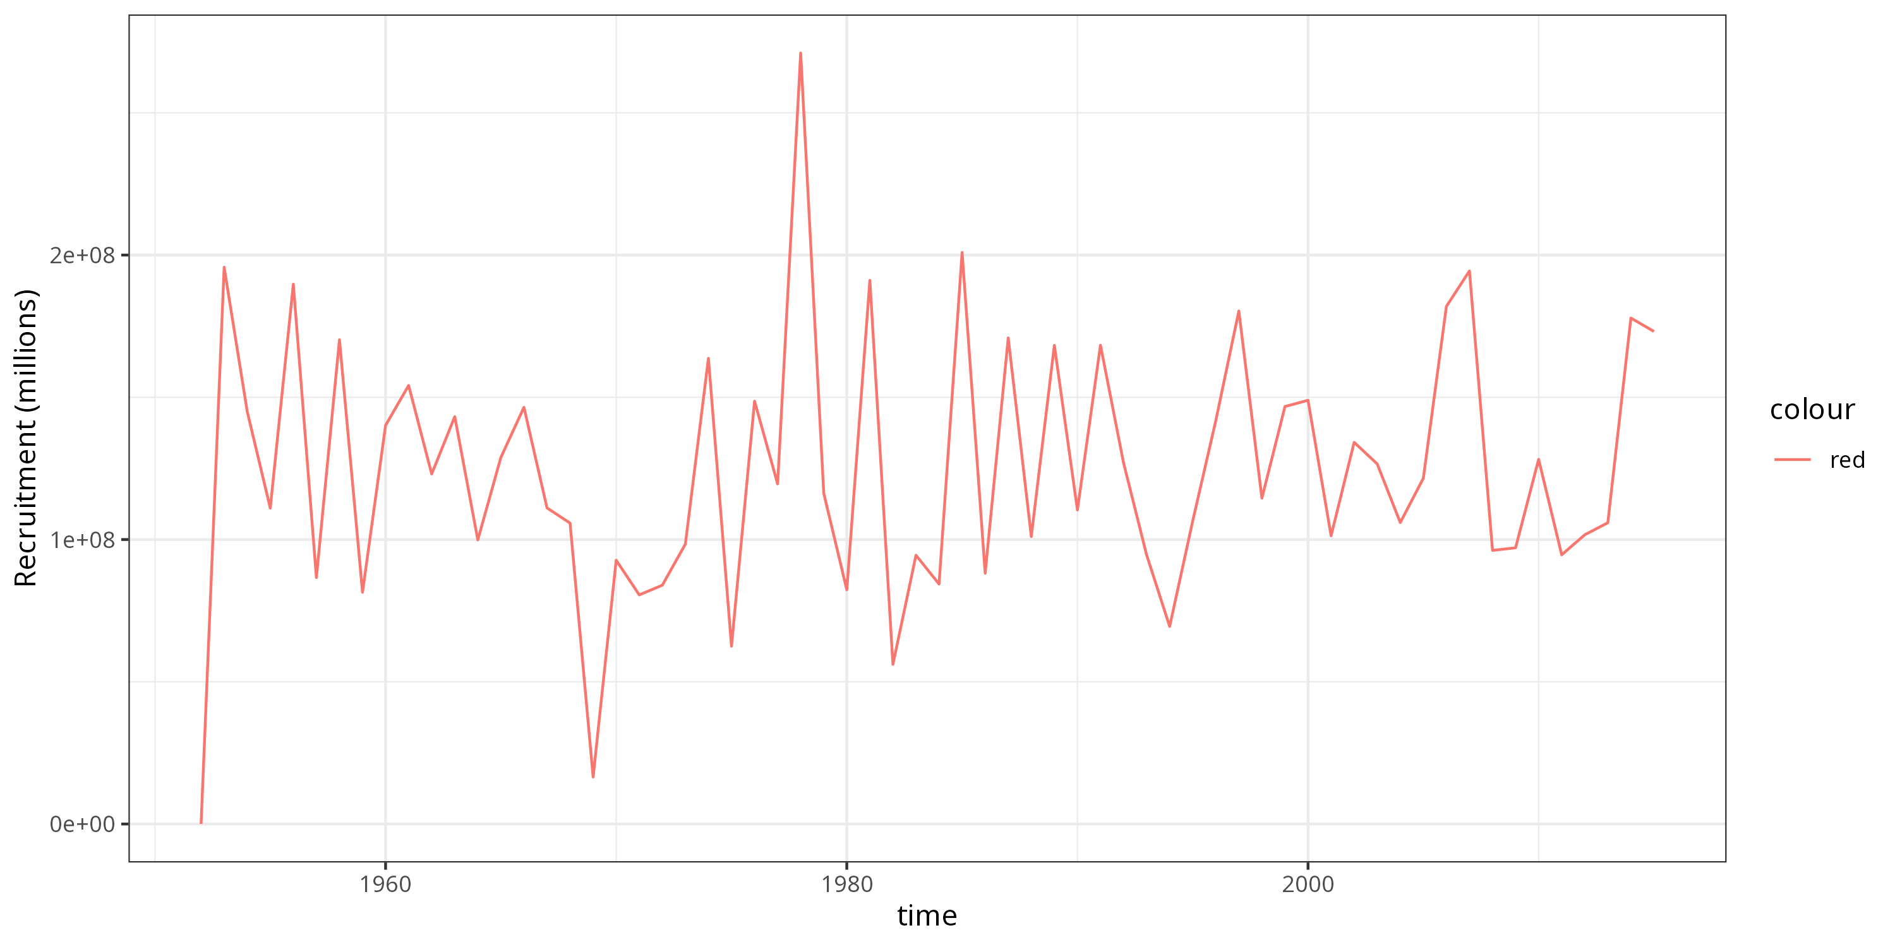
1A Recruitment

Slide 8
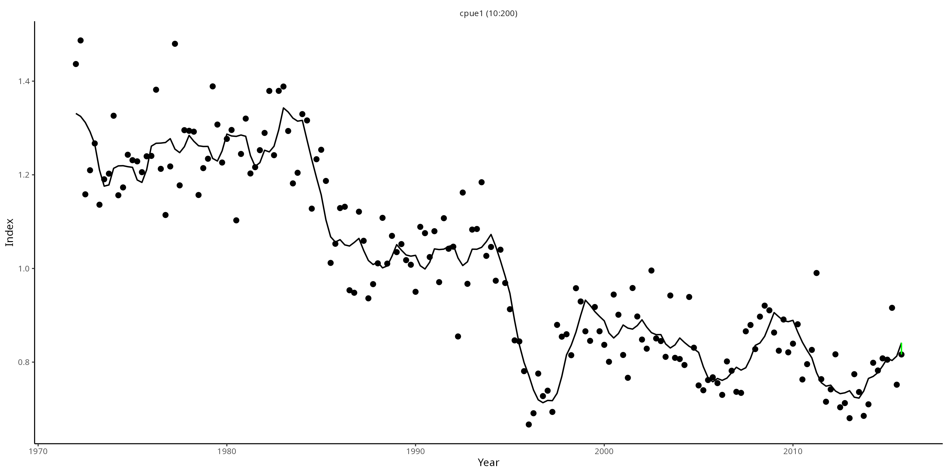
Abundance index

Slide 9
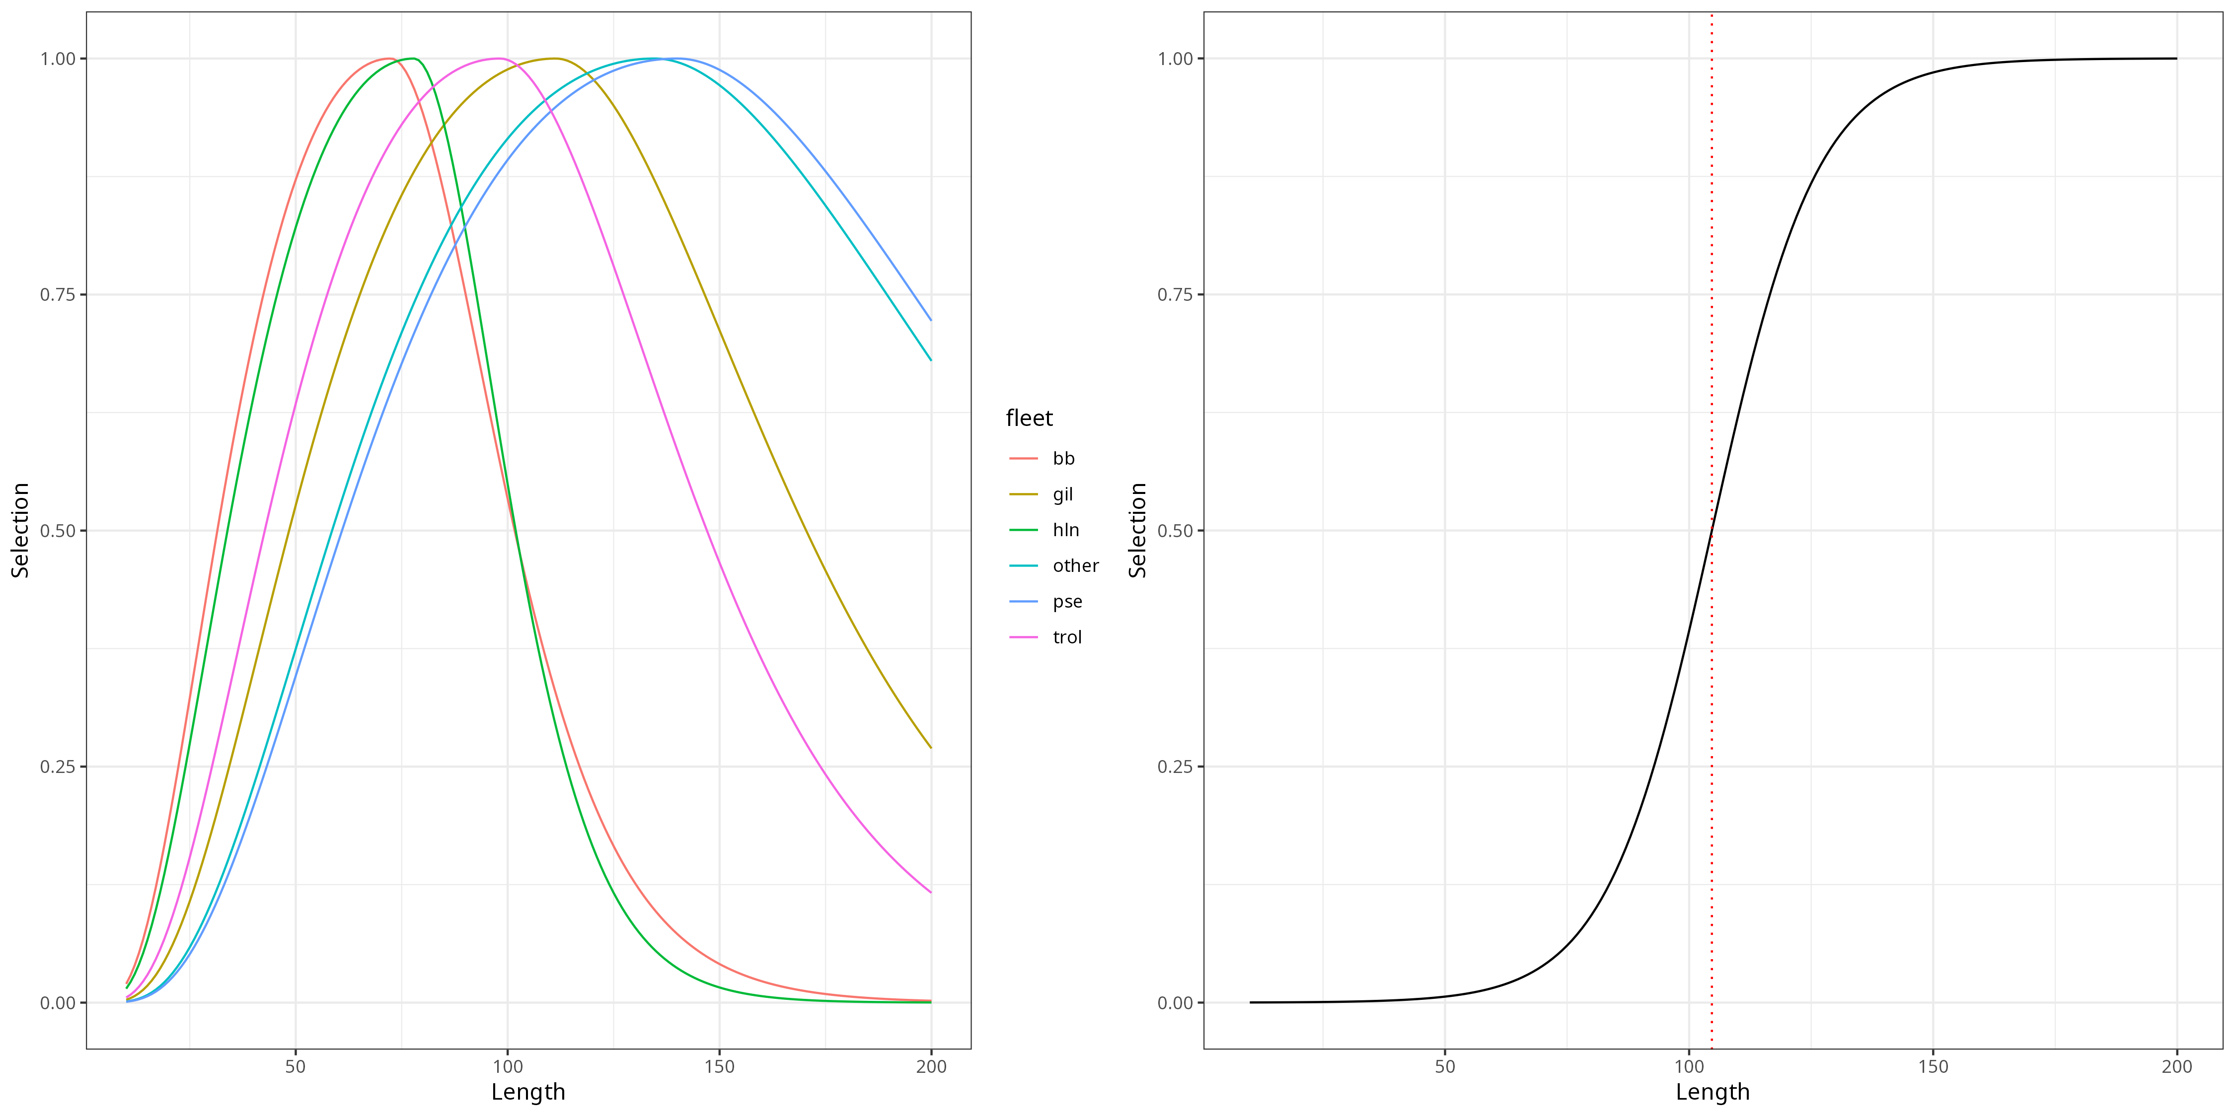
Selectivity

Slide 10
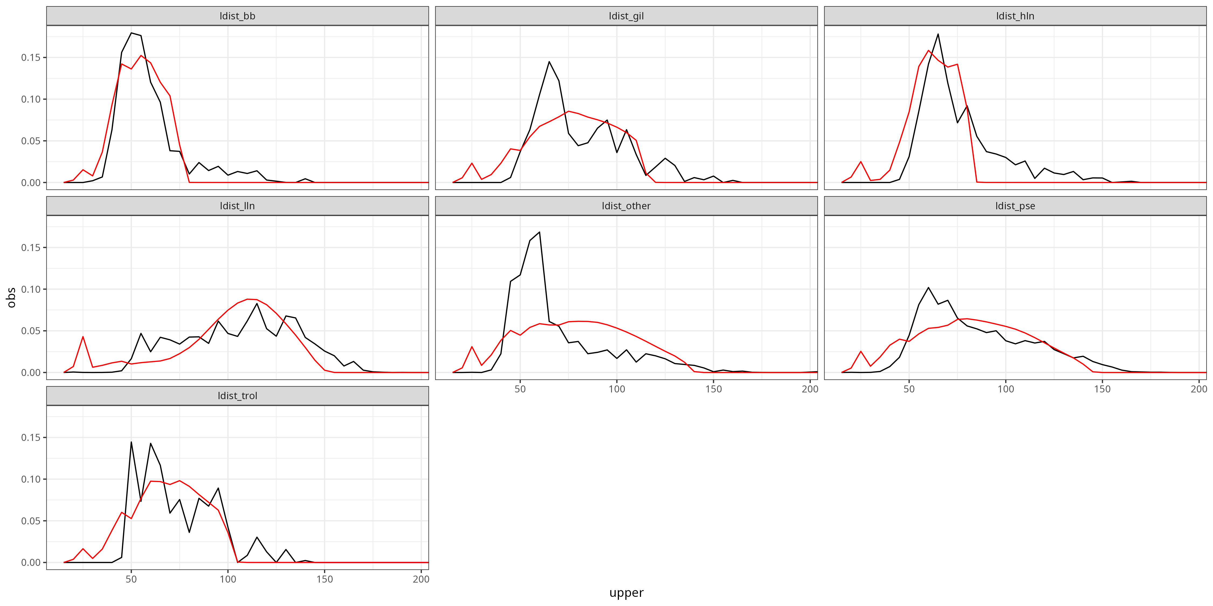
Length-distributions

Slide 11
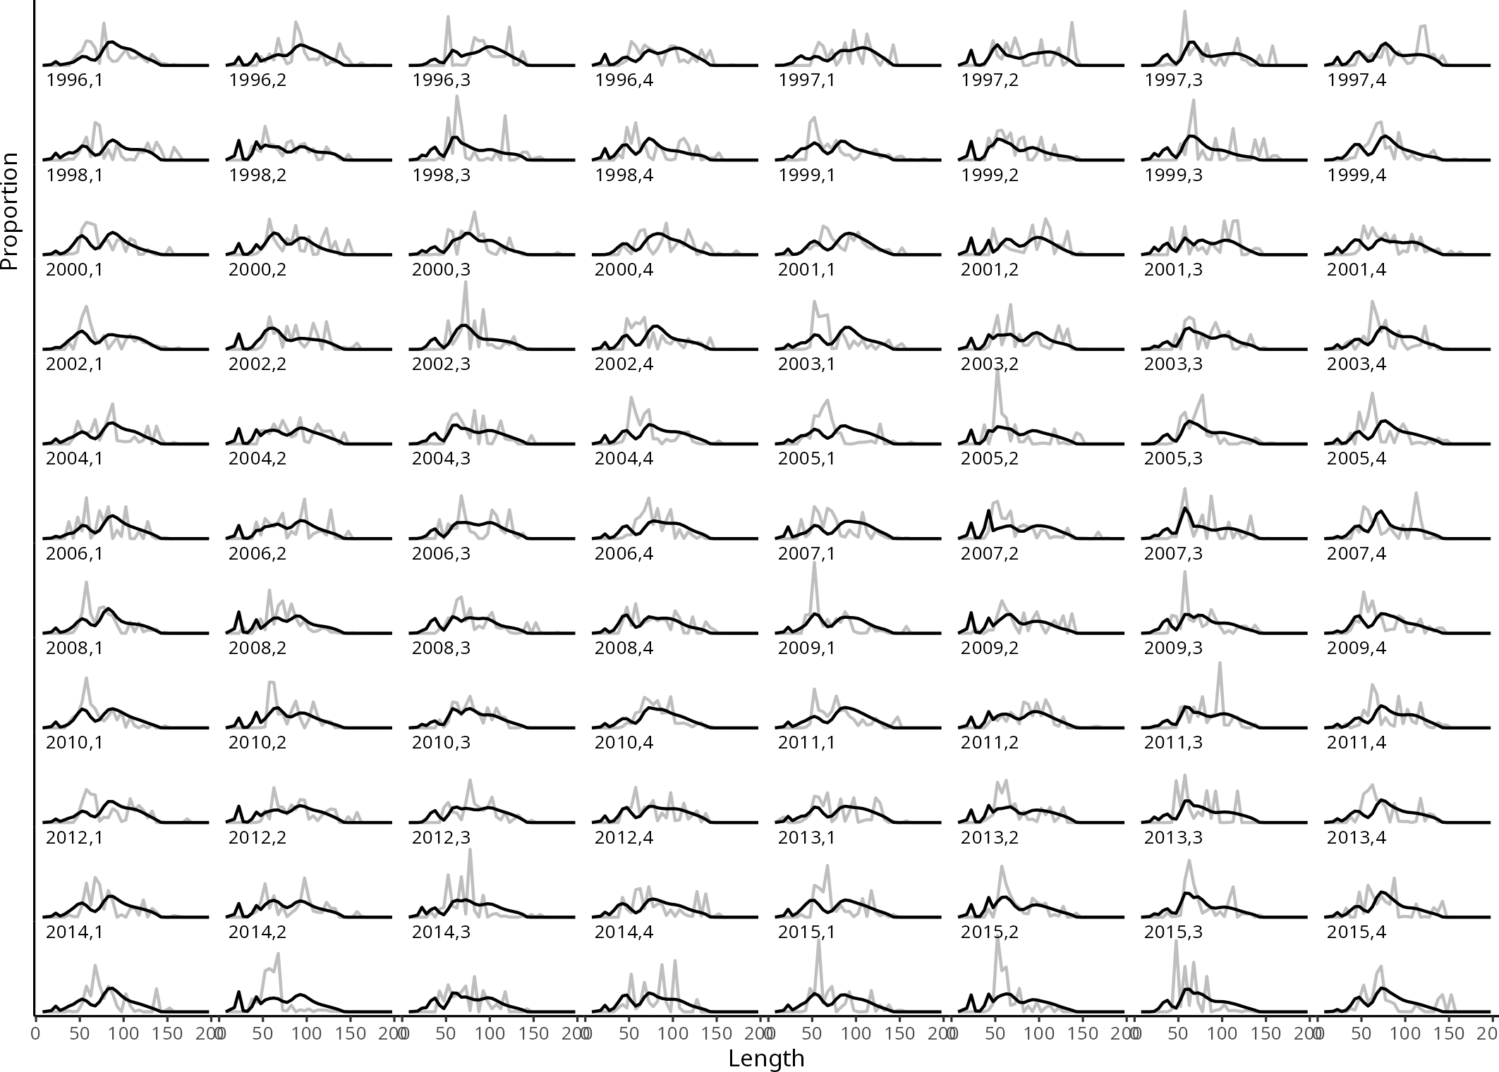
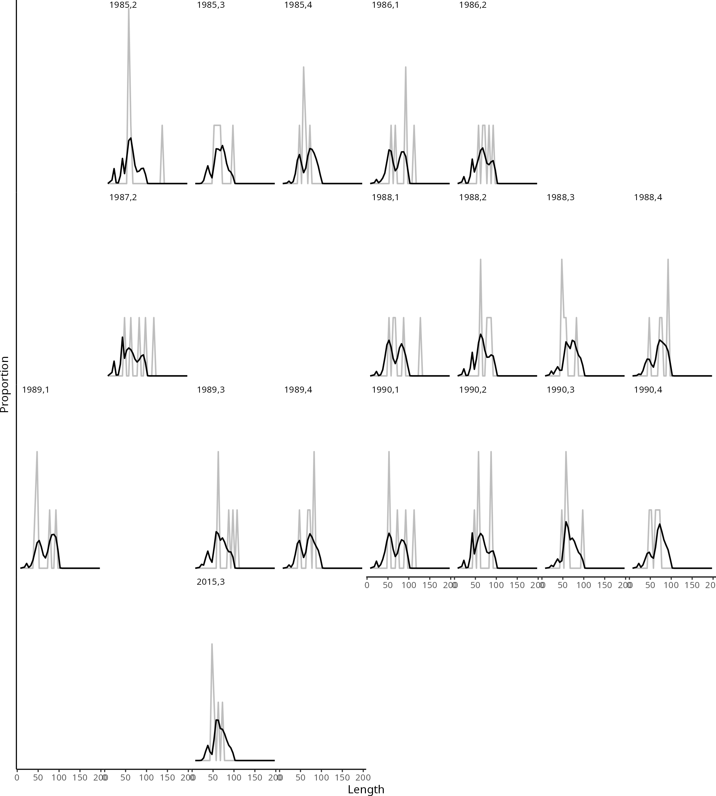
Length-distributions
Pse
Trol

Slide 12
Problems encountered
Recruitment dynamics
Utilised the ´standard´ Gadget approach – free parameters
Move to stock-recruit curve?
Random effects courtesy of TMB
Growth
Potential misspecification
Move to length-based K
Fleet interactions
Spiky length distributions are causing problems
Try alternative selectivity functions
Clamp parameters

Slide 13
Next steps
Single area model
Check the growth model and selectivity, try different likelihood functions
Run full set of diagnostics: retrospective analysis, leave one out, jitter
Compare with model that includes tagging
Run using 100 set of inputs
Recruitment as a random effect
Fleets-as-areas
Four area model
TBD

Slide 14
Thanks

