Slide 1

Four area model investigation

Slide 2
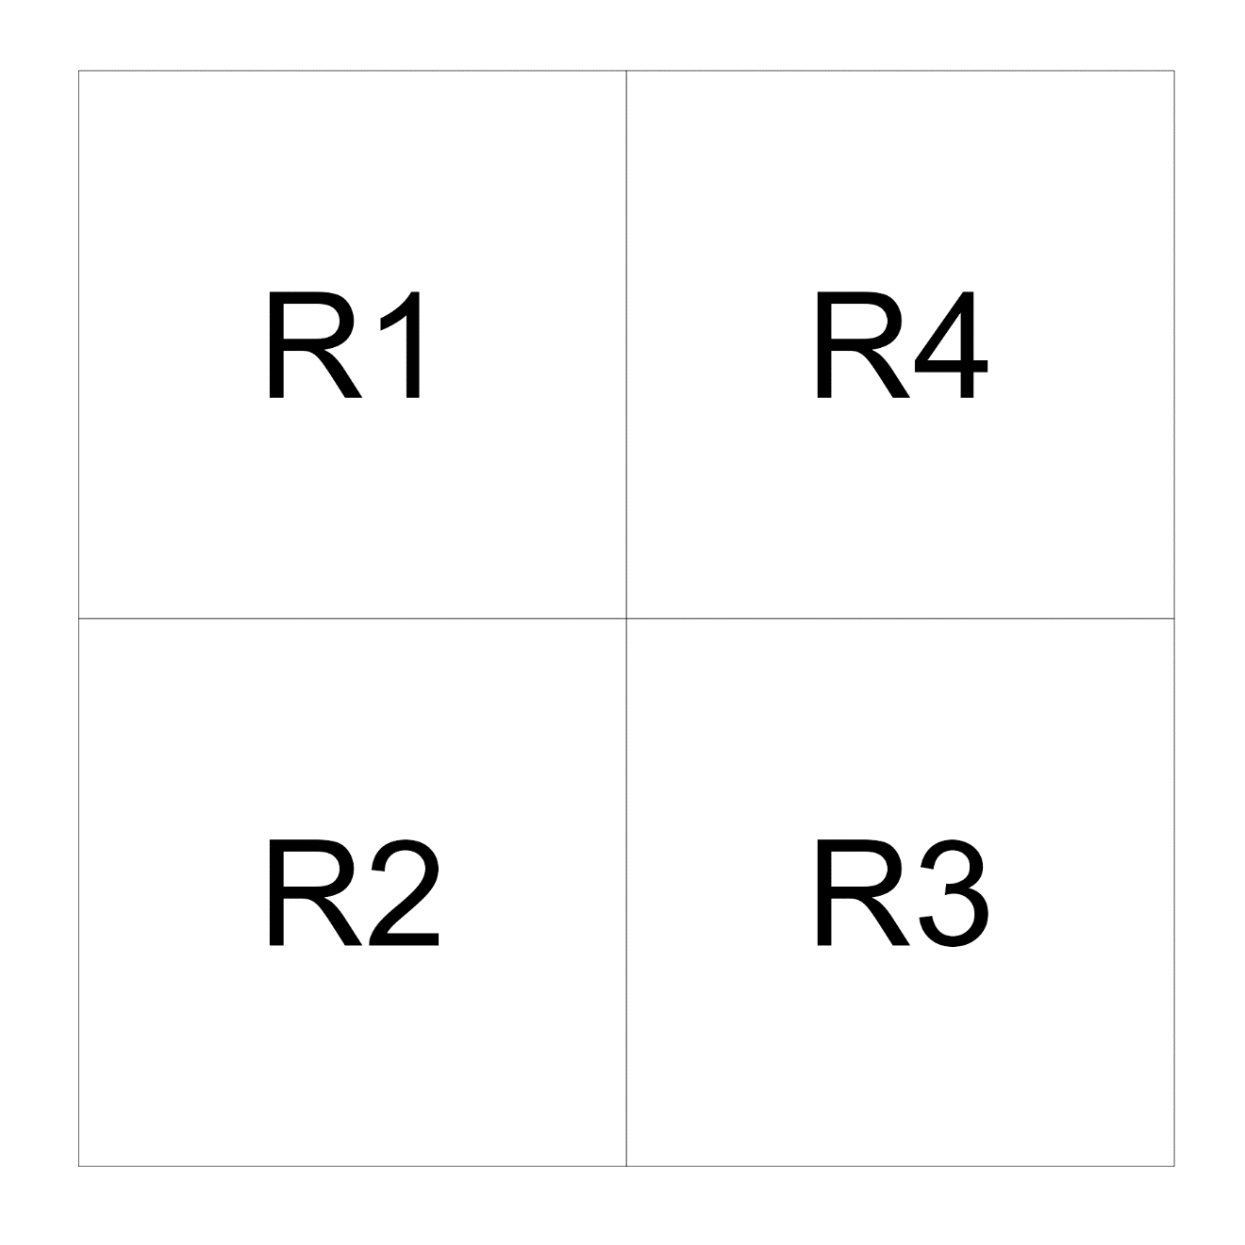
Initial model
Single Spawning stock with equal apportionment among regions
Fishery gears have common selectivity over space and time
Catchability time and area invariant
No tagging data
No movement

Slide 3
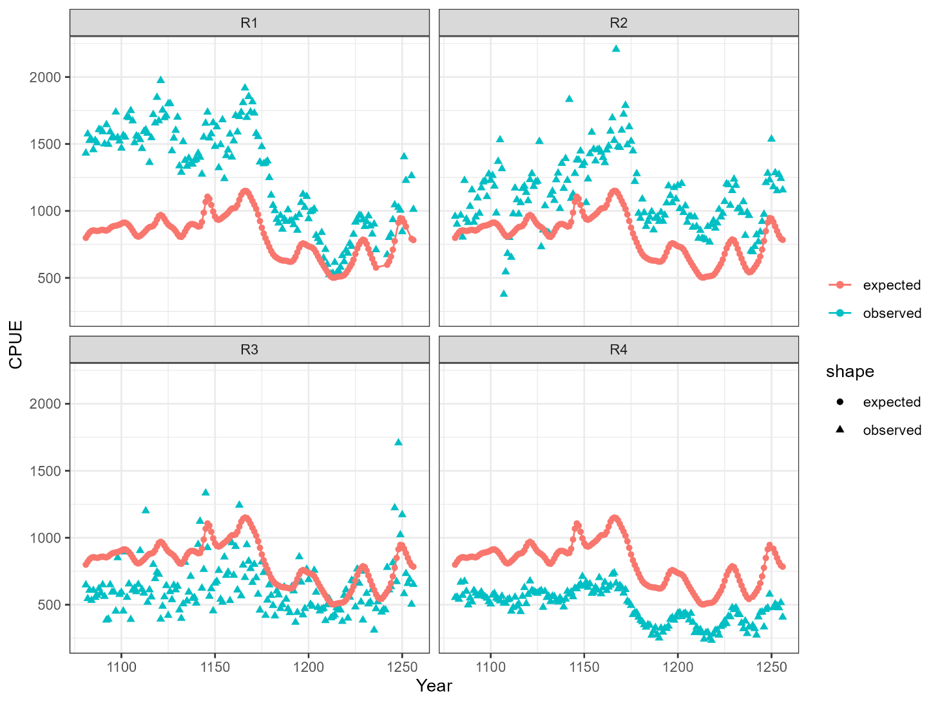
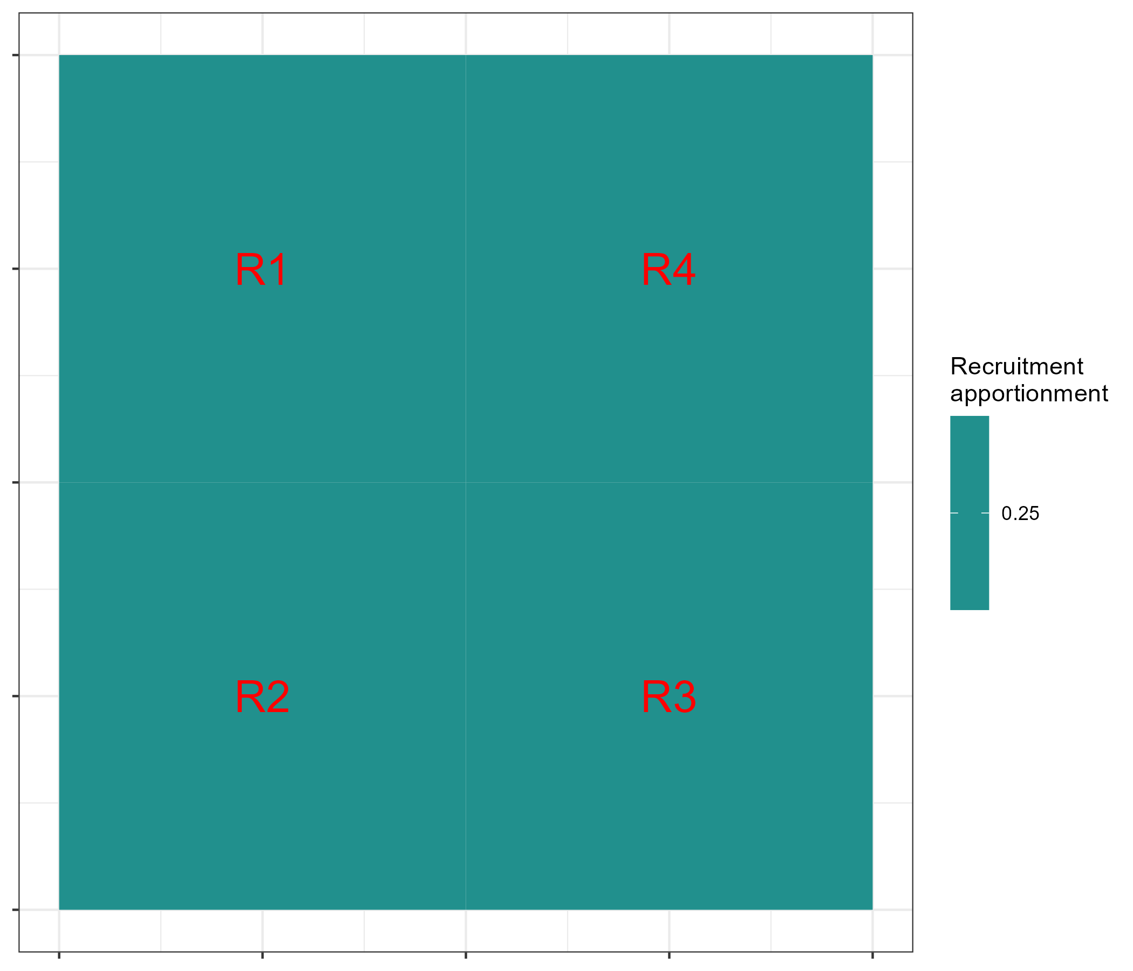
Initial model
CPUE fit
Recruitment apportionment assumption

Slide 4
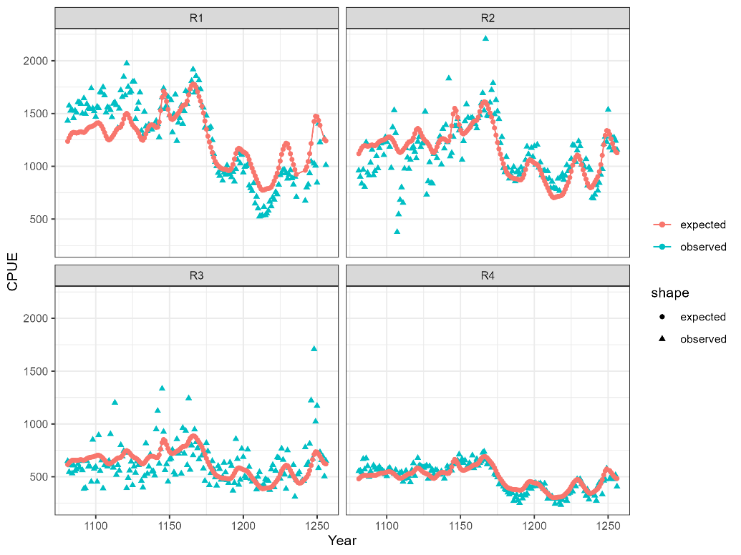
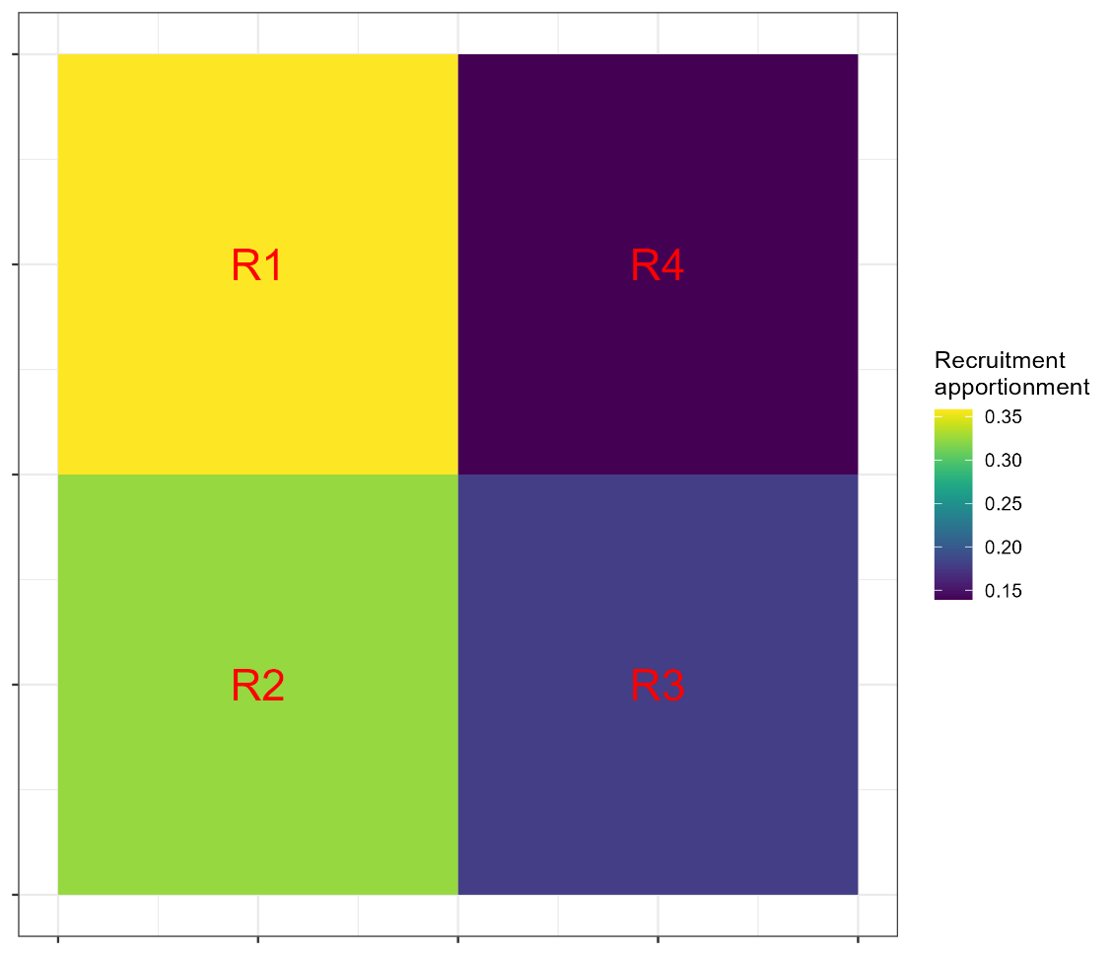
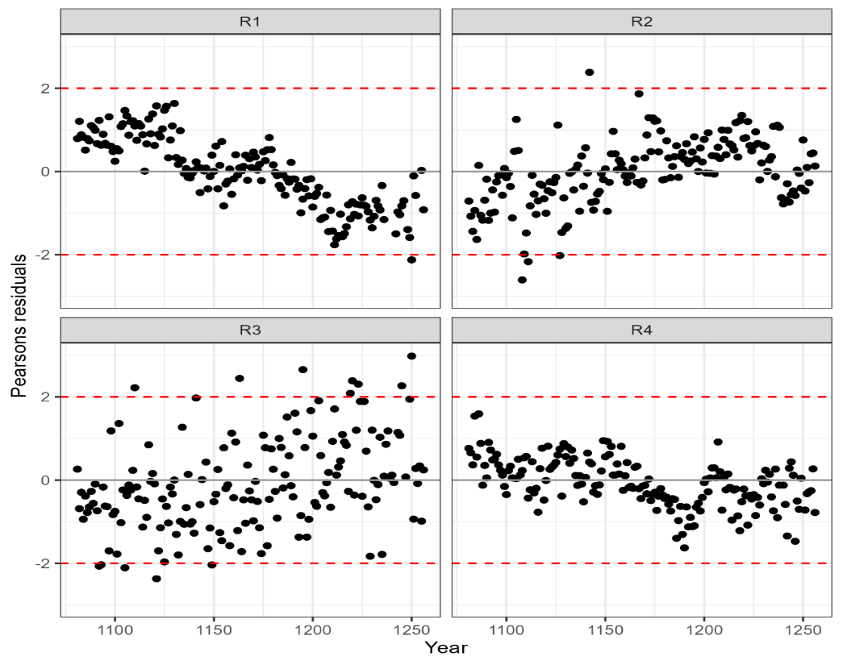
Model 02
Estimate recruitment apportionment among regions

Slide 5
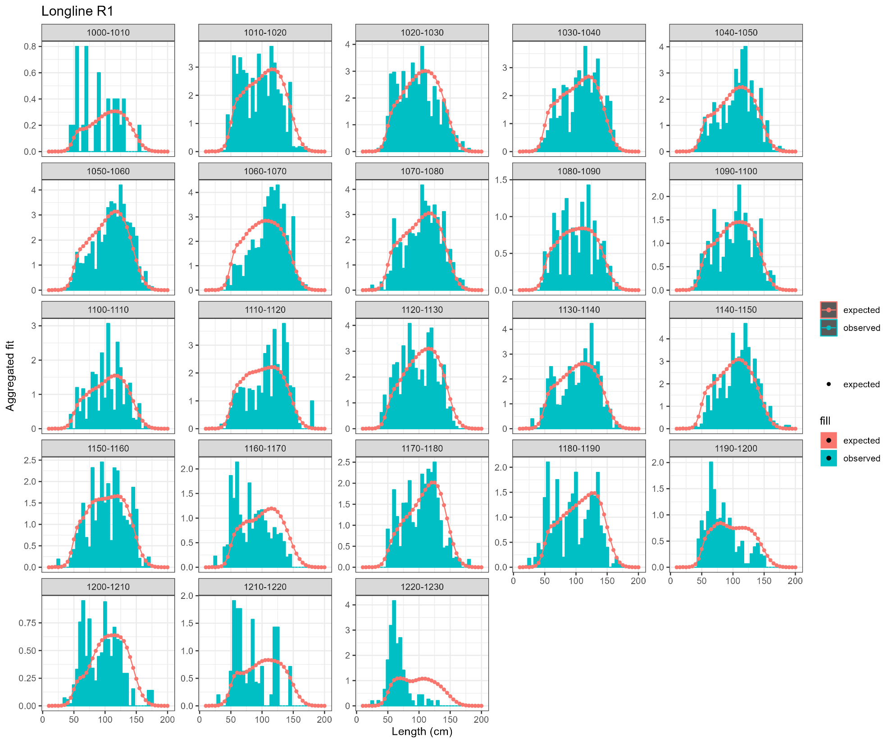
Model 02
Were there trends in LF fits the same as CPUE for Longline fishery in R1?
Notes:
Looks to be mis-fitting young cohorts (bi-modality)

Slide 6
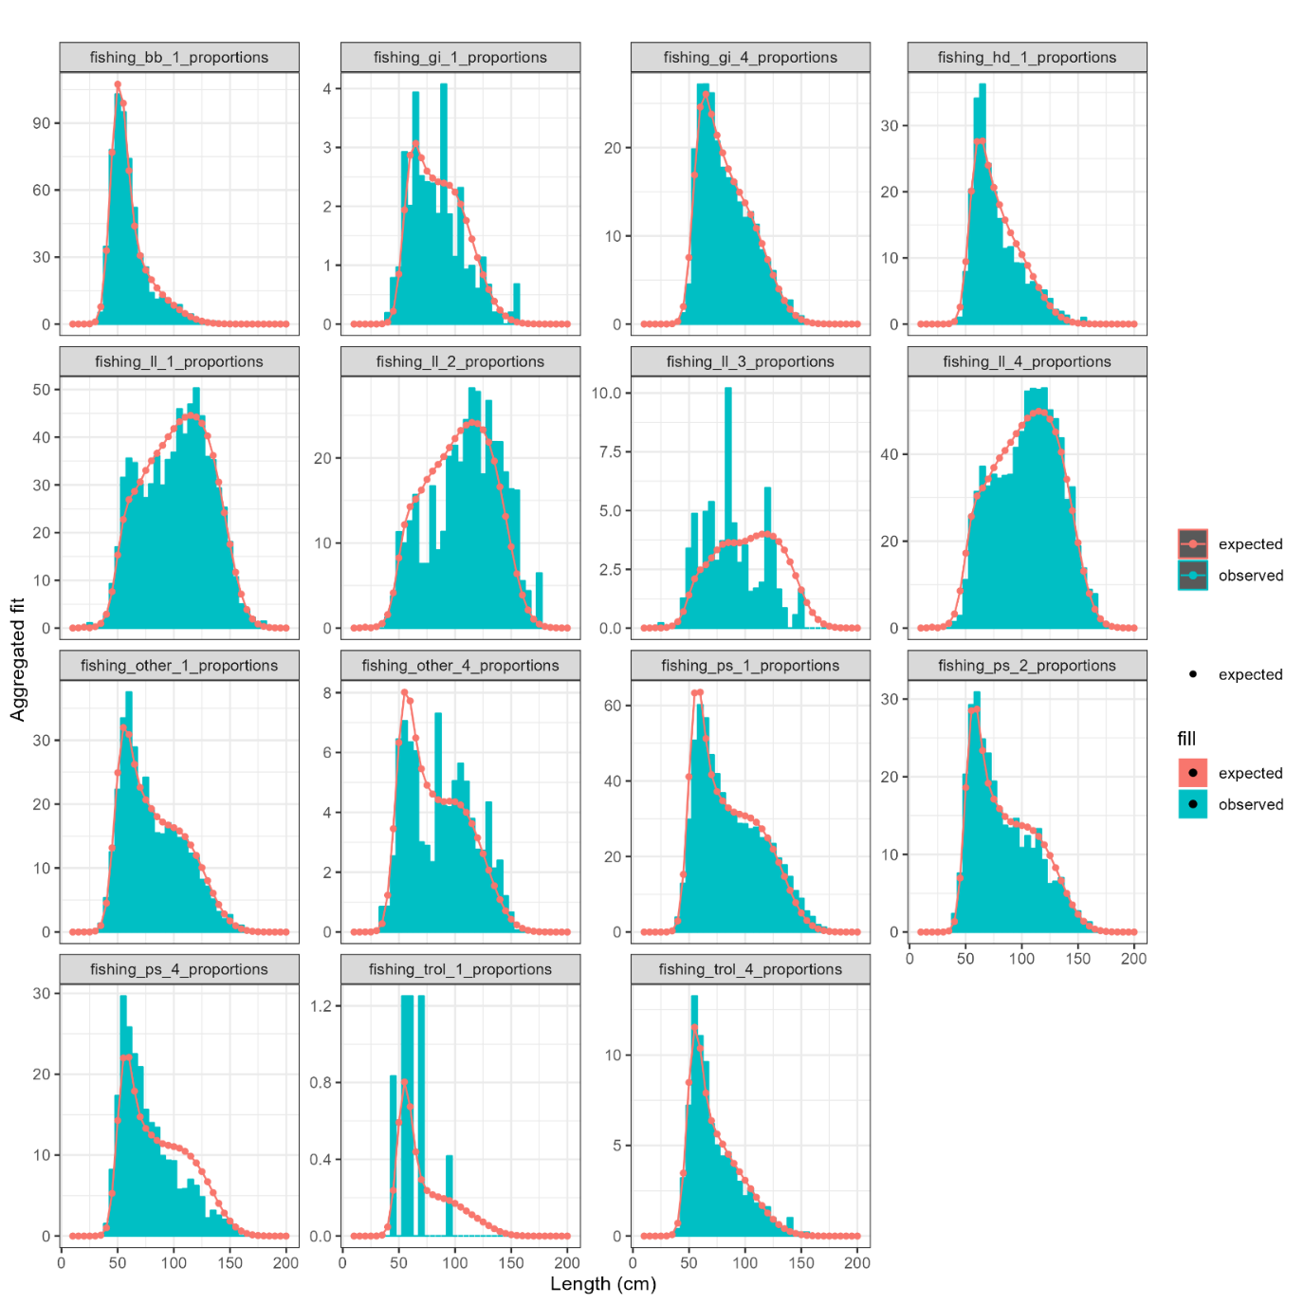
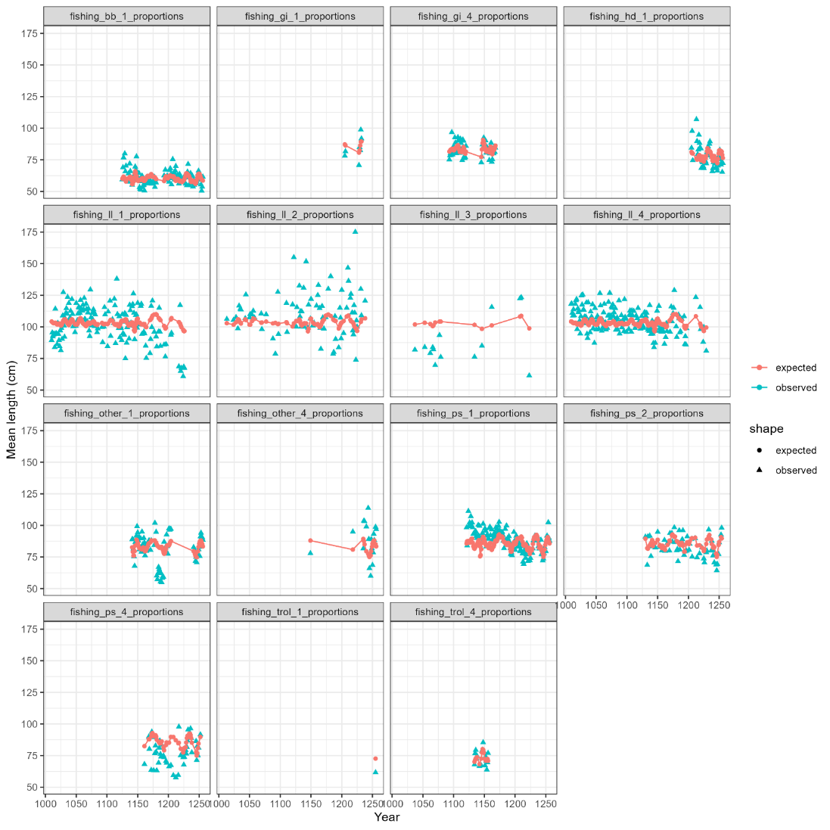
Model 02
Mean length LFs
Aggregated LF fits

Slide 7
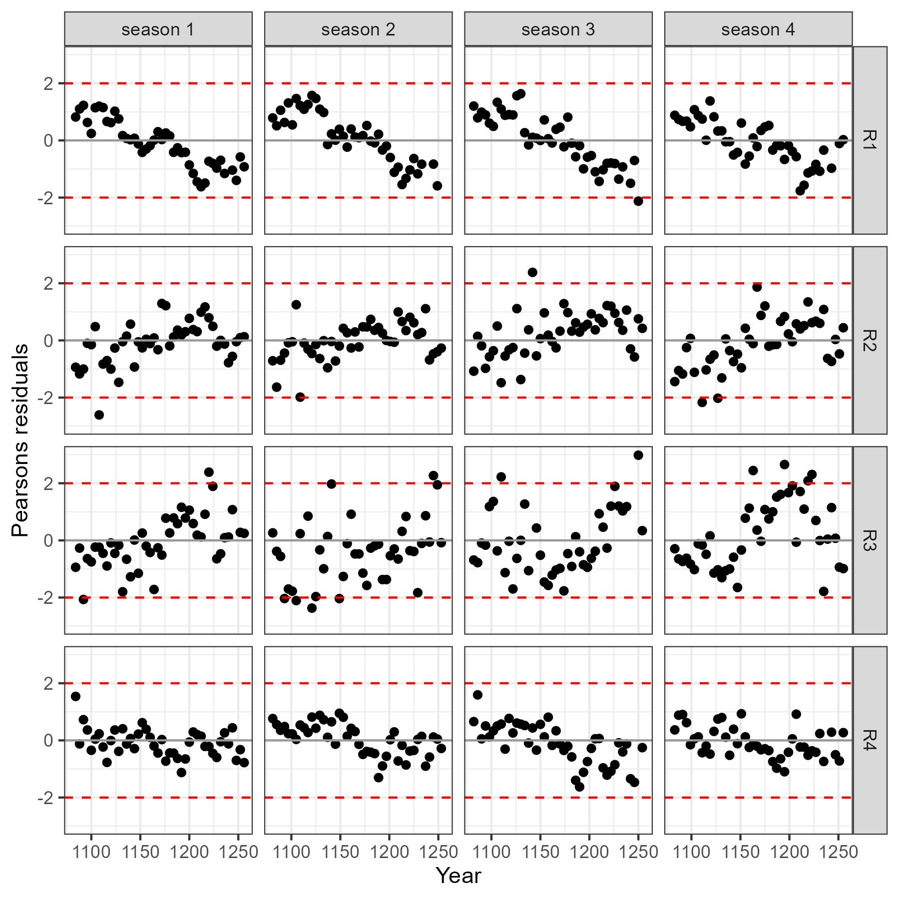
Implied seasonal CPUE residuals
Region 1 residual pattern consistent among “true seasons”

Slide 8
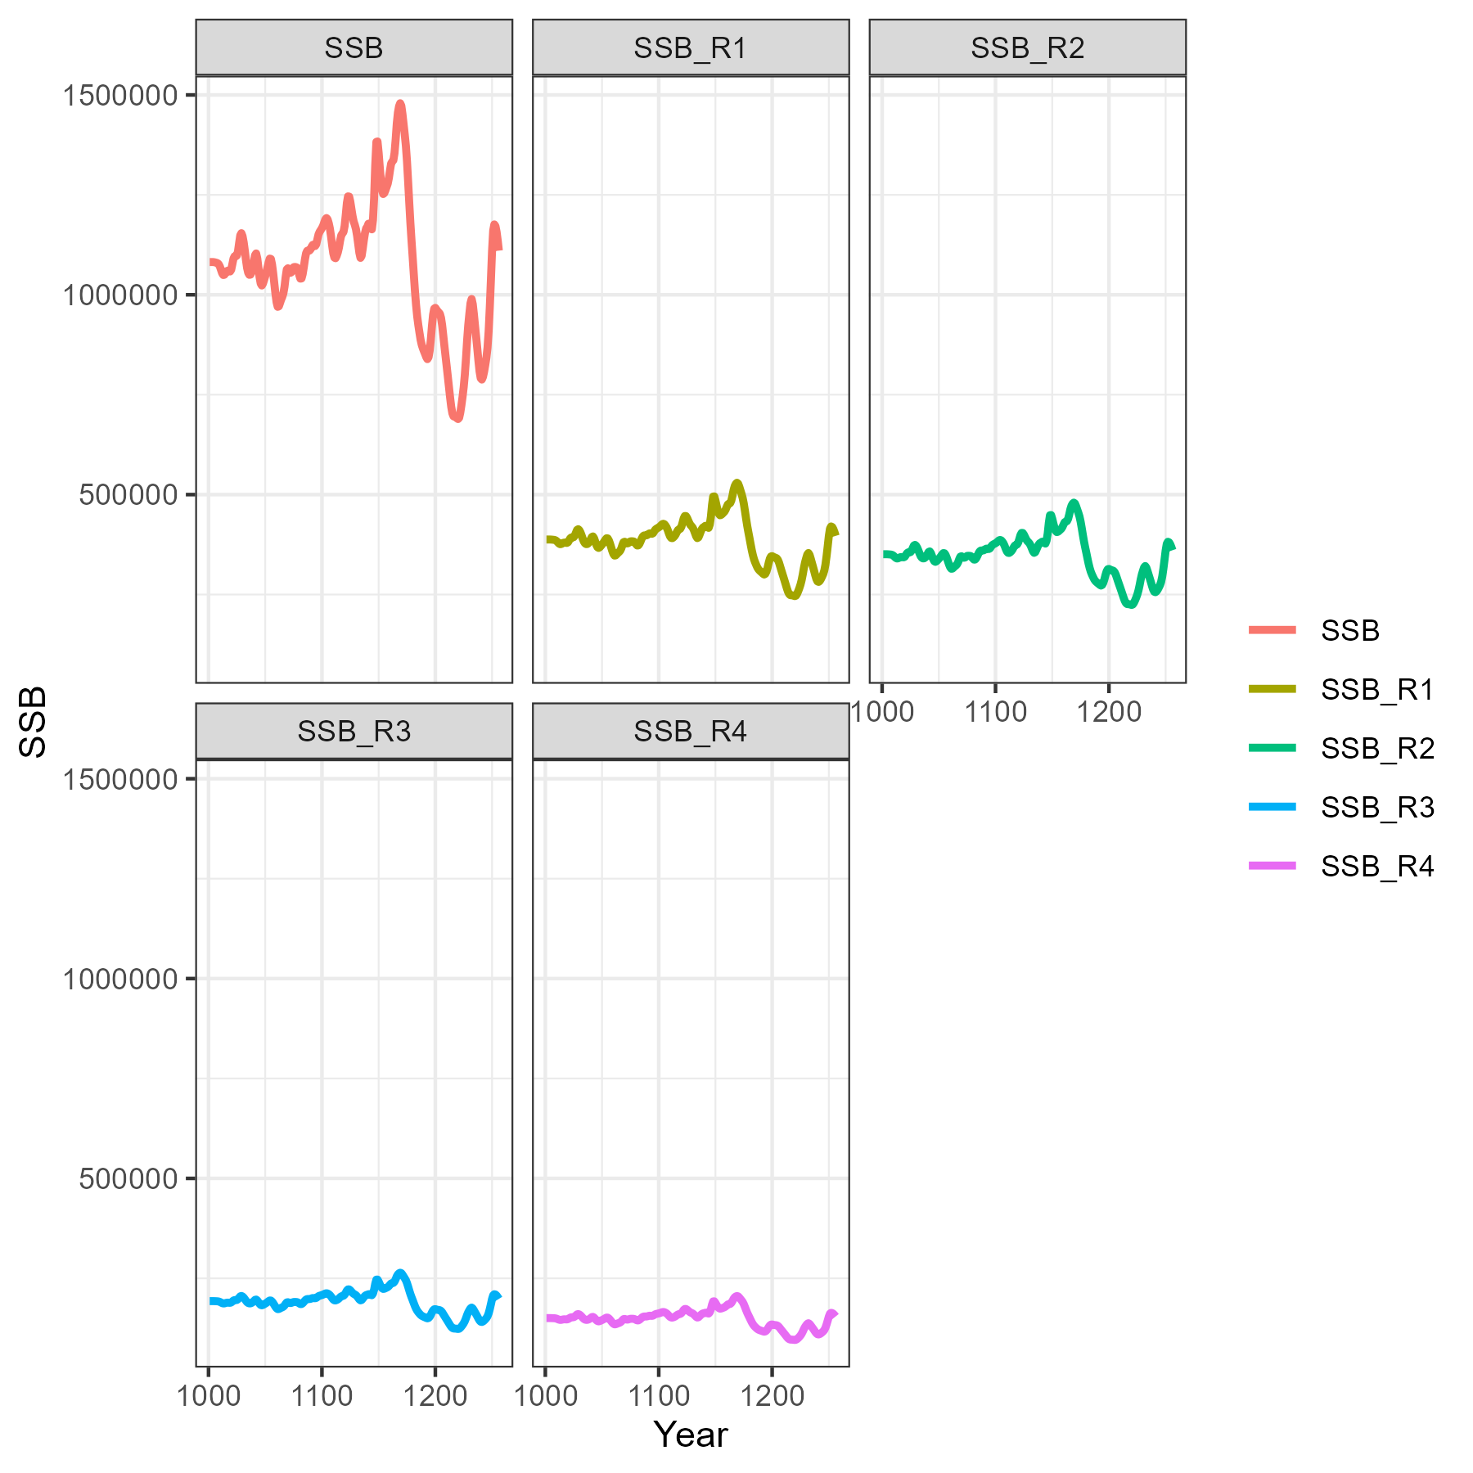
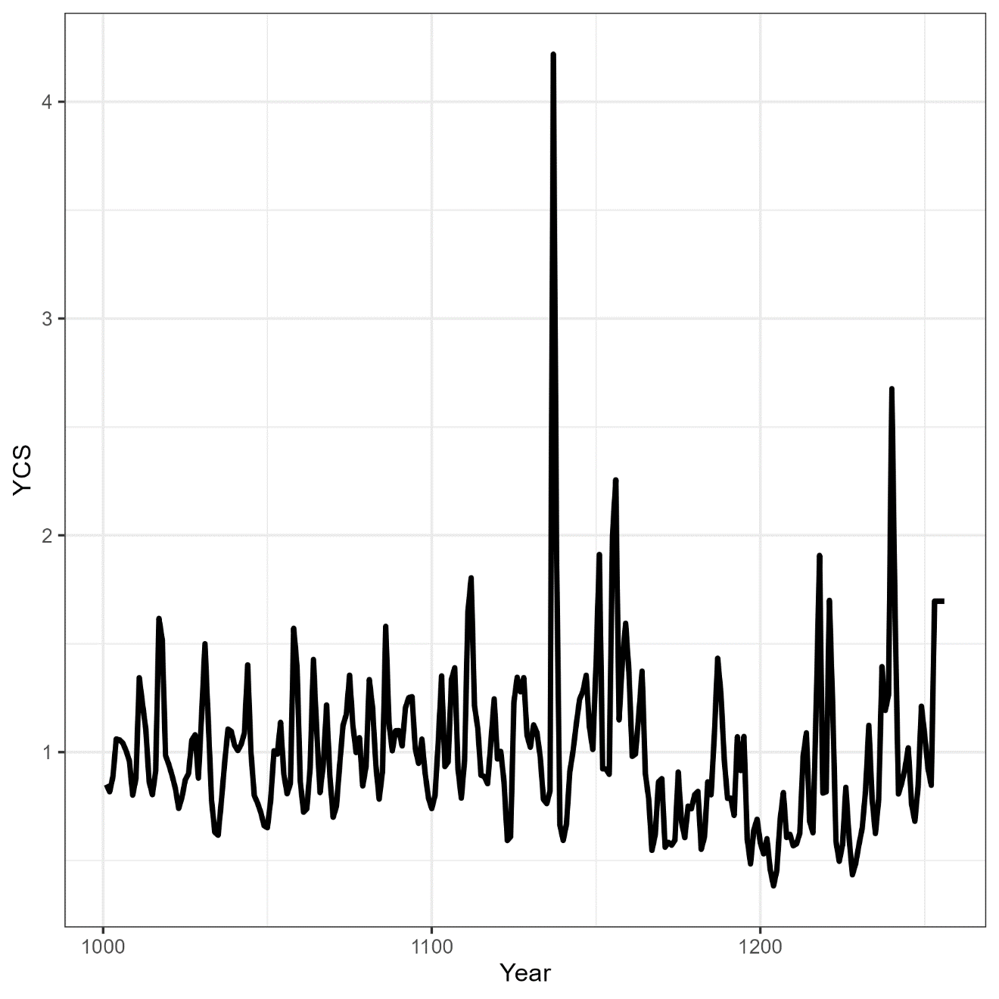
Model 02

Slide 9
Interim model structures
Seasonally structured CPUE observations
length-based selectivity's
Split out Longline R1 selectivity

Slide 10
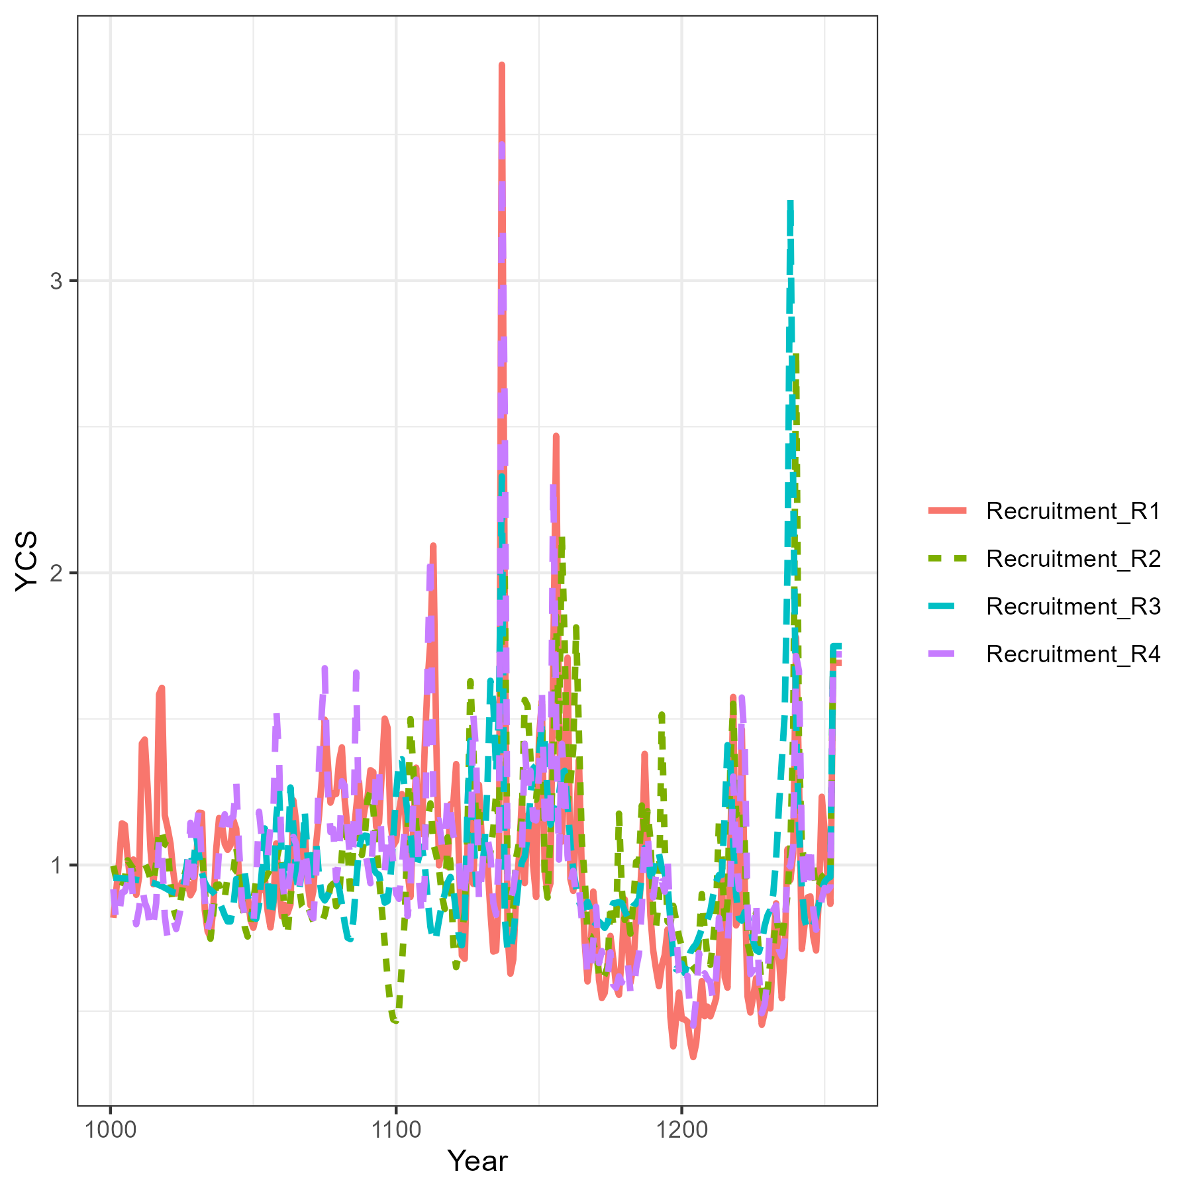
Model 05
Multiple independent stocks in each region.
Although not a priori appropriate for a transient species. Our rationale is that it will proxy for spatiotemporal shifts in productivity

Slide 11
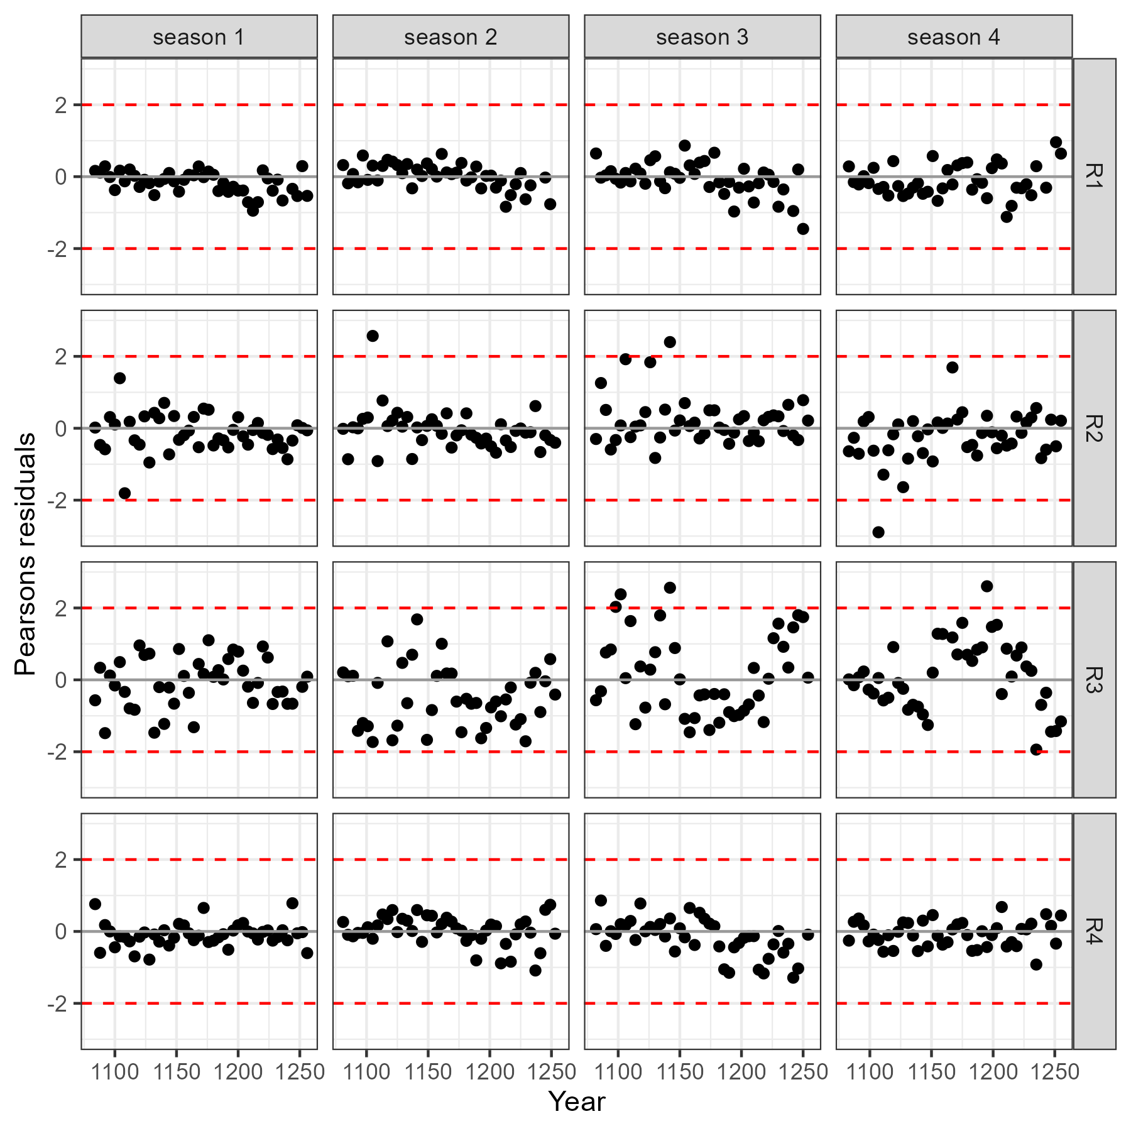
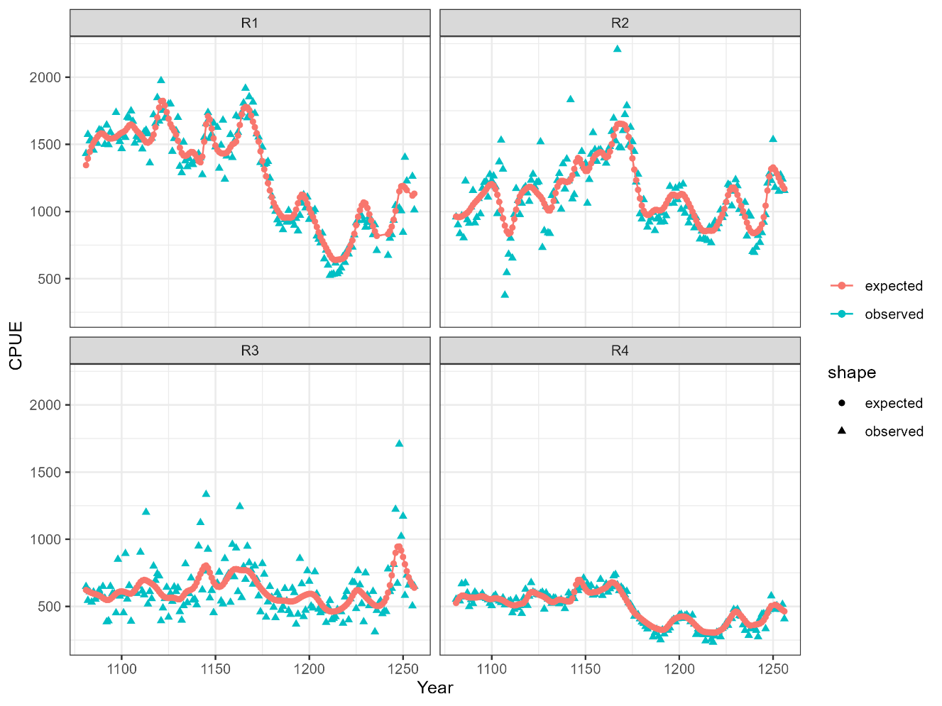
Model 05
Resolved fits to CPUE

Slide 12


Model 05
Resolved fits to CPUE, but

Slide 13
Model 05-Summary
over parameterized!
Is it sensible to use recruitment to proxy movement for transient species?
Future considerations
Aggregated R3 into R4 (not much happening in R3 so group it with adjacent region)
Include tag-data and Markovian movement process (have a look to see if we can estimate the movement matrix)

