Slide 1
Predicting Performance
Aaron McDonald

Slide 2
All about me
Associate of Applied Science in Computer Programming
Interested in the story that can be created from data
Fascinated with the intersection of sports and technology
Notes:
I obtained an Associate of Applied Science Degree from Mesa Community College and in the process of looking for opportunities, I stumbled upon Galvanize and was intrigued by the opportunity to expand on my programming skills.
I’ve kind of always been interested in the information that can be gained from data and the stories/explanations derived from it. Working at QuikTrip for 8 years, we were regularly handed packets of data and it was up to us to interpret it.
With the growing world of analytics in sports, I’ve become more and more interested in looking at this data and trying to interpret what it says about a team or player.

Slide 3
motivation
Die hard baseball fan
Interested in the growing world of baseball analytics
Notes:
Big motivation for this project was my love for baseball and the ability to combine what I’ve learned with what I love
I’ve had a growing interest in the world of SABRmetrics which many see as the exploration of baseball through its statistics.

Slide 4
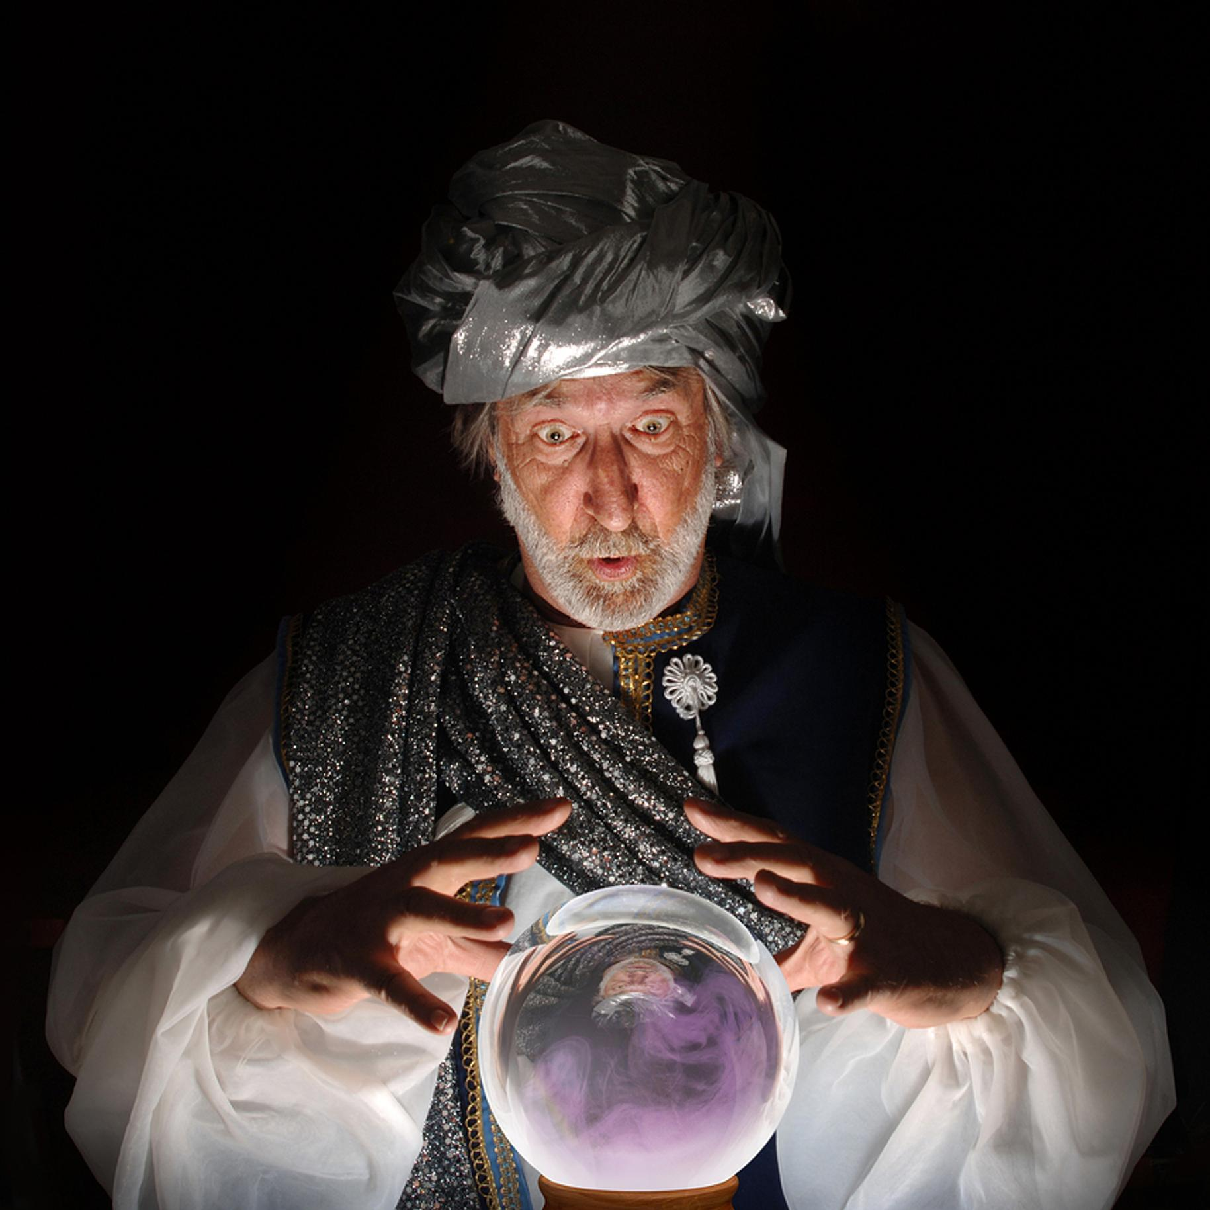
The project
How well can we predict a player’s performance next year, given his history?
Notes:
An essential role of every professional sports team is the General Manager.
It’s their job to draft and sign players that give the team the best chance to win.
Those that are considered the best are the ones that are able to use their experience and the data that’s given to them to project player performance into the future.
The idea of this project was too see if a model could be created that a General Manager might use to assist their decision making, particularly when it comes projecting free agents.

Slide 5
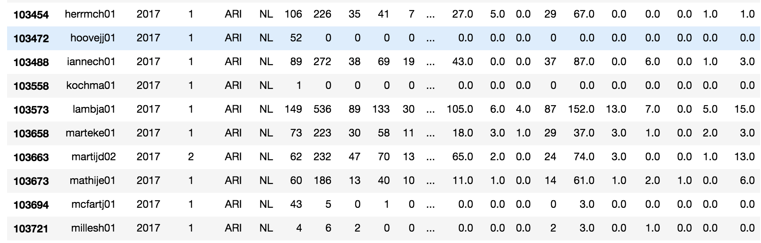
EDA

Slide 6
EDA
7 years experience
At-Bats $≥$ 400
At-Bats ≥ 400
963 players
7 years experience
At-Bats $≥$ 300
At-Bats ≥ 300
1364 players
7 years experience
At-Bats $≥$ 100
At-Bats ≥ 100
2351 players

Slide 7
Persistence models
Carry Over
MSE = .0013587
RMSE = .03688602
Average
MSE = .0010056
RMSE = .0317108
R² = .061
R² = .305
Notes:
Carry over,
Total average,
Moving average?

Slide 8
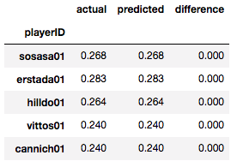



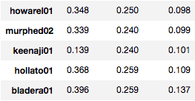
Decision Tree
...
Notes:
The first model I explored was the Decision Tree.
This one gave decent

Slide 9
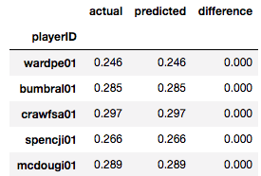



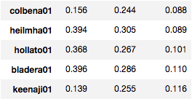
Random (decision) Forest
…
Notes:
MSE:

Slide 10
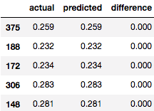


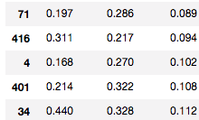

Long Short Term memory (LSTM)
Goldschmidt
Allen
…

Slide 11
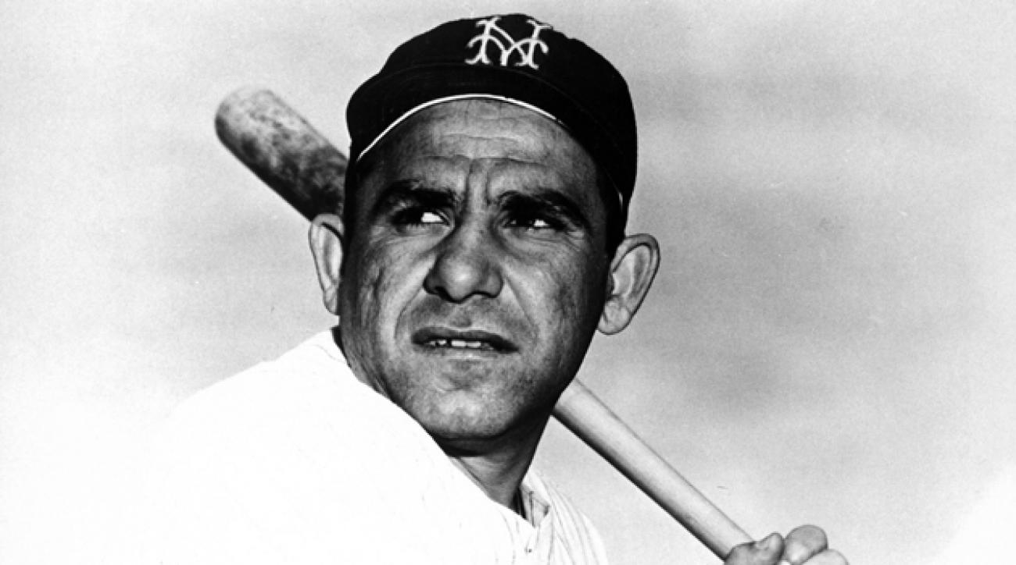
conclusions
It's tough to make predictions, especially about the future – Yogi Berra

Slide 12




Tools used
seanlahman.com’s
Baseball Databank

Slide 13
next steps
Web app to be able to insert player name and get a prediction for the next year
Expand to select desired stat?

