Slide 1
Predicting Player Performance
Aaron McDonald
Notes:
Good afternoon, my name is Aaron McDonald and today we will be exploring a few different models in attempt to predict a baseball player’s batting average
<add baseball bat>

Slide 2

Who am i?
Associate of Applied Science in Computer Programming
Interested in the story that can be created from data
Notes:
AAS Computer Programming from MCC in May 2017
While exploring opportunities, stumbled upon Galvanize Data Science program
Decided to attend to expand skillset as a programmer and gain new skills in the world of Data Science

Slide 3

motivation
Go D-Backs!
Die hard baseball fan
Fascinated with the intersection of sports and technology
Interested in the growing world of baseball analytics
Notes:
Mild obsession with baseball
Always interested in the intersection of sports & technology
Recently became interested in the analytics side of baseball

Slide 4
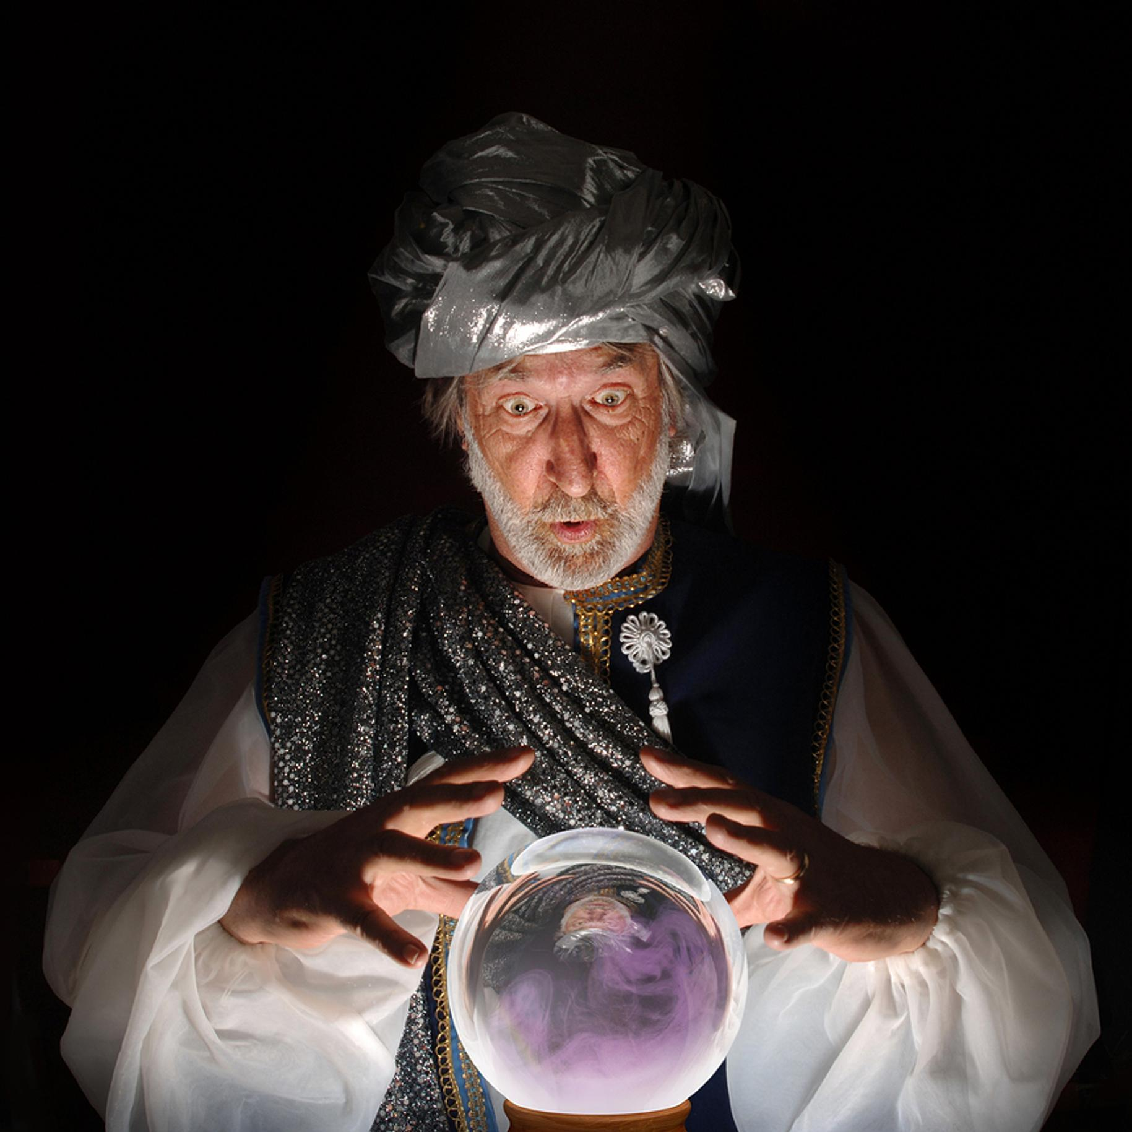
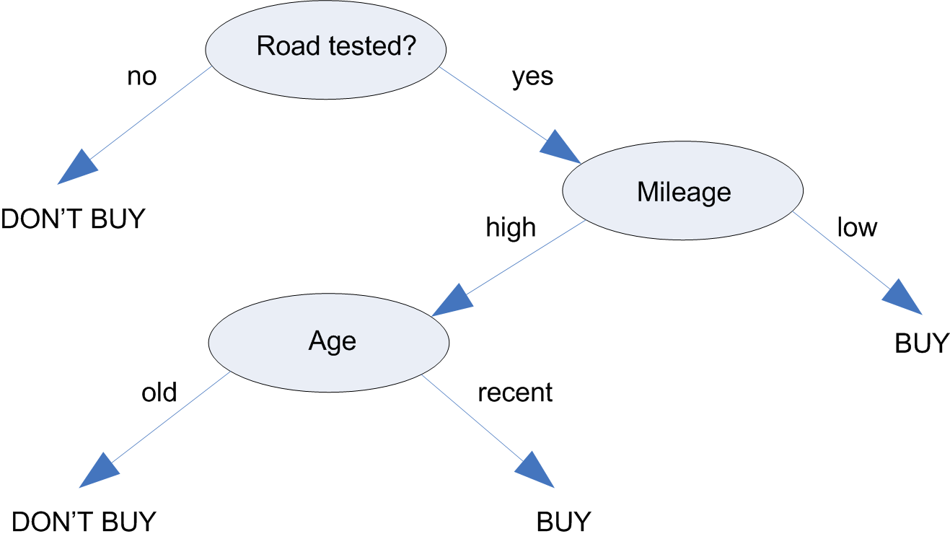
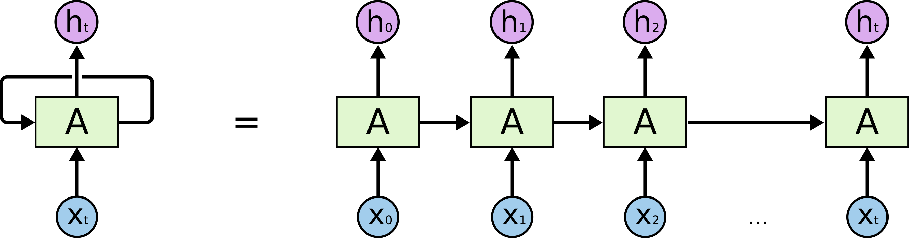
The project
How well can we predict a player’s performance next year, given his history?
Decision Tree
Random Forest
Long Short Term Memory (LSTM)
GM constructs rosters
Draft
Free Agency
Free agent after 6 years
Can we predict year 7?
Notes:
- POV of a GM
- Players reach free agency after 6 years of MLB service
- Look at other players in history as well as current
- Decision tree splits observations based on whether or not they meet certain criteria
RNNs use their memory or what they've already learned to process new information
LSTM improves on RNN models in that it maintains memory over a long period of time

Slide 5
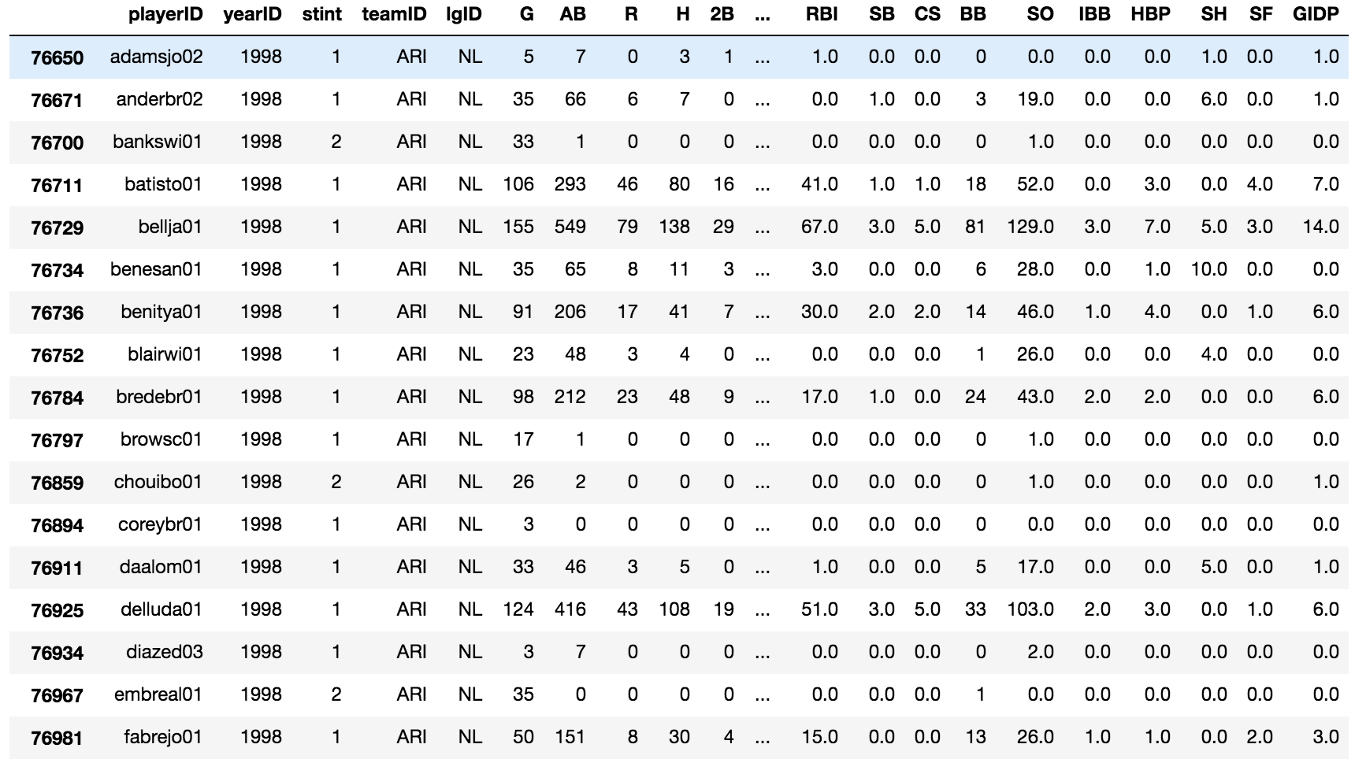
EDA
19,370 players from 1872 - 2017
Credit: www.seanlahman.com
Notes:
- www.seanlahman.com
- known for his database of baseball statistics that ranges all the way back to the 1800s
- transferred data to Pandas dataframes for processing and feature engineering
<add source to screen, get screenshot with column names>

Slide 6
EDA
7 years experience
At-Bats $≥$ 400
At-Bats ≥ 400
963 players
7 years experience
At-Bats $≥$ 300
At-Bats ≥ 300
1364 players
7 years experience
At-Bats $≥$ 100
At-Bats ≥ 100
2351 players
Notes:
Biggest challenge was getting the type of players needed
Needed players with 7 years history, 6 for training, 7th to evaluate against

Slide 7
Persistence models
Carry Over
MSE = .0013587
RMSE = .03688602
Average
MSE = .0010056
RMSE = .0317108
R² = .061
R² = .305
Notes:
- Carry over
- Total average
<Note about range of differences>
Make it better?
MSE: average of differences between the actual and the predicted, then squared
RMSE: sqare root of MSE
R2: answers the question: How well do the other stats predict the batting average?

Slide 8
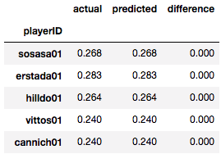



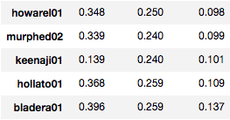
Decision Tree
Perfect Predictions: 25
...
Notes:
The first model I explored was the Decision Tree.
Two player examples
MSE and RMSE
Score is the R2 score, did mildly better than total average
Range, top 5, bottom 5, <x> predicted perfectly
In 25 cases, the predictions were exact

Slide 9
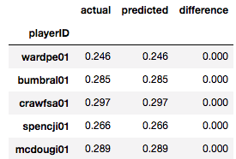



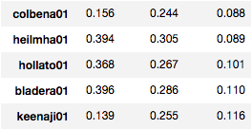
Random Forest
Perfect Predictions: 48
…
Notes:
Single player examples
MSE, RMSE
R2 score is getting better
Range, top 5, bottom 5, x-players were predicted perfectly

Slide 10
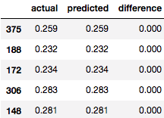


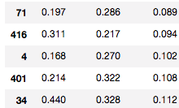

Long Short Term memory (LSTM)
Perfect Predictions: 6
Goldschmidt
Allen
…
Notes:
- LSTM models are a type of RECURRANT NEURAL NETWORK which attempts to learn like we do
Takes initial input, moves to next layer, learns more while considering what it learned in the previous layers
Single player predictions, Goldy back to decision tree similar to decision tree, Allen similar to Random Forest
R2 not great, could be improved by exploring stats to leave out
Range, top 5, bottom 5, x-players predicted perfectly

Slide 11
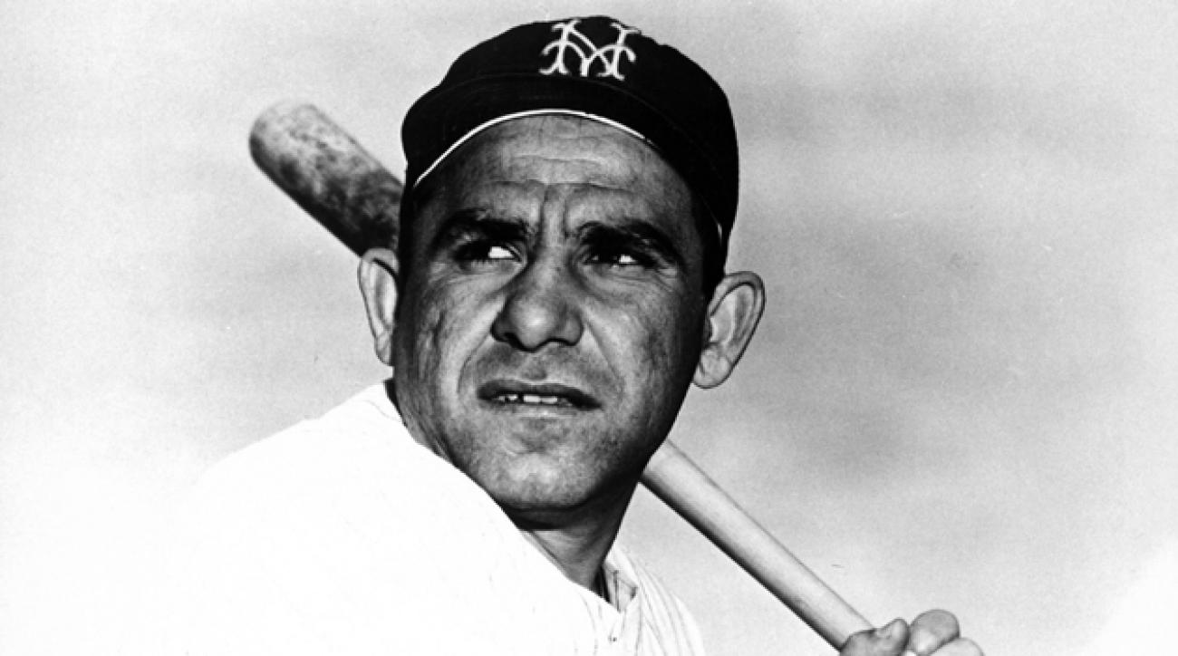
conclusions
It's tough to make predictions, especially about the future – Yogi Berra

Slide 12
next steps
Dive deeper into the models and explore which features may be adding noise to the model and hindering its performance
Web app to be able to insert player name and get a prediction for the next year
Expand to select desired stat?

Slide 13



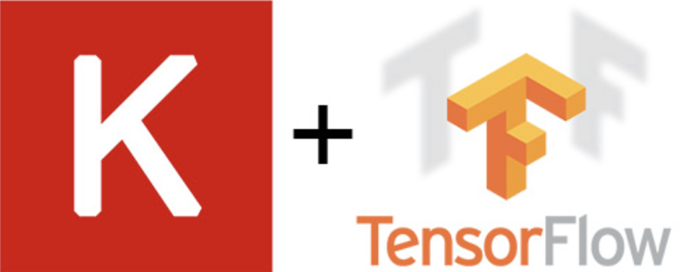
Tools used
seanlahman.com’s
Baseball Databank

Slide 14
Contact Information
Github: https://github.com/aaronmcd1214
LinkedIn: https://www.linkedin.com/in/aaronmcd1214/
Email: mcdonald_aaron@outlook.com
Phone: (623) 628-5537

