Slide 1


Risky Business? Deep Dives into DeFi
Presenter: Michael Giannattasio
Faculty: Aaron Green, John Erickson, Oshani Seneviratne and Kristin Bennett

Slide 2
Research Focus
Research goal:
We seek to investigate current patterns of usage in DeFi protocols, and quantify risk and user behaviors across various protocols.
Significance:
$50.96 billion USD in TVL in DeFi¹
Incentive to find ways for profit (CRAFT goals)
Desire to understand how users use novel financial platforms
Hypothesis:
There are different types of user behaviors and risk patterns in DeFi protocols which can be understood using AI methods such as temporal clustering and survival analysis.
Notes:
https://defillama.com/ as of 4/5/2023

Slide 3
Work Plan
Completed:
Expand Data Feeds to Include Multiple Markets of AAVE
Collected data from six other Aave markets on networks besides Ethereum, including Polygon, Avalanche, and others
AI Transaction Analysis Methods for DeFi Ecosystem
Paper: DeFi Survival Analysis: Insights Into the Emerging Decentralized Financial Ecosystem submitted ACM-DLT
Paper: Characterizing Common Quarterly Behaviors in DeFi (MARBLE 2023, under review)
Prototype AI Methods and Dashboard for AAVE DeFi Transactions
AI Methods and Dashboard for AAVE DeFi Transaction Analysis (prototype methods and dashboard completed, but also being continually improved): https://inciteprojects.idea.rpi.edu/defitoolkit/app/defitoolkit/
Extension of Data Feeds to Other Lending Protocols
Collected data from other major lending protocols (Compound and MakerDAO)
Future:
AI Transaction Analysis Methods for DeFi Ecosystem (05/2023)
Currently focused on expanding clustering to other protocols/markets (transfer learning/novel clustering)
Prototype Open-Source AI Transactions Analysis Toolkit for DeFi Ecosystems (05/2023)
Fully integrate all AI clustering methods into the app
Make new visualizations in app specifically to view clusters meaningfully

Slide 4
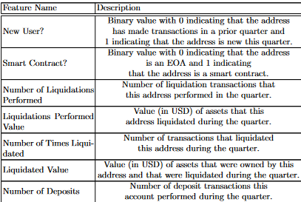
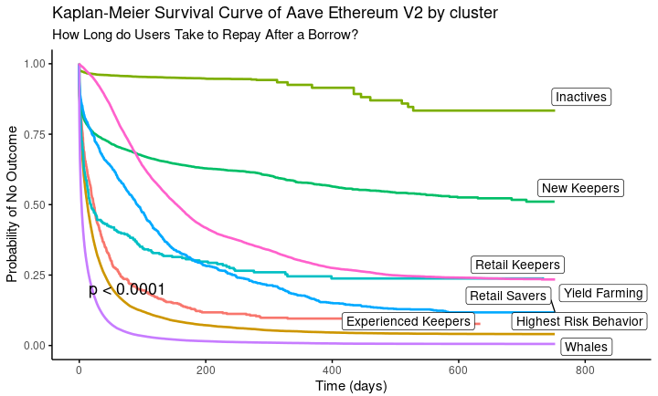
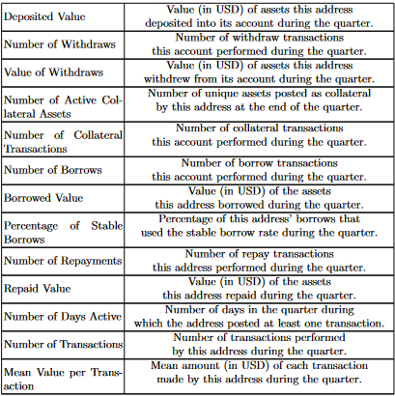
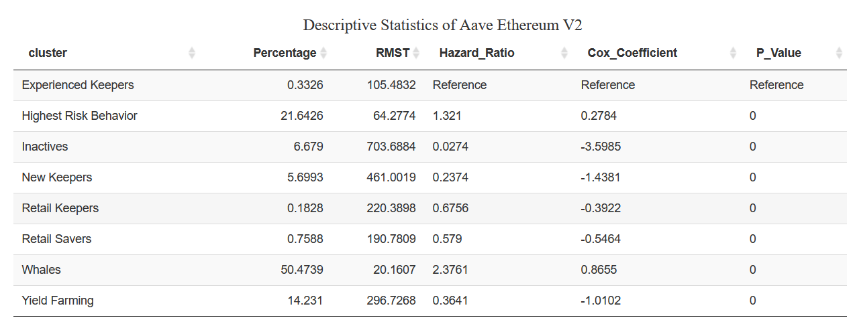
Methods & Materials
User Clustering: Use of fuzzy c-means algorithm
Feature engineering: creation of novel features from raw transaction-level data to represent user-level behavior.
In order to track temporal change, we use user-quarter summaries
Survival Analysis: Example of Kaplan-Meier Survival Curve and descriptive statistics table in toolkit
Notes:
Comment on RMST and p-value rounding

Slide 5
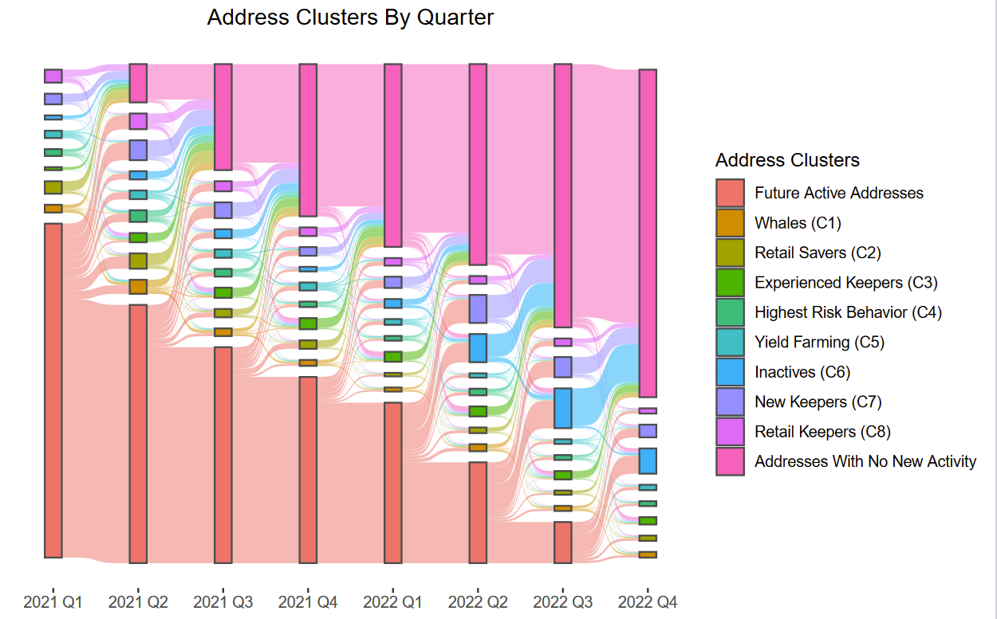
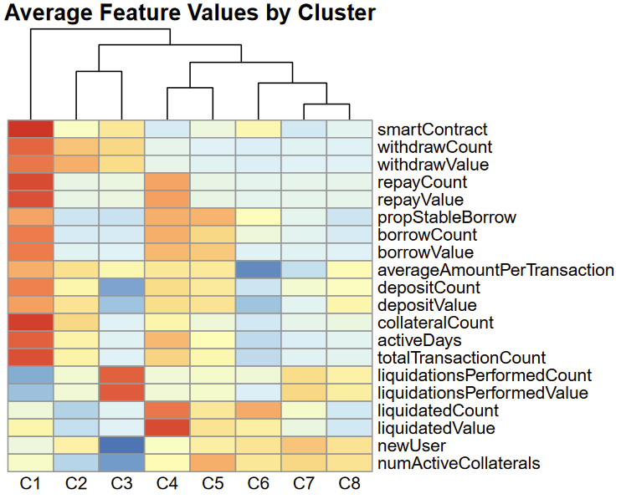
Results & Analysis
C1: “Whales” show high activity, high-value contracts that emphasize creating and re-balancing complex but safe positions.
C6: “Inactives” are users that do not transact much in a given quarter
Overall: Issues with user retention/high user churn as displayed by the growing percentage of addresses with no new activity
C3,7,8: “Keepers” that ensure AAVE’s health by performing liquidations

Slide 6
Conclusion
There are different types of users behaviors and risk patterns in DeFi protocols which we displayed some understanding of using temporal clustering and survival analysis
We have created a toolkit to facilitate the creation of survival analysis plots with covariates on transaction data across DeFi protocols and markets
Designed to be extensible to any new transaction data
We have displayed user/quarter-level representations of raw transaction data is able to represent users enough to extract meaningful clusters of user behaviors over time
We have described these different groups’ behaviors and shown large-scale temporal trends in behavior type prevalence amongst entire DeFi protocols
We plan to expand clustering from AAVE’s ethereum market to more markets/protocols using AI techniques such as transfer learning and novel clustering methods.
These methods will be included in open source toolkit (located here)

