Slide 1


Language and Data Agnostic Computational Designs
Presenter: Conor Flynn
Faculty: Aaron Green, John Erickson, Oshani Seneviratne, and Kristin Bennett
Team Members: Michael Giannattasio, Jared Gridley
Notes:
Slide 1 –Title Slide (your name, research project title, faculty and laboratory name)
Slide 2-Research Statement, Project relevance, and hypothesis
Slide 3-Work Plan
Slide-4 Method and Materials
Slide 5-Results and Analysis
Slide 6- Conclusion

Slide 2


Research Overview
Statement:
Is there a way to connect various data sources abstractly such that a uniquely designed system is not required for each source?
Relevance:
Using the engine to retrieve blockchain data from multiple sources for general data analysis.
Storing large amount of data so repetitive calls to data sources are not required.
Hypothesis:
Can we design a system that meets the criteria provided above such that regardless of the language chosen and the data provided, the system will be able to manage and handle it?

Slide 3





Work Plan
Preliminary Work:
Selection of programming language
Selection of database management system
Primary system architecture write-up
Developmental Work:
Programming of the proposed system
DevOps setup of code repository and server
Database management and configuration
Concluding Work:
Comprehensive testing suite
Documentation write-up of given architecture

Slide 4
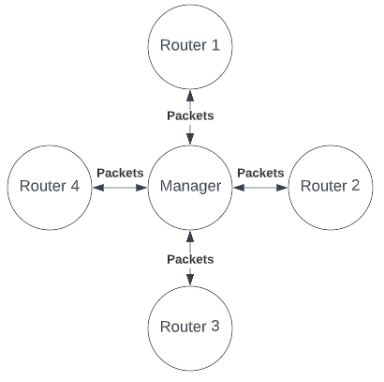
Methods and Materials
Packets:
Used for standardized communication throughout the engine
Always have a Response after being sent
Packet Contents:
sender: String
tag: String
sub_tag: String
data: HashMap<String, String>
Response:
code: int
message: String
data: String

Slide 5
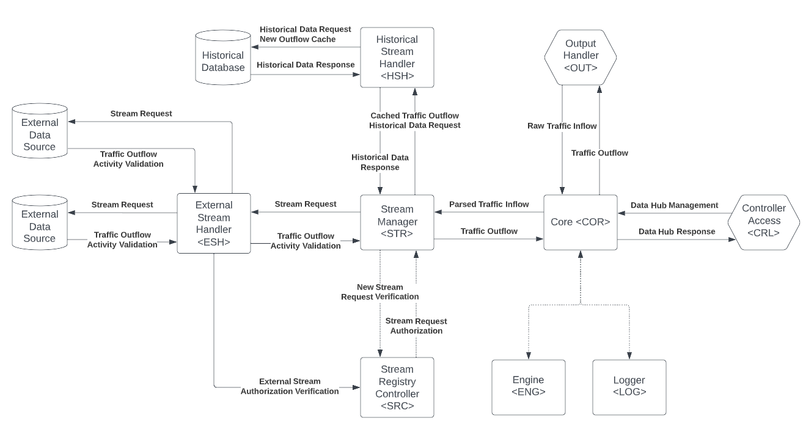
Results and Analysis

Slide 6
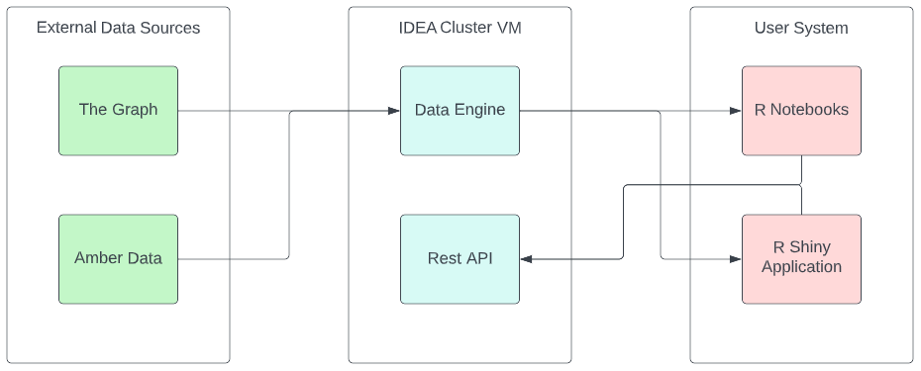
Conclusion
Internal packet transfer system speed: ~230ns per packet
Cached data request speed: ~0.037ms per data point
Concurrent user capacity: Limited by system threading capabilities (currently ~15-20)
Number of error codes: 39 unique responses
Integrated endpoints: 12

