Slide 1

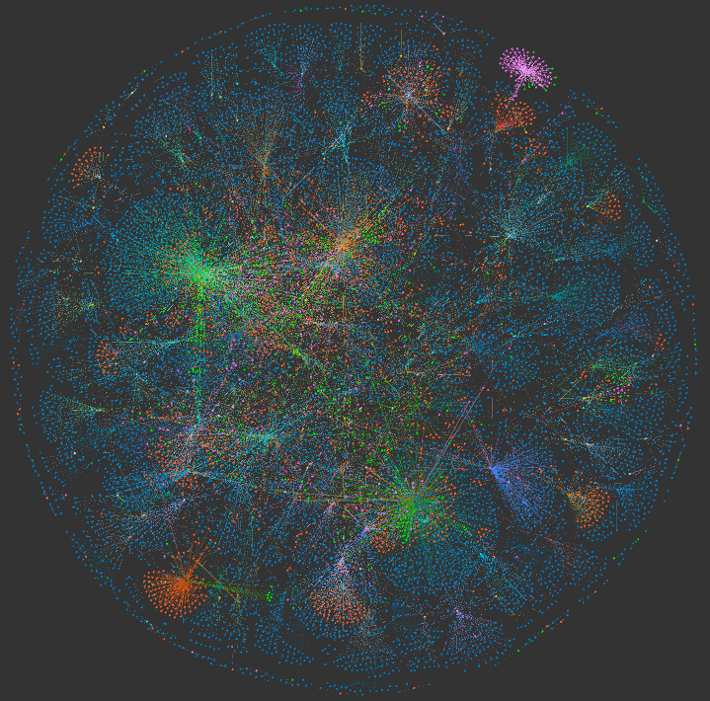
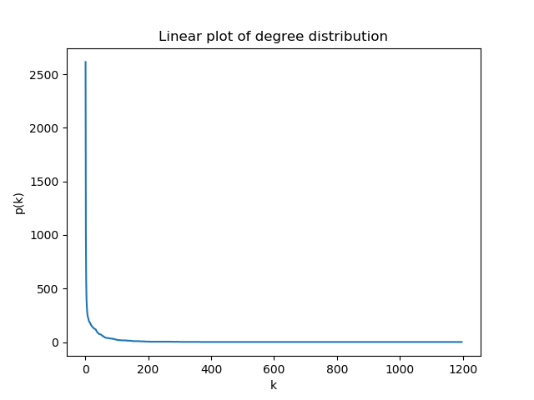
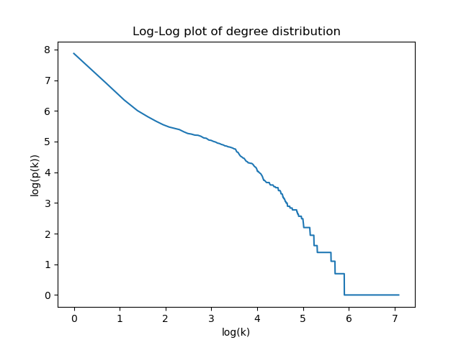
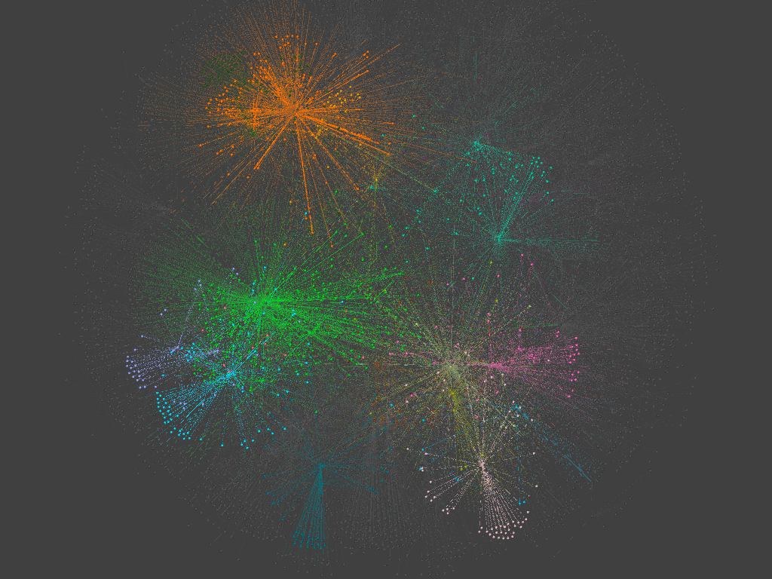
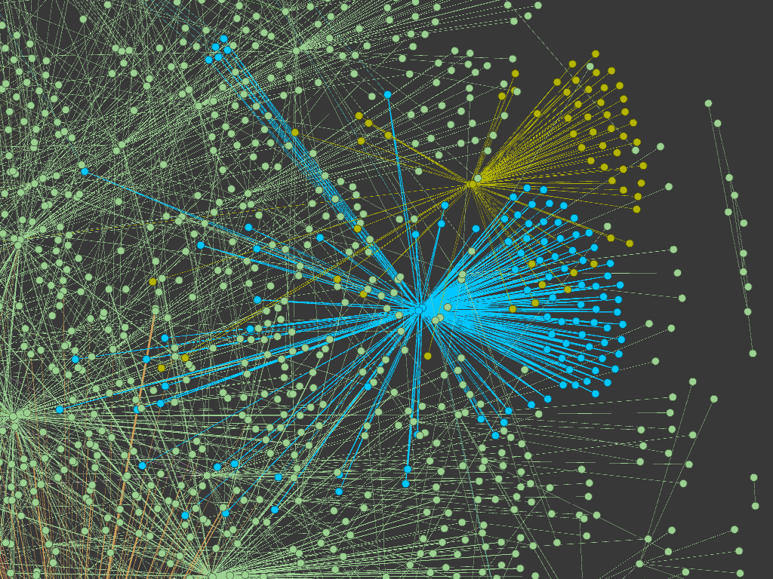
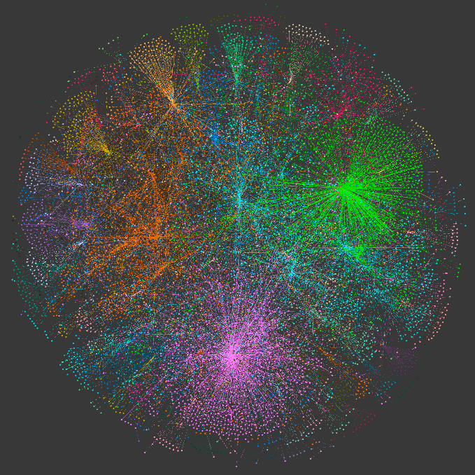
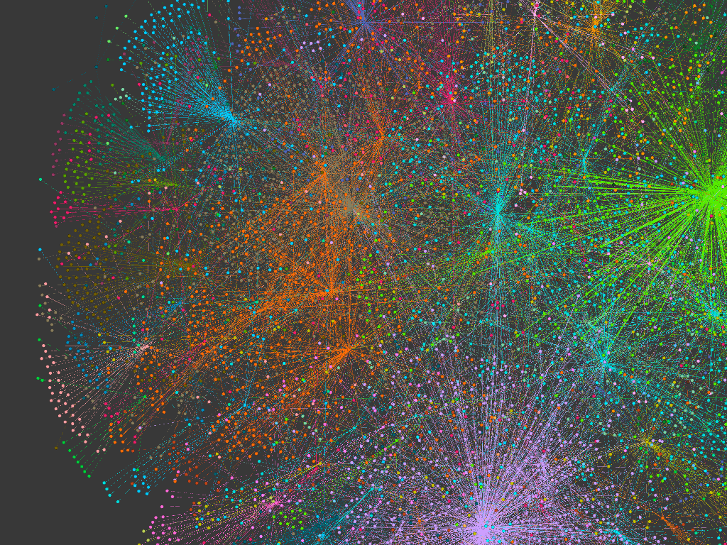
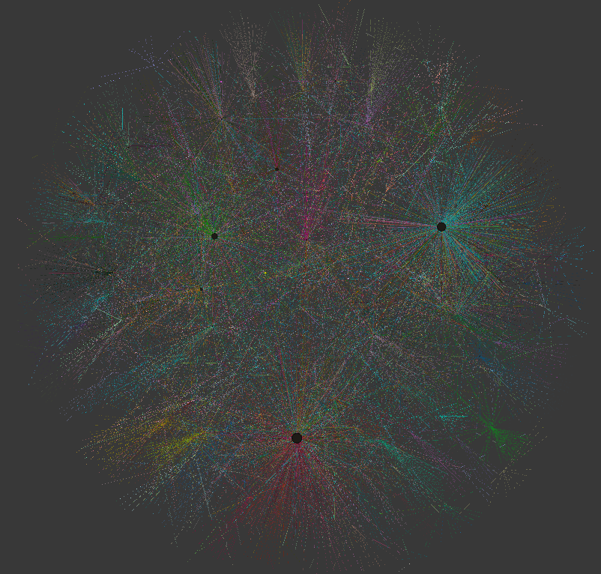
Network Analysis of Song Relationships
Aaron Wilson
CS 5483 Network Science, Fall 2018
Graph Structure
8,810 nodes and 11,652 edges
Sparse graph
Density = 0.00013
Expected to increase with more playlists
Diameter = 18
Not well connected
Very different songs unlikely to overlap
135 separate connected components
Degree analysis
Most nodes only have degree of 1, colored blue
Average degree is 2.645
Average weighted degree is 6.914
Roughly follows scale-free model
Project Goals
Millions use streaming services -- Spotify, Apple, Google
They create millions of public playlists
Mine this data to find how songs connect by sharing playlists
Discover interesting connections between artists, songs, genres
Graph definition
Nodes are songs (and their info)
Weighted, undirected edges exist between songs when they both exist on a playlist
The weight of the edges is the number of playlists two songs share
Member-based Community Detection
Clique percolation in NetworkX
Applied to giant component
Using cliques of size k=3
16 distinct communities
Only 812 songs assigned
Smaller, highly connected communities
Average community size: 50.75
Finds small close communities
Specific sub-genres and soundtracks
Building the Network
Gather playlist and song information using the Spotify Web API and Python
Connect songs when they appear on the same playlists -- connection weights are the number of times this happens
Randomly sample the nodes to limit the network size
Use NetworkX and Gephi to build and display the network
Upbeat string music
“Another One Bites the Dust” by Queen
Songs by “The Weeknd”
Giant Component
6,681 nodes, 9,251 edges
Density = 0.000414
~4x higher
Simplifies visualization
These nodes are the ones that will join large communities and have significance to connections
Sensitive to popular songs forming “hubs”
Group-based Community Detection
Used Gephi for modularity maximization
Applied to giant component
Assigns community to every node
40 separate modularity clusters
Average community size: 167.025
“Lord of The Rings” soundtrack
Centrality
Betweenness centrality
Measures how well songs place on playlists of different artists or genres
“Shake It” by Metro Station
Degree of 367 -- much less than top degrees of 600-700
3rd on betweenness centrality, with 0.186
Very accessible song -- popular for many types of listeners
Other very popular songs may have high betweenness simply by their high degree
“Shake It” by Metro Station
Finds broad communities
Every node gets a community
Separates by similar artists and genres
“Happier” by Marshmello
Hip-hop/Rap music colored orange

