Slide 1
Pac-Man 2.0
By Aaron Pan, Melissa Gibble, Kwadwo Osafo, Vaibhavi Hansrajani, Noah Taniguchi

Slide 2
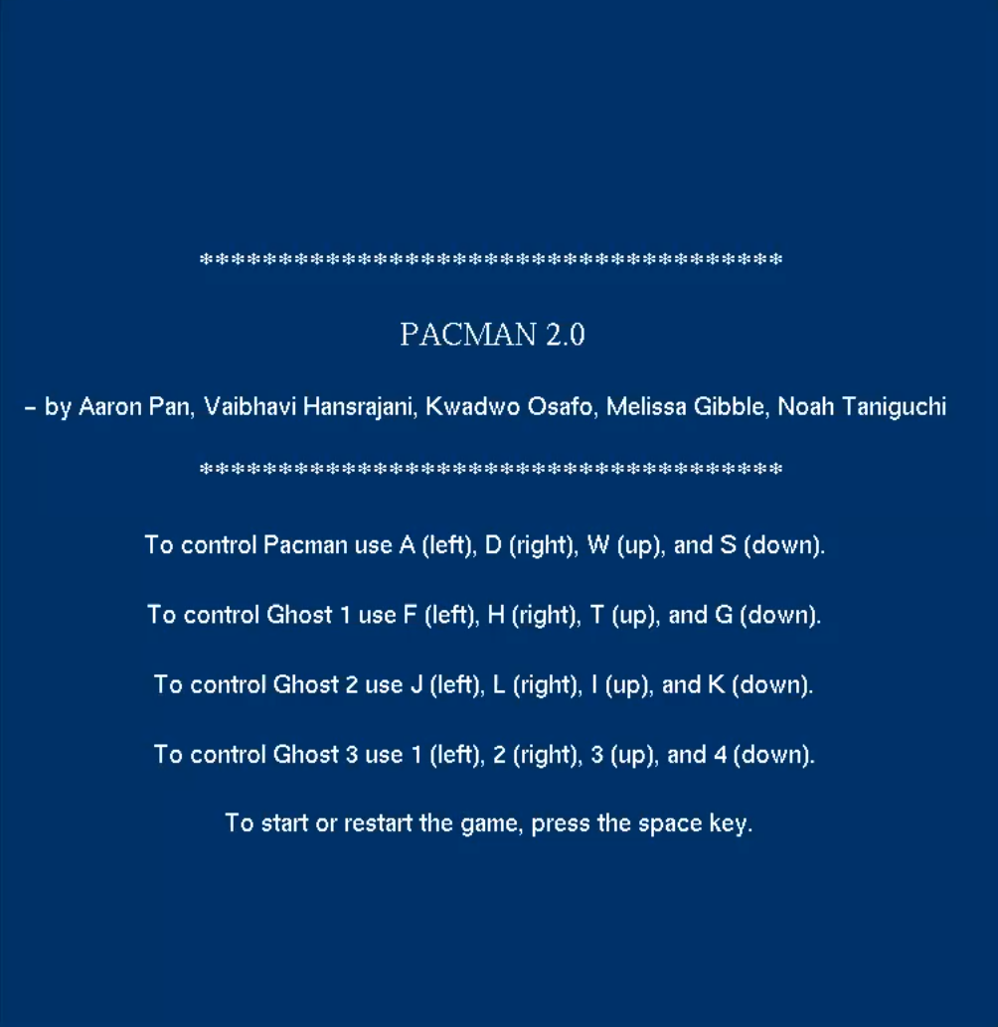
Welcome Screen and Controls
How Do I Even Play?
Pac-Man Controls:
‘wasd’
Ghost Controls:
‘tfgh’, ‘ijkl’, and ‘1234’
Get Comfortable!:
Played on 1 computer
Can plug in an extra keyboard for extra hand space

Slide 3
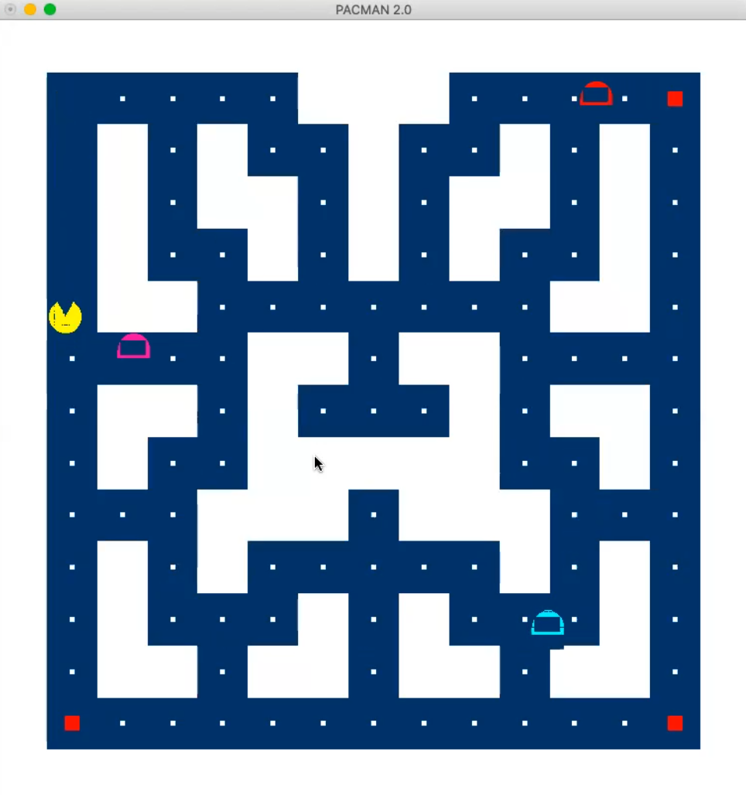
Gameplay
Pac-Man Details/Goals:
Objective: Eat all the food on the screen (white dots)
Use power-ups to eat ghosts!
Ghosts Details/Goals:
Objective: Touch Pac-Man to defeat him
Positioned at 3 quadrants of gameboard
Team up to defeat Pac-Man!

Slide 4
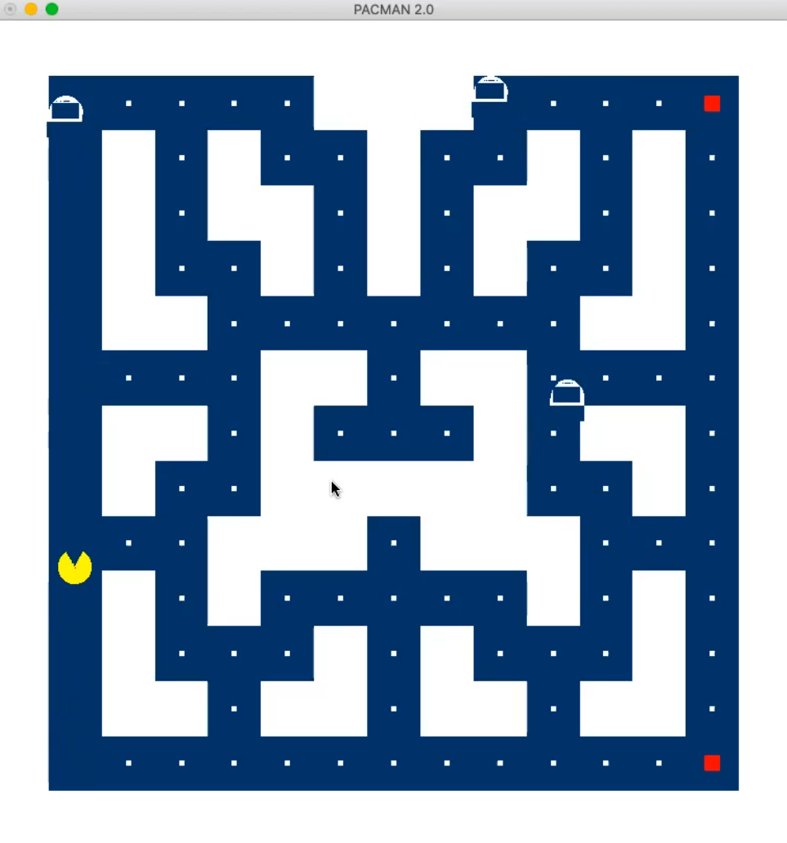
Pac-Man Power-Ups
How to get a Power-Up?
Red food dots located at corners
Allows Pac-Man to travel long distances with protection
Power-Up Functions:
Give Pac-Man a handicap: letting him eat user controlled ghosts
Ghosts are edible temporarily
Only 3 of these: Use wisely

Slide 5
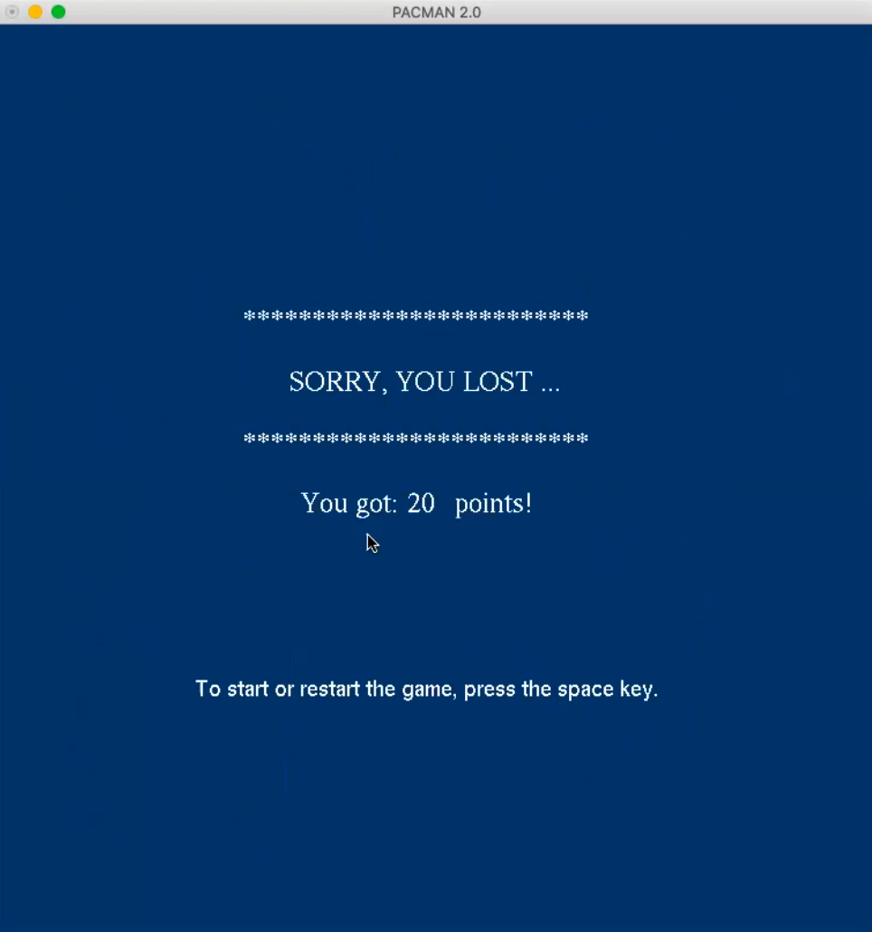
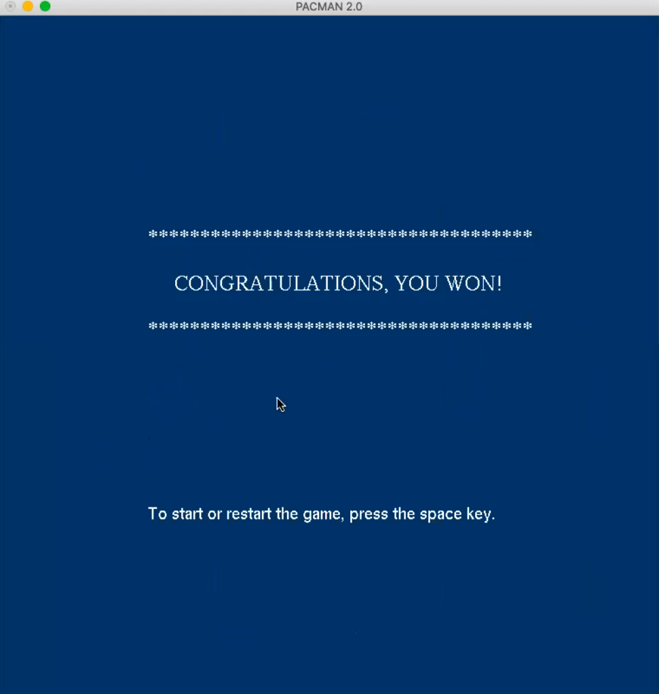
Game Over Screens

Slide 6
Thank You!

