Slide 1
Trail Tracker Case Study
Aaron Perez

Slide 2
Project overview
The product:
Trail Tracker is a finder of new hiking trails in the surroundings of Madrid. It shows every hiking trail and they can be sorted and filter by distance, level and length. The apps target users are people who want to discover and track their new favorite trail.
Project duration:
February 2021 to November 2021.

Slide 3
Project overview
The problem:
It is not easy to find new trails and there isn’t a place to store and track all the routes from the area.
The goal:
Create an app for users who wants to discover new and near trails around them.

Slide 4
Project overview
My role:
UX designer designing from conception to delivery.
Responsibilities:
Conducting interviews, paper and digital wireframing, low and high-fidelity prototyping, conducting usability studies, accounting for accessibility, and iterating on designs.

Slide 5
User research
Personas
Problem statements
User journey maps
Understanding
the user

Slide 6
User research: summary
I conducted interviews and created empathy maps to understand the users I’m
designing for and their needs. A primary user group identified through research
was people who don’t have the knowledge of finding new trails.
This user group confirmed initial assumptions about potential users, but research
also revealed that people know new trails by word of mouth.
Other user problems included challenges that make it
difficult to find new trails without knowing other hikers.

Slide 7
User research: pain points
1
2
3
Accessibility
Distance
Information
It is hard to find the information of these trails and a JSON file provided by the government is not something accessible.
User sometimes can’t go by car to hike and want to hike in the nearest trail as possible.
Sometimes the users want to know the level of the trail before they started it. Family trips can turn into a nightmare.

Slide 8
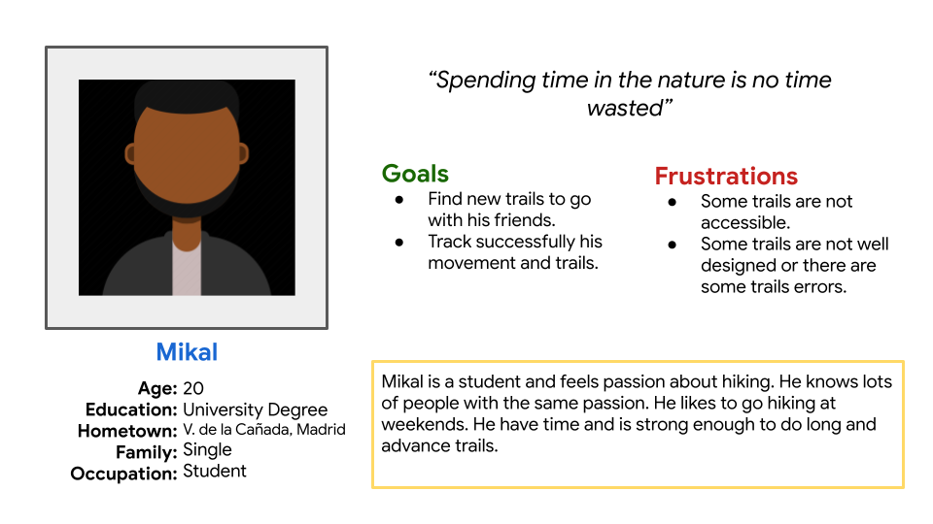
Persona: Mikal
Problem statement:
Mikal is a student
who needs to find an advanced trail because he wants to spend time in the nature and exercise.

Slide 9
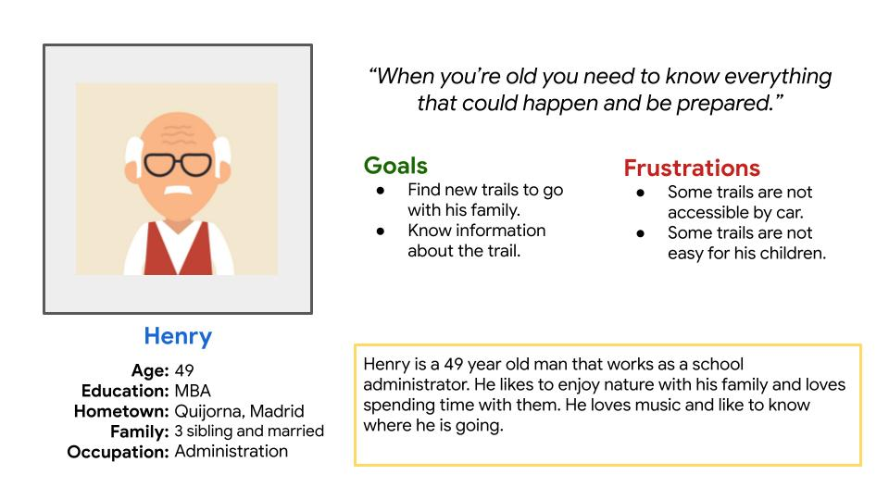
Persona: Henry
Problem statement:
Henry is a school administrator and a father who needs to find an undemanding trail because he wants to spend time with his family while having a walk.

Slide 10
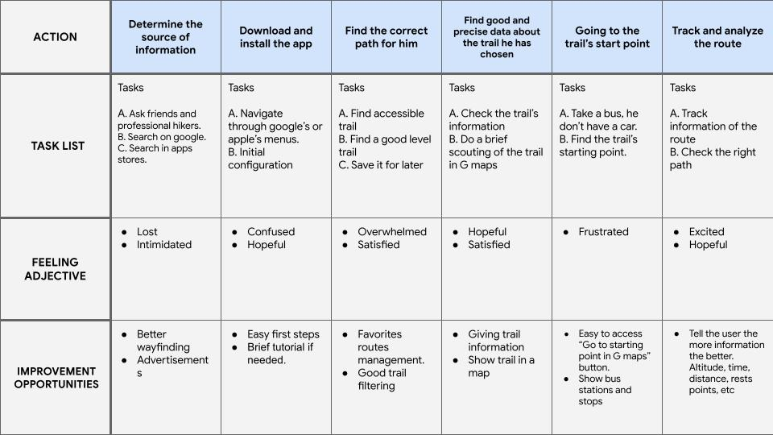
User journey map
Goal: Find and go to an advanced level hiking trail with his friends.

Slide 11
Paper wireframes
Digital wireframes
Low-fidelity prototype
Usability studies
Starting
the design

Slide 12
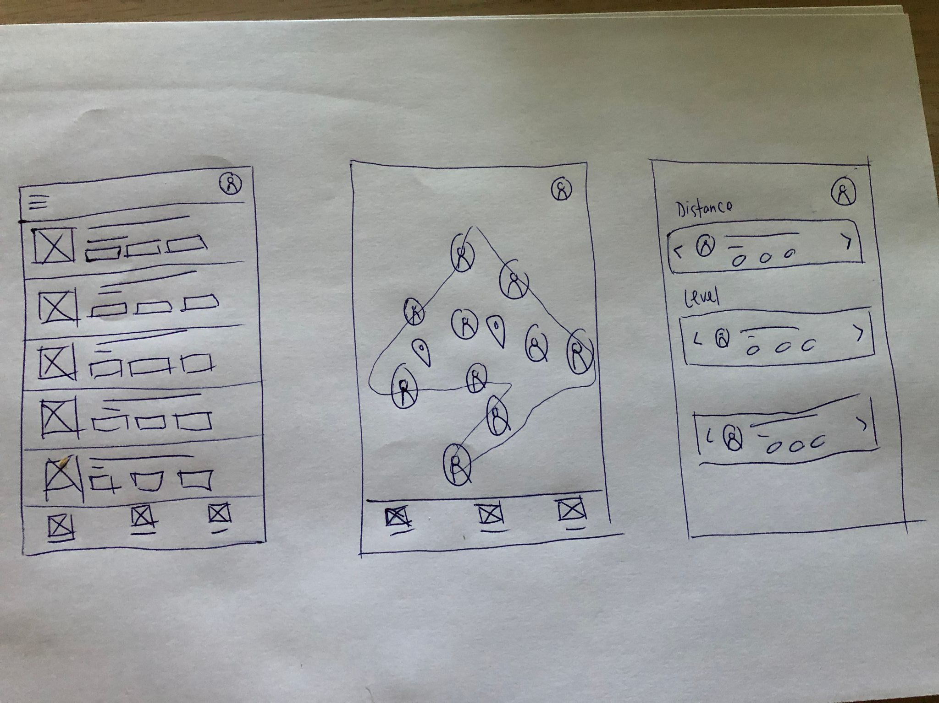
Paper wireframes
Taking the time to draft iterations of each screen of the app on paper ensured that the elements that made it to digital wireframes would be well-suited to address user pain points.

Slide 13
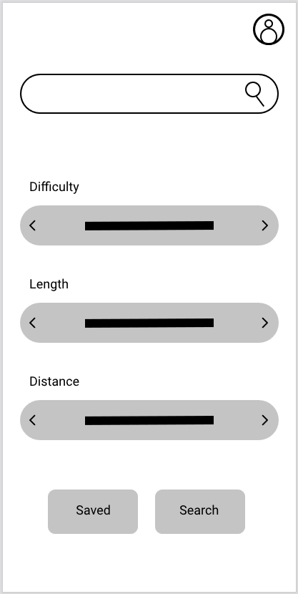
Digital wireframes
Search bar for quickly search any already known trail
As the initial design phase continued, I made sure to base screen designs on feedback and findings from the user research.
A quick filter screen would make user easier to find what the are looking for.
Filter to fit the results to the user preferences

Slide 14
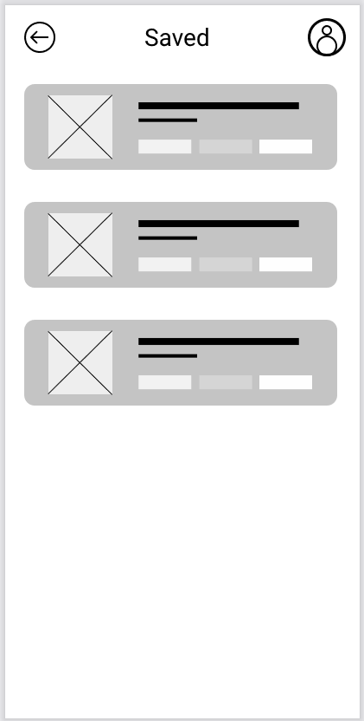
Digital wireframes
Profile page for settings and saved trails management
Saving trails is a key feature in order to make to users easy to find their favorites trails.
Trails showing information before showing the trail details

Slide 15
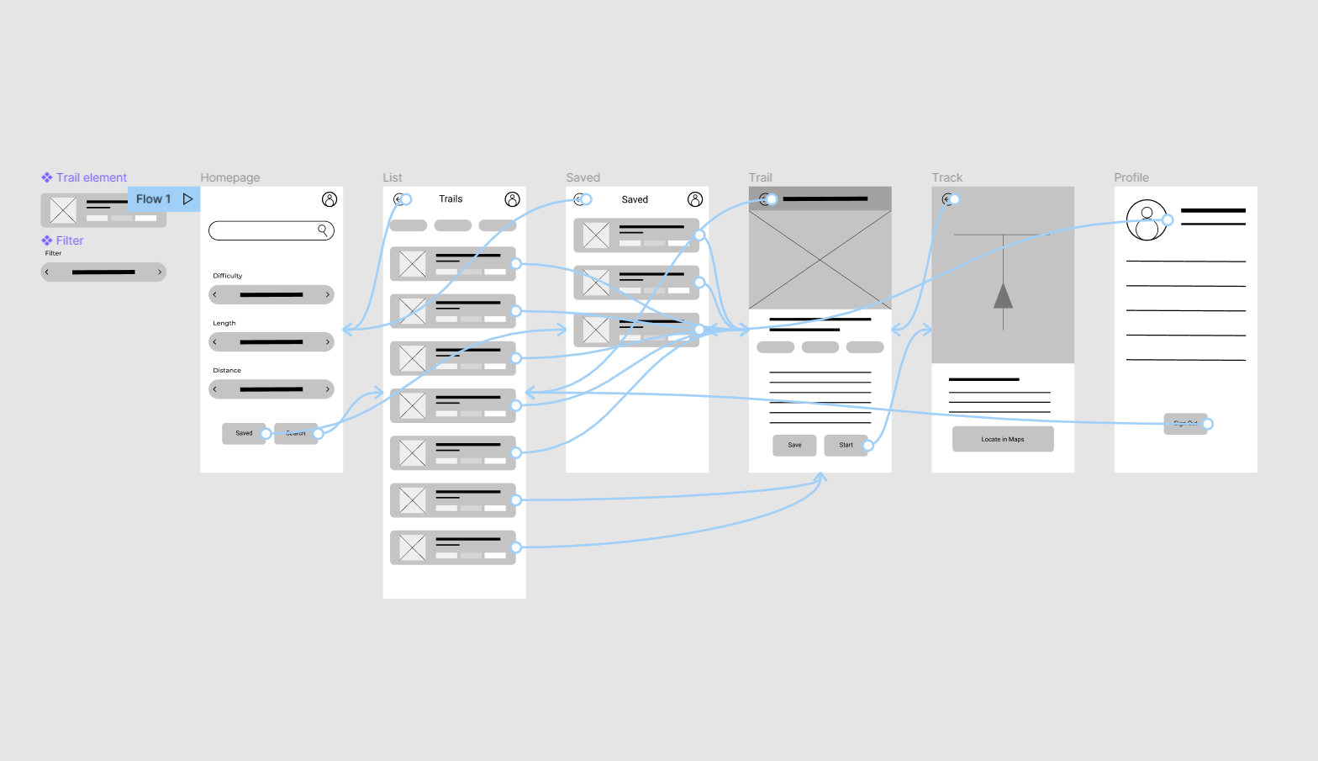
Low-fidelity prototype
Using the completed set of digital wireframes, I created a low-fidelity prototype. The primary user flow I connected was building and ordering a pizza, so the prototype could be used in a usability study.
View the Trail Tracker prototype
Low-Fidelity prototype

Slide 16
Usability study: parameters
Study type:
Usability Study
Location:
Online - Madrid
Participants:
4 participants
Length:
15 minutes

Slide 17
Usability study: findings
I conducted two rounds of usability studies. Findings from the first study helped guide the designs from wireframes to mockups. The second study used a high-fidelity prototype and revealed what aspects of the mockups needed refining.
Round 1 findings
Round 2 findings
1
Users want to go walking to the start of the trail
1
The filtering and searching process could be better
2
Users want to know if the will be able to finish the trail
2
The colours might be distracting
3
Users want to share their experience

Slide 18
Refining
the design
Mockups
High-fidelity prototype
Accessibility

Slide 19
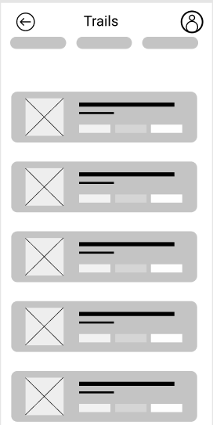
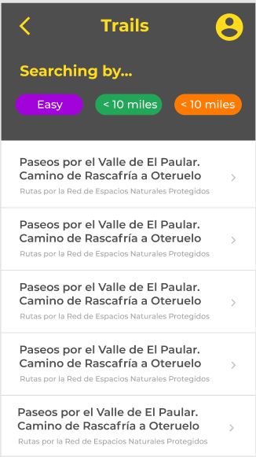
Mockups
Before usability study
After usability study
Showing all the details in every trail looked overwhelming but now we can see the details above and the list filtered now.
Mockup 1 before

Slide 20
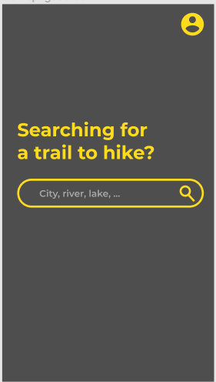
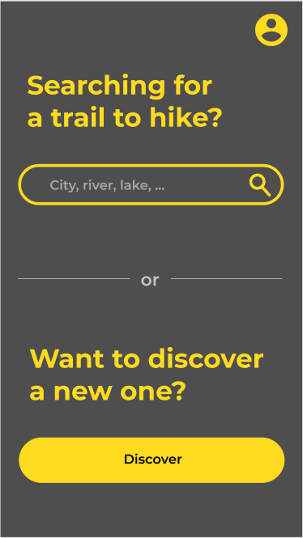
Mockups
Before usability study
After usability study
Giving the option to the user to choose if he/she wants to discover a new trail is something we should ask the first.

Slide 21
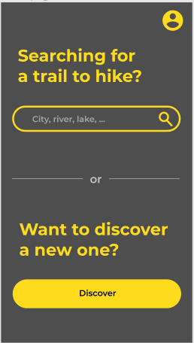
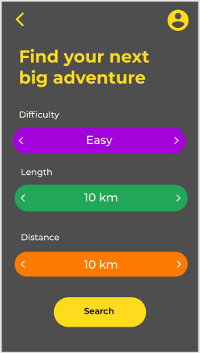
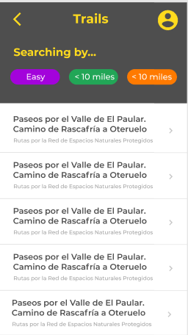
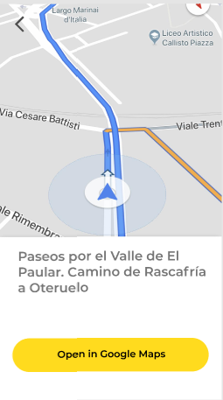
Key mockups

Slide 22
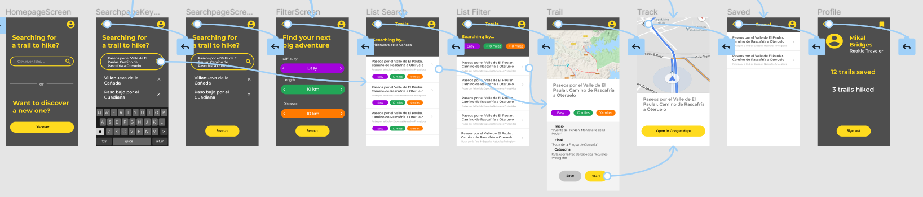
High-fidelity
prototype
The final high-fidelity prototype presented cleaner user flows for finding a trail and starting it. You can also save a trail and filter by your needs.
View the trail tracker high-fidelity prototype

Slide 23
Accessibility considerations
1
2
Big spacing and big buttons for people with cognitive disabilities
High contrast for vision impaired people.

Slide 24
Going forward
Takeaways
Next steps

Slide 25
Takeaways
Impact:
The app makes users feel like they can go everywhere and they will find a nice trail to hike no matter where they are.
What I learned:
While designing the app, I learned that the first ideas for the app are only the beginning of the process. Usability studies and peer feedback influenced each iteration of the app’s designs. From now on I will take more care about accessibility in my designs.

Slide 26
Next steps
1
2
Conduct another round of usability studies to validate whether the pain points users experienced have been effectively addressed.
Conduct more user research to determine any new areas of need.

Slide 27
Let’s connect!
Thank you for your time reviewing my work on the Trail Tracker app! If you’d like to
see more or get in touch, my contact information is provided below.
Email: aaronperezmail@gmail.com

Slide 28
Thank you!

