Slide 1
Reverse Engineering Python Applications
Aaron Portnoy , Ali Rizvi-Santiago

Slide 2

About Us
Work in TippingPoint DVLabs (http://dvlabs.tippingpoint.com)
Responsible for bughunting, patch analysis, vuln-dev
Authors and contributors to…
Sulley Fuzzing Framework
PaiMei
PyMSRPC
OpenRCE.org
Notes:
Brief history of TippingPoint and foundation for starting the discussion or as a segue from the 3Com corporate overview.
2001 – TippingPoint is founded
2002 – TippingPoint introduces the first IPS at RSA Trade Show in the USA
2003 – Gartner declares IDS is ‘Dead’ in their report: “Intrusion Prevention will Replace Intrusion Detection” by Richard Stiennon
2004 – TippingPoint wins NSS Gold. This is the first multi-vendor, gigabit throughput, objective test of Intrusion Prevention System vendors that tests both security features and throughput. Only 3 vendors have ever been given a ‘Gold’ award in the history of all NSS testing – regardless of product. TippingPoint was the 4th!!
2005 – 3Com acquires market leading IPS vendor, TippingPoint
2006 – TippingPoint redefines IPS with new multi-security platform in one appliance (X505), the most powerful IPS in the world (M60) and a whole new strategy towards building intelligence in the network.

Slide 3
Talk Outline
We will be focusing on Python in its binary forms
Disassembling code
Code object modification
Runtime instrumentation
An example case study
Cheating at an MMORPG

Slide 4
Introduction to Dynamic Languages
What are the characteristics of a dynamic language?
Tasks performed at runtime rather than during compilation
Advantages to dynamic languages
  Development speed
  Small learning curve
  Portability
Examples of dynamic languages
  Python
  Ruby
  Haskell

Slide 5
Why Python?
Implements many dynamic features
Rapidly gaining popularity
We were already familiar with its internals

Slide 6
Pirates of the Caribbean MMORPG
Multiplayer Online Role-Playing Game
10,000+ Subscribers
Written in Python
Distributed in binary form

Slide 7
First Look
python24.dll
Safe to assume, contains a fair bit of python code
130mb PYD file
Google tells us this consists of frozen python objects
Grepping yields interesting strings
Panda3D Library
Made by Disney

Slide 8
What do we know about Python?
Source code compiled to objects
Interpreted
Python is a dynamic language
Type information must be present somewhere
Python implements a virtual machine
Byte code must also be present somewhere

Slide 9
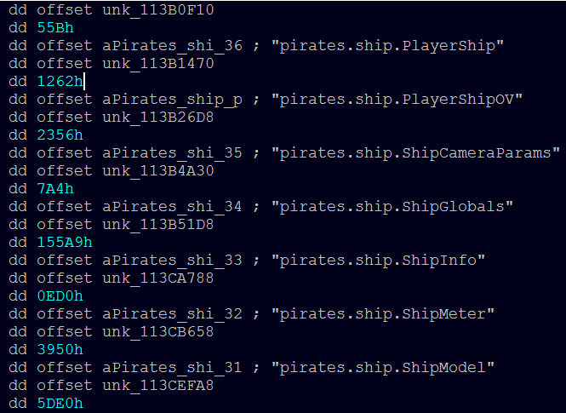
Structure of a PYD
Take a look in IDA:

Slide 10
Python Serialization
The ‘marshal’ module
Similar to ‘pickle’, but handles internal types
What is this currently used for?
.pyc – cached code objects
avoid having to re-parse source
.pyz – squeezed code objects
.pyd – marshalled code objects
shared object (.dll, .so, and so forth)

Slide 11
Python Code Object
What do we get when we serialize?
An object of type ‘code’
Code object properties:
co_argcount, co_nlocals, co_stacksize, co_flags, co_code, co_consts, co_names, co_varnames, co_filename, co_name, co_firstlineno, co_lnotab, co_freevars, co_cellvars
Which is most interesting to a reverse engineer?
co_code – string representation of an object’s byte code

Slide 12
Byte Code Primer
An instruction consists of a 1-byte opcode
Followed by a 16-bit argument if required
Python has support for extended args
Used if your code has more than 64k of defined constants
Data is not part of byte code
Stored in other code properties, referenced by index
co_consts
co_names
co_varnames

Slide 13
Byte Code Example
\x64\x02\x00
\x64\x4E\x00
\x64\x17\x00
\x66\x03\x00
\x55
LOAD_CONST 2
LOAD_CONST 78
LOAD_CONST 23
BUILD_TUPLE 3
RETURN_VALUE

Slide 14
Code Object Modification
Code objects are immutable
BUT, you can clone an object and modify attributes
We call this “sneaking the type”™
>>> code = type(eval('lambda:x').func_code)
>>> help(code)
Help on class code in module __builtin__:
class code(object)
| code(argcount, nlocals, stacksize, flags, codestring,
| constants, names, varnames, filename, name,
| firstlineno, lnotab[, freevars[, cellvars]])
|
| Create a code object. Not for the faint of heart.

Slide 15
Introducing AntiFreeze
Tool for statically modifying binary python code objects
Browser-based
Interface utilizes Ext-js javascript library
Components
Disassembly Engine
Assembler
Functionality for extracting code from binary python
PE Parser
Intel Disassembler

Slide 16
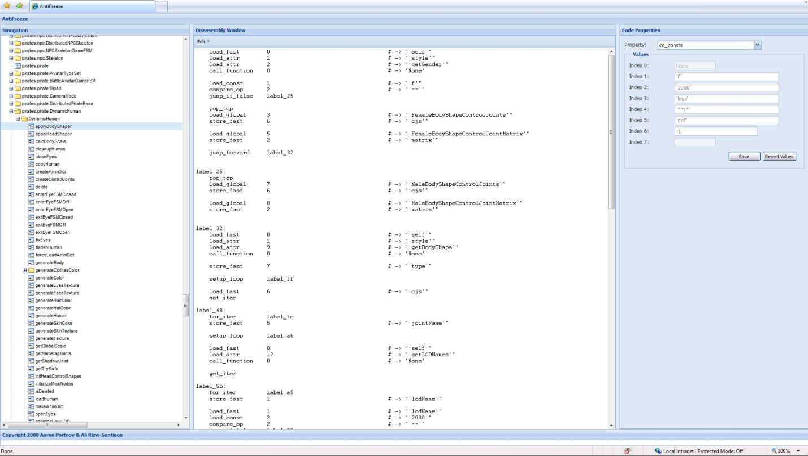
Introducing AntiFreeze (cont.)

Slide 17
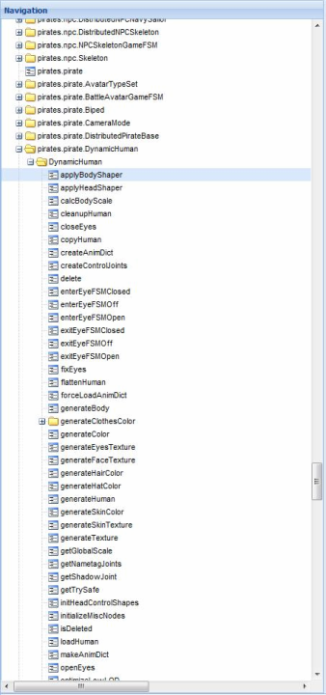

Introducing AntiFreeze (cont.)
P

Slide 18
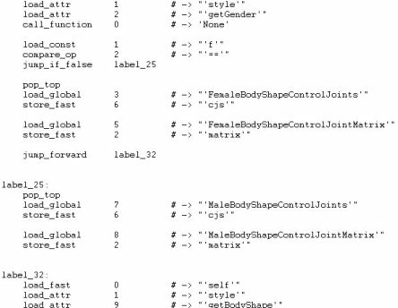
Introducing AntiFreeze (cont.)

Slide 19
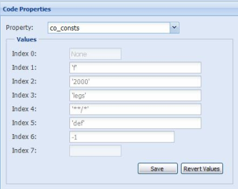
Introducing AntiFreeze (cont.)

Slide 20
Runtime Analysis
Static analysis is limited
Runtime analysis allows us to understand how code is interpreted and executed dynamically

Slide 21
Python Object Data Structure
All instantiated objects are prefixed with the following information:
0 int ob_refcnt
4 struct _typeobject* ob_type
8 int ob_size
ob_refcnt – reference counter for the object (used for gc)
ob_type – contains a pointer to the type of the object
ob_size – byte size of the object in memory

Slide 22
Python Standard Types
All base types are exported by the python DLL
Check your local dependency viewer for all types
0:001> dd 0x1663660 *this is the address of an object
01663660 00000002 1e1959d0 0000001c 0000001c
01663670 0000007f 01706498 1e051f70 dea555d0
01663680 0166c660 0166c630 7d8c4178 0166f598
0:001> ln 0x1e1959d0 *your ob_type goes here
(1e1959d0) python24!PyDict_Type
Exact matches:
python24!PyDict_Type (<no parameter info>)

Slide 23
Execution of a Code Object
PyFrameObject*
PyEval_EvalCode(PyCodeObject* co, PyObject* globals, PyObject* locals)
Binds Code object to globals()/locals() and returns a PyFrameObject
PyObject*
PyEval_EvalFrame(PyFrameObject* f)
PyEval_EvalFrame is responsible for executing the new frame.

Slide 24
Concurrent Execution of Code Objects
Multiple interpreters can exist in a single process
Each Interpreter has a list of threads associated with it
Concurrency is handled via a lock known as the GIL
Similar to FreeBSD
PyEval_EvalFrame is responsible for releasing the lock

Slide 25
Diving in With a Debugger
Key things we will need to identify
All existing interpreters
Threads associated with an interpreter
What is currently being executed

Slide 26
Identifying All Existing Interpreters
The list of interpreters is a plain old stack
Just need to find a reference to the head of the stack.
“interp_head” in python-src/Python/pystate.c
0:001> u PyInterpreterState_Head
python24!PyInterpreterState_Head:
1e08ce90 a1c0871b1e mov eax, [python24!1e1b87c0]
1e08ce95 c3 ret

Slide 27
Interpreter Data Structure
0 struct _is* next
4 struct _ts* tstate_head
8 PyObject* modules
c PyObject* sysdict
10 PyObject* builtins
14 PyObject* codec_search_path
18 PyObject* codec_search_cache
1c PyObject* codec_error_registry

Slide 28
Threads
0 struct _ts* next
4 PyInterpreterState* interp
8 struct _frame* frame
c int recursion_depth
10 int tracing
14 int use_tracing
…
40 PyObject* dict
…
50 long thread_id ; this is your GetCurrentThreadId()

Slide 29
Frame Object
0 int ob_refcnt
4 struct _typeobject* ob_type
8 int ob_size
0c struct _frame *f_back ; calling frame
10 PyCodeObject *f_code
PyObject *f_builtins
18 PyDictObject *f_globals
1c PyDictObject *f_locals
20 PyObject **f_valuestack
24 PyObject **f_stacktop
28 PyObject *f_trace

Slide 30
Hooking
All code must pass through PyEval_EvalCode or PyEval_EvalFrame
Can also hook PyObject_CallFunction or PyObject_CallMethod
Sounds easy enough…

Slide 31
Breakpoints
Breaking on PyEval_EvalFrame
  Display name of code object
    da poi(poi(poi(@esp+4)+0xc+4)+8+0x2c)+8+0xc
  Display Locals
    r@$t1=poi(@esp+4);r@$t1=poi(@$t1+0x18);r@$t2=dwo(@$t1+0x10)+1;r@$t1=poi(@$t1+0x14);r@$t3=@$t1+@$t2*@$ptrsize;.while(@$t1<@$t3){r@$t2=poi(@$t1+4);r@$t1=@$t1+@$ptrsize;j(@$t2>0x14)'da@$t2+0x14';''}
  Display Globals
    r@$t1=poi(@esp+4);r@$t1=poi(@$t1+0x1c);r@$t2=dwo(@$t1+0x10)+1;r@$t1=poi(@$t1+0x14);r@$t3=@$t1+@$t2*@$ptrsize;.while(@$t1<@$t3){r@$t2=poi(@$t1+4);r@$t1=@$t1+@$ptrsize;j(@$t2>0x14)'da@$t2+0x14';''}
Breaking on a PyObject_Call*
  r@$t1=poi(@esp+4);r@$t2=@$t1;r@$t2=poi(@$t2+0x1c)+0x14;.printf "PyFunction_Type:";da@$t2;r@$t3=@$t1;r@$t3=poi(@$t3+8);r@$t3=poi(@$t3);.printf"PyCFunction_Type";da@$t3;r@$t4=@$t1;r@$t4=poi(@$t4+8);r@$t4=poi(@$t4+0x1c)+0x14;.printf"PyMethod_Type";da@$t4

Slide 32
Context Switch
That’s a context switch into and out of kernel for
execution of EVERY frame?

Slide 33
Userspace Hooking
0:000> .dvalloc 1000
Allocated 1000 bytes starting at 00430000
0:000> u PyEval_EvalFrame
python24!PyEval_EvalFrame:
1e027940 83ec54 sub esp,54h
1e027943 53 push ebx
1e027944 8b1dc4871b1e mov ebx, [1e1b87c4]
1e02794a 56 push esi
0:000> a PyEval_EvalFrame
1e027940 jmp 0x430000
1e027945
0:000> u PyEval_EvalFrame
python24!PyEval_EvalFrame:
1e027940 e9bb8640e2 jmp 00430000
1e027945 1dc4871b1e sbb eax, 1e1b87c4
1e02794a 56 push esi
1e02794b 8b742460 mov esi,dword ptr [esp+60h]
1e02794f 57 push edi
1e027950 33ff xor edi,edi
1e027952 83c8ff or eax,0FFFFFFFFh
1e027955 3bf7 cmp esi,edi
0:000> a 430000
00430000 int 3
00430001 sub esp, 0x54
00430004 push ebx
00430005 mov ebx, [0x1e1b87c4]
0043000b jmp 0x1e02794a

Slide 34
Dynamic Recompilation
PyRun_* makes injection incredibly easy.
Let's take a look at PyRun_String:
PyObject*
PyRun_String(const char* str, int start, PyObject* globals, PyObject* locals)
{
return run_err_node(PyParser_SimpleParseString(str, start),
"<string>", globals, locals, NULL);
}

Slide 35
Function Hooking
Straightforward approach, re-declare the function and call the original:
def old(blah, heh, ok, im, over, it):
print "hello globals()"
original_old = old
def new(*args, **kwds):
print repr(args), repr(kwds)
res = original_old(*args, **kwds)
print "result was: %s"% repr(res)
return res
old = new

Slide 36
Instance Method Hooking
instancemethods are immutable and are bound to an instance
Just need to sneak it’s type and then clone with a new function:
instancemethod = type(Exception.__str__)
instancemethod(function, instance, class)
class obj(object):
def method(self):
print "yay for methods"
def new(self):
print "okay...."
x = obj()
old = x.method.im_func
x.method = instancemethod(new, x, type(x))

Slide 37
Debugging Hooks
sys.settrace(fn)
http://docs.python.org/lib/debugger-hooks.html
def fn(*args):
print repr(args)
sys.settrace(fn)
ihooks
http://effbot.org/librarybook/ihooks.htm

Slide 38
Case Study: Pirates of the Caribbean Online MMORPG
Static PYD Modifications for Pirates
  Digging through the disassembly using AntiFreeze….
  We notice *Globals generally contain interesting constants to modify
  pirates.reputation.ReputationGlobals
  Level/Experience cheats
  pirates.economy.EconomyGlobals
  Gold cheats
  pirates.piratebase.PirateGlobals
  Speed/Acceleration/Jump Height/… cheats
  pirates.ship.ShipGlobals
  Speed/Acceleration cheats

Slide 39
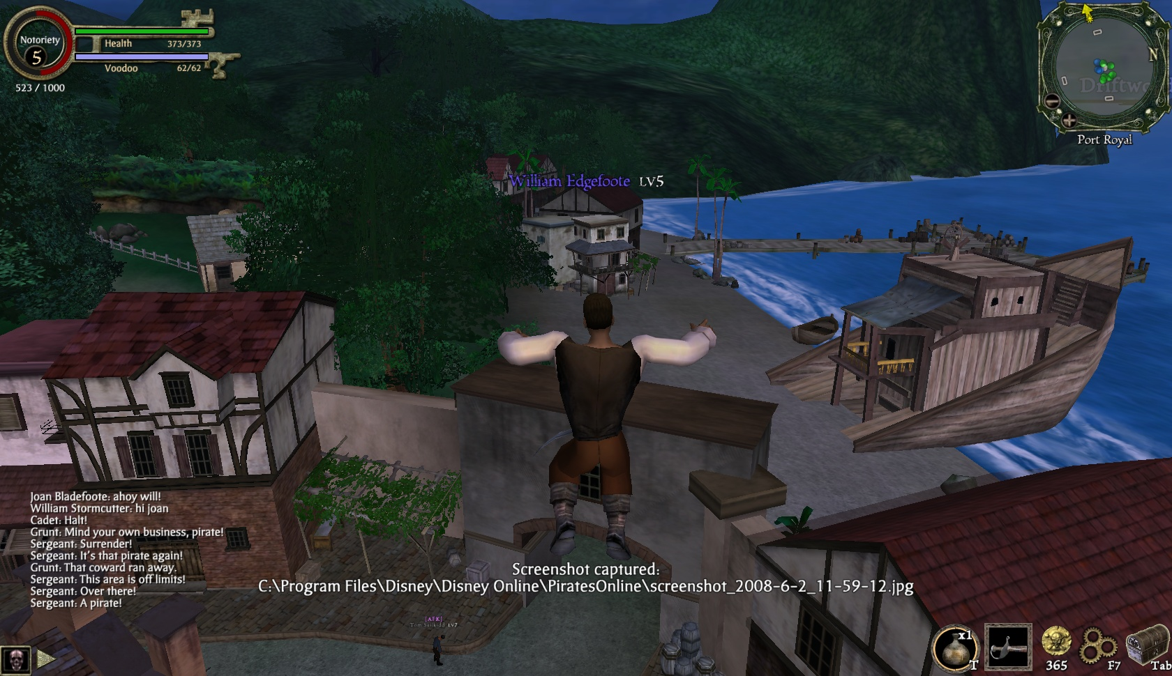
Screenshot

Slide 40
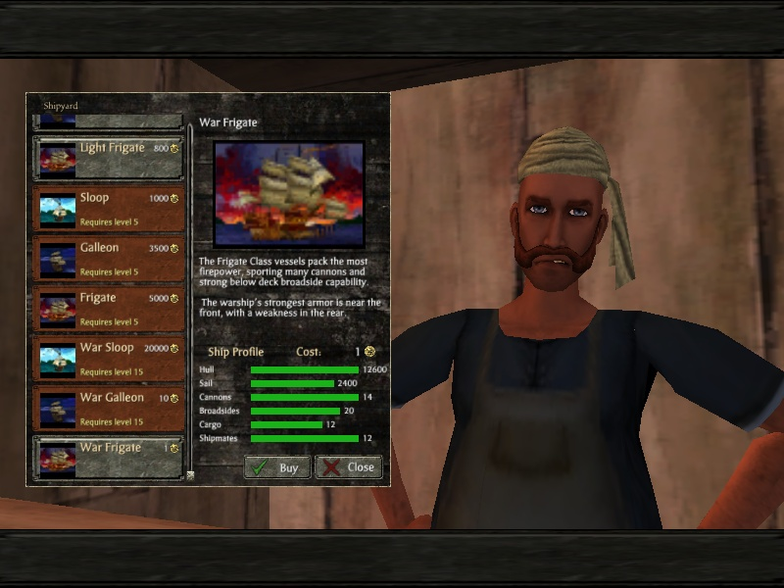
Screenshot

Slide 41

Screenshot

Slide 42
Anti-Reversing
Some mitigation ideas
  Runtime translation of byte code
  Symbol lookup obfuscation

Slide 43
Questions
Questions?
Additionally, contact us via e-mail
aportnoy tippingpoint.com
arizvisa tippingpoint.com
Blog/Updates/etc at http://dvlabs.tippingpoint.com

