Slide 1
NYU Poly Reverse Engineering Lecture
Aaron Portnoy
TippingPoint Security Research
Peter Silberman
Mandiant Engineering and Research

Slide 2
Outline
Agenda
Software auditing and reverse engineering on Windows
SESSION ONE
Auditing methodologies
Tools of the trade
Disassembling and IDA Pro
SESSION TWO
Reversing styles and techniques
Vulnerability classes
Vulnerability analysis and debugging
Automation (if time permits)
Focus on vulnerability discovery and analysis
Notes:
I'll cover software reversing engineering on Windows with a focus on vulnerability discovery and analysis as it is pertinent to this course.
The techniques described are applicable to other operating systems and applications, however the tools presented will focus on Windows.
Software auditing, for the purposes of this class, can be defined as locating vulnerabilities in compiled applications.

Slide 3
Introduction to RE
Why is this skill set valuable?
Source is not often available for Windows applications
Eliteness factor
Often exponentially more difficult than source auditing
Find bugs where few others are comfortable
Homebrew patches
Patch analysis
e.g. Reversing Microsoft patches to discover root cause
1st with a new exploit or Metasploit module?
1st with a new signature for an AV or IPS?
Binary code is a $ goldmine $
Bugs exist for long periods of time in binary code
Notes:
Debugging in general is more streamlined with a reverse engineering background
Everything is open to you if you are good at reverse engineering. Want to know how * works? Reverse it.
Pick your favorite windows application. Chances are, source is not available. AIM, IE, Office, Adobe Reader, Exchange, VMware

Slide 4
Introduction to RE (cont.)
Why is this skill set valuable (cont.)?
Knowledge is portable
Apply techniques to wide array of tasks
New architectures become approachable
Developing countries rely on it
Why engineer from scratch when you can copy
Reverse for security, ensure there are no backdoors
In the US we take these things for granted
Notes:
Mention how debugging in general is more streamlined with a reverse engineering background
Mention how everything is open to you if you are good at reverse engineering. Want to know how * works? Reverse it.
Pick your favorite windows application. Chances are, source is not available. AIM, IE, Office, Adobe Reader, Exchange, VMware

Slide 5
Introduction to RE (cont.)
It's not always about the assembly
Reversing is the process by which you attempt to understand the system
- Operating system
- Software - Hardware - Plane, train, auto, anything that was engineered
Reverse the system as a whole, helps locate trust boundaries
Malkovich malkovich, malkovich?
GOAL: Get inside the developer’s head
Reverse engineer intentional behavior to determine how to deviate execution
from that intention
Notes:
What constitutes reverse engineering?
I'll cover software reversing engineering on Windows with a focus on vulnerability discovery and analysis as it is pertinent to this course
Reversing the system allows you to fully understand TRUST BOUNDARIES. Many of the techniques I’ll talk about are applicable to other operating systems. Many of the tools have counterparts.

Slide 6
Overview of Approach
General Steps, pre-disassembling
- Examine system behavior
- Enumerate components
- Determine relationships
- Determine trust
- Locate and probe inputs
Many tools to aid in this process
We’ll cover some of these
Notes:
If we are analyzing an application we need to fully understand the breadth of it’s components in order to find vulnerabilities
You don’t need to step inside the black box to begin enumerating it’s exposed parts. Disassembling comes later.

Slide 7
Step by step
Examining system behavior
Documentation
Install & use the product!
Support forums
Exploitable bugs might be “annoyances” to regular users
Notes:
I cannot stress enough how important it can be to use the product and read the documentation. You should be able to admin it before you attempt to reverse it.
> Show the tools, screenshots? Or run them.

Slide 8
Step by step (cont.)
Enumerating components
Documentation
Product prerequisites (Java, .NET, …)
MSRPC
Process Explorer
rpcdump, rpcinfo
mIDA
ActiveX, Codecs, File formats, Protocol Handlers, …
RegMon
FileMon
ProcessMon
Services
services.msc / TCPView
Notes:
I cannot stress enough how important it can be to use the product and read the documentation. You should be able to admin it before you attempt to reverse it.
> Show the tools, screenshots? Or run them.

Slide 9
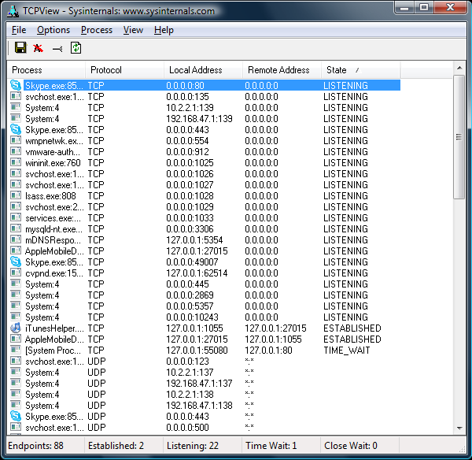
TCP View from MS
Notes:
Edit->Plugins, mIDA
Perhaps show this live?

Slide 10
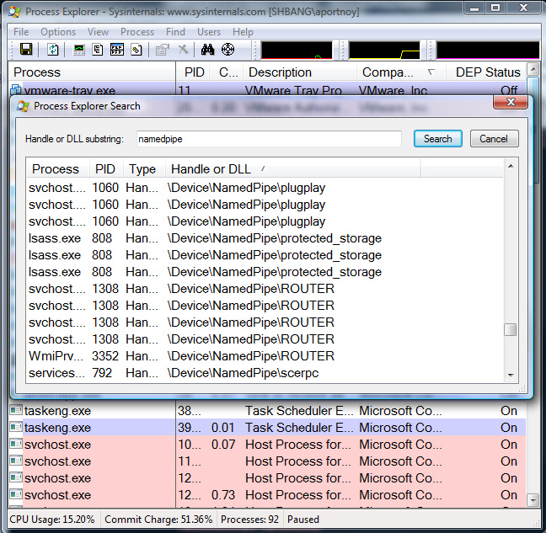
Process Explorer from MS
Notes:
Find->Find Handle or DLL…

Slide 11
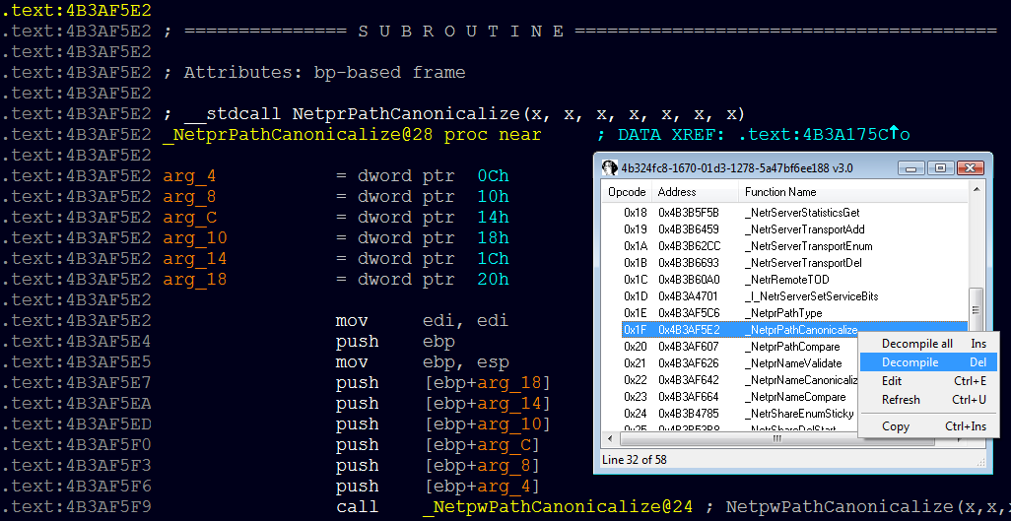
mIDA from Tenable (MSRPC)
Notes:
Edit->Plugins, mIDA
Perhaps show this live?

Slide 12
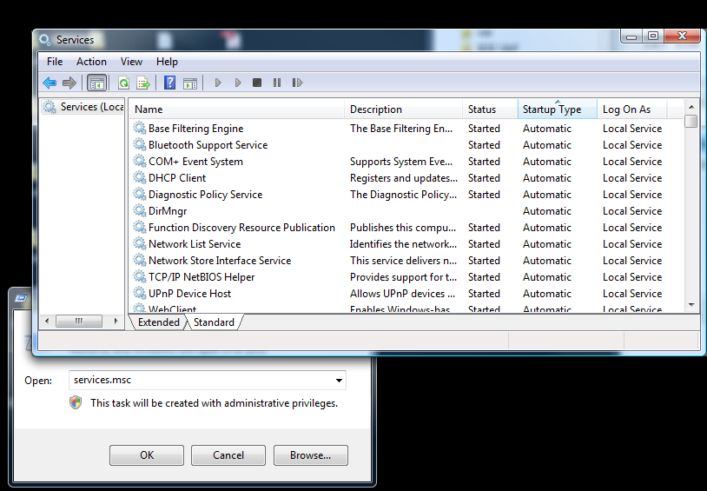
Services
Notes:
Start->Run services.msc
Check for new entries upon installation of a product

Slide 13
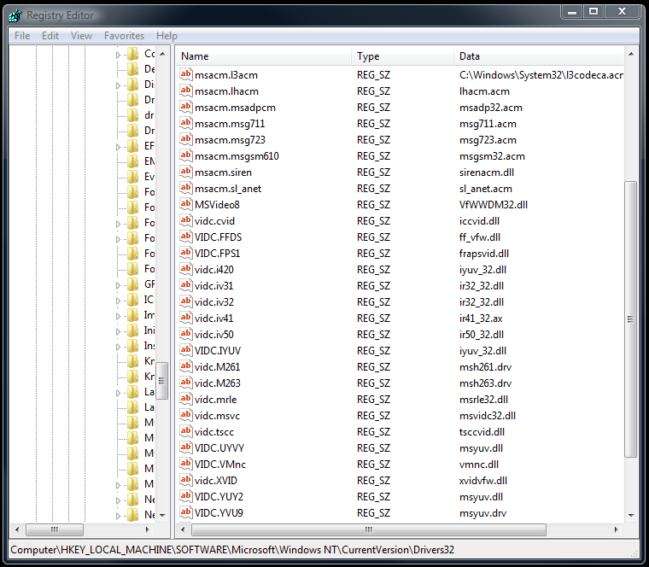
Registered Codecs
Notes:
Start->Run regedit
HKLM\Software\Microsoft\Windows NT\CurrentVersion\Drivers32
Check for new entries upon installation of a product

Slide 14
Registered Codecs
Notes:
I found two vulnerabilities in this codec which is installed by default with multiple VMware products.
I can own anyone with VMware products installed… through a browser.

Slide 15
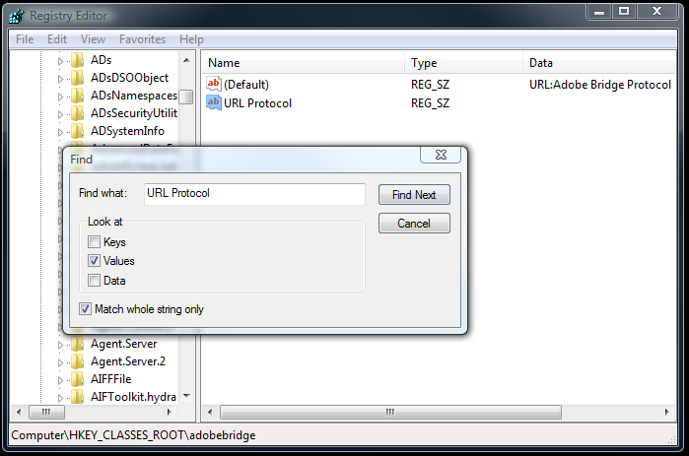
Registered Protocol Handlers
Notes:
Start->Run regedit
Search for URL Protocol value
Check for new entries upon installation of a product
XXX: add slide for file format associations

Slide 16
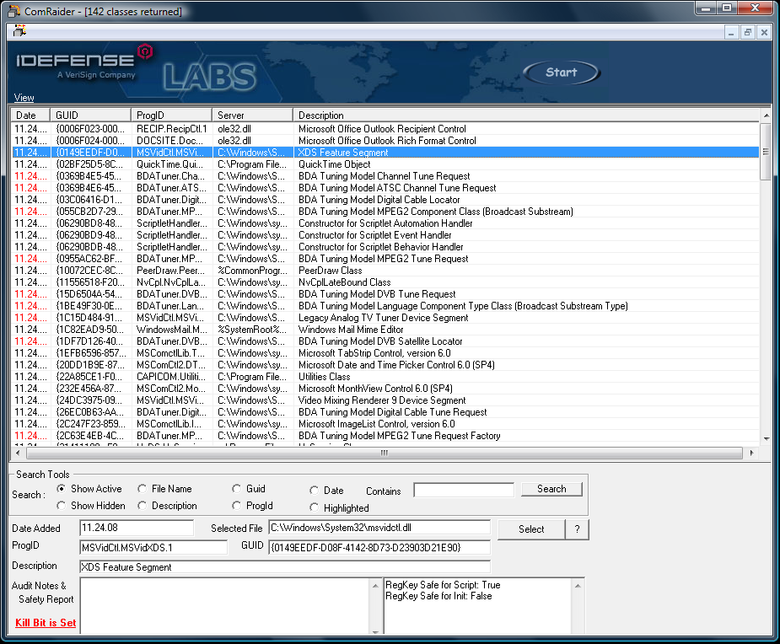
ActiveX Controls
Notes:
Start->Run regedit
Search for URL Protocol value
Check for new entries upon installation of a product
XXX: add slide for file format associations

Slide 17
Step by step (cont.)
Determining relationships
Documentation
Loaded modules
Do different processes share 3rd party DLL files?
Local ports, Named pipes
IPC
Check shared handles
Wireshark
Use the product, sniff
Notes:
Library calls can show you what type of relationships processes may have… think IPC, shared resources, etc

Slide 18
Step by step (cont.)
Determining trust
Documentation
Ethernet interfaces bound
Local? Remote? TCP? UDP? …
Named pipe restrictions
Authentication
ActiveX
Safe for scripting
Safe for init
Privileges of users running processes
Permissions on resources, directories, handles, …
Notes:
Mention interface hopping
Insert slide with TCP View screenshot

Slide 19
Step by step (cont.)
Locating inputs
Documentation
Registry entries
File formats, codecs, protocol handlers
TCP View /Process Explorer
Probing inputs
Create your own “clients”
MSRPC
Impacket (Core), PyMSRPC (Myself and Cody Pierce)
ActiveX
COMRaider (David Zimmer), Axman (HD Moore)
TCP/UDP/…
Socket code (py, pl, C, take your pick)
Subverting client code
Don’t bother implementing an encryption if you can steal theirs
Notes:
I say “clients” because sometimes a client to an activex control could be seen as the html file that instantiates it

Slide 20
Questions?
Notes:
Firstly, some questions…
How many people understand what a module is?
Function?
Basic block?
Instruction?

Slide 21
Disassembling and IDA Pro
Notes:
Firstly, some questions…
How many people understand what a module is?
Function?
Basic block?
Instruction?

Slide 22
Intro to binary code structure
Modules
process.exe, library.dll
Functions
At least one basic block, can be called
Basic Blocks
Groups of instructions terminated at a branch or return
mov ebx, dword_0x400400
test ebx, ebx
jz fail
Instructions
Atomic
mov eax, [ebp+0x4c]
Notes:
Four basic levels of granularity
This applies to other operating systems and architectures

Slide 23
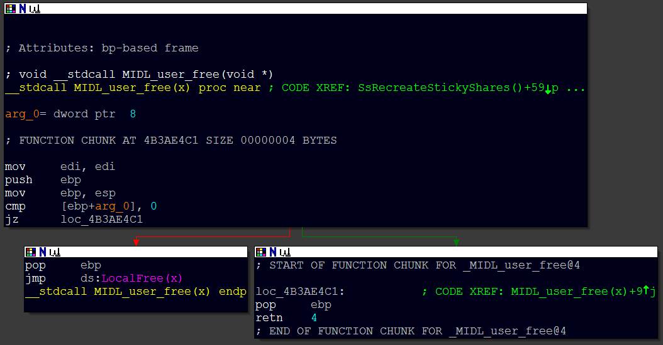
Func/Basic block/Instruction

Slide 24
Func/Basic block/Instruction
FUNCTION

Slide 25
Func/Basic block/Instruction
BASIC BLOCK
BASIC BLOCK
BASIC BLOCK

Slide 26
Func/Basic block/Instruction
INSTRUCTIONS

Slide 27
Graphing
Code can be represented as a graph, as shown previously
Graph traversal code is applicable here
Assuming no dynamic transfers of execution, like:
call [edx+0x20]
Graphing tricks
Reachability (Function & Basic Block)
Upgraph/Downgraph/Intersection
Discover new vectors for attacks
Discover paths to interesting code
Locate recursive functions programmatically
Loop detection
Binary diffing (BinDiff from Zynamics)
Notes:
Mention C++ ABI
If you locate a given vulnerability, you can graph upwards to find all possible paths to it. This applies to function-level graphs as well as basic blocks.

Slide 28
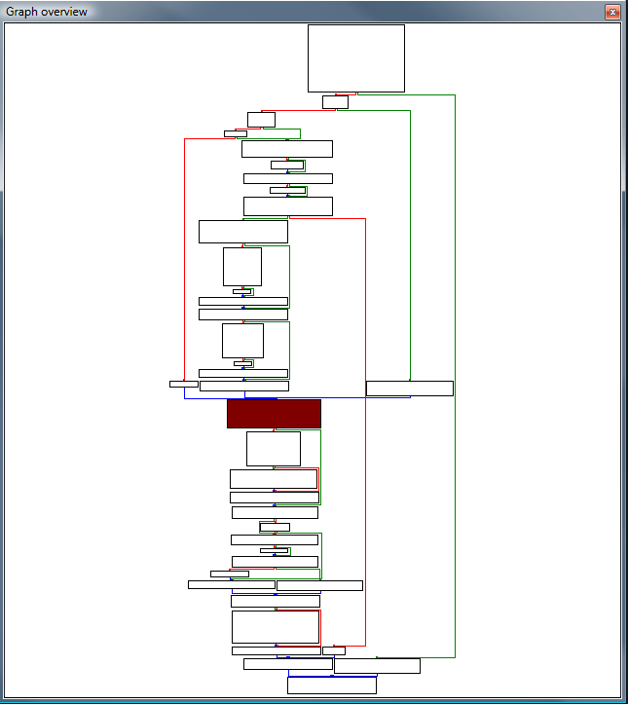
Graphing
Notes:
Mention C++ ABI
If you locate a given vulnerability, you can graph upwards to find all possible paths to it. This applies to function-level graphs as well as basic blocks.

Slide 29
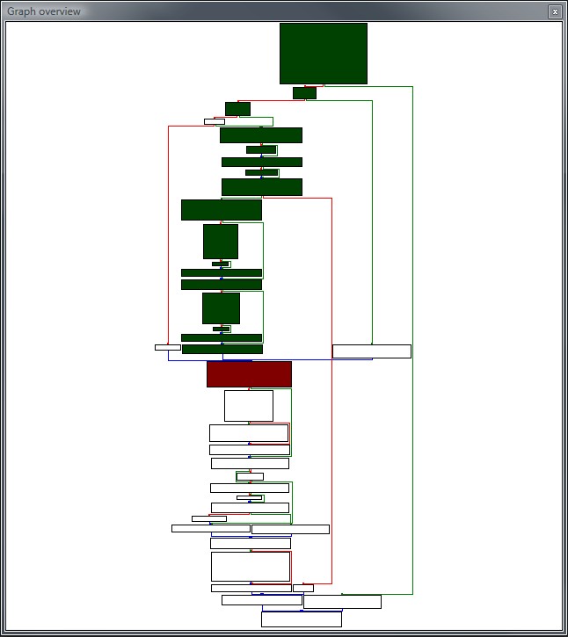
Graphing
Notes:
Mention C++ ABI
If you locate a given vulnerability, you can graph upwards to find all possible paths to it. This applies to function-level graphs as well as basic blocks.

Slide 30
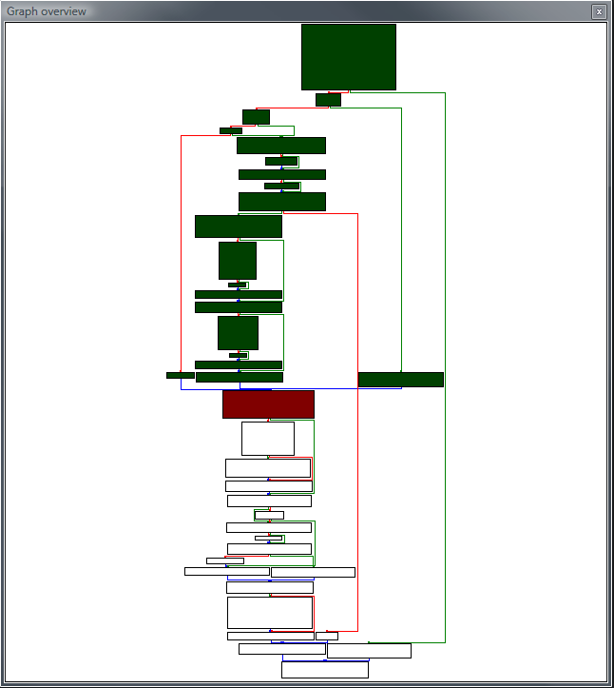
Graphing
Notes:
Mention C++ ABI
If you locate a given vulnerability, you can graph upwards to find all possible paths to it. This applies to function-level graphs as well as basic blocks.

Slide 31
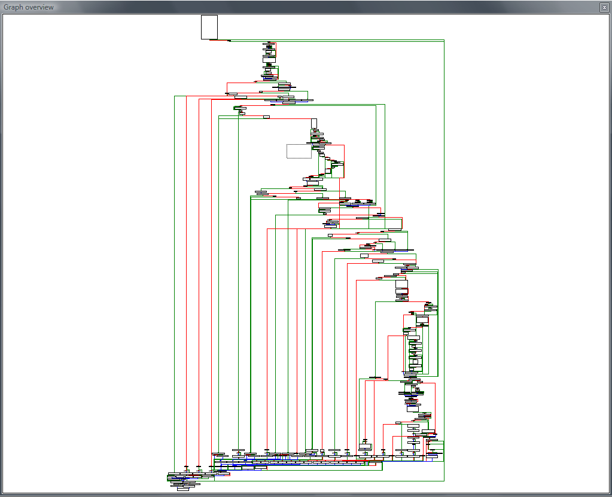
Graphing
Notes:
nasty

Slide 32
Questions?
Notes:
Firstly, some questions…
How many people understand what a module is?
Function?
Basic block?
Instruction?

Slide 33
Intro to binary data structures
Objects (think object-oriented, C++, …)
@ecx
Constructors
Destructors
Function tables
Methods
Inheritance
Variables
Local
Global
Structures
Defined on Stack vs. Heap
Important for exploitation
Notes:
Mention C++ ABI

Slide 34
Introduction to IDA Pro
How many here have used a disassembler? IDA?
Important facilities to a reverser provided by IDA
FLIRT
Strings
assert() calls
debug functions
Cross referencing
Imports/Exports
Segments
IDA SDK, IDC, IDAPython, IDA Debugger
Plugins
Automated analysis (we’ll get to this later)
Notes:
Mention base address

Slide 35
RE – Static Analysis
Important to locate sources of user input
No runtime info available (besides sometimes RTTI)
Cross referencing and graphing is key
C++ can make this aggravating
Pattern matching is helpful
IDC/IDAPython
Find me all “movsx” from this function down
Find me all “add reg32, x” followed by malloc()
Loop detection
Unsafe library calls
*cpy
*alloc

Slide 36
RE – Dynamic Analysis
Breakpoints allow for jump start on analysis
e.g. Memory breakpoint on recv() buffer
Ability to resolve…
Object structure and relationships
Type information
Input from other processes/systems/configs/…
Global variables
Ability to populate .idb with runtime information
Crucial to exploit development
e.g. Analyze heap layout dynamically
Notes:
Should show some C++ and how we cannot resolve function pointers or perhaps global variables
Split into more slides

Slide 37
Questions?
Notes:
Firstly, some questions…
How many people understand what a module is?
Function?
Basic block?
Instruction?

Slide 38
RE – Debuggers
 | Pros | Cons
WinDBG | Mature piece of software. Great symbol support. Allows for neat tricks like heap walking and integrity checks. Kernel! | Steep learning curve. Poor plugin API.
OllyDBG | Intuitive user interface. Large community of users. Nice plugin API. | Flakey symbol support. Only supports 32-bit. Default install exposes exploitable vulnerabilities!
PyDBG | Scriptable and easily extensible. | Python is slow. Only supports 32-bit. Designed to be event-based.
IDA debugger | Contains 9 debugging engines. Built-in to IDA. | Multiple module support can be tricky to get the hang of. UI sketchy.

Slide 39
Simple Protocol Reversing
Walkthrough
Going to show you a vulnerability in an unnamed product
This is 0day and exploitable
It has been reported to the affected vendor
Note how little x86 knowledge is required to locate the issue
More importantly, to analyze and understand it
Notes:
Should show some C++ and how we cannot resolve function pointers or perhaps global variables
Split into more slides

Slide 40
To Recap
Reverse from the top down
Understand the system to understand it’s parts
Use the proper tools to aid you
Saves time and focus
Use every technique you have available
Mixture of static and dynamic analysis

Slide 41
Conclusion of Session One
Questions?
E-mail the mailing list if you have additional questions
I am subscribed as well
Alternatively
My gmail username is aportnoy
Thanks!

