Slide 1
Reversing Microsoft DirectShow
And 3rd Party Codecs
Aaron Portnoy, TippingPoint DVLabs
You Sh0t The Sheriff 3.0 – Sao Paulo, Brazil

Slide 2
Obligatory Introduction
TippingPoint DVLabs
  Security Research
  Vulnerability Discovery
  Vulnerability Exploitation
  http://dvlabs.tippingpoint.com
    Published and Upcoming Advisories
    Blog
Zero Day Initiative
  Vulnerability Purchasing Program

Slide 3
Overview
Video For Windows
  Obsolete, will touch briefly on this
DirectShow
  Current, please follow along with your favorite disassembler…
Media Foundation
  The new hotness, will discuss if time permits

Slide 4
Why You Should Care
Bugs bugs bugs bugs bugs bugs bugs bugs
  Recent unpatched examples include…
    MS DirectShow QuickTime 0day (MS Security Advisory 971778)
    A Microsoft DirectShow 0day I discovered last week
  Recent patched examples include…
    My VMware Codec Vulns
      Will demo a working exploit if we have time
    ISS’ Xvid Vulns (see Dowd/McDonald presentation at CSW08)
Extensible Framework
  Same mistakes are made in new codecs (OFTEN)
Client-side vulns are ubiquitous and fun to exploit

Slide 5
DirectShow and AVI Primer

Slide 6
From The Top – RIFF-based Media
AVI for Video, WAVE for Audio
  Container format (RIFF)
  Streams
  Compression Formats (FOURCCs)
Compressors/Decompressors
  Third party code ftw
  Audio and Video
  Registered in…. the registry
    HKLM\SOFTWARE\Microsoft\Windows NT\CurrentVersion\Drivers32
  Divx, Xvid, Cinepak, Indeo, …

Slide 7
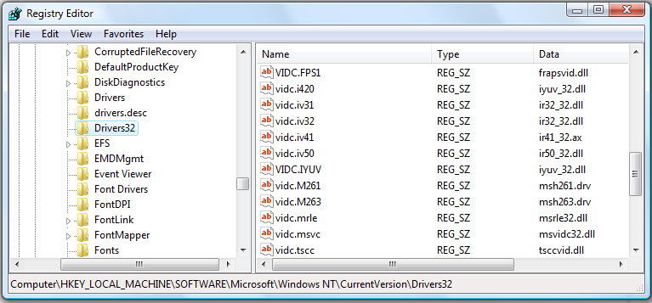
Registry
Entries for Installable Compressors/Decompressors

Slide 8
DirectShow Pins, Filters, and Graphs
Filters
  A node on the filter graph
    Responsible for one phase of processing
    Source, Transform, Renderer
Pins
  Each filter has at least one Pin
    Specifies which type of media the Filter can accept or produce
  Can be either Input or Output
  Codecs register Media Types they can handle
Filter Graphs
  Putting it all together, contains Filters and Pins

Slide 9
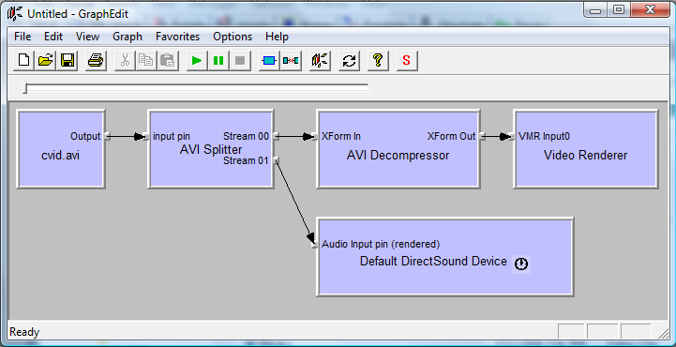
Filter Graph Example
Filter graph for rendering an AVI with a CVID stream

Slide 10
So, How’s it Really Work?
You open a media file and DirectShow…
  Creates a filter graph:
  Parses the RIFF chunks:
ole32!CoCreateInstance
quartz!CoCreateFilter+0x1a
quartz!CFilterGraph::CreateFilter+0x4c
quartz!CFilterGraph::AddSourceFilterInternal+0x199
quartz!CFilterGraph::RenderFile+0x77
quartz!CAviMSRFilter::ParseHeaderCreatePins
quartz!CAviMSRFilter::LoadHeaderParseHeaderCreatePins+0xa5
quartz!CBaseMSRFilter::NotifyInputConnected+0x50
quartz!CBaseMSRInPin::CompleteConnect+0x3a
quartz!CBasePin::ReceiveConnection+0xc2
quartz!CBasePin::AttemptConnection+0x54
quartz!CBasePin::TryMediaTypes+0x64
quartz!CBasePin::AgreeMediaType+0x73
quartz!CBasePin::Connect+0x55
…

Slide 11
So, How’s it Really Work? (cont.)
  Determines which codec can accept the media type
    Specified as a GUID
    AM_MEDIA_TYPE structure
  Creates BITMAPINFOHEADER or WAVEFORMATEX
    Passes this with a driver message, to the appropriate codec
Creation of filters can be tracked here
  bp quartz!CFilterGraph::CreateFilterAndNotify+0x32 "dd @esi ; .echo ; g“
  The above breakpoint will dump the GUID shown in memory for that filter
quartz!CBaseMSRFilter::NotifyInputConnected+0x50
quartz!CBaseMSRInPin::CompleteConnect+0x3a
quartz!CBasePin::ReceiveConnection+0xc2
quartz!CBasePin::AttemptConnection+0x54
[loop here until a successful connection]
quartz!CBasePin::TryMediaTypes+0x64
quartz!CBasePin::AgreeMediaType+0x73
quartz!CBasePin::Connect+0x55

Slide 12
Auditing Codecs

Slide 13
Codec Structure
Implemented as Drivers
  Generally in \Windows\System32
  DriverProc function exported
    Called by quartz, receives driver messages
      ICM_DECOMPRESS, ICM_GET_FORMAT, ICM_GET_INFO,…
    Starting point to look for fun trust-boundary bugs
      Track allocations here! (ICM_DECOMPRESS_BEGIN)
  Accept data generically
    BITMAPINFOHEADER and WAVEFORMATEX
Decompresses or compresses media data
  ICM_DECOMPRESS is where custom compressions are used
  Useful debugging breakpoint for grabbing driver message #
    bp codec!DriverProc "dd @esp+C L1;g"

Slide 14
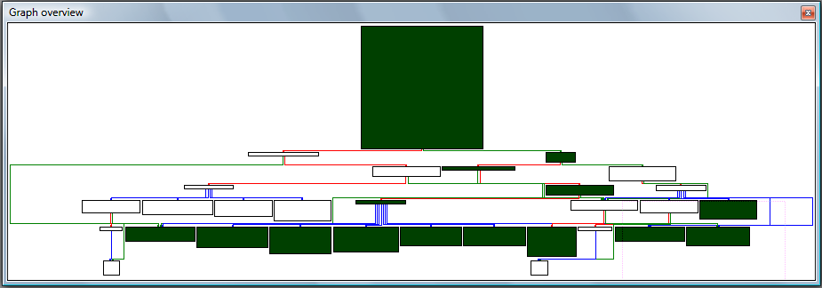
DriverProc Graph
Function graph for a generic codec’s DriverProc
Switch jump on message type
ICM_DECOMPRESS function call here

Slide 15
Writing a Fuzzing Codec
We can write our own proxy codec
  Implement DriverProc
  Retrieve handle to the codec we want to fuzz
typedef LRESULT (CALLBACK *REMOTEDRIVERPROC)(DWORD, HDRVR, UINT, LPARAM, LPARAM);
REMOTEDRIVERPROC hRemoteDriverProc = NULL;
LRESULT CALLBACK DriverProc(DWORD dwID, HDRVR hDriver, UINT uiMessage, LPARAM lParam1, LPARAM lParam2)
{
if (hRemoteDriverProc == NULL)
{
HMODULE hRemoteModule;
hRemoteModule = LoadLibrary("C:\\windows\\system32\\cvid.dll");
hRemoteDriverProc = (REMOTEDRIVERPROC)GetProcAddress(hRemoteModule, "DriverProc");
assert(hRemoteDriverProc != NULL);
}

Slide 16
Writing a Fuzzing Codec (cont.)
Now we can fuzz data frame-by-frame
  Very fast, cool Screensaver
  OutputDebugString is helpful, yay WinDBG
switch(uiMessage)
{
case ICM_DECOMPRESS:
ICDECOMPRESS * icdecomp;
BITMAPINFOHEADER *bmp;
icdecomp = (ICDECOMPRESS *)lParam1;
bmp = (BITMAPINFOHEADER *)icdecomp->lpbiInput;
char foo[818];
sprintf(foo, "old bitmap width is 0x%08x, new is 0x%08x\n", bmp->biWidth, -1);
OutputDebugString(foo);
bmp->biWidth = -1;
// Proxy the modified data to the codec we want to fuzz via the handle
return hRemoteDriverProc(dwID, hDriver, uiMessage, lParam1, lParam2);
}

Slide 17
Writing a Fuzzing Codec (cont.)
Problems
  False positives
    DirectShow verifies certain data, thus a bug you find might not be reachable
DirectShow verifications
  quartz!ValidateBitmapInfoHeader
  quartz!AMValidateAndFixWaveFormatEx
  quartz!CImplStdAviIndex::ValidateStdIndex
  quartz!CImplStdAviIndex::ValidateSuperIndex
Don’t waste CPU cycles…
quartz!ValidateBitmapInfoHeader+0x8b
.text:6C239F38 call MultiplyCheckOverflow(x,x,x) ; if biWidth * biHeight * 200 wraps a DWORD you’re busted here

Slide 18
redacted

Slide 19
redacted

Slide 20
redacted

Slide 21
redacted

Slide 22
redacted

Slide 23
redacted

Slide 24
redacted

Slide 25
redacted

Slide 26
redacted

Slide 27
redacted

Slide 28
redacted

Slide 29
redacted

Slide 30
redacted

Slide 31
redacted

Slide 32
redacted

Slide 33
Demo!

Slide 34
Thank You – Questions…?
dvlabs.tippingpoint.com
aportnoy [.at.] tippingpoint.com

