Slide 1
Black Box Auditing Adobe Shockwave
Aaron Portnoy and Logan Brown, TippingPoint DVLabs
March 9th, 2011: CanSecWest
Notes:
A

Slide 2
Introductions (or lack thereof)
About us
http://dvlabs.tippingpoint.com/team/aportnoy
http://dvlabs.tippingpoint.com/team/lbrown
TippingPoint DVLabs
Security Research / Vuln Discovery
http://dvlabs.tippingpoint.com/appearances
http://dvlabs.tippingpoint.com/advisories/published
Zero Day Initiative
http://www.zerodayinitiative.com
Notes:
A

Slide 3
Preface (purpose of this talk)
Verifying Shockwave vulnerabilities the easy way
…and why it’s only a temporary solution
Auditing an unfamiliar codebase/file format
First approaches and their shortcomings
Individual vs. Team Contributions
“Dumb” fuzzing vs. “Smart” fuzzing
More thorough (and abstract) approaches
Tools developed
Techniques utilized
Lessons learned
Notes:
A
The purpose of this talk is to demonstrate the limits of an uncoordinated approach to both discovering and validating vulnerabilities in an unknown codebase. In doing so, we will walk through both our successful approaches and more importantly, the failed ones. As we begin to understand our limits we realize with greater clarity the work that needed to be done to save ourselves a lot of unnecessary effort. We hope this "story" will serve as a guide to others when they are faced with the task of bughunting in a large binary audit.

Slide 4



Quick Clarification
Firstly, because so many seem to think so…
“Over 450 million Internet-enabled desktops have installed Adobe Shockwave Player.” -Adobe
One helluva botnet
!=
Flash
Notes:
L
When talking about shockwave, we have realized that a lot of people are under the impression that shockwave is the same as flash player. Although they are both media players from adobe, they are completely different code bases. Shockwave is not as widely used as adobe’s flashplayer, but adobe gloats that shockwave is used on over 450 million desktops. It was just a matter of time before we get a submission through our program (the ZDI) in shockwave…

Slide 5
TSRT, meet Shockwave
ZDI submission arrives…
Fuzzed file
No file format documentation
Backtrace shows modules exporting by ordinal
iml32.dll (766 total)
dirapi.dll (368 total)
Our initial questions
Is this exploitable?
Is this a duplicate submission?
Why does the bug occur? How?
Notes:
L
Which brings us to the start of our shockwave... experience *Talk about portal*.Our first submission to the ZDI was simply a fuzz file, with no documentation or analysis. It was pretty much someone saying “Hey, here is a crash I encountered in shockwave. Is it exploitable??”. We actually get these types of submissions frequently, and we are lucky if there is any analysis, or even an offset to the changed data. Usually we can handle analyzing these to determine exploitability. When we receive submissions we have to try to determine what type of vulnerability it is, where the vulnerable code exists, if the vulnerable code has been reported through our program, or has been publicized by a different program, and we have to determine if the vulnerability could be exploitable. Having no analysis, no documentation of the file format, or any idea of how the software works, we generally start by looking at the backtrace to try and get an idea of what is going on. With shockwave, the backtraces show a series of calls to modules defined by ordinal. Most shockwave files go through 2 main modules, iml32, and dirapi. By loading these modules in IDA we see that iml32 has 766 functions exported by ordinal, and dirapi has 368 exported by ordinal. Since the functions are defined by ordinal rather than symbols, the backtrace only helps as a starting point for reversing, but gives no idea of what the code is doing. We now have to start from the crash and work backwards. Our analysis is vital for ensuring we don’t buy a duplicate vulnerability in the future, and for reporting the vulnerable code to the vendor…

Slide 6
TSRT, meet Shockwave (cont.)
What we strive to provide to vendors
Location of faulty code
Smallest possible trigger (PoC)
Values or conditions that should be considered *bad*
Usually requires reversing thoroughly
Before we get into it…
Assume version 11.5.8.612 for the rest of this presentation
Notes:
L
We try to give the vendors as much information as possible. We at least need to provide them with the location of the faulty code, the values that we consider ‘bad’, and a proof of concept that will reliably trigger the bug. From here on out, consider any references to be from version 11.5.8.612. As this was the most up to date version when we started our audit.

Slide 7
First Impressions
Crashes in some obvious structure manipulation
Inside an ordinal in iml32, definitely manipulating heap
No symbols/strings
Standard procedure…
WinDBG !heap extension to the rescue
!heap –p –a <address>
User mode stack trace db should show alloc stack
Notes:
A

Slide 8
!heap WTF
0:008> !heap -p -a @eax
address 03910020 found in
_HEAP @ 150000
HEAP_ENTRY Size Prev Flags UserPtr UserSize - state
03910018 20000 0000 [0b] 03910020 100000 –
Trace: 2712
7c96eed2 ntdll!RtlDebugAllocateHeap+0x000000e1
7c94b394 ntdll!RtlAllocateHeapSlowly+0x00000044
7c918f21 ntdll!RtlAllocateHeap+0x00000e64
7c80ff0f kernel32!GlobalAlloc+0x00000066
690148aa IML32!Ordinal1218+0x0000002a
Notes:
A

Slide 9
!heap WTF
0:008> !heap -p -a @eax
address 03910020 found in
_HEAP @ 150000
HEAP_ENTRY Size Prev Flags UserPtr UserSize - state
03910018 20000 0000 [0b] 03910020 100000 –
Trace: 2712
7c96eed2 ntdll!RtlDebugAllocateHeap+0x000000e1
7c94b394 ntdll!RtlAllocateHeapSlowly+0x00000044
7c918f21 ntdll!RtlAllocateHeap+0x00000e64
7c80ff0f kernel32!GlobalAlloc+0x00000066
690148aa IML32!Ordinal1218+0x0000002a
Whaaa…?
Notes:
A

Slide 10

Well, that sucks
Realization #1
We’re inside a memory manager
Not using the Windows Heap
!heap/PageHeap/etc are of no use to us…
Notes:
A

Slide 11
Verifying the Old Fashioned Way™
Reviewing ZDI bugs is time-sensitive
Researchers expect at most a 3 week turnaround
We receive upwards of 30 vuln submissions per week
How can I verify this quickly?
The faulting instruction is not necessarily useful
Heap corruption often manifests itself in numerous ways
Many crashes are not indicative of the original bug
Red herrings
We need to ensure we don’t buy the same bug twice
Notes:
A

Slide 12
Verifying the Old Fashioned Way™ (cont.)
Screw reversing the memory manager
Could be quite time consuming
It makes more sense to RE from first use of fuzzed data
We must locate where the process reads in the file
Turns out it uses MSVCR71!read
.text:690709C4 call ds:_read (iml32, base 0x69001000)
Shockwave reads bytes in strange increments
Notes:
A

Slide 13

Verifying the Old Fashioned Way™ (cont.)
Possible solution
We could set some clever breakpoints
Grab dst buffer before, search it after call to read
Context switches are expensive
This is a job for… Instrumentation!
Notes:
A

Slide 14
Dynamic Binary Instrumentation
DBI (read: hooking) allows for injection of arbitrary logic
We can hook anywhere with any asm we’d like to run
Nothing new, this has been around since the 80s (or earlier)
Several different instrumentation frameworks out there
DynamoRIO (http://dynamorio.org)
Pin (http://pintool.org)
ERESI (http://www.eresi-project.org)
We have our own internal library for this
What we demonstrate will use ours, but we will explain how one can replicate this using the other frameworks
Notes:
A

Slide 15
Dynamic Binary Instrumentation (cont.)
Basic overview of capabilities
We have the ability to allocate/free memory
Using this, we can “lift” code from within a given module
Hooking implementation
Our code works by patching a far jmp at the desired hook point that jmps to the asm we want to run
Afterwards, we jmp to the lifted code
And then patch a far jmp from the lifted code back to the original module
Notes:
A

Slide 16
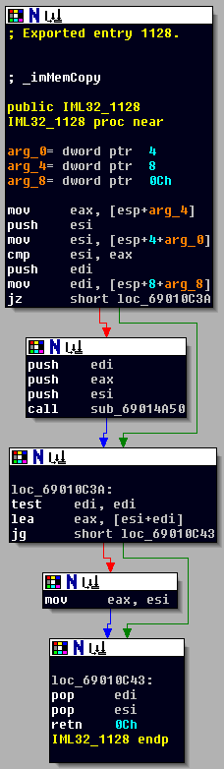
Dynamic Binary Instrumentation (cont.)
VirtualAlloc some memory
0xwhatever:
Notes:
A

Slide 17
Dynamic Binary Instrumentation (cont.)
VirtualAlloc some memory
0xwhatever:
Lift original code
Notes:
A

Slide 18
Dynamic Binary Instrumentation (cont.)
VirtualAlloc some memory
0xwhatever:
jmp IML32_1128+0x05
Write a long jump back
Notes:
A

Slide 19
Dynamic Binary Instrumentation (cont.)
VirtualAlloc some memory
0xwhatever:
jmp IML32_1128+0x05
0xwhatever2:
<our asm logic>
Write the code we
want to run to memory
Notes:
A

Slide 20
Dynamic Binary Instrumentation (cont.)
VirtualAlloc some memory
0xwhatever:
jmp IML32_1128+0x05
jmp far 0xwhatever2
0xwhatever2:
<our asm logic>
Inject a long
jump to it
Notes:
A

Slide 21
Dynamic Binary Instrumentation (cont.)
VirtualAlloc some memory
0xwhatever:
jmp IML32_1128+0x05
jmp far 0xwhatever2
0xwhatever2:
<our asm logic>
jmp 0xwhatever
Write a jump to
lifted code
Notes:
A

Slide 22
Hooking file reads
First approach
Hook Shockwave when it calls read
Save the dst buffer and size
Hook after the read call and search the buffer
For the fuzzed file data
This works well, but there’s a better generic solution…
Hook MSVCR71!read itself
This allows us to re-use the hook for other projects
Turned out to be quite helpful later on…
Notes:
A

Slide 23
Hooking file reads (cont.)
MSVCR71.dll version 7.10.3052.4, base 0x7C341000
Hook #1
.text:7C36364F mov eax, ebx
Near the prologue, lets us grab the arguments
Hook #2
.text:7C3636BA jmp short loc_7C3636DD
Near the epilogue, lets us search the populated buffer
Notes:
A

Slide 24
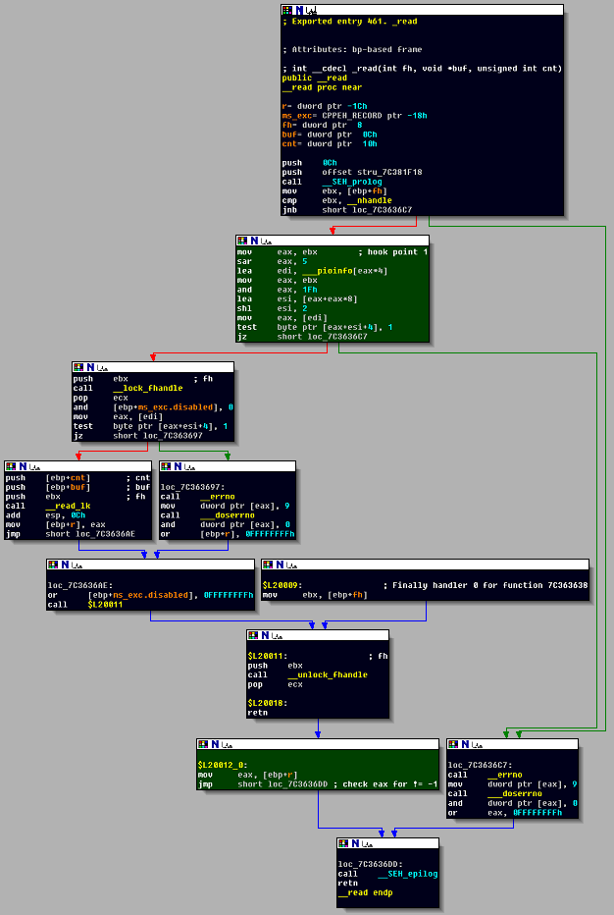
Hooking file reads (cont.)
Notes:
A

Slide 25
Hooking file reads (cont.)
[BITS 32]
push ecx
push esi
mov ecx, [esp+0x14]
mov esi, [esp+0x10]
mov [_symCount], ecx
mov [_symBuf], esi
pop esi
pop ecx
Notes:
A

Slide 26
Hooking file reads (cont.)
[BITS 32]
pushad
pushfd
mov ecx, [_symCount]
mov esi, [_symBuf]
shr ecx, 2
mov eax, _symNeedle
TEXT
.loop
cmp [esi], eax
jnz .increment
jmp .success
.increment
lea esi, [esi+4]
dec ecx
jz .fail
jmp .loop
.success
int3
.fail
jmp .exit
.exit
popfd
popad
Notes:
A

Slide 27

Hooking file reads (cont.)
The asm just shown is assembled using nasm
The resulting opcodes are injected using our framework
The static addresses/values shown are replaced dynamically when we inject
Thanks, Python
Notes:
A

Slide 28
Hooking file reads (cont.)
The hooks are inserted once the process is loaded
The assembly will throw an INT3 (breakpoint) when it finds the DWORD we were looking for
Requires that MSVCR71 is loaded into memory
sxe ld:msvcr71 in WinDBG, then inject
Once the data has been read in, we can begin RE
Set a memory breakpoint at @esi
ba r1 @esi
Shockwave will usually hit some inline memcpys before really using the data, just set extra bps
Notes:
A

Slide 29
Hooking file reads (cont.)
File data (note the 0x0000dc50):
0000h: 52 49 46 58 00 00 DC 50 4D 56 39 33 69 6D 61 70 RIFX..ÜPMV93imap
0010h: 00 00 00 18 00 00 00 01 00 00 00 2C 00 00 07 3A ...........,...:
0020h: 00 00 00 00 00 00 00 00 00 00 00 00 6D 6D 61 70 ............mmap
Injecting our msvcr71 hook:
S:\Tools\hooking>python.exe -i read_search.py 812 0x0000dc50
[*] Injecting hooks
[*] Successfully injected
>>>
Notes:
A

Slide 30
Hooking file reads (cont.)
0:015> sxe ld:dirapi
0:015> sxe ld:iml32
0:015> g
ModLoad: 69000000 6910b000 C:\WINDOWS\system32\Adobe\Shockwave 11\IML32.dll
eax=7c37b9b0 ebx=00000000 ecx=7c37d5b8 edx=03b4285f esi=00000000 edi=00000000
eip=7c90e514 esp=025dca04 ebp=025dcaf8 iopl=0 nv up ei ng nz ac pe nc
cs=001b ss=0023 ds=0023 es=0023 fs=003b gs=0000 efl=00000296
ntdll!KiFastSystemCallRet:
7c90e514 c3 ret
0:008> g
(32c.210): Break instruction exception - code 80000003 (first chance)
eax=50dc0000 ebx=00000000 ecx=00001fff edx=03b71fc0 esi=04712a10 edi=04712a0c
eip=03b60089 esp=025dbaa4 ebp=00000003 iopl=0 nv up ei pl zr na pe nc
cs=001b ss=0023 ds=0023 es=0023 fs=003b gs=0000 efl=00000246
03b60089 cc int 3
0:008> dc esi L3
04712a10 50dc0000 3339564d 70616d69 ...PMV93imap
Notes:
A

Slide 31
Hooking file reads (cont.)
0:015> sxe ld:dirapi
0:015> sxe ld:iml32
0:015> g
ModLoad: 69000000 6910b000 C:\WINDOWS\system32\Adobe\Shockwave 11\IML32.dll
eax=7c37b9b0 ebx=00000000 ecx=7c37d5b8 edx=03b4285f esi=00000000 edi=00000000
eip=7c90e514 esp=025dca04 ebp=025dcaf8 iopl=0 nv up ei ng nz ac pe nc
cs=001b ss=0023 ds=0023 es=0023 fs=003b gs=0000 efl=00000296
ntdll!KiFastSystemCallRet:
7c90e514 c3 ret
0:008> g
(32c.210): Break instruction exception - code 80000003 (first chance)
eax=50dc0000 ebx=00000000 ecx=00001fff edx=03b71fc0 esi=04712a10 edi=04712a0c
eip=03b60089 esp=025dbaa4 ebp=00000003 iopl=0 nv up ei pl zr na pe nc
cs=001b ss=0023 ds=0023 es=0023 fs=003b gs=0000 efl=00000246
03b60089 cc int 3
0:008> dc esi L3
04712a10 50dc0000 3339564d 70616d69 ...PMV93imap
File data
Notes:
A

Slide 32
Back to the bug
After using our hook, we were able to find the parser
At this point it was just some simple reversing to see how our value was used
Luckily for us, we could see the logical flaw quickly
What’s all this ordinal nonsense?
We did notice a lot of calls to ordinals from dirapi->iml32
…and we naively assumed we wouldn’t have to reverse them (‘cause who wants to RE a memory manager?)
Brett Moore
Matt Conover
Chris Valasek & John McDonald
Nico Waisman
Sean Heelan & Agustin Gianni
Notes:
A

Slide 33

Back to the bug (cont.)
So, we finished the verification and moved on
We reflected on the process and were satisfied with a 4 day turnaround time
Notes:
A

Slide 34
Where the wild things are
Where there is one bug, there are more
At this point, we decided to try our hand at fuzzing
First, though, we wanted to dissect the file format
No point in fuzzing compressed data
It would be nice to tie crash results back to file format structures
Notes:
L
Through Aarons verification of the case, we realized that shockwave has a rather large attack surface, and there are more than likely many more bugs. Since I really like fuzzing file formats, we decided that shockwave would be a good target for the fuzzers. When I am going to point the fuzzers at a new target, I like to get an idea of the file format so that im not blindly bit flipping. The very first thing I look for is compression. Sure enough shockwave handles 2 different file formats, dcr, and dir…

Slide 35
Director file format
Shockwave files are made in Director Studio
Hence the .dir extension
.dcr for zlib-compressed
The DIR format is essentially RIFF
Actually, it’s big endian RIFF (denoted by RIFX magic)
Like AVI, just a container format
We were somewhat familiar with this from our prior research on DirectShow
Notes:
L
Adobe Director Studio is responsible for generating the dcr and dir file formats that are played through shockwave. The dcr files are zlib-compressed data, and dir is uncompressed. At first glance, we noticed the RIFX header. We know this format is big endian RIFF container format. Aaron had done prior research on DirectShow, so he was pretty familiar with this format.

Slide 36
RIFX format
0000h: 52 49 46 58 00 00 DC 50 4D 56 39 33 69 6D 61 70 RIFX..ÜPMV93imap
0010h: 00 00 00 18 00 00 00 01 00 00 00 2C 00 00 07 3A ...........,...:
0020h: 00 00 00 00 00 00 00 00 00 00 00 00 6D 6D 61 70 ............mmap
0030h: 00 00 0F E0 00 18 00 14 00 00 00 CA 00 00 00 97 ...à.......Ê...—
0040h: 00 00 00 90 FF FF FF FF 00 00 00 68 52 49 46 58 ...ÿÿÿÿ...hRIFX
0050h: 00 00 DC 50 00 00 00 00 00 01 00 00 00 00 00 00 ..ÜP............
0060h: 69 6D 61 70 00 00 00 18 00 00 00 0C 00 01 00 00 imap............
0070h: 0A AF D9 24 6D 6D 61 70 00 00 0F E0 00 00 00 2C .¯Ù$mmap...à...,
0080h: 00 00 00 00 0A AF B0 AC 4B 45 59 2A 00 00 02 28 .....¯°¬KEY*...(
0090h: 00 00 10 14 00 00 00 00 00 00 00 00 43 41 53 74 ............CASt
00A0h: 00 00 1D 2C 00 00 38 B6 00 00 00 00 00 00 00 00 ...,..8¶........
00B0h: 66 72 65 65 00 00 00 00 00 00 00 00 00 0C 00 00 free............
00C0h: 00 00 00 75 66 72 65 65 00 00 00 00 00 00 00 00 ...ufree........
00D0h: 00 0C 00 00 00 00 00 05 66 72 65 65 00 00 00 00 ........free....
00E0h: 00 00 00 00 00 0C 00 00 00 00 00 06 66 72 65 65 ............free
Notes:
L
RIFF format is a container format that chunks out its data and references FourCC headers to determine the data type. The chunks are structures that can contain substructures

Slide 37
RIFX format (cont.)
0000h: 52 49 46 58 00 00 DC 50 4D 56 39 33 69 6D 61 70 RIFX..ÜPMV93imap
0010h: 00 00 00 18 00 00 00 01 00 00 00 2C 00 00 07 3A ...........,...:
0020h: 00 00 00 00 00 00 00 00 00 00 00 00 6D 6D 61 70 ............mmap
0030h: 00 00 0F E0 00 18 00 14 00 00 00 CA 00 00 00 97 ...à.......Ê...—
0040h: 00 00 00 90 FF FF FF FF 00 00 00 68 52 49 46 58 ...ÿÿÿÿ...hRIFX
0050h: 00 00 DC 50 00 00 00 00 00 01 00 00 00 00 00 00 ..ÜP............
0060h: 69 6D 61 70 00 00 00 18 00 00 00 0C 00 01 00 00 imap............
0070h: 0A AF D9 24 6D 6D 61 70 00 00 0F E0 00 00 00 2C .¯Ù$mmap...à...,
0080h: 00 00 00 00 0A AF B0 AC 4B 45 59 2A 00 00 02 28 .....¯°¬KEY*...(
0090h: 00 00 10 14 00 00 00 00 00 00 00 00 43 41 53 74 ............CASt
00A0h: 00 00 1D 2C 00 00 38 B6 00 00 00 00 00 00 00 00 ...,..8¶........
00B0h: 66 72 65 65 00 00 00 00 00 00 00 00 00 0C 00 00 free............
00C0h: 00 00 00 75 66 72 65 65 00 00 00 00 00 00 00 00 ...ufree........
00D0h: 00 0C 00 00 00 00 00 05 66 72 65 65 00 00 00 00 ........free....
00E0h: 00 00 00 00 00 0C 00 00 00 00 00 06 66 72 65 65 ............free
Notes:
L
The structure FourCCs are highlighted. The un-highlighted data is structure, and substructure data. In the data there are structure specifiers(size, offset, structure type).

Slide 38
RIFX parsing
We can use the MSVCR71!read injection to find the parser
Set the needle to ‘RIFX’
Turns out, the parser begins in the dirapi module
Dirapi ordinal number 82
Also responsible for calling memory manager init
Notes:
L
Now that we have an understanding of the file format, we need to determine where the data is read, and how it is parsed. To accomplish this we can use the MSVCR71!read injection with the needle set to RIFX, to find the parser. The debugger ends up breaking inside dirapi!ordinal_82. This function is not only the parser, but it is also responsible for calling the memory manager. Since this function handles so much data, it is rather large…

Slide 39
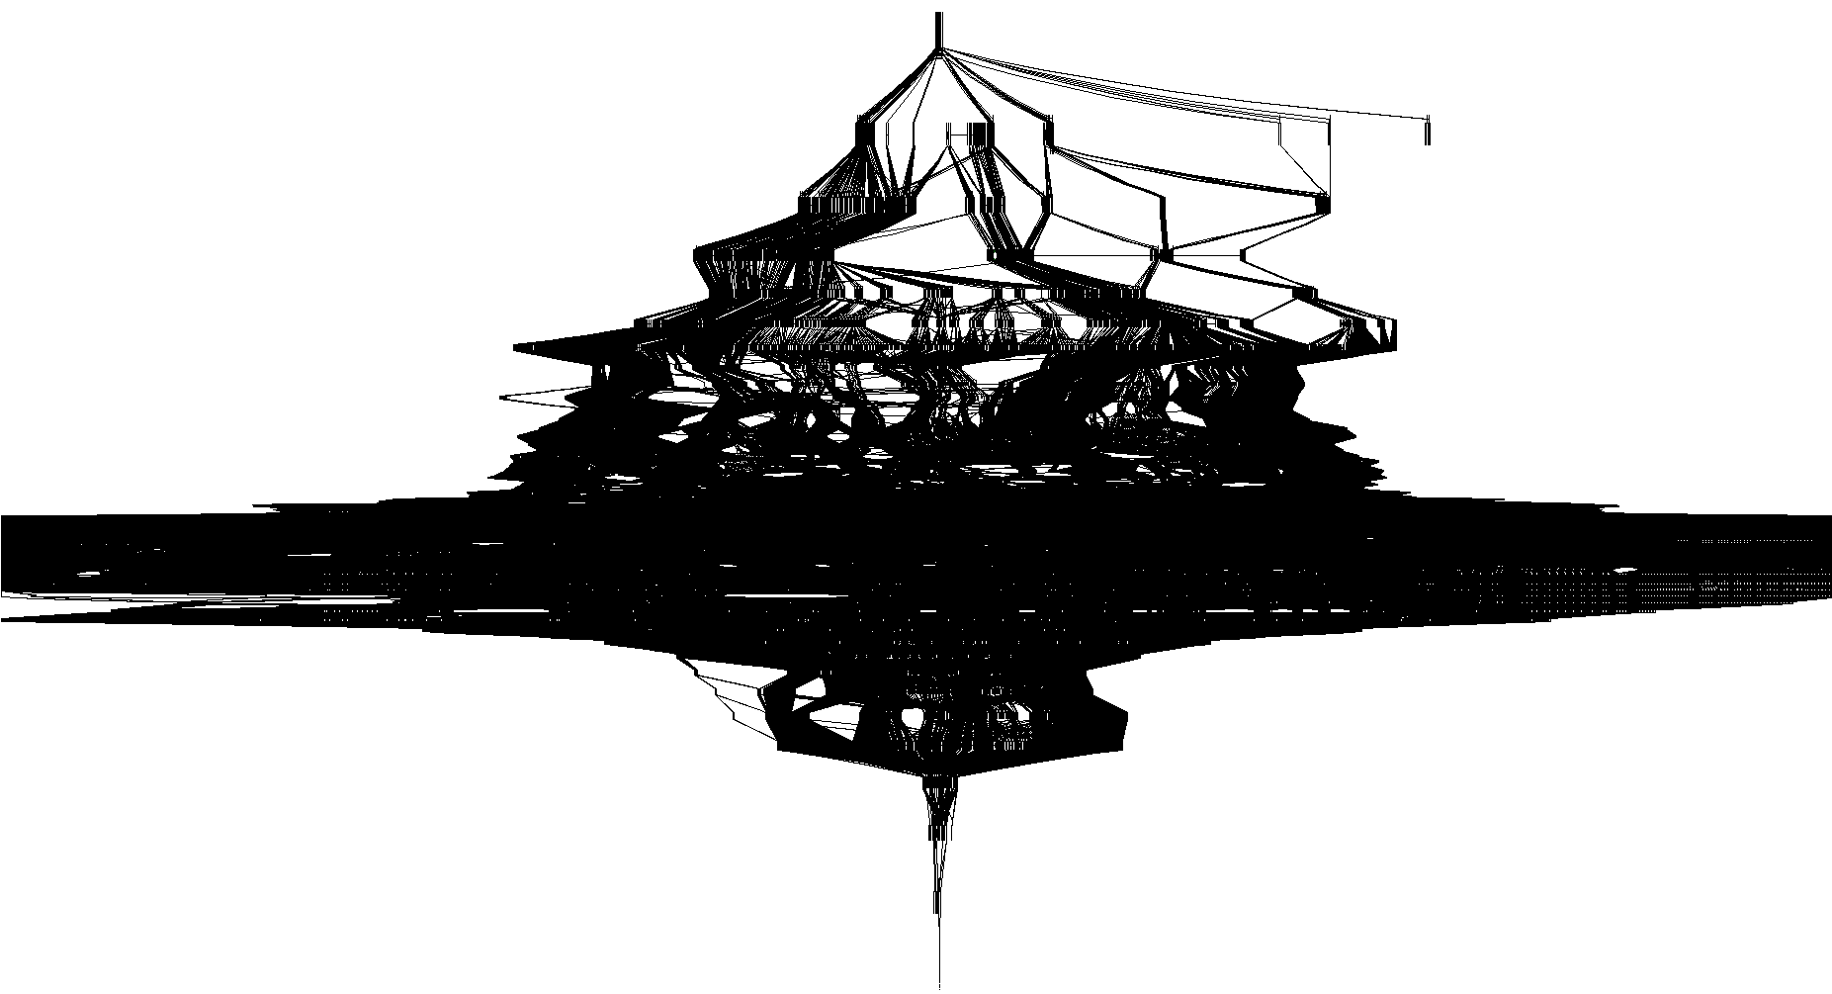
Dirapi!Ordinal_82
5926 nodes
323176 edges
Notes:
L
Really large, actually. Almost 6,000 nodes and 32,000 edges

Slide 40
Dirapi!Ordinal_82
Let’s zoom here…
Notes:
L
This view is rather abstract though. We cant really see the nodes. So lets pick a spot and zoom in.

Slide 41
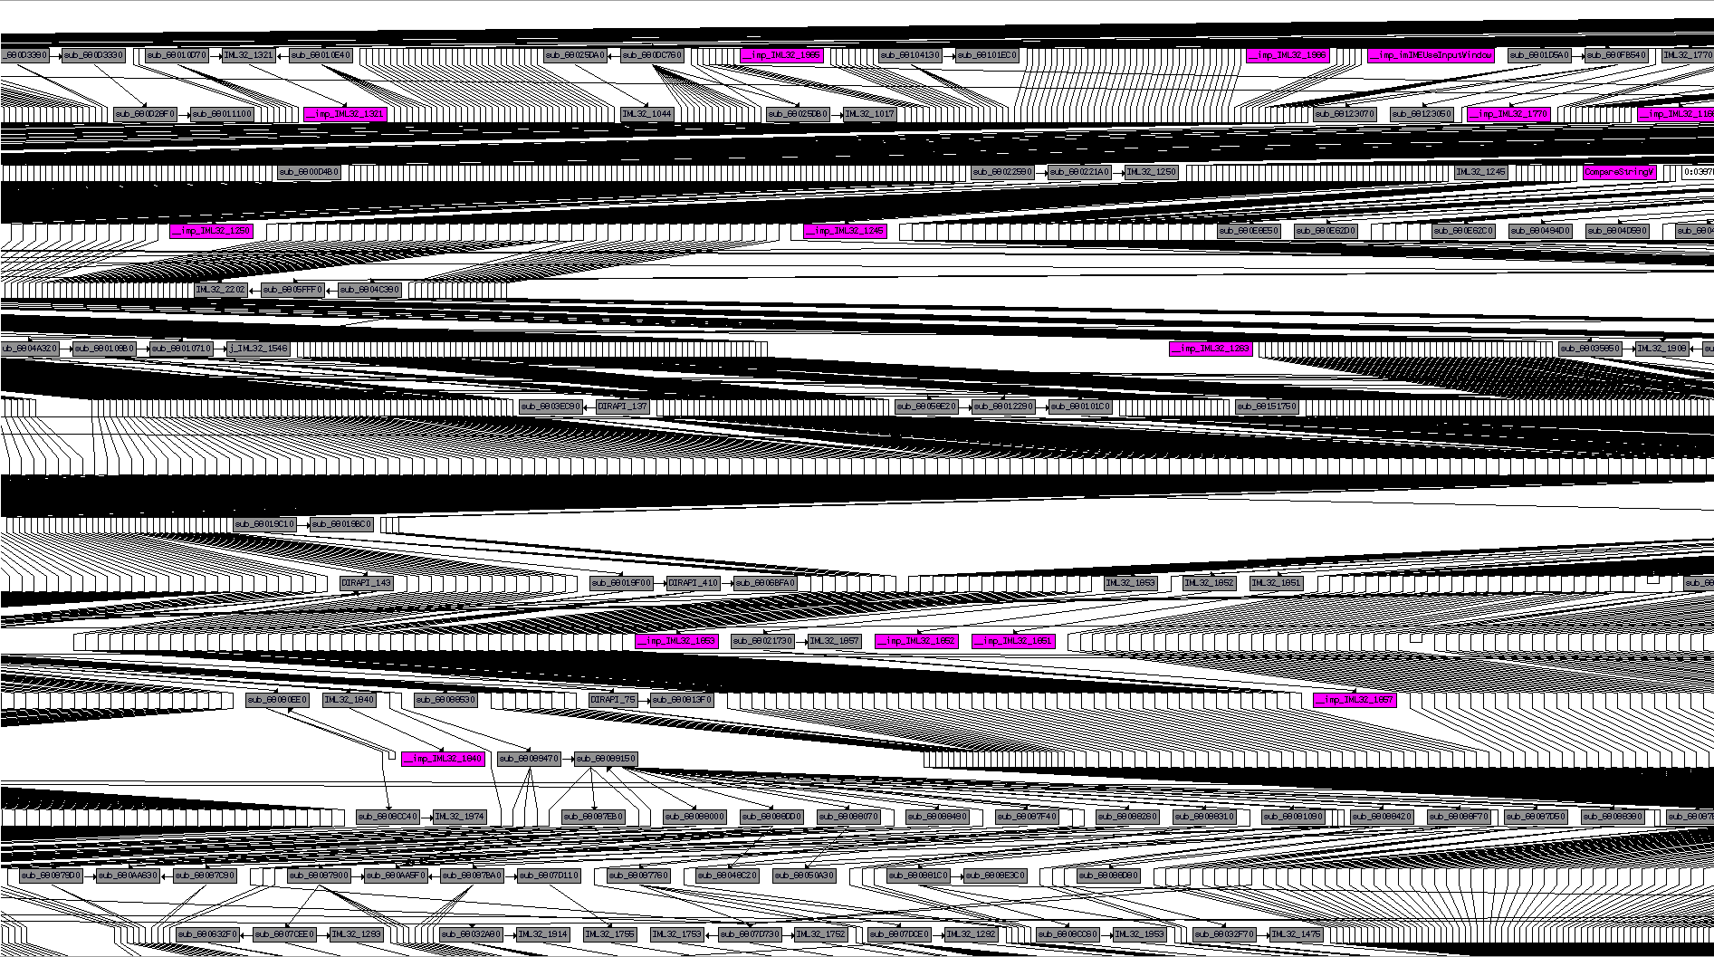
Dirapi!Ordinal_82 (cont.)
Notes:
L
Here we can actually see the nodes, and get an idea of just how big the ordinal 82 function is…

Slide 42
Reversing the parser
There’s no way we want to step through all this
As the file format is based on chunks, we should be able to isolate the code we care about
Enter IDAPython
FourCC finding code is simple to implement
Find all cmp reg32, immediate
Notes:
L
As you can imagine, the function is way to large for us to manually step through it all, so we want to look for the code relative to the FourCCs we know about. Finding the FourCCs is relatively trivial. We just have to search for all the compare reg32, to an immediate value. All we have to do is write some code to do this for us, and boom.

Slide 43
Reversing the parser (cont.)
Turns out there are quite a few
We can use IDA’s new simplecustviewer_t to display them
We’ll release the code to do so
For reference: http://www.hexblog.com/?p=119
Also, an 010 template is available
http://www.sweetscape.com/010editor/
E-mail us for it
Notes:
A

Slide 44
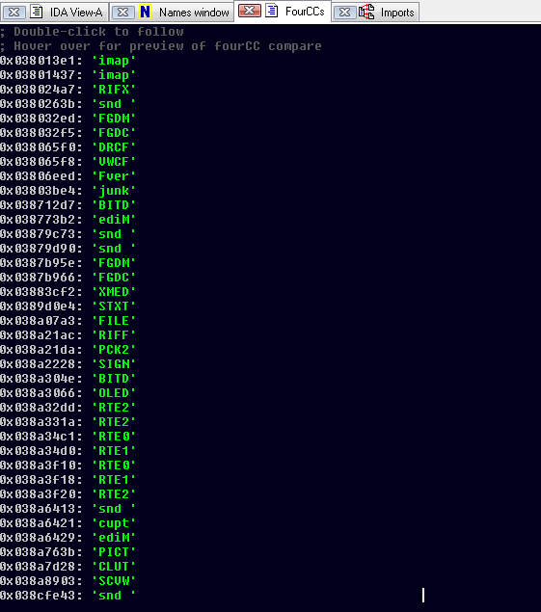
Reversing the parser (cont.)
Notes:
A

Slide 45
Enumerating the attack surface
We noticed many FourCCs that weren’t .dir specific
We realized Shockwave also parses other formats
Specifically, it downloads “asset files” on-demand
These can be identified by their .x32 extensions
Sniff the network traffic and you can see them being pulled from the Shockwave servers
You don’t have that vulnerable component?
Let me download that for you…
Notes:
A

Slide 46
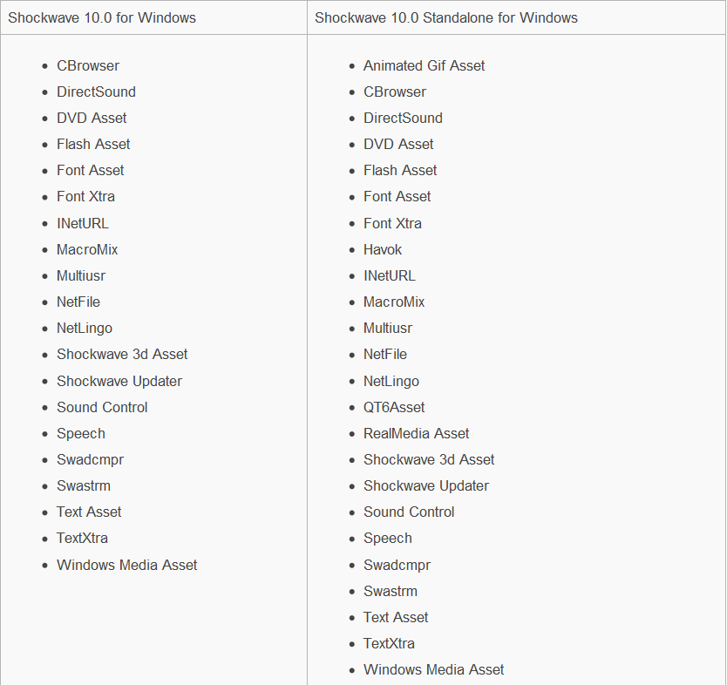
Enumerating the attack surface (cont.)
Slim vs Full Shockwave (here be dragons)
Notes:
A

Slide 47
Enumerating the attack surface (cont.)
Zef and I spent a weekend investigating this
Shockwave downloads package files ending in .w32 when required
These are ZLIB compressed
They contain the .x32 asset modules (PE format)
We tried MitM’ing the connection (evilgrade)
But it turns out there is an embedded certificate in the CERT chunk
And it’s legit
Notes:
A

Slide 48
Enumerating the attack surface (cont.)
0000h: 52 49 46 46 00 06 9D 4F 50 43 4B 32 49 4E 46 4F RIFF..OPCK2INFO
0010h: 00 00 00 A2 00 00 00 18 00 00 00 03 00 00 00 00 ...¢............
0020h: 00 00 00 00 00 00 00 9B 00 00 00 8A 78 DA 35 CB .......›...ŠxÚ5Ë
0030h: 3B 12 82 30 10 00 D0 3D CA 96 DA F0 0B 82 D8 59 ;.‚0..Ð=Ê–Úð.‚ØY
0040h: DA D8 C0 38 B6 F9 AC C2 38 10 66 B3 18 BD BD 69 ÚØÀ8¶ù¬Â8.f³.½½i
0050h: EC DF 1B E8 23 77 61 0D 67 E7 0D 61 FF 0D 42 73 ìß.è#wa.gç.aÿ.Bs
0060h: C0 CB 62 3D AF 9E B5 90 83 E1 6F E0 46 3C F5 D3 ÀËb=¯žµƒáoàF<õÓ
0070h: 73 C1 81 B7 20 78 25 89 9E 5F 09 70 3A FE 81 5B sÁ· x%‰ž_.p:þ[
0080h: 20 D4 82 A3 C8 1A 4E 79 1E 63 CC DE A9 84 54 32 Ô‚£È.Ny.cÌÞ©„T2
0090h: EB E7 9C 57 8D 3B BB 2F 6A 00 E5 AA CA E8 C6 18 ëçœW;»/j.åªÊèÆ.
00A0h: 65 0A 7B B0 65 D5 76 D4 D6 CD D1 2A D7 36 54 76 e.{°eÕvÔÖÍÑ*×6Tv
00B0h: 00 3F B9 E7 33 16 46 4C 53 54 00 00 00 24 00 00 .?¹ç3.FLST...$..
00C0h: 00 08 00 00 00 01 00 00 00 00 54 65 78 74 58 74 ..........TextXt
00D0h: 72 61 2E 78 33 32 00 31 31 2E 35 2E 38 72 36 31 ra.x32.11.5.8r61
00E0h: 32 00 53 49 47 4E 00 00 00 40 23 87 1A 11 A1 E9 2.SIGN...@#‡..¡é
00F0h: D1 75 BE EE 08 BA E6 73 89 6A 2E 58 B0 CE EA 53 Ñu¾î.ºæs‰j.X°ÎêS
0100h: E1 BA D5 16 94 4D 28 7C 7B C8 AD 1F 16 D6 60 D0 áºÕ.”M(|{È­..Ö`Ð
0110h: 48 BB 25 9A C7 22 C6 68 E3 75 B7 A3 83 01 3C 64 H»%šÇ"Æhãu·£ƒ.<d
0120h: BC 1C FC 9B FB C7 D7 0A 89 2C 43 45 52 54 00 00 ¼.ü›ûÇ×.‰,CERT..
Notes:
A

Slide 49
Generating sample files
We turned back to .dir and decided we needed samples
So we pulled in Derek on our team to learn Director Studio
He would then hand these off to Logan for fuzzing
It’s nice having a team…
By using Director Studio Derek was able to embed data
3D assets
Fonts
Images
Videos
Lingo
…
Notes:
L
We continued our focus on the dir file format. Up until now we had utilized aaron’s snagger code to pull input files using google’s api. But we needed our input files to have as much diversity as possible, so that we could hit the most code as we could. For this we turned to the team. We pulled in Derek to get familiar with Director Studio and produce input files for the fuzzer. Through some minor trials and tribulations he was able to produce dir files with 3d assets, fonts, images, and Lingo script. Lingo is shockwave’s ECMA like language that allows you to dynamically interact with everything. Very similar to flash’s actionscript

Slide 50
Fuzzing setup
We already had an established fuzzing setup
Physical and virtual machines
Target process launched under pydbg
IRC bot receives crash information from fuzzer
Bot also accepts commands
Switch target
Change values/methods
Add/remove machines
…
Simple bit-flipping was surprisingly successful
About 2500 crashes from the initial run
Notes:
L
Now that we have proper input files, we need to load them into our fuzzer. Our fuzzer consists of 20 plus virtual machines and real machines all networked together, and controlled by the ‘Master Fuzz’ IRC bot. Master Fuzz has the ability to send commands to all the fuzz boxes instructing them to start/stop fuzzing, update code, report progress, and receive input files. Master Fuzz is also responsible for receiving all crashes, and binning them into a database. The fuzzers launch the specified process using pydbg, and simply flips bits. This method of fuzzing, although considered ‘dumb’ fuzzing, actually turned out more than 2500 crashes on its first run..

Slide 51
Crowd sourcing vulnerability verification
Right around this time we were about to go to Recon
We had been toying with the idea of running a contest there
We decided it would be interesting to crowd source vuln analysis
We selected 10 of our Shockwave bugs
… and gave them out to the conference goers
Those who proved exploitability first were awarded $2500 USD
TPTI-10-12 - Adobe Shockwave TextXtra Allocator Integer Overflow Remote Code Execution Vulnerability
TPTI-10-11 - Adobe Shockwave tSAC Chunk Pointer Offset Memory Corruption Remote Code Execution Vulnerability
TPTI-10-10 - Adobe Shockwave tSAC Chunk Invalid Seek Memory Corruption Remote Code Execution Vulnerability
TPTI-10-09 - Adobe Shockwave CSWV Chunk Memory Corruption Remote Code Execution Vulnerability
Notes:
L
Shortly after the fuzz boxes finished going through the input files, we had Recon coming up, and we had been talking about hosting a contest there. We thought it would be a good opportunity, and a good venue, to test an independent researchers reversing skills, and crowd sourcing. We glanced through our crash files, and selected 10 of the write violations that seemed like they would be exploitable. We would then sign up contestants to join our program, and handed them the shockwave crashes. The first of the contestants to prove exploitability would receive $2500 through our program, and get credit attached to the disclosure.

Slide 52
Efficiency++
While we were at Recon we improved our fuzzer
We modified it to be RIFF chunk aware
Fuzzing chunk sizes, substructure counts, and so on
When we returned to TX we had many more crashes
Around 4000 new crashes or so
We decided to improve our crash binning to keep up
Notes:
L
The contest was such a success, we were motivated to make the fuzzer smarter and find some better bugs. We decided that the fuzzer should be chunk aware, and fuzz more than just the chunk data, but fuzz the chunk size specifies, substructure counts, and so on. When we got back to texas, we reran the fuzzers, and turned up more than 4000 crashes. The number of crashes were getting a little out of hand, and we required a better method for binning them.

Slide 53
Crash binning
The purpose of binning is to determine uniqueness
Violation type (read/write/execute)
Faulting address (module)
Faulting instruction and surrounding disassembly
Hex dump of relevant file data
Call stack
Utilizing chunk knowledge to bin
One of the best characteristics to determine uniqueness was the chunk our fuzzed data was within
Notes:
L
In an effort to divide up the crashes, and determine uniqueness, we decided to change from crash binning based only on the crash dump, to binning the crashes based on the file data that was modified. We would still utilize the data from the crash report to determine the violation type, faulting address, instruction, surrounding disassembly, and call stack, but we would add the name of the chunk that we modified, the value, and the original bytes.

Slide 54
Injection + Fuzzing = Winning
Memory layout assumptions
We’re within a browser thus we can influence lower memory ranges
If the crash is attempting a read of these addresses, a heap spray may allow us to populate that memory
We can use injection to “simulate” a heap spray
By hooking ntdll!KiUserExceptionDispatcher
Rewriting access violations as they happen
Allocating memory on-demand
Notes:
A

Slide 55
Injection + Fuzzing = Winning (cont.)
From MSDN:
If the attempted read address is within our range…
We inject a call to VirtualAlloc and then inline memset the buffer
Then we return execution to the process as if nothing happened
This has turned quite a few read violations into writes
Which are indicative of exploitable vulnerabilities
typedef struct _EXCEPTION_RECORD {
DWORD ExceptionCode;
DWORD ExceptionFlags;
struct _EXCEPTION_RECORD *ExceptionRecord;
PVOID ExceptionAddress;
DWORD NumberParameters;
ULONG_PTR ExceptionInformation[EXCEPTION_MAXIMUM_PARAMETERS];
} EXCEPTION_RECORD, *PEXCEPTION_RECORD;
Notes:
A

Slide 56
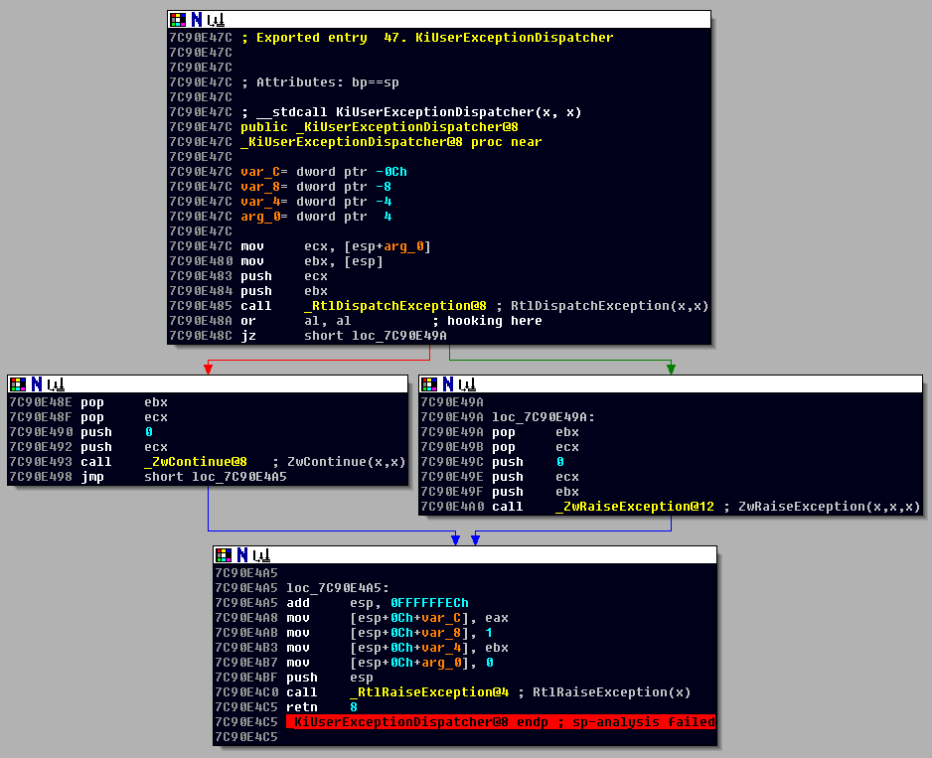
Injection + Fuzzing = Winning (cont.)
Tested on ntdll.dll version 5.1.2600.5755
We inject at 0x7C90E48A, base 0x7C901000
Notes:
A

Slide 57
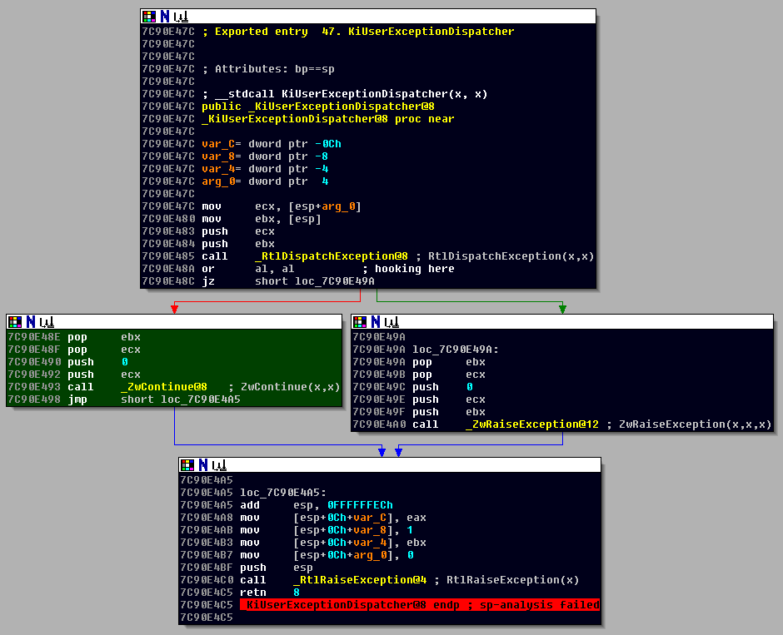
Injection + Fuzzing = Winning (cont.)
If we decided to call VirtualAlloc and pass execution back to the process, we jump to ZwContinue
Notes:
A

Slide 58
Fuzzing DIR files
Analyzing 4000 crashes is time consuming
Extrapolate: the 1st ZDI bug took 4 days, these’d take ~44 years
Yes, that’s hyperbole
Thankfully, due to Logan’s crash binning, we had a plan
We reversed the obviously exploitable bugs
And published them:
TPTI-10-13 - Adobe Shockwave Director tSAC Chunk Remote Code Execution Vulnerability
TPTI-10-14 - Adobe Shockwave Director rcsL Chunk Pointer Offset Remote Code Execution Vulnerability
TPTI-10-15 - Adobe Shockwave Director mmap Trusted Chunk Size Remote Code Execution Vulnerability
TPTI-11-01 - Adobe Shockwave dirapi.dll IFWV Trusted Offset Remote Code Execution Vulnerability
TPTI-11-02 - Adobe Shockwave TextXtra Invalid Seek Remote Code Execution Vulnerability
TPTI-11-03 - Adobe Shockwave Font Xtra String Decoding Remote Code Execution Vulnerability
TPTI-11-05 - Adobe Shockwave PFR1 Font Chunk Parsing Remote Code Execution Vulnerability
Notes:
L
Its really nice that we have so many crashes. And we have done a lot of work on figuring out how to make Shockwave crash. However, with our current methods for verification, and analyzing crashes, assuming it would take an average of 4 days per case, we can extrapolate that it would take close to 44 years to go through 4000 crashes… That’s a long time. We took advantage of the crash binning reports, and verified 7 of the exploitable bugs, and published them.

Slide 59
Fuzzing DIR files
Once these were disclosed publicly, ZDI ramped up
For the rest of 2010 we received a Shockwave bug every two days
Now we had a bigger problem
We could no longer idly sit on our thousands of crashes
ZDI researchers expect a quick turnaround
We have to ensure the bugs are unique
Notes:
L
Our researchers apparently take note of what we publish. Closely following our publications, we started receiving new shockwave reports through our program at an average of one case every two days. We realized that we could no longer sit on our enormous pile of crashes, and rely on our method for verification. We need to speed up the process, and ensure that we arent going to purchase duplicate bugs of past cases, or crashes we have already found.

Slide 60
Shockwave memory manager, revisited
We came to a conclusion
We had to reverse the memory manager
At least well enough to track allocations
Only way to be sure of uniqueness
Luckily we had a starting point
As all heap allocations come from a GlobalAlloc we could just bp there and start reversing
Notes:
L
In order to really be able to determine uniqueness, we had to understand the memory manager, to at least be able to track allocations. We decided that the best starting point would be to break on a call to GlobalAlloc, since all heap allocations rely on GlobalAlloc

Slide 61
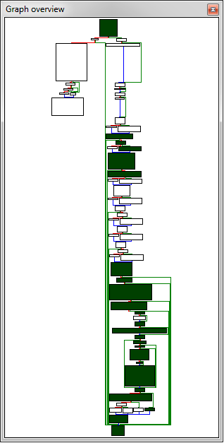
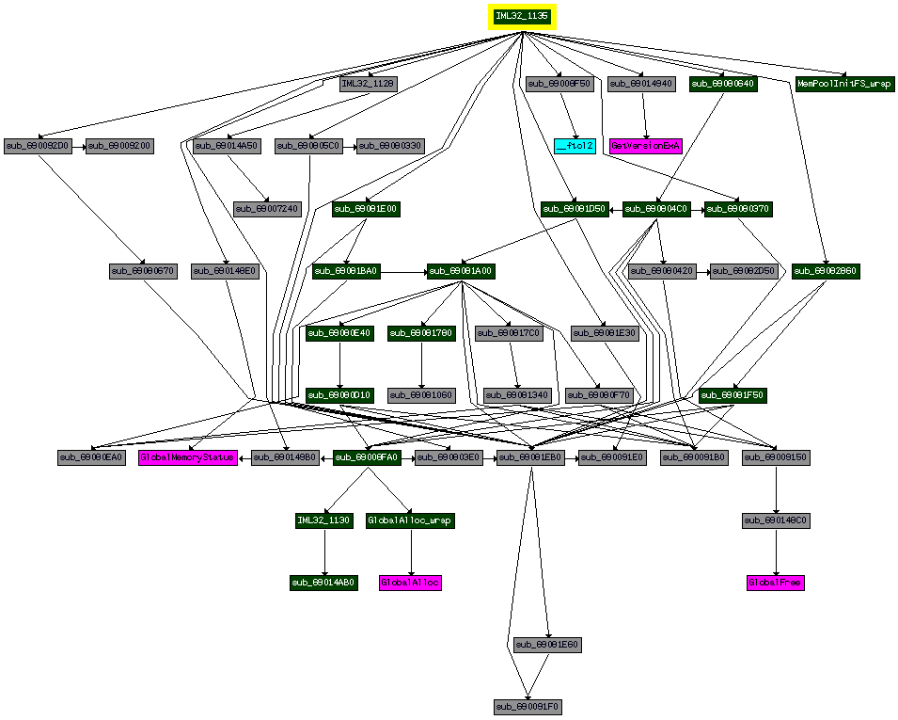
Shockwave memory manager, revisited
Turns out, the call to GlobalAlloc wrappers is in iml32
More importantly, it appears as though Ordinal 1135 is the init
Notes:
A

Slide 62
Shockwave memory manager, revisited
Breakpoint 0 hit
eax=00000000 ebx=00000000 ecx=00000000 edx=00004008 esi=00004008 edi=7c80fdcd
eip=7c80fdcd esp=025dd470 ebp=00004000 iopl=0 nv up ei pl zr na pe nc
cs=001b ss=0023 ds=0023 es=0023 fs=003b gs=0000 efl=00000246
kernel32!GlobalAlloc:
7c80fdcd 6a1c push 1Ch
0:008> kv
ChildEBP RetAddr Args to Child
025dd46c 690148aa 00000030 00004008 00004008 kernel32!GlobalAlloc
025dd480 69009071 00004008 00000001 00009100 IML32!Ordinal1218+0x2a
025dd49c 690804e0 00004000 00009100 00000001 IML32!Ordinal9233+0x9071
00000000 00000000 00000000 00000000 00000000 IML32!Ordinal2064+0x64d0
0:008> dd @esp L14
025dd470 690148aa 00000030 00004008 00004008
025dd480 00000001 69009071 00004008 00000001
025dd490 00009100 00000000 00008000 00000000
025dd4a0 690804e0 00004000 00009100 00000001
025dd4b0 00000000 00000000 00000000 6900966f
0:008> ub 6900966f L3
IML32!Ordinal1135+0x287:
69009667 52 push edx
69009668 6a20 push 20h
6900966a e8f16f0700 call IML32!Ordinal2064+0x6650 (69080660)
Notes:
A

Slide 63
Shockwave memory manager, revisited
Breakpoint 0 hit
eax=00000000 ebx=00000000 ecx=00000000 edx=00004008 esi=00004008 edi=7c80fdcd
eip=7c80fdcd esp=025dd470 ebp=00004000 iopl=0 nv up ei pl zr na pe nc
cs=001b ss=0023 ds=0023 es=0023 fs=003b gs=0000 efl=00000246
kernel32!GlobalAlloc:
7c80fdcd 6a1c push 1Ch
0:008> kv
ChildEBP RetAddr Args to Child
025dd46c 690148aa 00000030 00004008 00004008 kernel32!GlobalAlloc
025dd480 69009071 00004008 00000001 00009100 IML32!Ordinal1218+0x2a
025dd49c 690804e0 00004000 00009100 00000001 IML32!Ordinal9233+0x9071
00000000 00000000 00000000 00000000 00000000 IML32!Ordinal2064+0x64d0
0:008> dd @esp L14
025dd470 690148aa 00000030 00004008 00004008
025dd480 00000001 69009071 00004008 00000001
025dd490 00009100 00000000 00008000 00000000
025dd4a0 690804e0 00004000 00009100 00000001
025dd4b0 00000000 00000000 00000000 6900966f
0:008> ub 6900966f L3
IML32!Ordinal1135+0x287:
69009667 52 push edx
69009668 6a20 push 20h
6900966a e8f16f0700 call IML32!Ordinal2064+0x6650 (69080660)
@ebp fail
Notes:
A

Slide 64
Shockwave memory manager, revisited
In the process of poking around in 1135…
We noticed an error handler with the 1 useful string in all of Shockwave
…what the hell is SmartHeap?
The function that uses that string provided us with a useful execution path, at the very least
Notes:
A

Slide 65
Intro to SmartHeap
SmartHeap has been around for a while (>20 years)
Made by MicroQuill: http://www.microquill.com/smartheap/index.html
Yet nobody has apparently reversed/documented it
Woo, there’s API documentation!
http://www.microquill.com/kb/docs/01_intro.html
Short-lived victory…
There are 5 different possible APIs
ANSI C
C++
Fixed-size
Pointer-based
Handle-based
Notes:
A

Slide 66
Intro to SmartHeap (cont.)
Unfortunately, we have 0 symbols
We have no simple way of mapping the API docs to the binary
Ordinals are a pain
Also, docs don’t contain any structure definitions
So, as we know iml32 isn’t *just* SmartHeap…
We decided to try to chunk out the abstraction layer that deals with memory management
Luckily, the architecture of SmartHeap lends itself to this task
Notes:
A

Slide 67
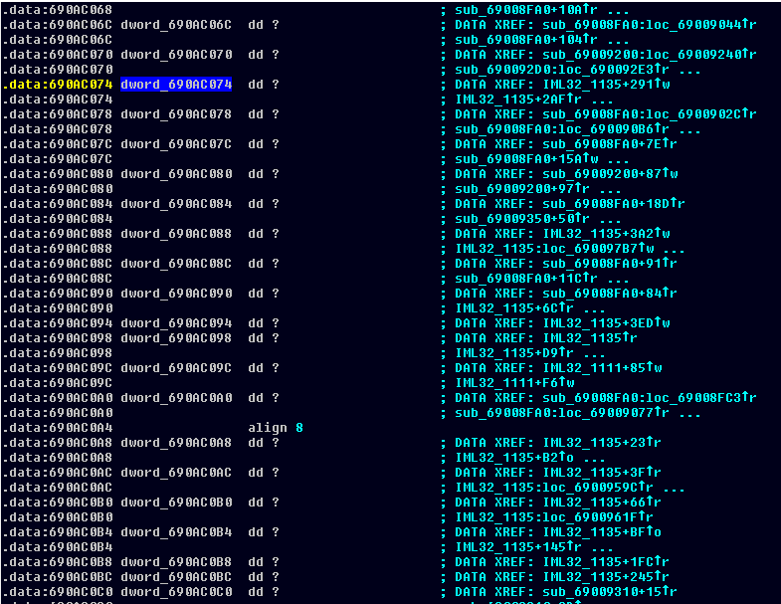
Slicing up iml32.dll
Notes:
A

Slide 68
Slicing up iml32.dll (cont.)
These globals (and their data xrefs) are useful
We can assume functions that xref these are part of the mm
Also, children of these functions
IDAPython to the rescue
Some quick IDApy foo and we’ve got a list of functions
Now what?
Notes:
A

Slide 69
Slicing up iml32.dll (cont.)
At this point, we needed to find certain functionality
Every memory manager should have a malloc and a free
And these should very likely be called during runtime a lot
Let’s make a runtime histogram
From load->unload of iml32
There are 95 functions we care about
We have no idea how often they will be called
We could set breakpoints and increment temp registers…
Or we could hook them and not have to perform a context switch
Notes:
A

Slide 70
Runtime histogram
We first allocate some memory to hold the data
4 bytes * 95 functions = 380 byte allocation
Each function will be assigned an index into this “array” to increment
This works very quickly and we can display it nicely
Using the IDA subview again
pushad
pushf
mov eax, _symArena
mov ebx, _symIndex
inc dword [eax+ebx*4]
popf
popad
Resolved dynamically
upon injection
Notes:
A

Slide 71
PyDbgExt
Flier Lu was kind enough to write PyDbgExt
http://sourceforge.net/projects/pydbgext
Allows us to run Python inside WinDBG
Unfortunately it was quite buggy and required a lot of manually tweaking and recompilation to get working properly
We used PyDbgExt to read the histogram from memory
And write it to disk for importing back to IDA
Notes:
A

Slide 72
PyDbgExt (cont.)
0:008> !load pydbgext
0:008> !help
Help for pydbgext.dll
[Environment]
Extension Image : 0.1.0.48
Python Version : 2.6.6rc1
[Usage]
eval : Evaluate a python expression
import : Import a python module
from : Import a list of symbols from a python module
print : Evaluate and then print a python expression
exec : Execute a python script
help : Shows this help
py : Evaluate a python expression
Notes:
A

Slide 73
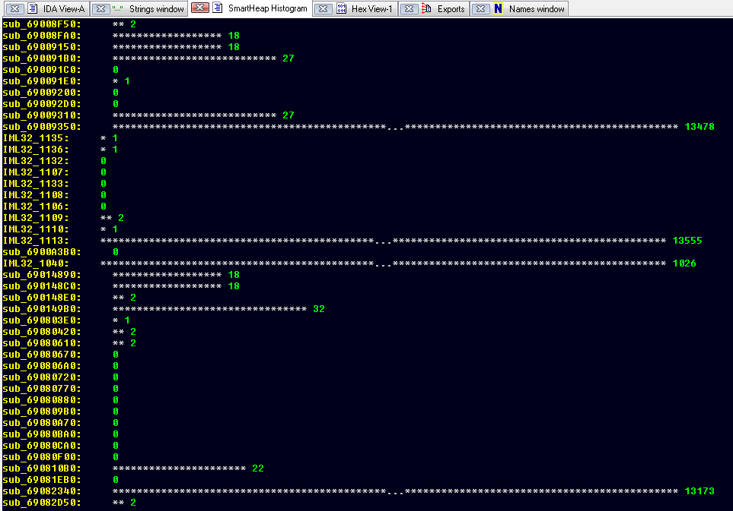
Runtime histogram (cont.)
Notes:
A

Slide 74
Runtime histogram (cont.)
Heap initialization called once
Notes:
A

Slide 75
Runtime histogram (cont.)
One of these is malloc,
one is free, one is realloc
Notes:
A

Slide 76
Reversing the allocator
After checking function prototypes, we found malloc
IML32!Ordinal1111
Except it doesn’t operate like the malloc we know…
We reversed the callers of this function
1111 doesn’t appear to ever return an actual buffer
Instead, it returns a pointer to a structure
Which in turn has a pointer to the buffer that’s used
Notes:
A

Slide 77
Debugging the allocator
Ordinal1111 always returned a pointer from an existing structure
And updated it’s elements
001ee218 001ee204 baadf00d baadf00d baadf00d baadf00d <--- NOT allocated
001ee22c 001ee218 baadf00d baadf00d baadf00d baadf00d <--- NOT allocated
001ee240 001ee22c baadf00d baadf00d baadf00d baadf00d ...
001ee254 001ee240 baadf00d baadf00d baadf00d baadf00d
001ee268 001ee254 baadf00d baadf00d baadf00d baadf00d
001ee27c 001ee268 baadf00d baadf00d baadf00d baadf00d
001ee290 001ee27c baadf00d baadf00d baadf00d baadf00d
001ee2a4 001ee290 baadf00d baadf00d baadf00d baadf00d ...
001ee2b8 001ee2a4 baadf00d baadf00d baadf00d baadf00d <--- NOT allocated
001ee2cc 045cffe0 00000030 baad0001 baadf001 baadf001 <--- allocated
001ee2e0 abababab abababab 00002774 00000000 080403a2
001ee2f4 00ee14ee 00150178 00163018 feeefeee feeefeee
Notes:
A

Slide 78
Debugging the allocator
Ordinal111 always returned a pointer from an existing structure
And updated it’s elements
001ee218 001ee204 baadf00d baadf00d baadf00d baadf00d <--- NOT allocated
001ee22c 001ee218 baadf00d baadf00d baadf00d baadf00d <--- NOT allocated
001ee240 001ee22c baadf00d baadf00d baadf00d baadf00d ...
001ee254 001ee240 baadf00d baadf00d baadf00d baadf00d
001ee268 001ee254 baadf00d baadf00d baadf00d baadf00d
001ee27c 001ee268 baadf00d baadf00d baadf00d baadf00d
001ee290 001ee27c baadf00d baadf00d baadf00d baadf00d
001ee2a4 001ee290 baadf00d baadf00d baadf00d baadf00d ...
001ee2b8 001ee2a4 baadf00d baadf00d baadf00d baadf00d <--- NOT allocated
001ee2cc 045cffe0 00000030 baad0001 baadf001 baadf001 <--- allocated
001ee2e0 abababab abababab 00002774 00000000 080403a2
001ee2f4 00ee14ee 00150178 00163018 feeefeee feeefeee
This is the pointer Ordinal1111 returns
Notes:
A

Slide 79
Debugging the allocator
Ordinal111 always returned a pointer from an existing structure
And updated it’s elements
001ee218 001ee204 baadf00d baadf00d baadf00d baadf00d <--- NOT allocated
001ee22c 001ee218 baadf00d baadf00d baadf00d baadf00d <--- NOT allocated
001ee240 001ee22c baadf00d baadf00d baadf00d baadf00d ...
001ee254 001ee240 baadf00d baadf00d baadf00d baadf00d
001ee268 001ee254 baadf00d baadf00d baadf00d baadf00d
001ee27c 001ee268 baadf00d baadf00d baadf00d baadf00d
001ee290 001ee27c baadf00d baadf00d baadf00d baadf00d
001ee2a4 001ee290 baadf00d baadf00d baadf00d baadf00d ...
001ee2b8 001ee2a4 baadf00d baadf00d baadf00d baadf00d <--- NOT allocated
001ee2cc 045cffe0 00000030 baad0001 baadf001 baadf001 <--- allocated
001ee2e0 abababab abababab 00002774 00000000 080403a2
001ee2f4 00ee14ee 00150178 00163018 feeefeee feeefeee
This is the pointer to the allocated buf
Notes:
A

Slide 80
Debugging the allocator (cont.)
The returned value isn’t a pointer, per se
It’s a handle
This must be the handle-based API
IML32!Ordinal1111 must be imMemHandleNew
HandleEntry._fields_ = [
(ptr(HandleEntry), 'prev'),
(uint32_t, 'size'),
(uint32_t, 'alloc_flag'),
(uint32_t, 'flag1'),
(uint32_t, 'flag2')
]
Notes:
A

Slide 81
Debugging the allocator (cont.)
The table handles are fetched from is pre-allocated
All the handle addresses are determined on heap initialization
We can walk it by dereferencing the global at 0x690AC084
Thx again to PyDbgExt we can do so via WinDBG
PyKD wasn’t available at the time
poi(0x690AC084)+0x1c = ptr to last free entry in handle table
poi(0x690AC084)+0x20 = ptr to start of handle table
Notes:
A

Slide 82
Implementing !heap for SmartHeap
Traversing the handle table is useful
It’s the first step in implementing !heap for SmartHeap
Specifically, !heap –a <address>
“Find me the chunk containing this address”
0:008> !exec S:\research\smartheap\sheap.py –a 0x043d0529
[*] Handle table starts at 0x001eb140
[*] Handle table ends at 0x001ef0dc
[*] Searching for chunk containing address 0x043d0529...
[*] Found address inside handle table entry at 0x001ef0f0
<class '__main__.HandleEntry'>
[1ef0f0] (HandleEntry)'> prev '(\x05=\x04'
[1ef0f4] size '\x04\x08\x00\x00'
[1ef0f8] alloc_flag '\x01\x00\xad\xba'
[1ef0fc] flag1 '\x00\xf0\xad\xba'
[1ef100] flag2 '\x00\xf0\xad\xba'
Notes:
A

Slide 83
Implementing !heap for SmartHeap (cont.)
Wishlist…
!heap –p –a <address> is even more useful
User-mode stack trace database option from Gflags.exe
“Find me the chunk containing this address and give me the call stack when it was allocated”
This would be infinitely useful in determining uniqueness of fuzzed crashes and ZDI cases
We *could* breakpoint on the allocator and store this…
Except for that pesky speed problem, incurred ~13,000 times
Injection to the rescue, again
Notes:
A

Slide 84
User-mode stack trace DB
This hook is a bit more complicated…
First, we allocate room to store our callstacks before injecting
We define a structure in Python for representing them:
Only need select pieces of data
The allocation address and the saved return addresses
CallStack._fields_ = [
(uint32_t, 'alloc_address'),
(uint32_t, 'funcret1'),
(uint32_t, 'funcret2'),
(uint32_t, 'funcret3'),
(uint32_t, 'funcret4'),
(uint32_t, 'funcret5'),
(uint32_t, 'funcret6'),
(uint32_t, 'funcret7'),
(uint32_t, 'funcret8')
]
Notes:
A

Slide 85
User-mode stack trace DB (cont.)
Now, we hook iml32!Ordinal1111
Specifically, the epilogue
We must walk the stack manually (no @ebp-based frame)
Assume iml32 and dirapi are based at 0x69001000 and 0x68001000
Even with ASLR it’ll be at 0x6xxxxxxx
Our hook ANDs the lower bytes of dwords on the stack
Is it 0x69 or 0x68? If so, save it to the region in memory
Cheap call stack, but it works
Notes:
A

Slide 86
User-mode stack trace DB (cont.)
0:008> !exec S:\research\smartheap\sheap.py –p –a 0x04560529
[*] Handle table starts at 0x001ed038
[*] Handle table's last free entry at 0x001f0fd4
[*] Searching for chunk containing address 0x04560529...
[*] Found address inside handle table entry at 0x001f0fe8
[*] Searching for stack trace for allocation at 0x04560528
[*] Found call stack for allocation starting at 0x04560528:
0x6900a295
0x6901b4b0
0x690aa518
0x6901b54e
0x69000000
0x69019ab9
0x69000000
0x00000000
Notes:
A

Slide 87
Rebuilding call stacks
Now we had a starting point and some data to catch it
So we could now set a conditional breakpoint on a function within our pseudo-callstack
And then utilize IDA to analyze the stack and build a real call stack
Step by step
Set bp (set anchor)
Retrieve @eip and @esp
Check stack delta from IDA
Match dwords on the stack with module address range
Notes:
L
From our pseudo-callstack, we could now set a conditional breakpoint on one of the functions, and utilize IDA to analyze the stack and rebuild a real call stack. To do so, we have to connect IDA to the debugger remotely using the dbgengine api. We pull eip and esp from the anchor point. Check the stack delta from IDA, and use the delta as an offset for the next pointers. We then match the dwords on the stack with the respective module address range.

Slide 88
Rebuilding call stacks (cont).
Even a complete call stack lacks info
Too many unknown symbols
0:010> k
ChildEBP RetAddr
025dd8a4 69010c03 IML32!Ordinal1218+0x230
025dd8bc 68091520 IML32!Ordinal1130+0x13
025dd8ec 69009f30 DIRAPI!Ordinal418+0x49450
025dd8f8 6800c492 IML32!Ordinal1113+0x20
025dd900 680dac1a DIRAPI!Ordinal967+0xc2
025dd908 680fecc1 DIRAPI!Ordinal418+0x92b4a
025dd924 6811459e DIRAPI!Ordinal418+0xb6bf1
025dd948 68114d55 DIRAPI!Ordinal418+0xcc4ce
00000000 00000000 DIRAPI!Ordinal418+0xccc85
Notes:
L
Although it is nice to have a proper backtrace, we still have a lot of unknown symbols

Slide 89
Symbols?
At this point we realized that the Shockwave was available for multiple platforms
Perhaps one of them had symbols…
As it turns out, the OS X version did
Sort of
Zef on my team owned this portion of the Shockwave project
Again, it’s awesome having a team…
Notes:
L
Doing research for symbols, we realized that shockwave was available for multiple platforms. When checking if symbols exist on the other platforms, we found that osx does in fact have symbols. Kind of. We pulled in Zef to look into porting the symbols over to windows.

Slide 90
Symbols? (cont.)
OS X code is vastly different from Windows
Thus we needed to figure out a way to match functions
Ideally, we’d have an IDA script that did this automatically for us
There exist tools for this… right?
Zef first tried TurboDiff
As well as Zynamics^H^H^H^H^H^HGoogle BinDiff
Notes:
L
Zef ran into a snag though. Porting the symbols was not a cut and dry solution. The code was very different. We needed to figure out a way to match functions, ideally with a script. Zef first tried using TurboDiff, and BinDiff…

Slide 91
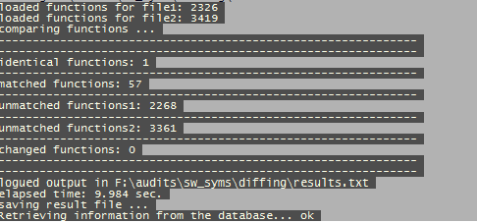
TurboDiff
Notes:
L
TurboDiff…. Fail…

Slide 92
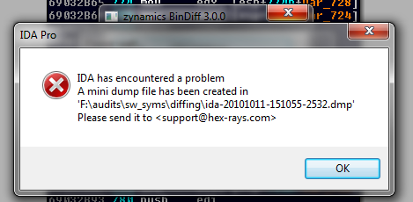
BinDiff
To be fair, v3.1 was latest. We only had 3.0.0.
Notes:
L
BinDiff…. Fail…

Slide 93
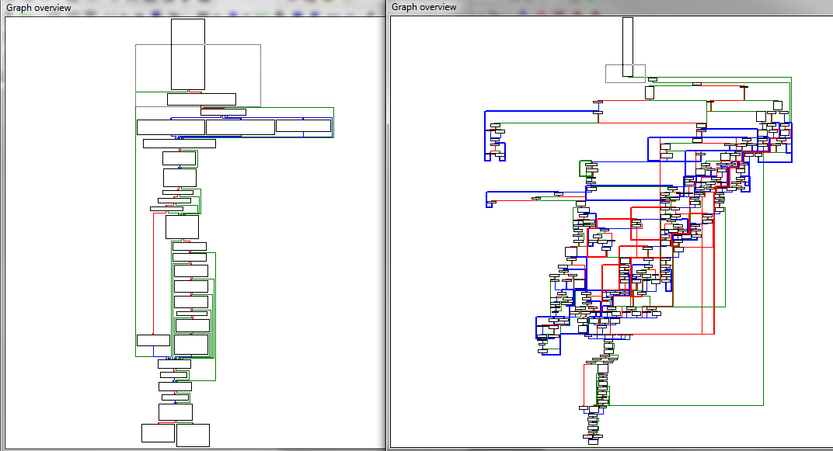
Symbol Porting
Alike, but different
Many functions that he *knew* were the same, didn’t appear so
We needed to do this with heuristics
Notes:
A

Slide 94
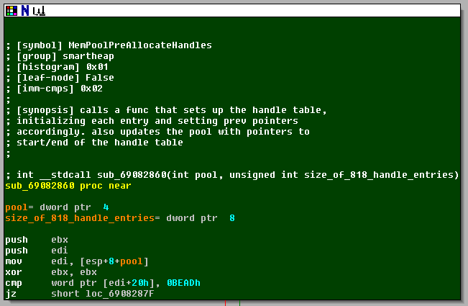
Symbol Porting (cont.)
We first needed to gather data to compare with later
Iterate functions/basic blocks/instructions using IDAPython
Save characteristics using marked locations
With a specific syntax
Notes:
A

Slide 95
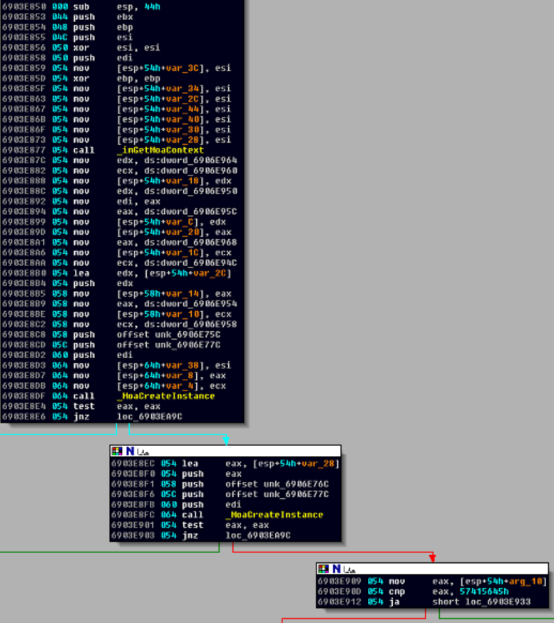
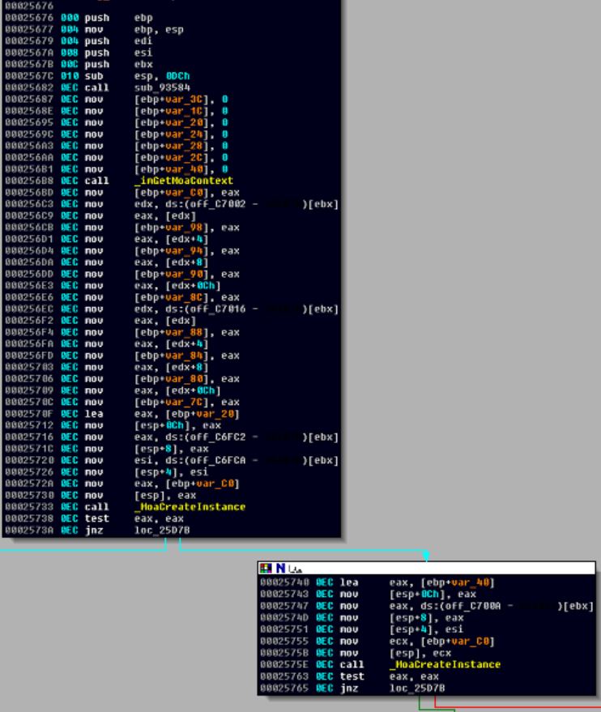
Function Characteristics
Cross references
Relative location
The number of times its called
Win32
OS X
Notes:
A

Slide 96
Function Characteristics
Cross references
Relative location
The number of times its called
Win32
OS X
Notes:
A

Slide 97
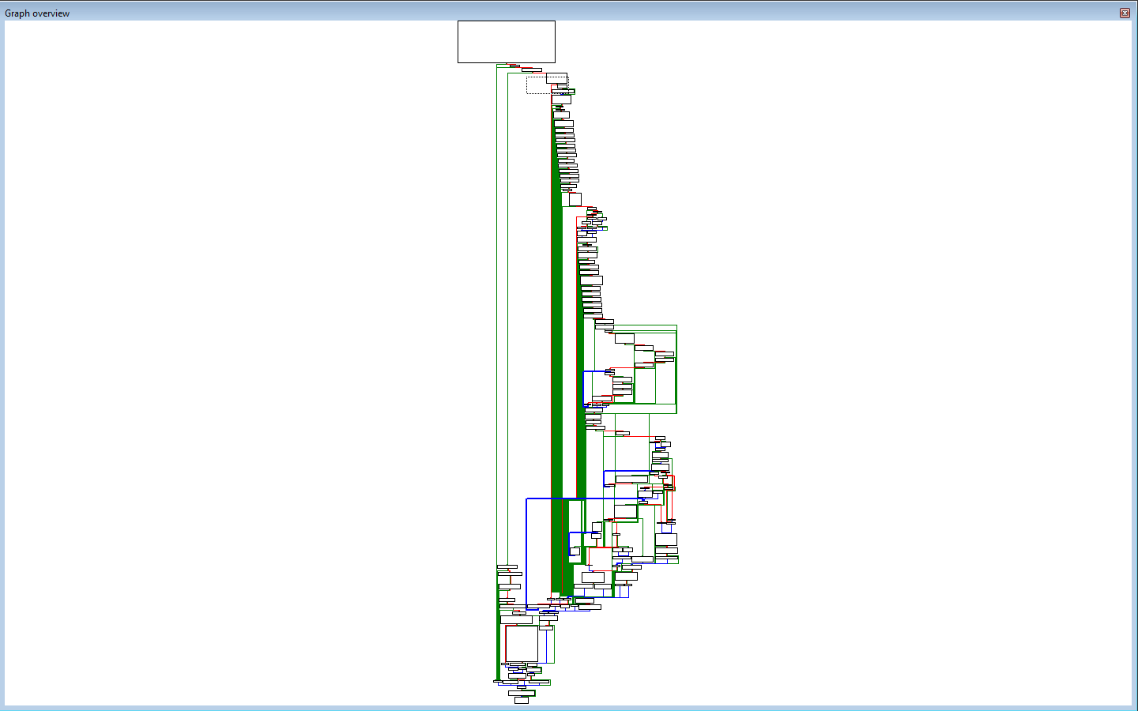
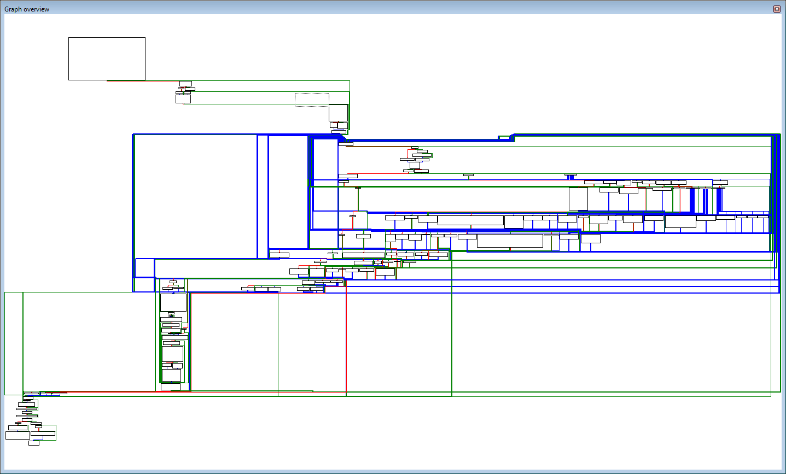
Function Characteristics (cont.)
Relative # of external calls
These below are the same, found via heuristics
Notes:
A

Slide 98
Function Characteristics (cont.)
Sub-graph comparisons
Top down and bottom up
Number of nodes
Number of branches
The body of these functions were often vastly different
Due to platform-specific code and conventions
Notes:
A

Slide 99
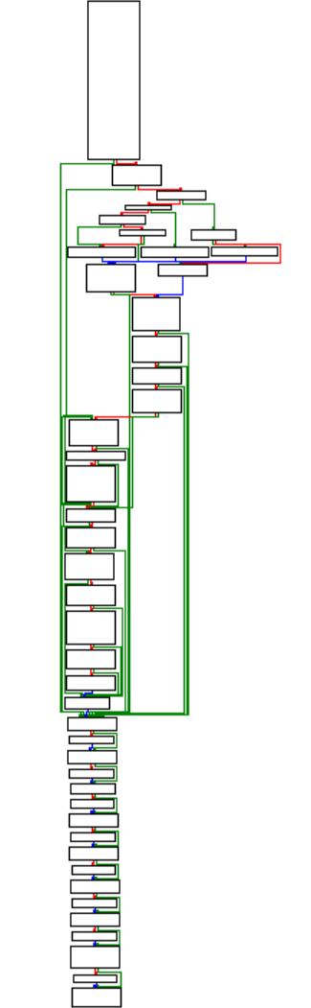
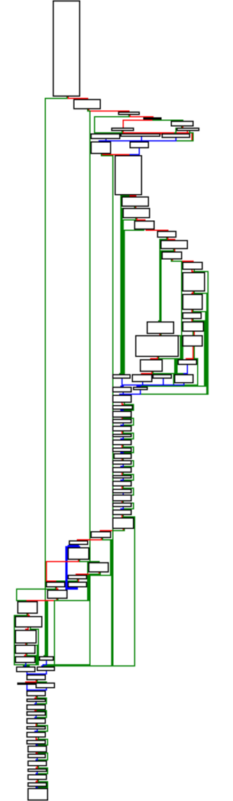
Function Characteristics (cont.)
Win32
OS X
Notes:
A

Slide 100
Function Characteristics (cont.)
Win32
OS X
Notes:
A

Slide 101
Function Characteristics (cont.)
Win32
OS X
Notes:
A

Slide 102
Function Characteristics (cont.)
Win32
OS X
Notes:
A

Slide 103
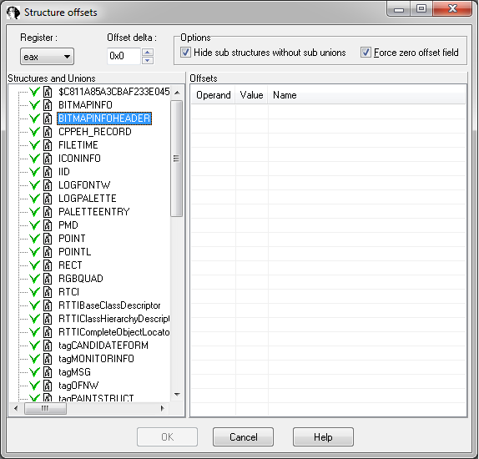
Function Characteristics (cont.)
Structures
At what offset are structures referenced?
Element sizes
Element types
To which functions are structures passed as arguments?
From which are they returned?
IDA request for Ilfak
Please expose this to idaapi:
Notes:
A

Slide 104
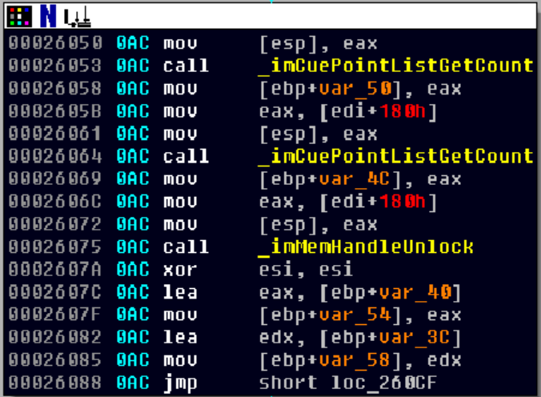
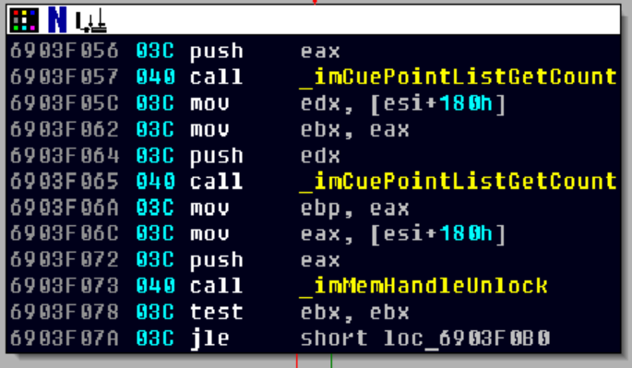
Function Characteristics (cont.)
Win32
OS X
Notes:
A

Slide 105
Function Characteristics (cont.)
Win32
OS X
Notes:
A

Slide 106
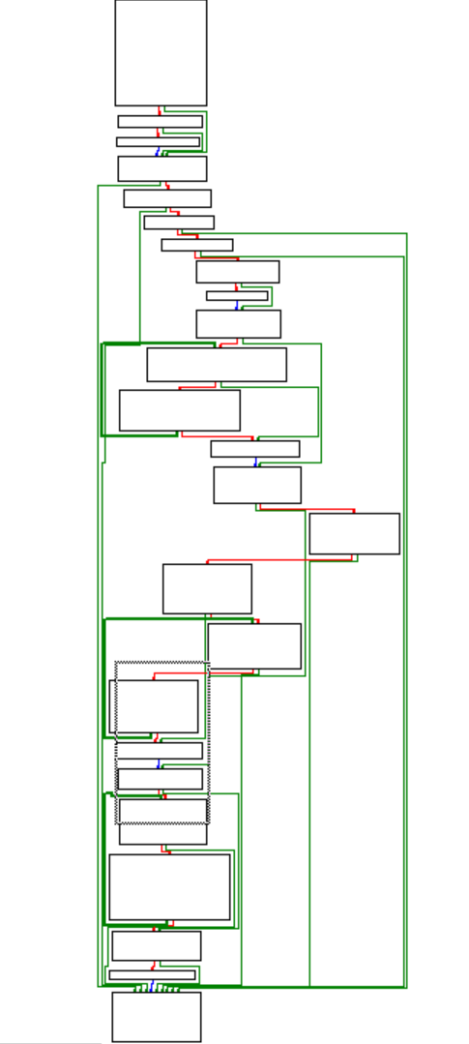
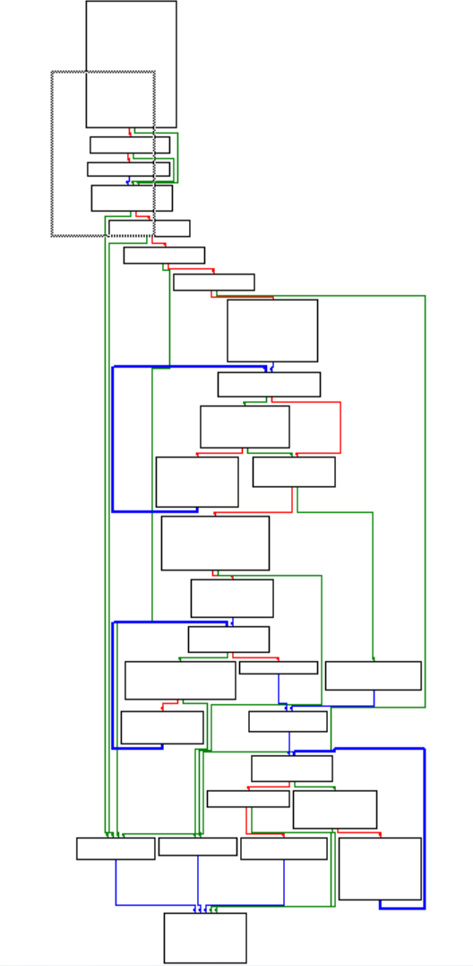
Function Characteristics (cont.)
Loops
How many loops
Nesting hierarchy
Win32
OS X
Notes:
A

Slide 107
Function Characteristics (cont.)
First Step
The easiest “anchor” was a call to a known libc function
Then we could begin applying the previously mentioned traits
Success!
imMemHandleNew
imMemHandleLock/Unlock
imMemHandleGetSize
imBufferNew
imMemCopy
imStreamRead
MemPoolInitFS
MemPoolSetBlockSizeFS
MemPoolPreAllocateHandles
…
Notes:
A

Slide 108
Back to SmartHeap
Reversing with limited symbols is better than none
We noticed a lot of references to handles in the symbols
SmartHeap has the handle-based API
So, we returned to the audit assuming it use that API
This allowed us to match function prototypes from the documentation
http://www.microquill.com/kb/docs/04_api.html
MEM_POOL MemPoolInitFS(unsigned short blockSize, unsigned long blockCount, unsigned flags);
unsigned long MemPoolPreAllocateHandles( MEM_POOL pool, unsigned long handleCount);
Notes:
A

Slide 109
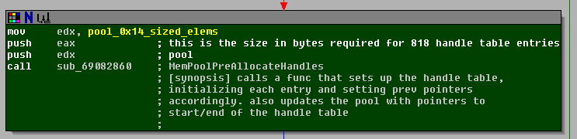
Back to SmartHeap (cont.)
These prototypes helped identify the global values
They were pointers to fixed-size memory pools
Notes:
A

Slide 110
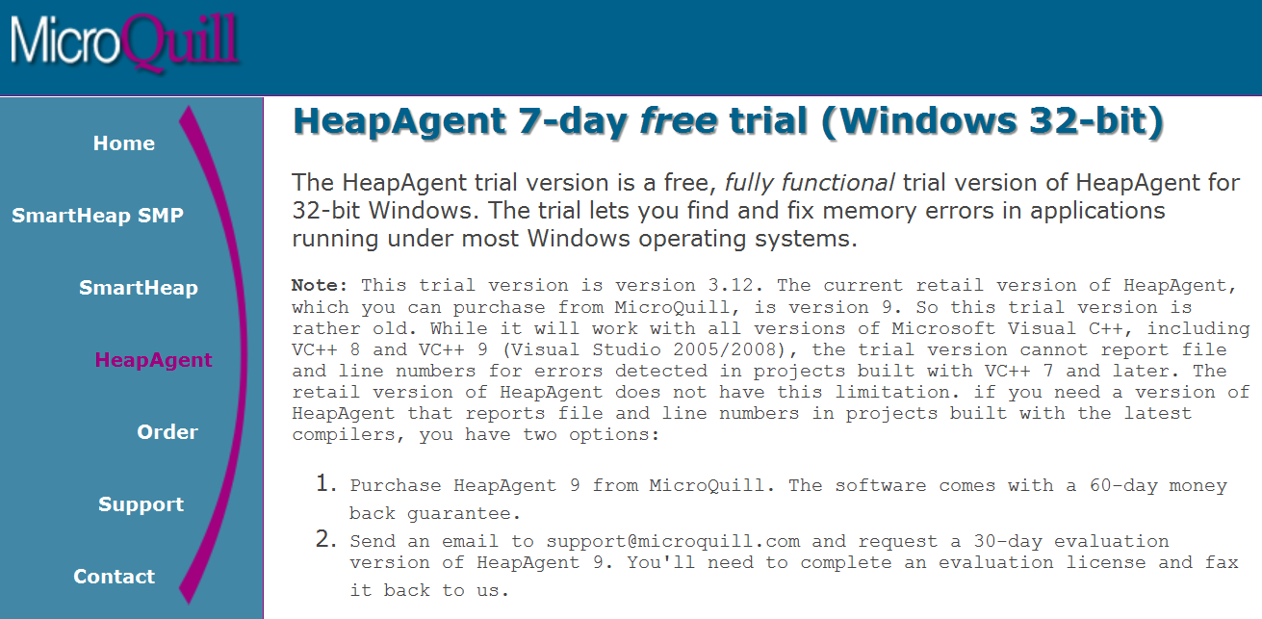
Back to SmartHeap (cont.)
Additionally, MicroQuill makes HeapAgent
Intended for developers to instrument their SmartHeap applications
Notes:
A

Slide 111
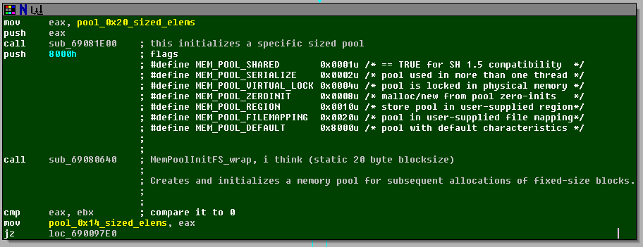
Back to SmartHeap (cont.)
Included with HeapAgent are some header files
Only some useful data was found (most only applicable to Debug)
/* Flags passed to MemPoolInit, MemPoolInitFS */
#define MEM_POOL_SHARED 0x0001u /* == TRUE for SH 1.5 compatibility */
#define MEM_POOL_SERIALIZE 0x0002u /* pool used in more than one thread */
#define MEM_POOL_VIRTUAL_LOCK 0x0004u /* pool is locked in physical memory */
#define MEM_POOL_ZEROINIT 0x0008u /* malloc/new from pool zero-inits */
#define MEM_POOL_REGION 0x0010u /* store pool in user-supplied region*/
#define MEM_POOL_FILEMAPPING 0x0020u /* pool in user-supplied file mapping*/
#define MEM_POOL_DEFAULT 0x8000u /* pool with default characteristics */
Notes:
A

Slide 112
SmartHeap exploitation
After REing these structures we noticed some things
They are ripe for exploitation
Function pointers to error handlers
Lack of mitigations on the structures and their elements
Like heap cookies
Or checksums
But wait, the API (and MicroQuill mktg) tells another story…
“SmartHeap also includes comprehensive memory debugging APIs to detect leakage, overwrites, double-frees, wild pointers, out of memory, references to previously freed memory, and other memory errors.”
Notes:
A

Slide 113
SmartHeap exploitation (cont.)
Error | Debug | Release
MEM_ALLOC_ZERO | •
MEM_BAD_BLOCK | •
MEM_BAD_FREE_BLOCK | •
MEM_BAD_BUFFER | •
MEM_BAD_FLAGS | •
MEM_BAD_HANDLE | •
MEM_BAD_POINTER | •
MEM_BAD_MEM_POOL | •
MEM_BLOCK_TOO_BIG |  | •
MEM_DOUBLE_FREE | •
MEM_EXCEEDED_CEILING |  | •
MEM_EXCEEDED_PROCESS_LIMIT |  | •
MEM_FREE_BLOCK_READ | •
MEM_FREE_BLOCK_WRITE | •
MEM_INTERNAL_ERROR | •
MEM_LEAKAGE | •
MEM_LOCK_ERROR |  | •
MEM_OUT_OF_BOUNDS_READ | •
MEM_OVERWRITE | •
MEM_UNDERWRITE | •
MEM_NOFREE | •
MEM_NOREALLOC | •
MEM_NOT_FIXED_SIZE | •
MEM_OUT_OF_MEMORY |  | •
MEM_READONLY_MODIFIED | •
MEM_RESIZE_FAILED |  | •
MEM_UNINITIALIZED_READ | •
MEM_UNINITIALIZED_WRITE | •
…
Notes:
A

Slide 114
Future Work
Empirical exploitation using SmartHeap tricks
Haven’t had time to really dig into this
Dissection of the asset-specific chunks
There are apparently quite a lot
Shockwave on OS X runtime
Rewriting exception handlers on OS X via injection
Lingo
Look for vulnerabilities in the handling of Lingo
Notes:
A

Slide 115
Conclusion
In summation
We started with a large symbol-less codebase that included an undocumented memory manager and parsed an undocumented file format
We ended with about 20 0day (more on the way) and tools to make any analysis much easier on the team going forward
We hope this demonstrated our process
And why it’s important to approach a problem thoroughly initially
As it saves a headache later
The tools/techniques can be applicable to other projects if designed properly

Slide 116
Wrapping Up
We’d like to release ‘stuff’ that’d help w/ shockwave
Our .idbs
IDAPython script that renames iml32/dirapi funcs we know about
Our x86 injected stubs
Code locations ideal for injection
…? Ask us if there’s anything you want in particular
Notes:
L
We have our idbs, symbols, and some of our tools available for release. If you are interested in auditing shockwave on your own, or using our research, please email us with what you want, and we will gladly try our best to supply your requests.

Slide 117
We’re hiring!
If this stuff is at all interesting to you…
…and you want to work with: http://dvlabs.tippingpoint.com/team
Or if you want to see more 0day than anyone, ever (ZDI)
Shoot me an e-mail, aaron.portnoy at HP com
Remote work is a possibility
The team is based in Austin, TX
I now work out of New York City
.
Notes:
A

Slide 118
Questions
Questions?
aaron.portnoy
logan.p.brown
@
hp.com
Notes:
A

Slide 119
Thanks & Greetz
Team collaboration
We hope this talk conveyed the fact that this was a team effort
Mad props to our team for their help
Brainstorming, reality checks, and slide review
Peter Silberman for slide review
Rolf Rolles for indirectly keeping us modest
busticati.org IRC for general brainstorming

