Slide 1
OAuth 2.0 and
OpenID Connect and
SSO, Oh My!
Security Simplified with IdentityServer4
http://aaronralls.com

Slide 2
Where to get this presentation and the resources?
IdentityServer4 Demos 1 & 2
IdentityServer4 Demo 3
OIDC JavaScript client
OpenID Connect Implementations
iOS OAuth 2.0 & OpenID Connect example
Xamarin example
OAuth 2.0 --rfc6749
OpenID Connect

Slide 3
What will you learn today?
The principals of OAuth 2.0 and OpenID Connect security protocols.
How IdentityServer4 can be used to implement the OAuth 2.0 and OpenID Connect protocols to secure your API’s, Web and Mobile applications.
How IdentityServer4 can be used to implement a SSO

Slide 4
Are you security aware? Are you implementing security at every layer or component of your application? If not, you should be!
Security is a growing concern for companies and users. If users lose trust in your applications they will abandon your products.
Are you implementing your own variation of API or application security? Could your solution be better? Why reinvent the wheel? Are you concerned it will take too long to implement?
Join me as we learn about authorization, OAuth 2.0, and authentication, OpenID Connect, standards you can start using today to improve your application security.
We leverage the open source solution of IdentityServer4 to implement these standards and get your security improved today!

Slide 6

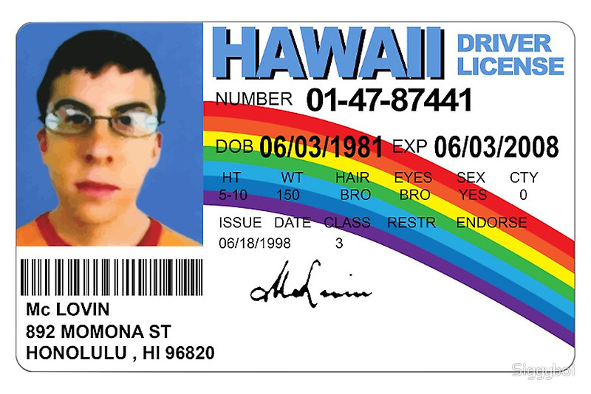
Authorization vs. Authentication
Notes:
Authorization (devices/services) Authentication (identification of users)

Slide 7
OAuth 2.0 (Authorization)
Resource Owner
Resource Server
End User
Business
API
Client
SPA
MVC App
Authorization Server
IdentityServer4
Okta
Console App
Mobile App
OWIN
Azure AD

Slide 8
OAuth 2.0 (Authorization)
Resource Owner
Resource Server
Business
API
Client
Authorization Server
IdentityServer4
Console App

Slide 9
OAuth 2.0 Authorization Grant Type: Client Credentials
IdentityServer4
Access Token
Client Cred.
Console App
API
Access Token
JSON
Notes:
“grant type” refers to the way an application gets an access token

Slide 10
DEMO 1
Console App(Windows Service) accessing a secured API

Slide 11
OAuth 2.0 Authorization Grant Types cont..
Authorization Code
Implicit
Resource Owner Password Credentials

Slide 12
OpenID Connect: Authentication Flows
Hybrid*
Server Side
Implicit
Mobile App
SPA
Authorization
Server Side
Notes:
Implicit Flow –ID Token and, if requested, an Access Token
client is not authorized/ID Token must be validated
NO Refresh Tokens
Hybrid Flow - some tokens are returned from the Authorization Endpoint and others are returned from the Token Endpoint
Authorization Code then req Access Token from token endpoint then gets ID Token and Access Token
hybrid flow. This gives you a verifiable token first before you make additional roundtrips

Slide 13
DEMO 2
MVC Web Application Authentication & Authorization

Slide 14
DEMO 3
SPA Web Application Authentication & Authorization

Slide 15
Authentication
IdentityServer4
Login/Logout
OpenID Connect
Authorization
End Session
OAuth
Discovery
Token
User Info
Notes:
Access Tokens, ID Tokens
UserInfo Endpoint is an OAuth 2.0 Protected Resource that returns Claims about the authenticated End-User.

Slide 16
OAuth 2.0 Spec Links
OAuth 2.0 Core
OAuth 2.0 Framework — RFC 6749
Bearer Token Usage — RFC 6750
Threat Model and Security Considerations — RFC 6819
OAuth 2.0 Extensions
JSON Web Token — RFC 7519
OAuth Assertions Framework — RFC 7521
SAML2 Bearer Assertion — RFC 7522, for integrating with existing identity systems
JWT Bearer Assertion — RFC 7523, for integrating with existing identity

Slide 17
OpenID Connect Spec Links
OpenID Connect
Core 1.0
Discovery

Slide 18
Helpful links
OAuth 2.0 Protocol Detailed Walkthrough
OpenID Connect Flows
OKTA - SaaS
Explicit Logout from IdentityServer4
Using existing DB with IdentityServer4
Why not use OAuth 2.0 Resource Owner Password Grant Type

Slide 19
Other Authorization Services

Slide 20
Q & A
Twitter :: @cajunAA
Instagram :: double_a_ralls
Stackoverflow :: aaronR
Email :: aaron.ralls@gmail.com
Blog :: https://arkeytek.com
Facebook.com/aaron.ralls.9
http://aaronralls.com
Github.com/aaronRalls

Slide 21
OAuth 2.0 (Authorization)
Resource Owner
Resource Server
End User
Business
API
Client
MVC App
Authorization Server
IdentityServer4

