Slide 1
OAuth 2.0 and
OpenID Connect and
SSO, Oh My!
Security Simplified with IdentityServer4
http://aaronralls.com

Slide 2
Where to get this presentation and the resources?
IdentityServer4 Demos 1 & 2
IdentityServer4 Demo 3
OIDC JavaScript client
OpenID Connect Implementations
iOS OAuth 2.0 & OpenID Connect example
Xamarin example
OAuth 2.0 --rfc6749
OpenID Connect

Slide 3
What will you learn today?
The principals of OAuth 2.0 and OpenID Connect protocols.
How IdentityServer4 can be used to implement the OAuth 2.0 and OpenID Connect protocols to secure your API’s, Web and Mobile applications.
How IdentityServer4 can be used to implement a SSO

Slide 4
Are you security aware? Are you implementing security at every layer or component of your application? If not, you should be!
Security is a growing concern for companies and users. If users lose trust in your applications they will abandon your products.
Are you implementing your own variation of API or application security? Could your solution be better? Why reinvent the wheel? Are you concerned it will take too long to implement?
Join me as we learn about authorization, OAuth 2.0, and authentication, OpenID Connect, standards you can start using today to improve your application security.
We leverage the open source solution of IdentityServer4 to implement these standards and get your security improved today!

Slide 5

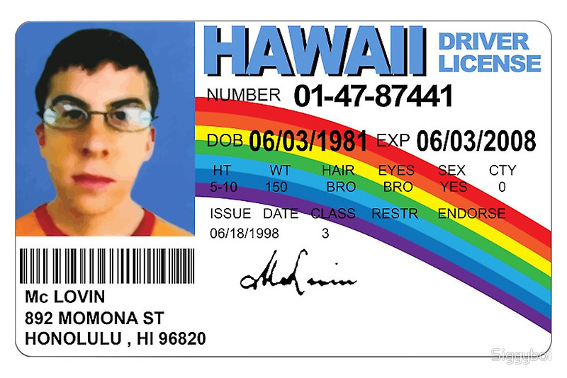
Authorization vs. Authentication
Notes:
Authorization (devices/services) Authentication (identification of users)

Slide 6
OAuth 2.0 (Authorization)
Resource Owner
Resource Server
End User
Business
API
Client
SPA
MVC App
Authorization Server
IdentityServer4
Okta
Console App
Mobile App
OWIN
Azure AD
Auth0.com

Slide 7
OAuth 2.0 (Authorization)
Resource Owner
Resource Server
Business
API
Client
Authorization Server
IdentityServer4
Console App

Slide 8
OAuth 2.0
Front Channel (Browser)
Back Channel
Notes:
reference tokens is that you have much more control over their lifetime.

Slide 9
OAuth 2.0 Access Tokens
Reference
Self contained - JWT
Notes:
reference tokens is that you have much more control over their lifetime.
recipient then needs to open a back-channel to the token service, send the token to a validation endpoint, and if valid, retrieves the contents as the response.

Slide 10
OAuth 2.0 Authorization Grant Type: Client Credentials
IdentityServer4
Access Token
Client Cred.
Console App
API
Access Token
JSON
Notes:
“grant type” refers to the way an application gets an access token

Slide 11
DEMO 1
Client Credentials
Console App/Windows Service accessing a secured API

Slide 12
OAuth 2.0 Authorization Grant Types cont..
Authorization Code (PKCE)
Implicit
Resource Owner Password Credentials
Notes:
Proof Key for Code Exchange (PKCE, pronounced pixie)

Slide 13
OpenID Connect: Authentication Flows
Hybrid*
Server Side
Implicit
SPA
Authorization code
Server Side
Authorization code
With PKE
Mobile App
Mobile App
Notes:
All of these add ability to get id_token
Implicit Flow –ID Token and, if requested, an Access Token
client is not authorized/ID Token must be validated
Mobile use Hybrid code with id_token
identity token is transmitted via the browser channel, so the client can validate it before doing any more work. And if validation is successful, the client opens a back-channel to the token service to retrieve the access token.
PKCE (RFC 7636) is a technique to secure public clients that don't use a client secret.
It is primarily used by native and mobile apps, but the technique can be applied to any public client as well. It requires additional support by the authorization server, so it is only supported on certain providers.
NO Refresh Tokens
Hybrid Flow - some tokens are returned from the Authorization Endpoint and others are returned from the Token Endpoint
Authorization Code then req Access Token from token endpoint then gets ID Token and Access Token
hybrid flow. This gives you a verifiable token first before you make additional roundtrips

Slide 14
Authentication & Authorization
OpenID Connect
User Info
End Session
OAuth
Discovery
Token
Authorization
Notes:
Access Tokens, ID Tokens
UserInfo Endpoint is an OAuth 2.0 Protected Resource that returns Claims about the authenticated End-User.

Slide 15
DEMO 2
MVC Web Application Authentication & Authorization

Slide 16
DEMO 3
SPA Web Application Authentication & Authorization

Slide 17
Authentication
IdentityServer4
Login/Logout
OpenID Connect
User Info
End Session
OAuth
Discovery
Token
Authorization
Notes:
Access Tokens, ID Tokens
UserInfo Endpoint is an OAuth 2.0 Protected Resource that returns Claims about the authenticated End-User.

Slide 18
OAuth 2.0 Spec Links
OAuth 2.0 Core
OAuth 2.0 Framework — RFC 6749
Bearer Token Usage — RFC 6750
Threat Model and Security Considerations — RFC 6819
OAuth 2.0 Extensions
JSON Web Token — RFC 7519
OAuth Assertions Framework — RFC 7521
SAML2 Bearer Assertion — RFC 7522, for integrating with existing identity systems
JWT Bearer Assertion — RFC 7523, for integrating with existing identity

Slide 19
OpenID Connect Spec Links
OpenID Connect
Core 1.0
Discovery

Slide 20
Helpful links
OAuth 2.0 Protocol Detailed Walkthrough
OpenID Connect Flows
OKTA - SaaS
Explicit Logout from IdentityServer4
Using existing DB with IdentityServer4
Why not use OAuth 2.0 Resource Owner Password Grant Type

Slide 21
Other Authorization Services

Slide 22
Q & A
Twitter :: @cajunAA
Instagram :: double_a_ralls
Stackoverflow :: aaronR
Email :: aaron.ralls@gmail.com
Blog :: https://arkeytek.com
Facebook.com/aaron.ralls.9
http://aaronralls.com
Github.com/aaronRalls

Slide 23
OAuth 2.0 (Authorization)
Resource Owner
Resource Server
End User
Business
API
Client
MVC App
Authorization Server
IdentityServer4

