Slide 1
Hello!

Slide 2
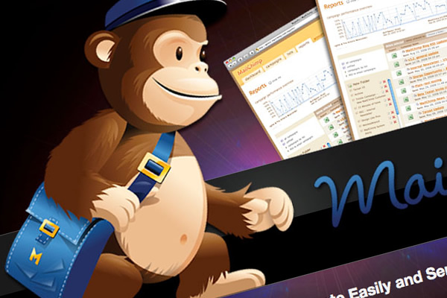
Introduction to Mailchimp
By Aaron Saray

Slide 3
Why trust Aaron Saray
Programming web applications for a decade
Programming since 8
Speaks both nerd and non-nerd
Uses mailchimp
Deals by Golly
Mark Neumann for Governor of Wisconsin
Organizer or Part of team for
MKEPUG
Milwaukee Web Design Meetup
Thanks for having me!

Slide 4
My Primary Focus
Primary focus is always on the list management and population
Work with the marketing people
Will try to give you an overview

Slide 5
What is Mailchimp?
Quote:
MailChimp helps you design email newsletters, share them on social networks, integrate with services you already use, and track your results. It's like your own personal publishing platform.
What I Say:
MailChimp is an email sending and marketing platform that both supports robust email campaigns and touts ease of use.
Easy to use web interface – customizable API
SPAM Control services help you stay in the white-list.

Slide 6
Main Features
Social Network Integration
Co-branding
Templates
A/B Split Testing
Custom variable tracking
Google Analytics
Inbox Inspector
Auto Responders
Groups / Segments
API

Slide 7
Who can use Mailchimp?
They have all size plans available:
Free Plan
Non Profit Discount
Up to 3.1 million subscribers / 24.8 million messages a month

Slide 8
Lets send a message: 3 steps
Create a template
These can be re-used, copied, modified later
Create a campaign
Basically create your message
Inserted into template
Send or Schedule
Send immediately
Schedule a specific time

Slide 9
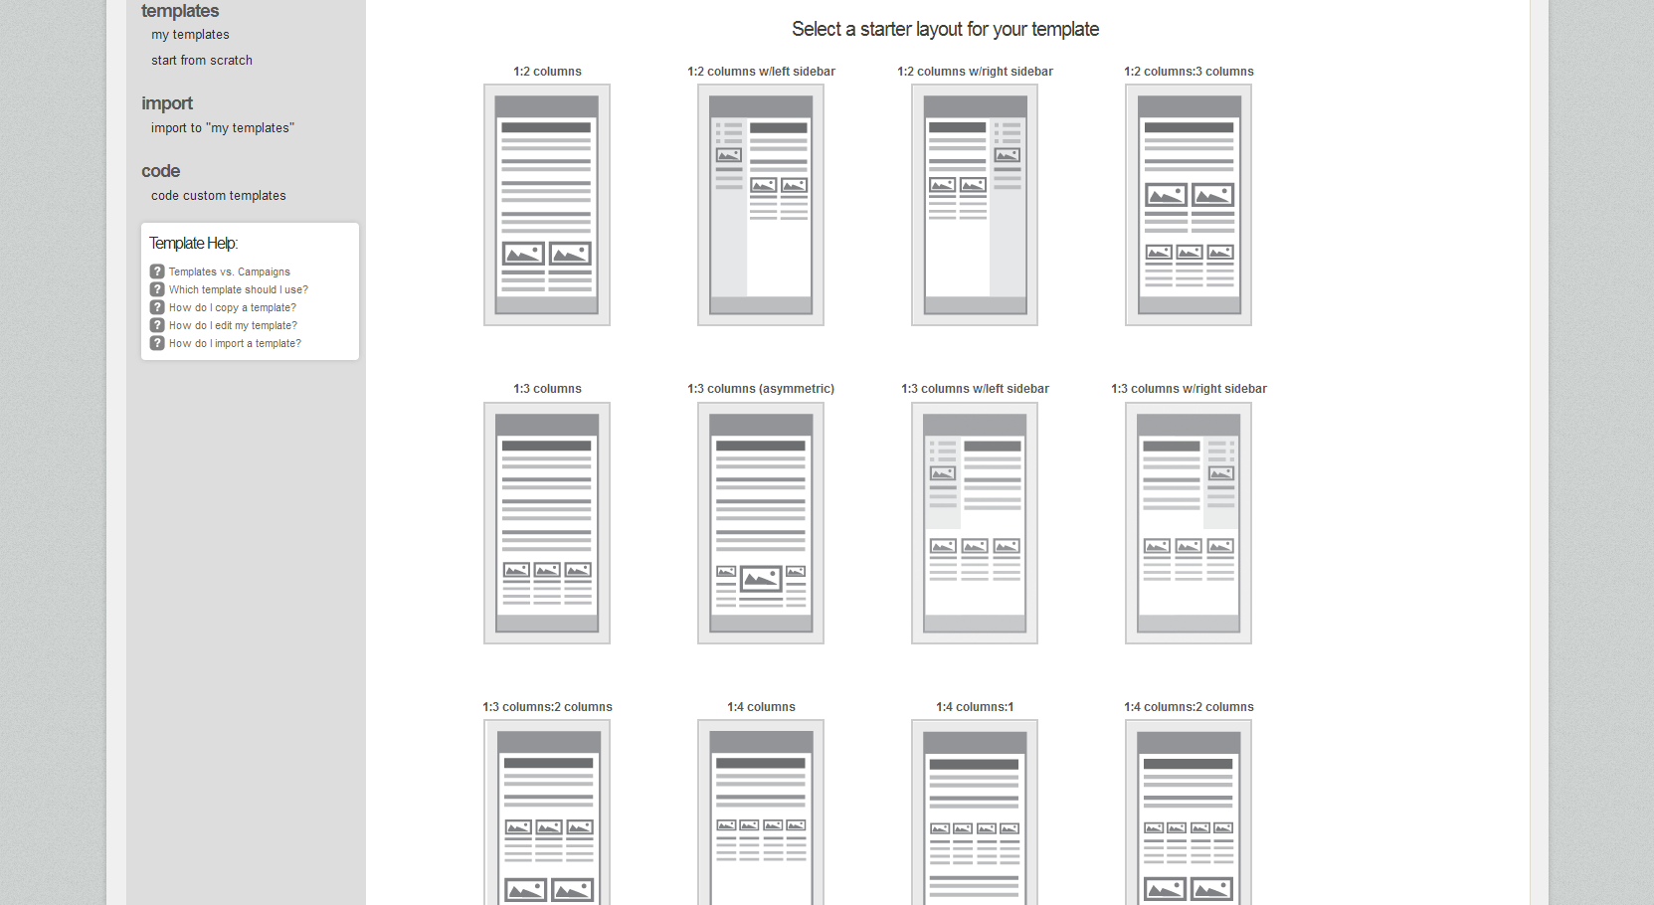
Create a Template

Slide 10
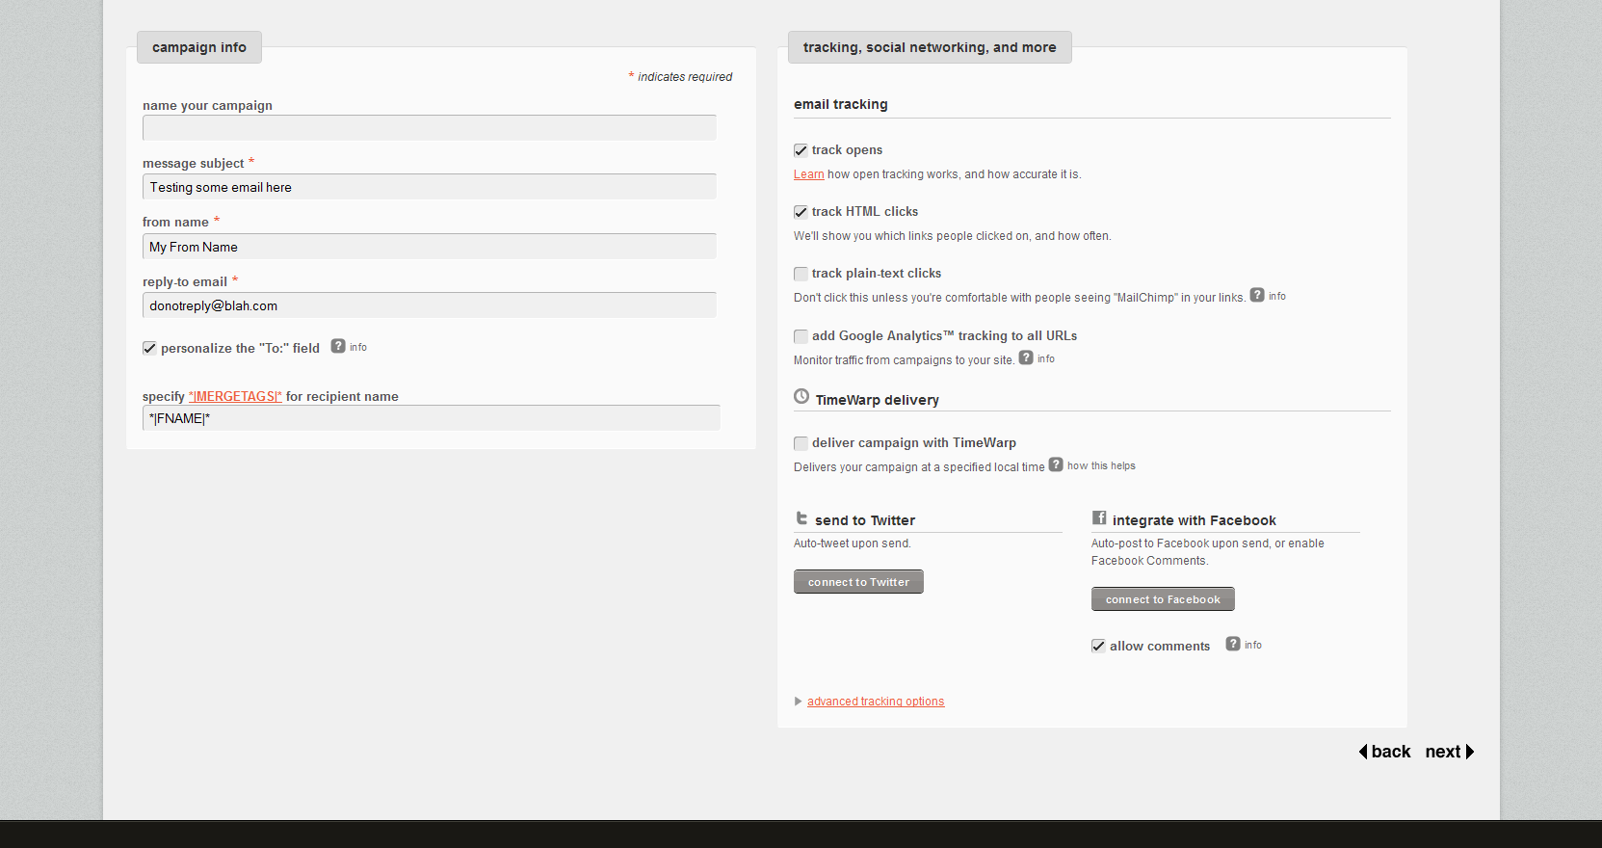
Create a Campaign
Choose Create Campaign
Select your List
Choose elements for your campaign

Slide 11
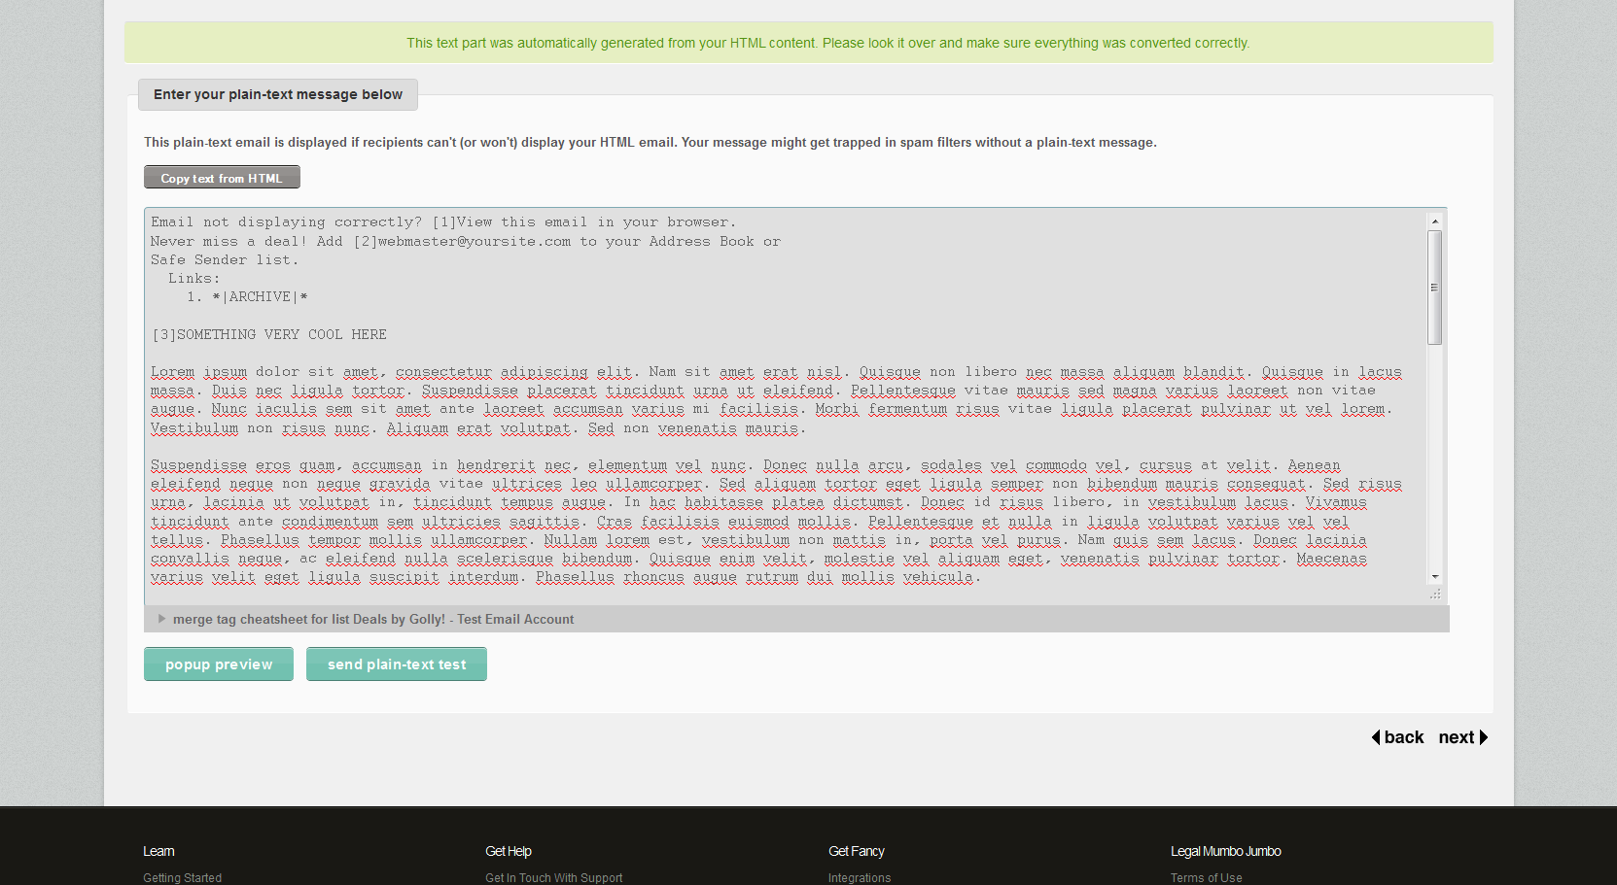
Create a campaign (cont’)
Select the template
Add your content in both HTML and plain-text

Slide 12
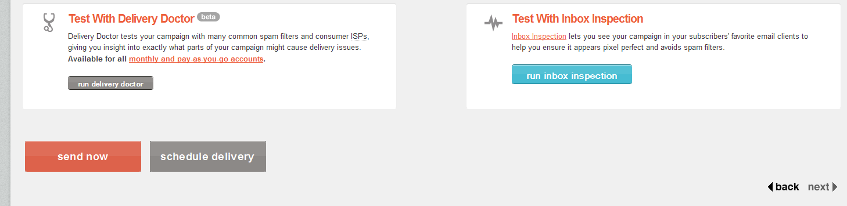
Create a campaign (last step)
Send Now, Schedule, or run inbox inspector

Slide 13
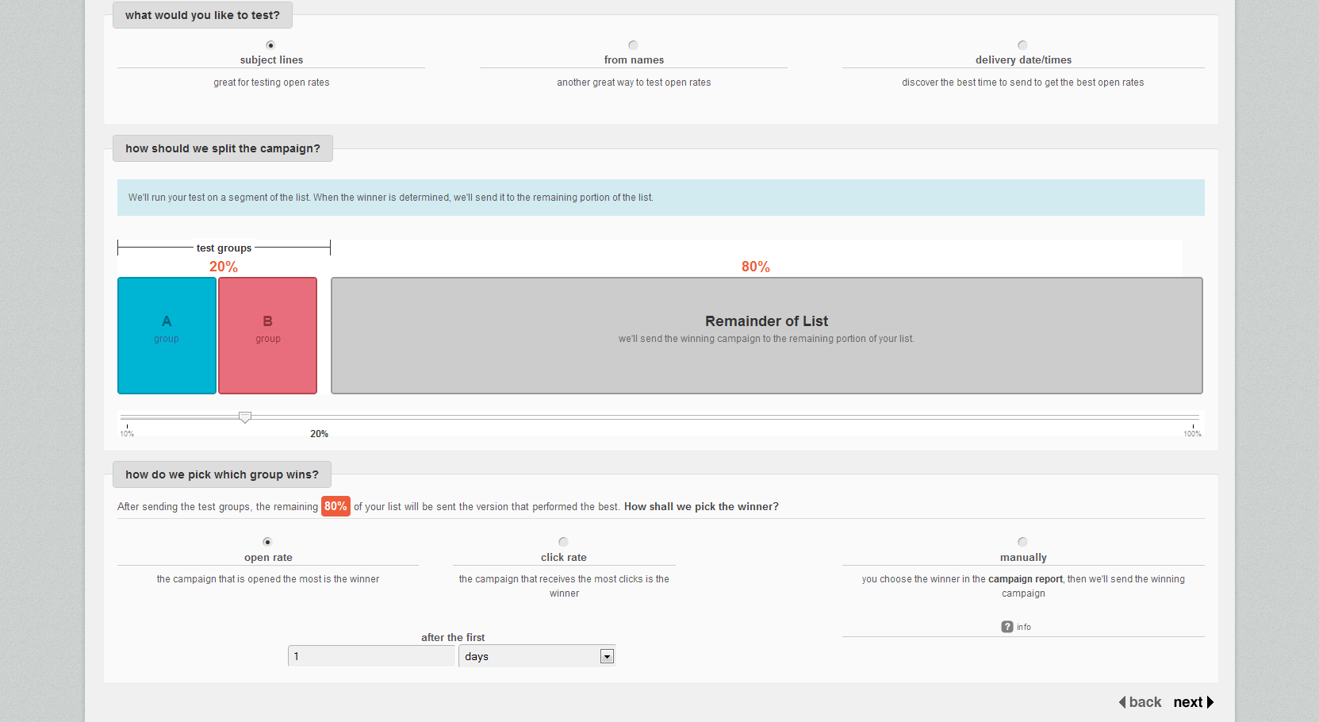
a/b Testing

Slide 14
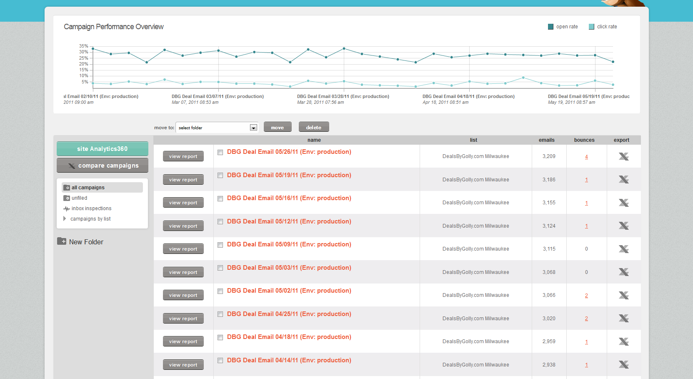
Reports

Slide 15
Opt-in/Opt-out
Double Opt-in List
What this means
Force Opt-In through API
Must track stuff
% marked as spam freezes account
0.1%!!!!

Slide 16
Pricing Options
Free Forever
0-2000 Subscribers / 12,000 Month
Unlimited sending plans
500 subscribers / $10
… more
Up to 25,000 / $150
Pay as you go ($.0x per email)
High Volume Plans (up to $12k a month, 3.1 million sub)

Slide 17
Killer Feature: API
Templates
Created, Modify, Delete
Campaigns
Create, Modify, Delete
Lists
Create, Modify, Delete
Custom Variables / segments
Schedule or send immediately
Track subscriptions (pingback)

Slide 18
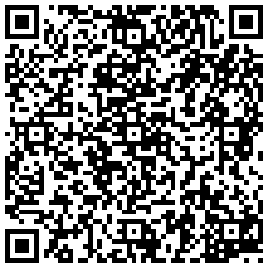



Questions??
Aaron Saray
http://aaronsaray.com
@aaronsaray

