Slide 1
Southern Ocean Carbon Sink
Internal Variability
Aaron Spring

Slide 2
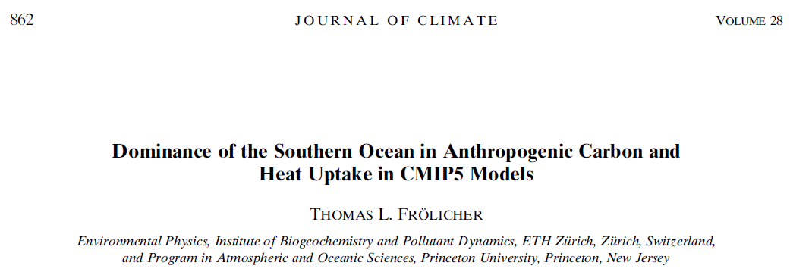
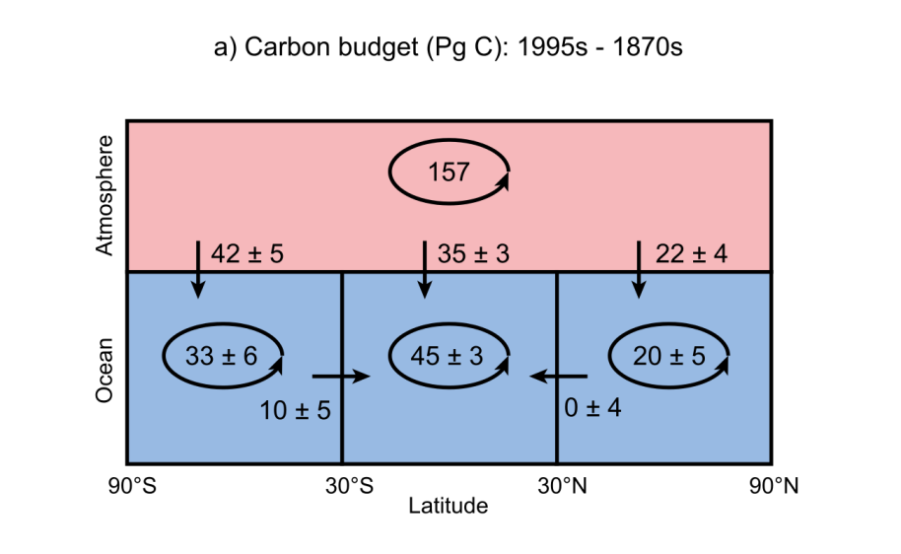
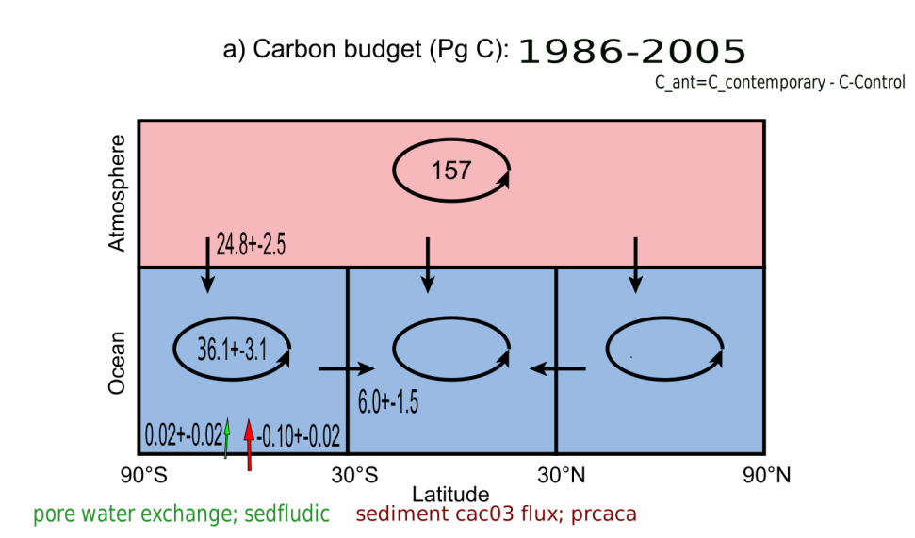
Anthropogenic Carbon Budget
Anthropogenic Carbon: -120 years or control run
Transport: difference or section transport
Sediment interaction: exclude or include
Uncertainty: inter-model or large ensemble

Slide 3
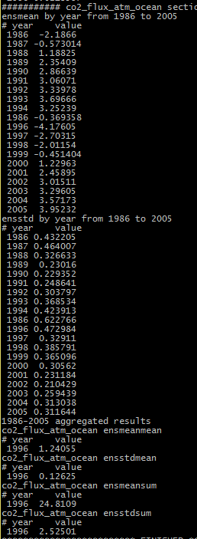
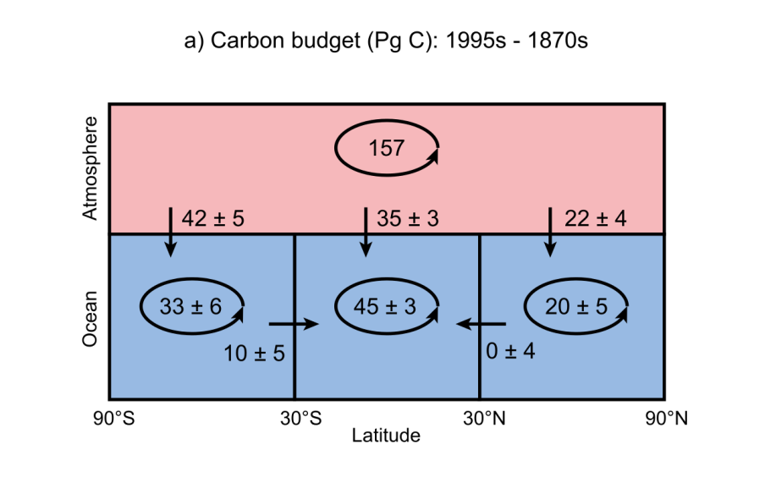
Gap in CO2Flux
Higher CO2 fluxes in HAMOCC
1995-1999 CO2 source
2 PgC/yrs usually
Now 5 yrs: -10 Pg C
Explanation?

Slide 4
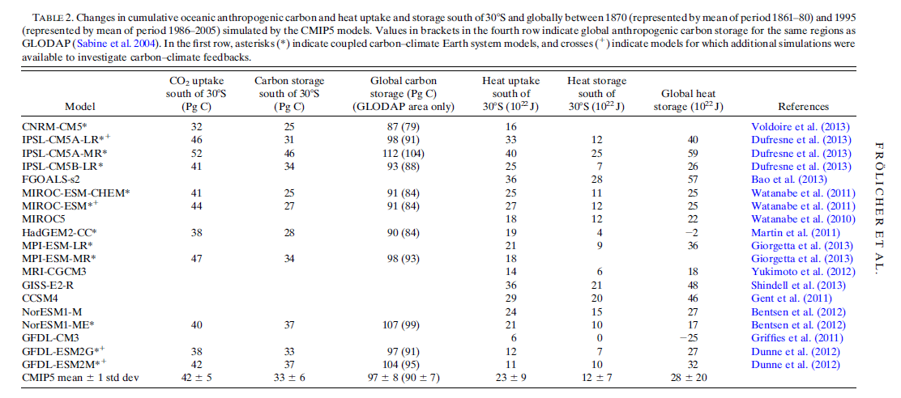
Reference to Giorgetta et al. 2013

Slide 5
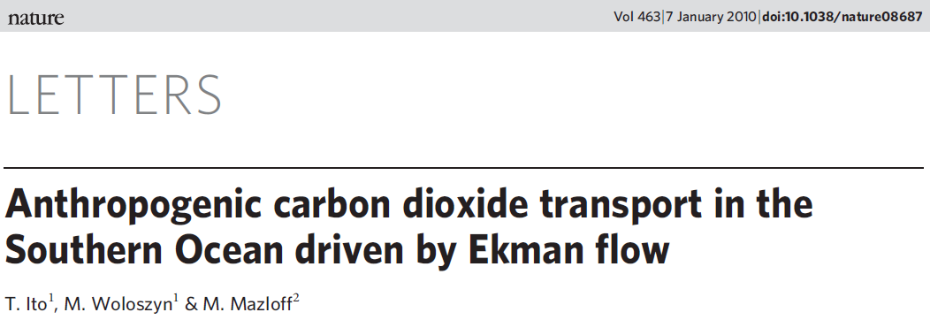
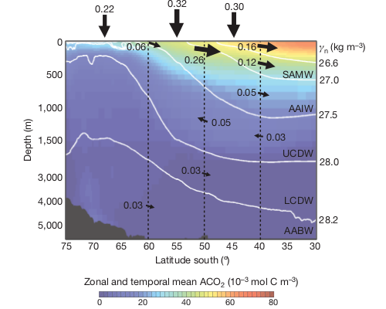
A look into the water column
+- +- +- +-
Sections each 10° Lat
Higher CO2fluxes in HAMOCC

Slide 6
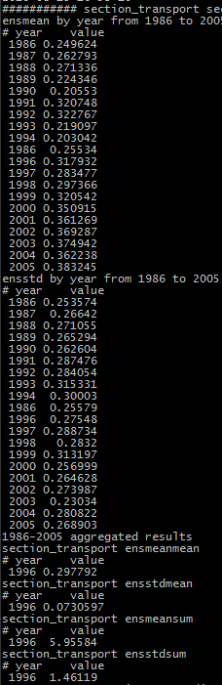
Increase in section transport

