Slide 1
Internal Variability of the Southern Ocean Carbon sink
Journal Club
Discussion based on Landschützer et al. 2015

Slide 2
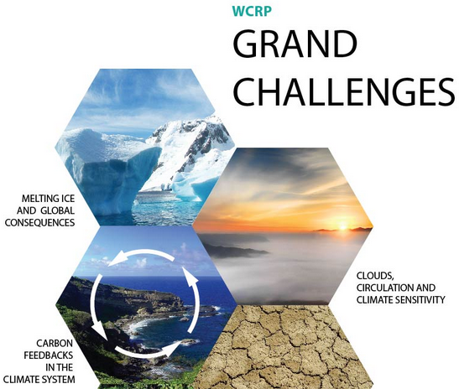
Why do I present this?
MSc Thesis on internal variability of Southern Ocean Carbon Sink
Southern Ocean is big contributor to Global Carbon Cycle and focus area of new WCRP Grand Challenge on carbon feedbacks
Use MPI-ESM Large Ensemble
Peter’s neural network is a powerful upgrade on SOCAT database

Slide 3
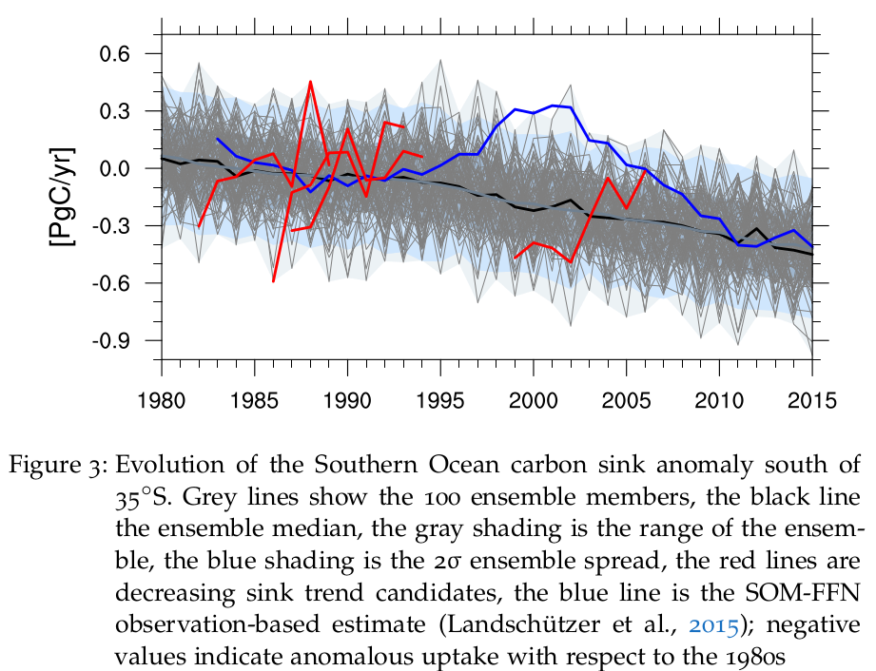

Southern Ocean carbon sink is varying

Slide 4
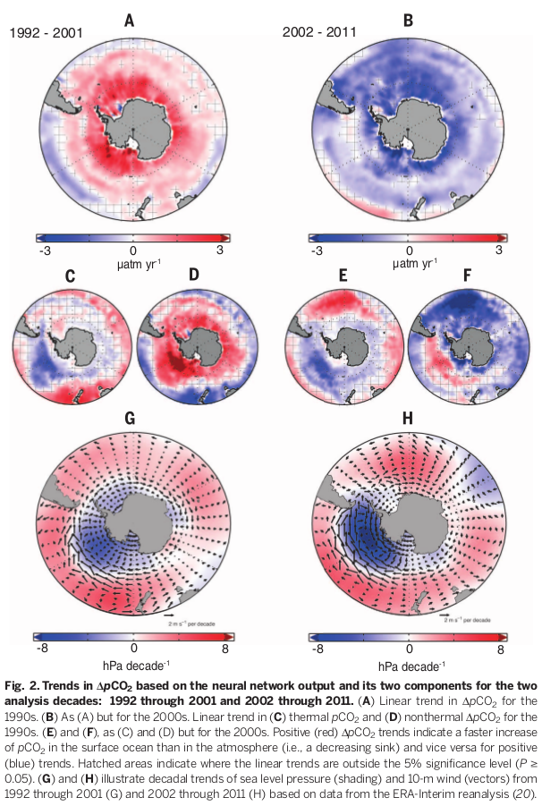


Results: pCO2 trends
symmetric pCO2 trends
pCO2 separation by Takahashi (2002)
asymmetric thermal responses
asymmetric SLP, but no reversal

Slide 5
Results: explanation
1990s: strengthening winds, more upwelling, “confirmed” [Le Quere, 2007]
2000s: no reversal of winds, but why decrease?
  Temperature effect on CO2flux
  upwelling anomalies from SLP anomalies
  assymetric response in T, but symmetric in total

Slide 6
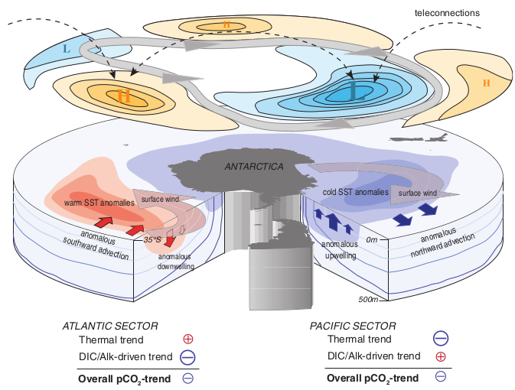
Southern Ocean carbon sink in the 2000s

Slide 7
Implications
Oceanic carbon sink more variable and sensitive than previously suggested
last sentense unclear: „This also suggests that should current climate trends reverse in the near future, the Southern Ocean might lose its recently regained uptake strength, leading to a faster accumulation of CO2 in the atmosphere…“
→ We don’t know for sure where we go

Slide 8
Papers
Le Quéré et al., (2007): Saturation of the Southern Ocean CO2 Sink Due to Recent Climate Change, Science, American Association for the Advancement of Science, 316, 1735-1738
Lovenduski et al., (2008): Toward a mechanistic understanding of the decadal trends in the Southern Ocean carbon sink Global Biogeochem. Cycles, 22
Landschützer et al., (2016): Decadal variations and trends of the global ocean carbon sink, Global Biogeochemical Cycles, Wiley-Blackwell, 30, 1396-1417
DeVries et al., (2017): Recent increase in oceanic carbon uptake driven by weaker upper-ocean overturning, Nature, Springer Nature, 542, 215-218

Slide 9
Backup slides

Slide 10
Method
pCO2: Neural network on SOCAT (Surface Ocean CO2 Atlas) database, because sparse observations
SLP/winds: ERA-interim reanalysis
T: NOAA Optimum Interpolation

Slide 11
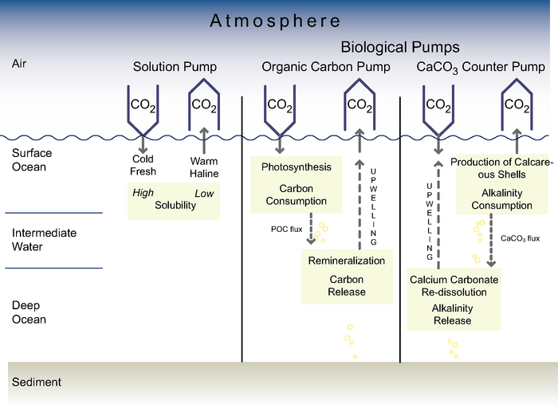
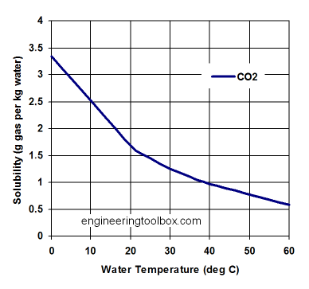
„pumps“ regulate carbon

Slide 12
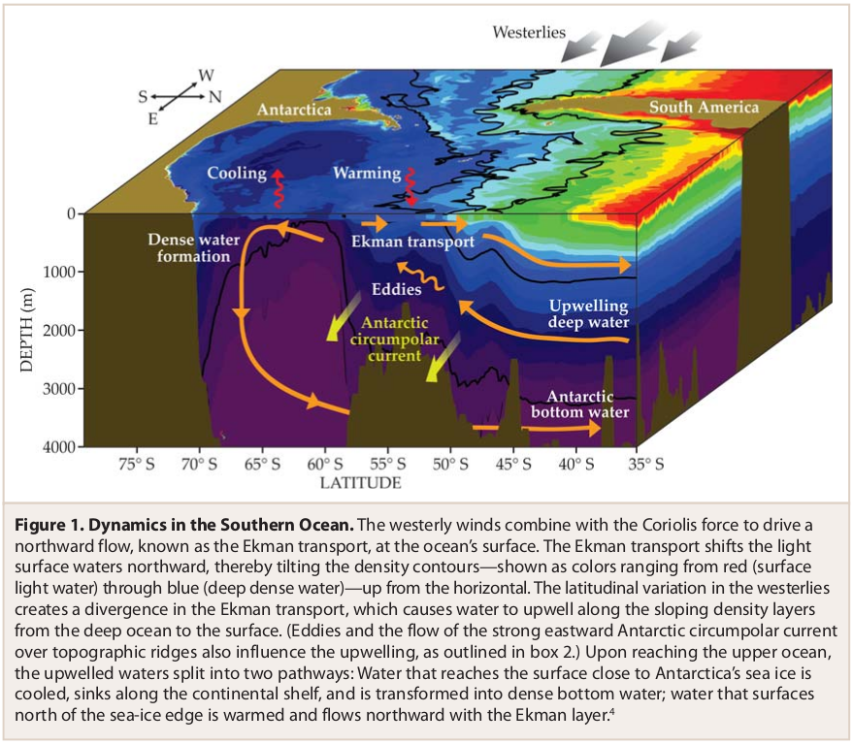
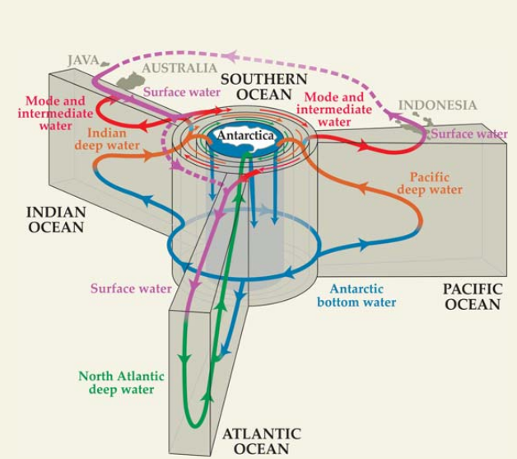
Southern Ocean Circulation

Slide 13
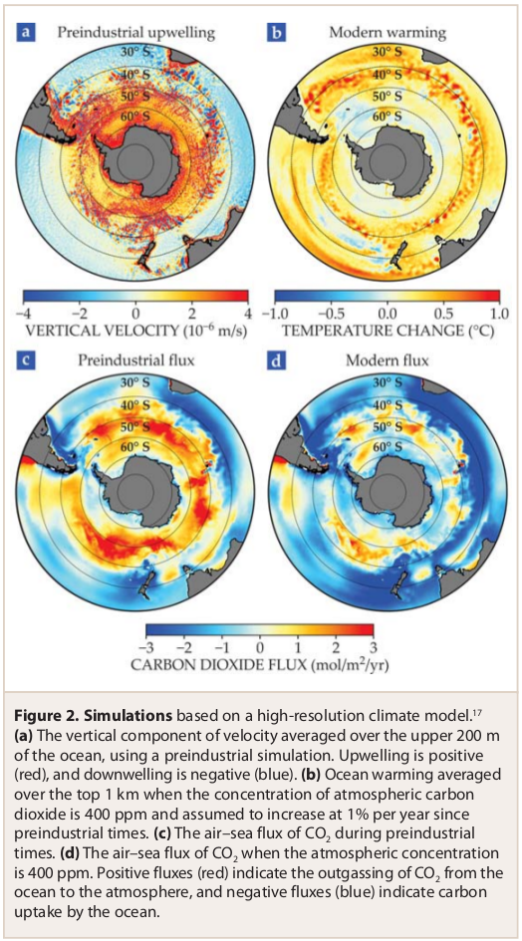
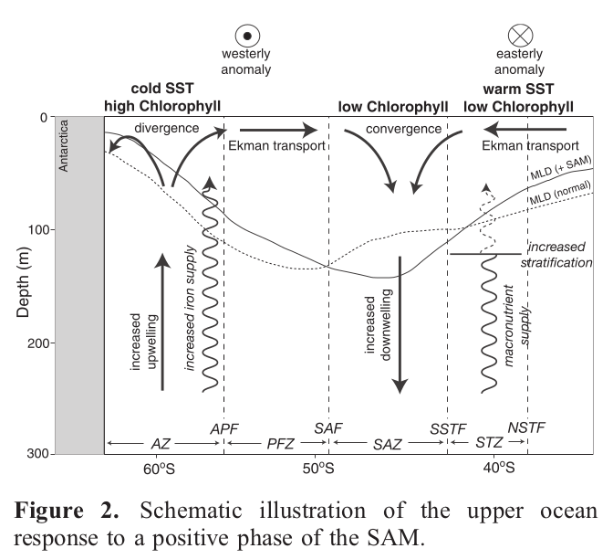
SO Circulation for CO2 sink

Slide 14
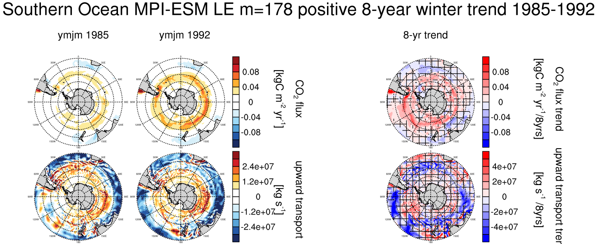

Slide 15
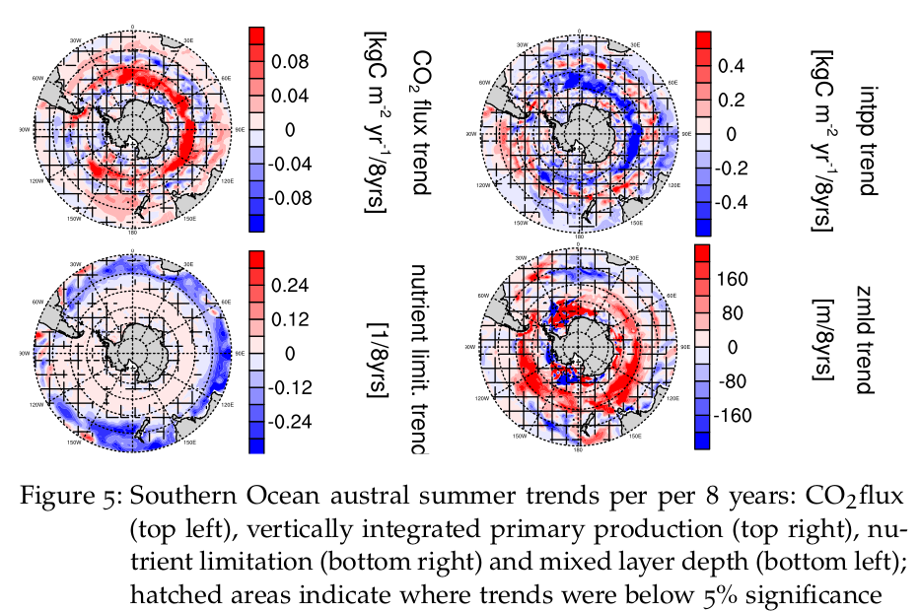
Summer trends MPI-ESM LE

Slide 16
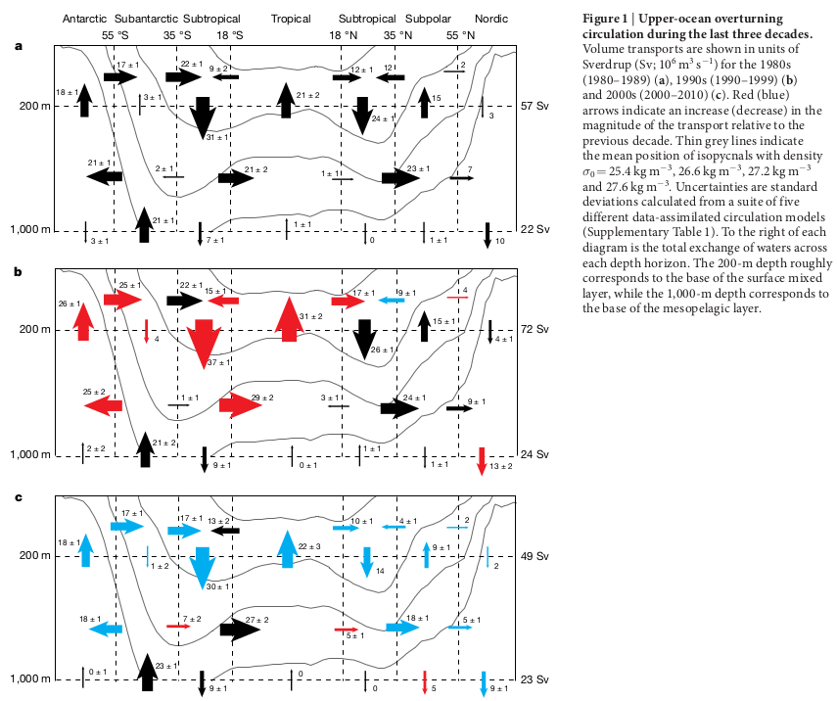
DeVries (2017)
Inverse modeling
Enhanced upper ocean circulation in 2000s
Nothing about reasons for this change

Slide 17
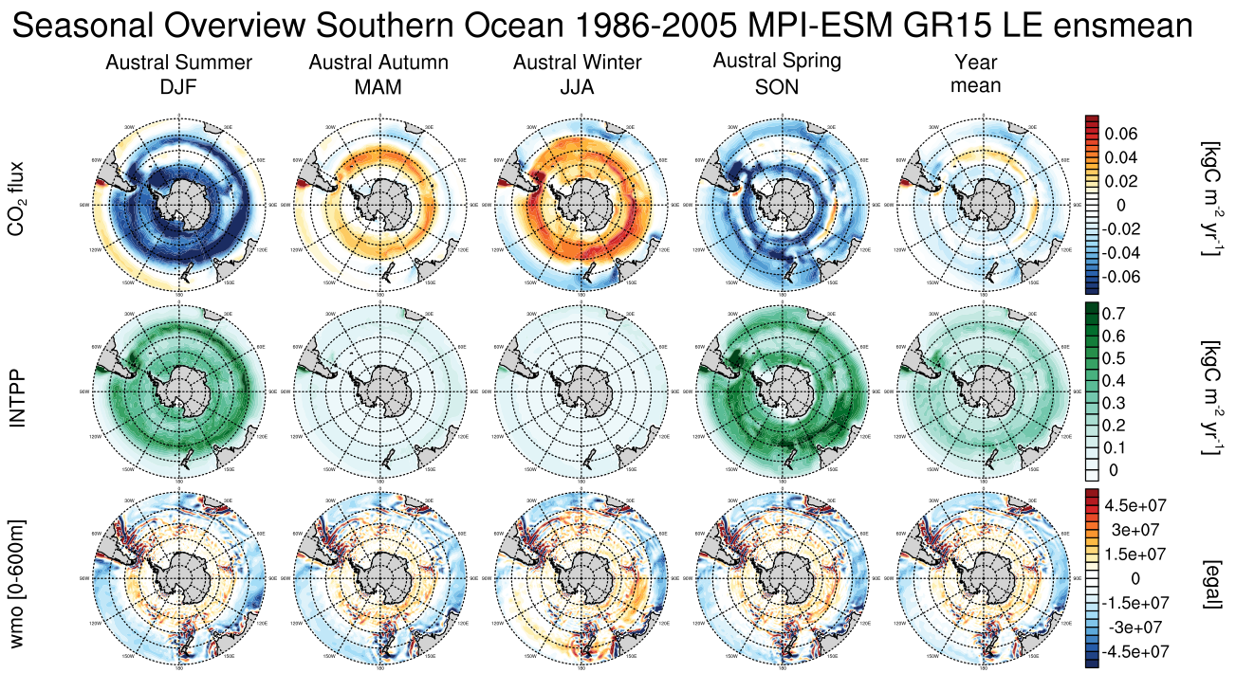
SO Circulation for CO2 sink

Slide 18


