Slide 1
Data Visualization using ParaView on Mistral

Slide 2
Lectures & Breaks
09.00 – 10.30 Lecture 1
10.30 – 11.00 Coffee & Cookies
11.00 – 12.30 Lecture 2
Lunch
13.30 – 15.00 Lecture 3
15.00 – 15.30 Coffee & Cookies
15.30 – 17.00 Lecture 4
Monday / Tuesday
2

Slide 3
Outline
Introduction, getting started
ECHAM data
ParaView basics
Lunch
HAMOCC TP6M data
ICON Ocean data
Snapshots and Animations
HD(CP) data (lon/lat)
Subsets
Derive Vorticity, Divergence …
Lunch
Open questions
Working with your data
Day1 (Basics) Day2 (Advanced)
2

Slide 4
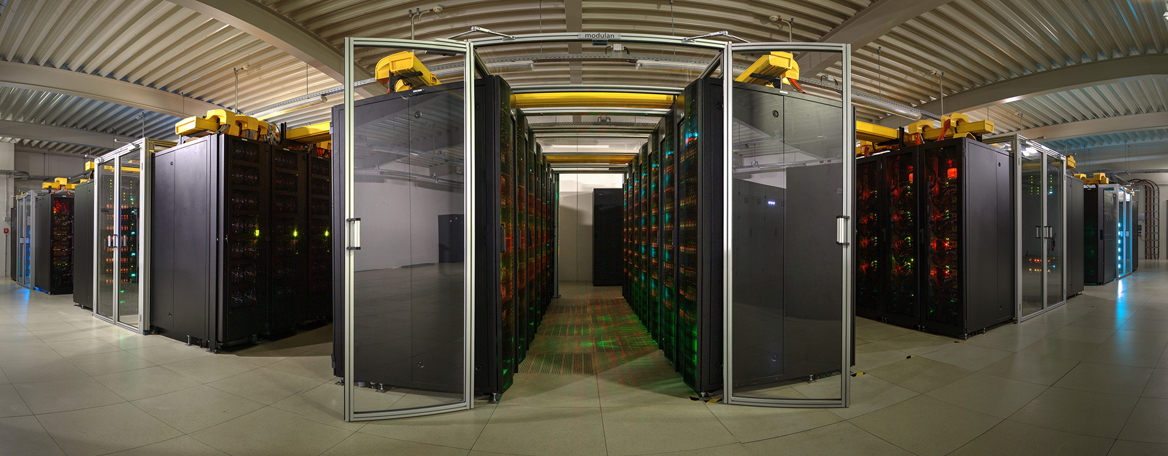
HLRE3 – Mistral
3000 Bullx DLC 720 ( >100.000 cores, 240 TB memory, 54 PB disk)
3.6 PetaFLOPS, Infiniband FDR (Top500: 33)

Slide 5
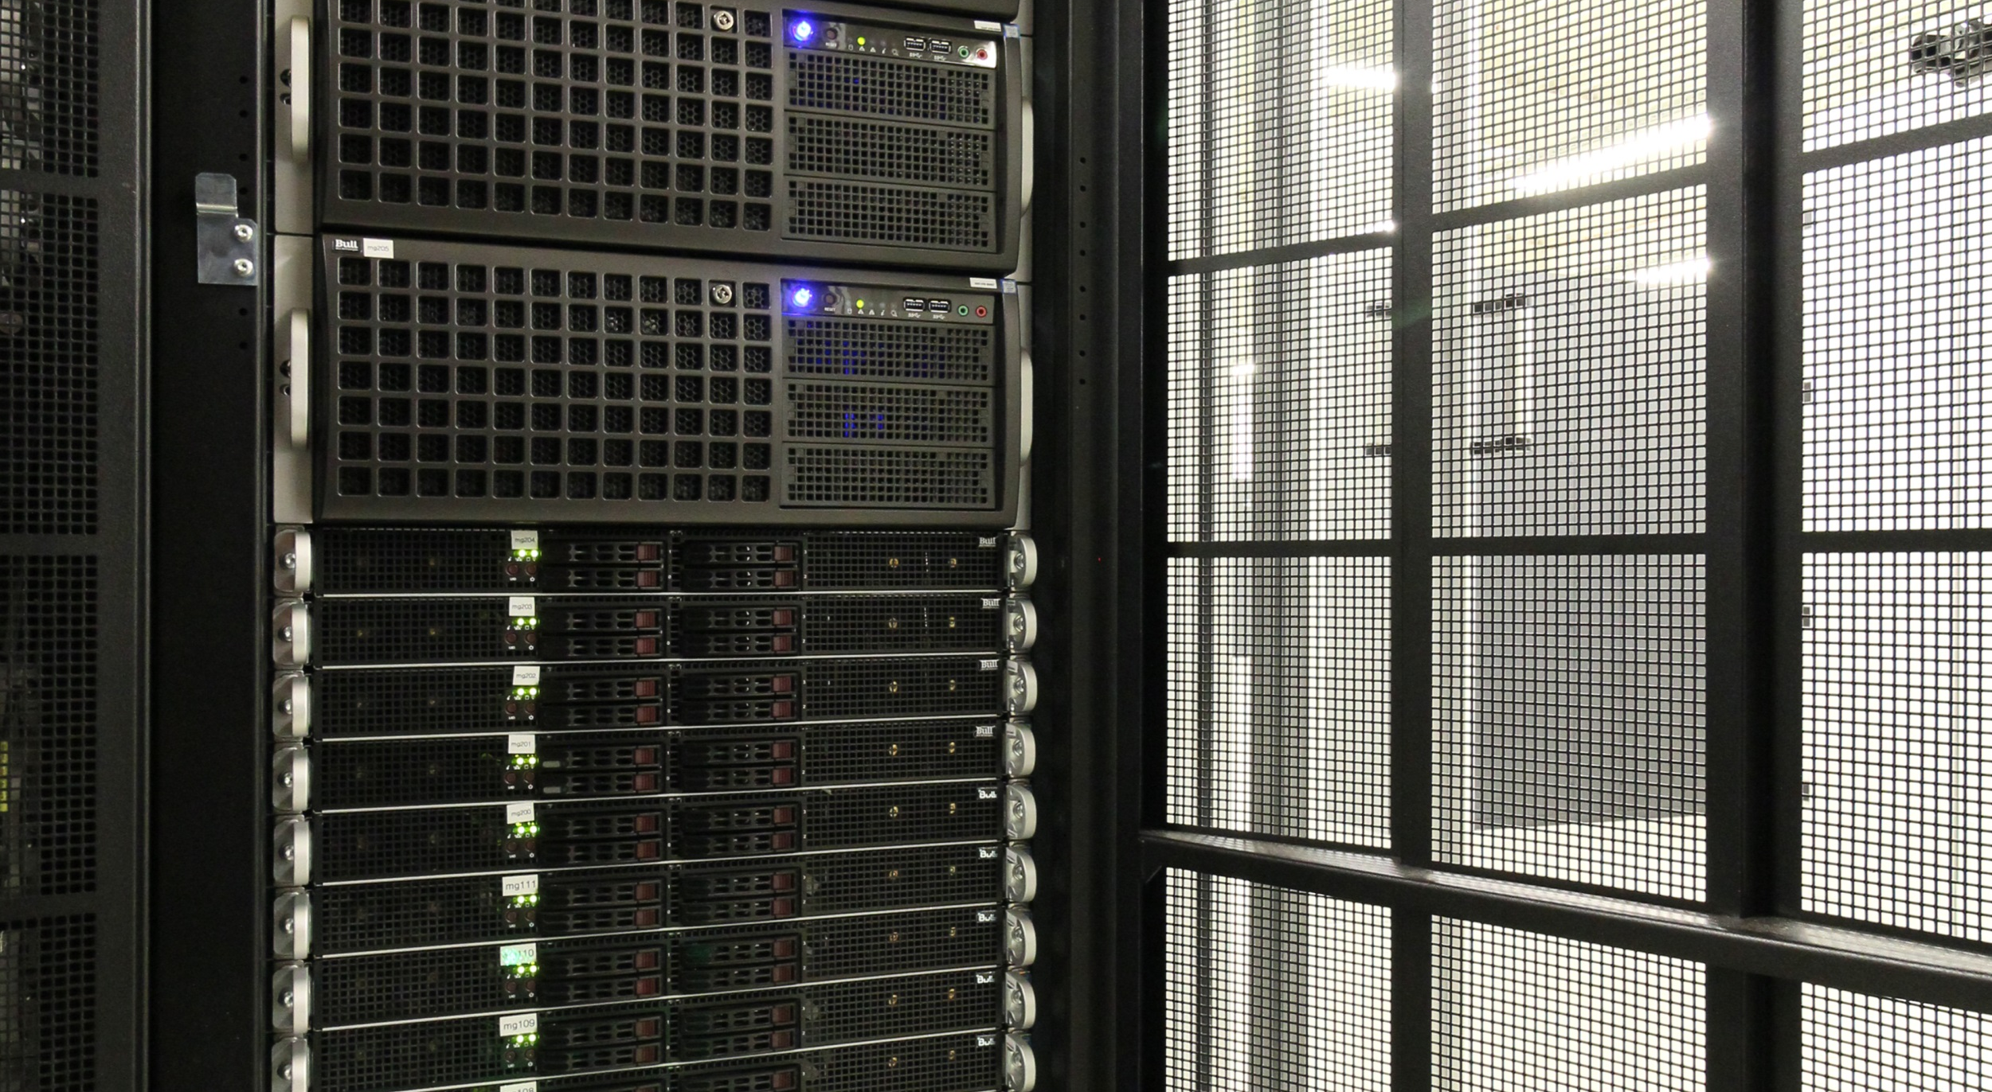
  21 GPU nodes (2 Haswell/Boadwell, 256/512/1024 GB memory)
  4 GPUs per node (2 dual Kepler/Maxwell)
  Software: NCL, ParaView, AvizoGreen, VAPOR

Slide 6
Hardware
Linux nodes with XAS software tree:
avizo/9.0.1
paraview/5.0.1
simvis/3.4.4
vapor/2.5
idl/8.5
ncl/6.2.1
grads/2.0.2
ferret/6.9.3
gmt/5.1.2

Slide 7
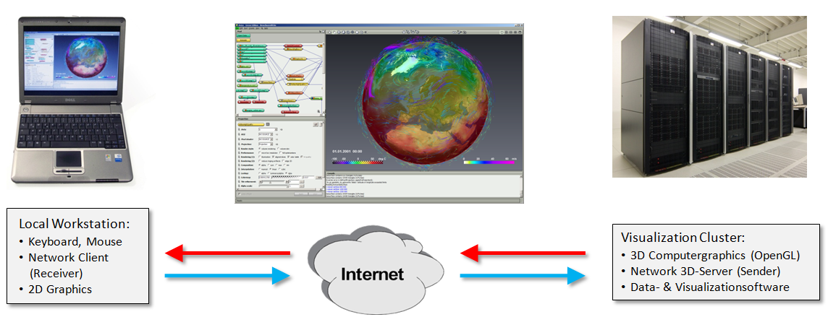
Remote 3D Rendering

Slide 8
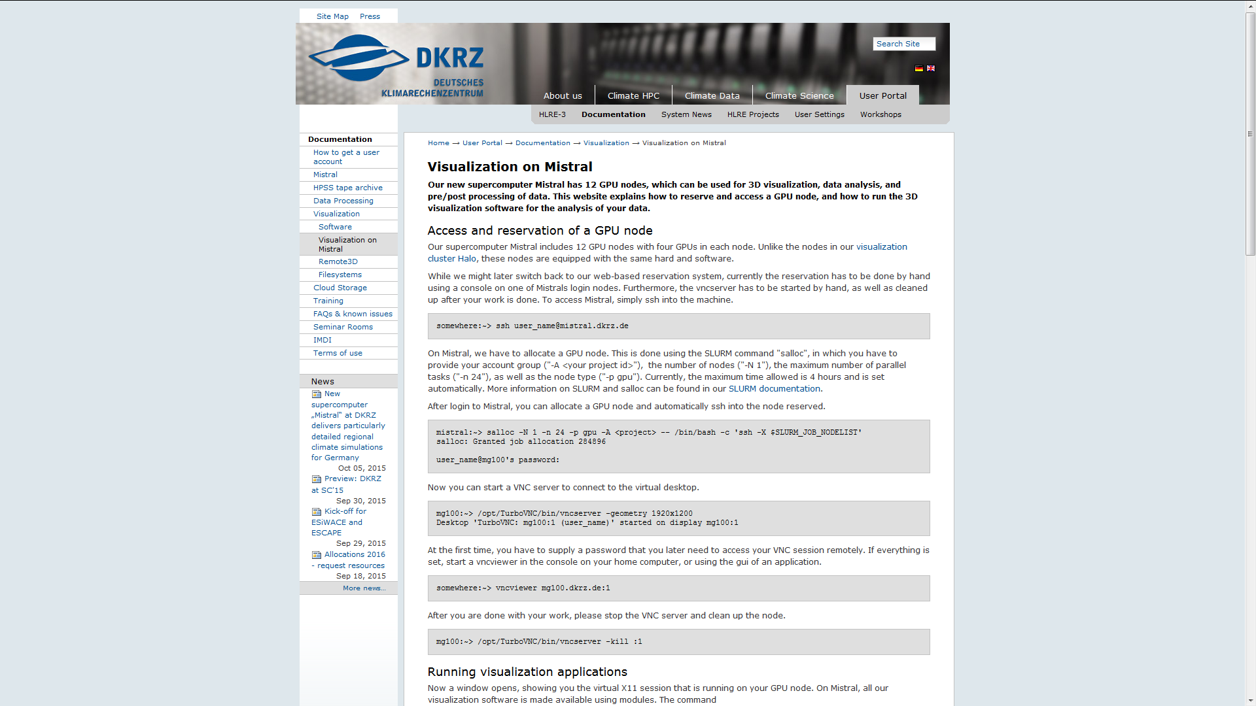

Slide 9
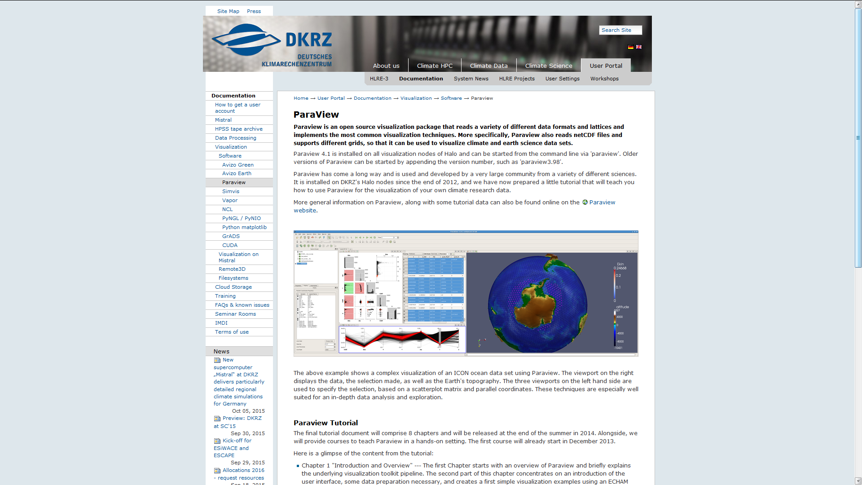

Slide 10
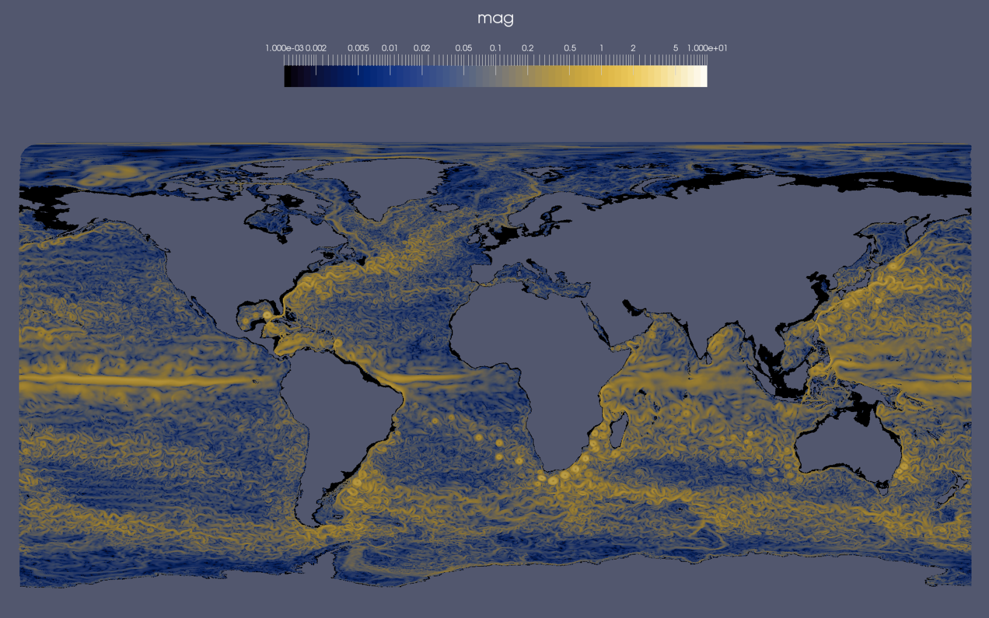

Slide 11
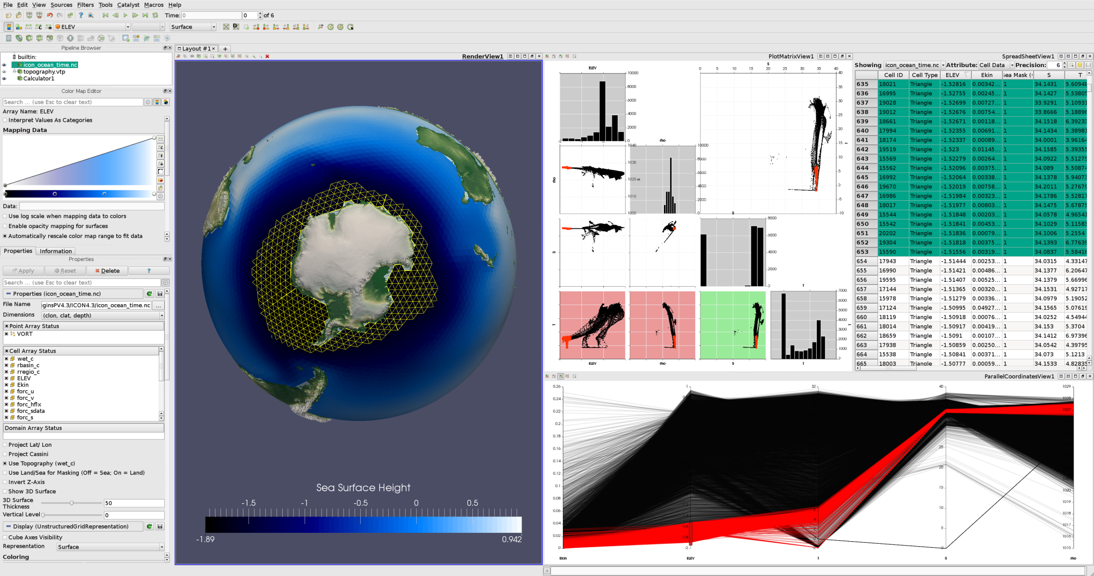

Slide 12
Visualization of performance data
ICON data with cell/point variables performance data
Select interesting areas and display results using parallel coordinates view
Integrated into vtkCDIReader
Requires domain decomposition and performance data
and
Notes:
Currently we work together with the Planetarium of Hamburg on a show that puts our results/animations in the focus.

Slide 13
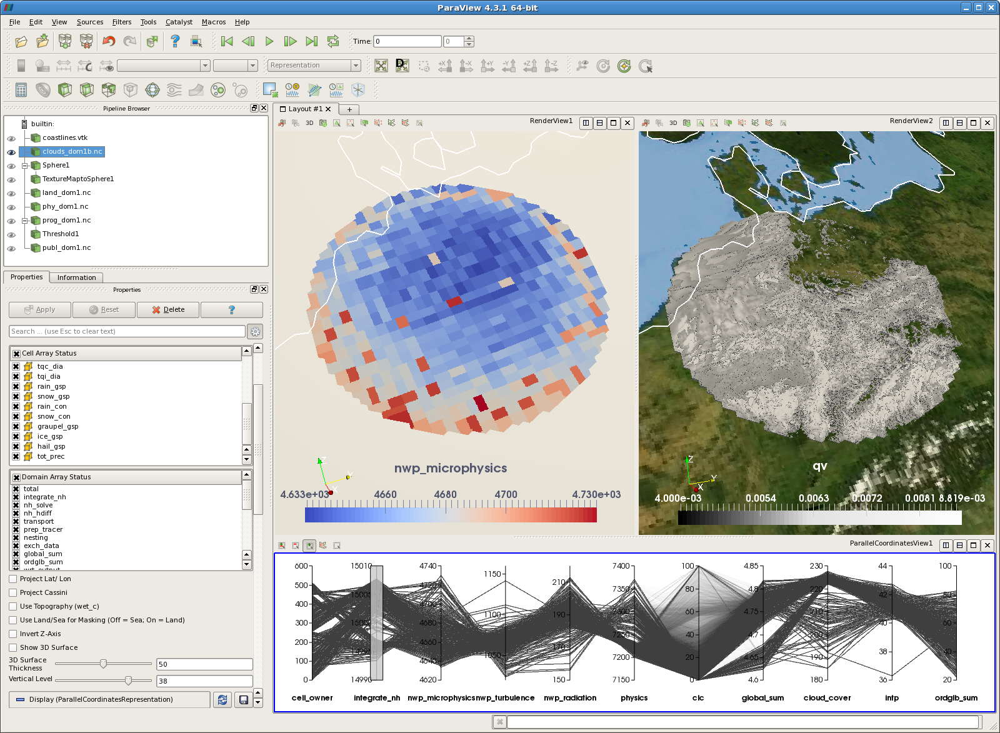
Performance Data Simulation Data

Slide 14
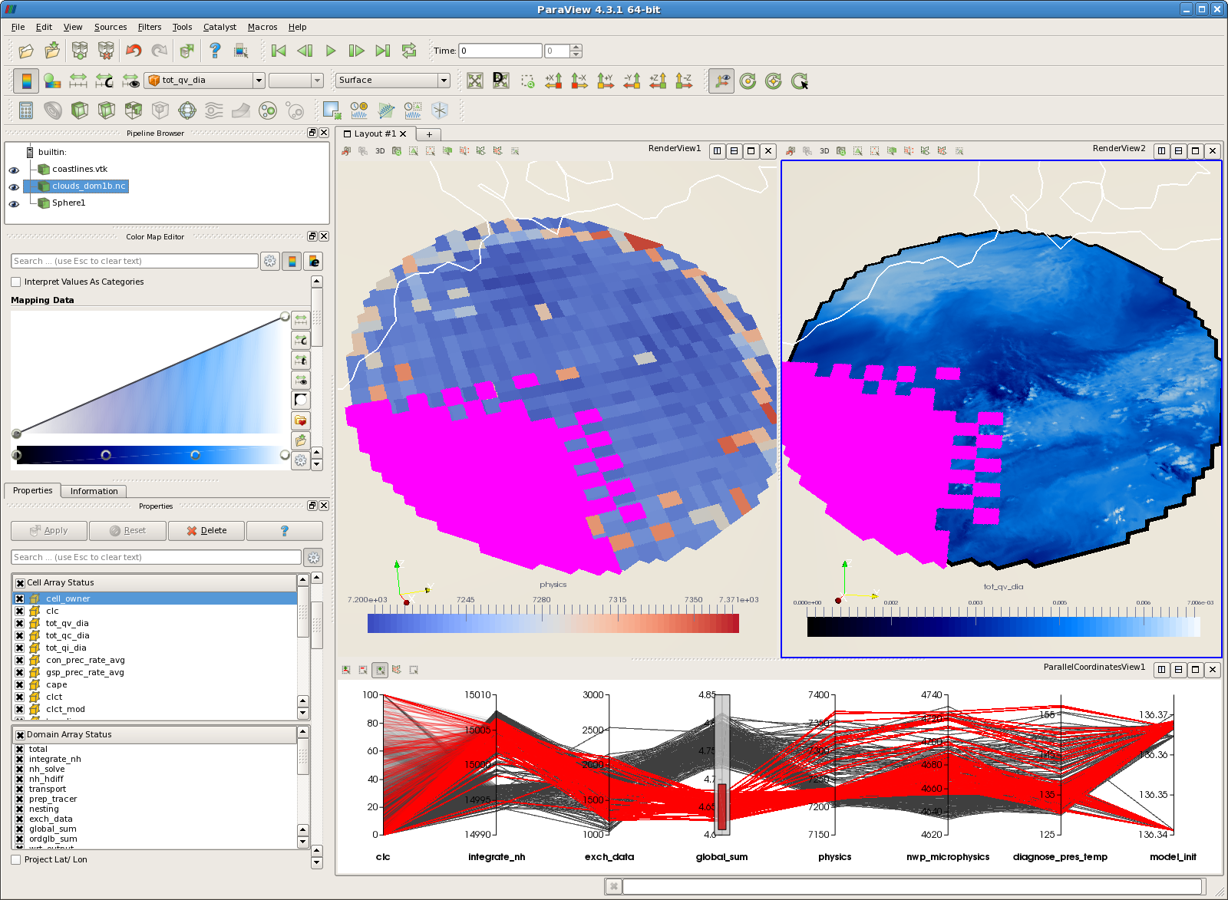
Global Sum

Slide 15
Login
local:~> ssh user_name@mistral.dkrz.de
mistral:~> salloc -N 1 -n 24 -p gpu -A <project> -- /bin/bash -c 'ssh -X
mg100:~> /opt/TurboVNC/bin/vncserver -geometry 1920x1200
local :~> vncviewer mg100.dkrz.de:1
mg100:~> cd /work/kv0653/ParaView-Workshop
mg100:~> module load paraview
mg100:~> paraview
https://www.dkrz.de/Nutzerportal-en/doku/vis/visualization-on-mistral

