Slide 1
Aaron‘s storyline

Slide 2
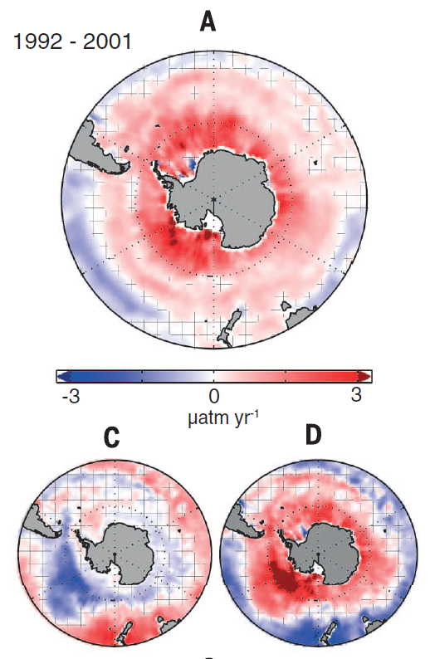

Observations (Landschützer et al. 2015) show anomalous outgassing decadal trend in the Southern Ocean Carbon Sink in the 1990s.

Slide 3
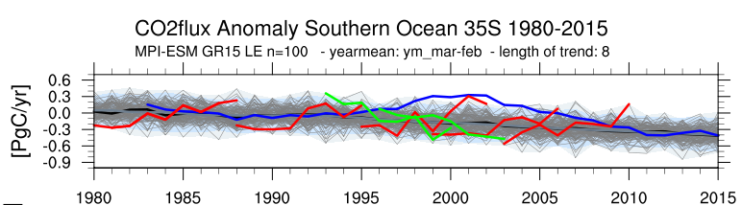
I use initially perturbed large ensemble simulations to assess the variability of the carbon sink and its underlying processes. I identify similar decadal trends in the MPI-ESM LE.

Slide 4
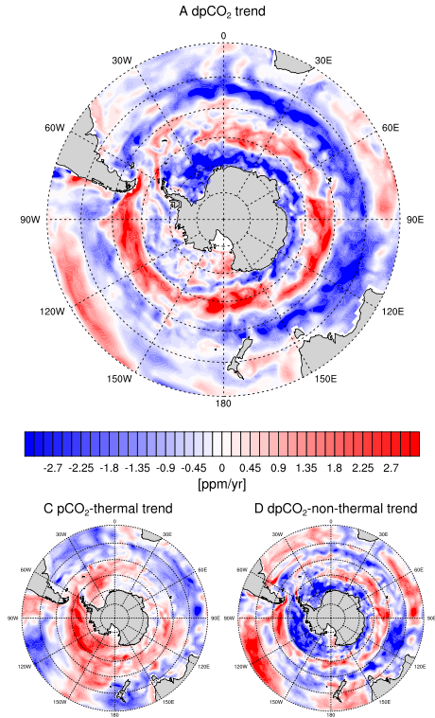
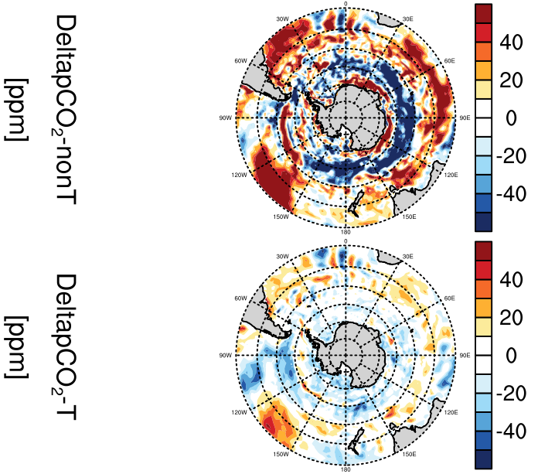
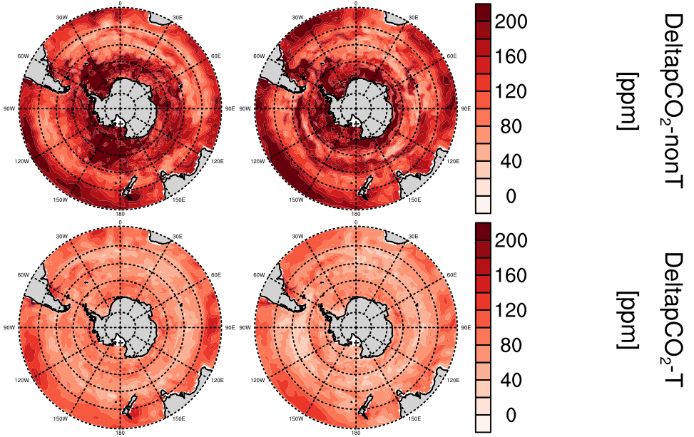
Non-thermal processes dominate dpCO2 trends.
MPI-ESM M130 1981-1988
Takahashi et al. 2012
dpco2 separation trends
non-
te
temp
Landschützer et al. 2015
Peter thinks its interesting:
Assymetric contributions results in zonal dpco2 trends!
A ~ C + D

Slide 5
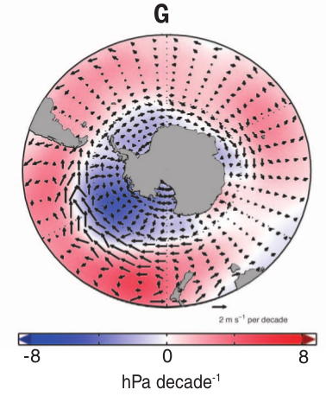
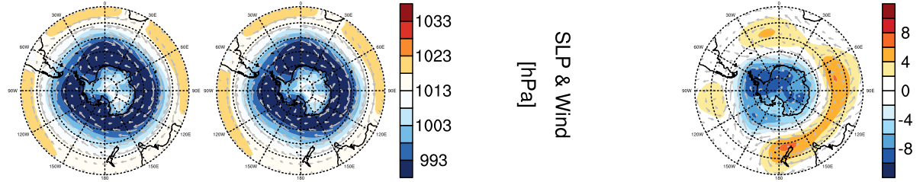
First explanation: SLP & patterns lead to increased upwelling.
Landschützer et al. 2015
MPI-ESM M130 1981-1988

Slide 6
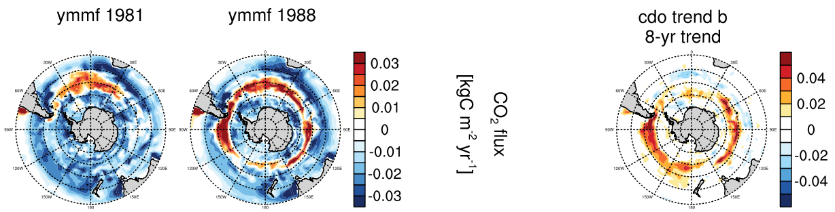
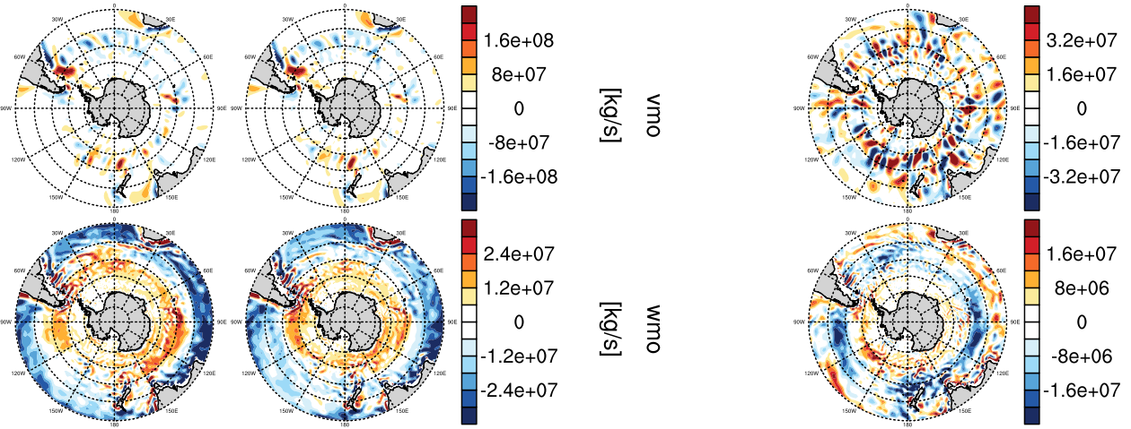
The anomalous outgassing trend is most dominant in 50s°S, a region with increased upwelling is induced by intensifying winds.

Slide 7
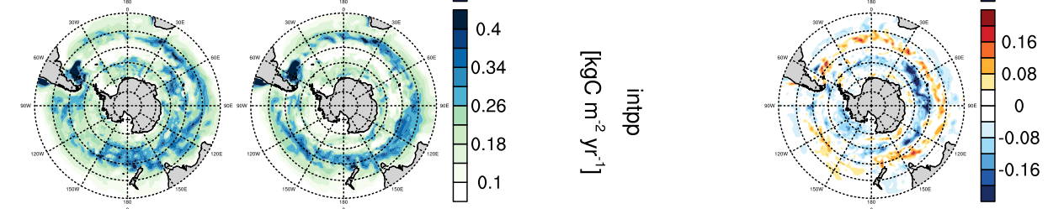
Second explanation: Primary production follows co2flux trend. How does intpp trend?

Slide 8
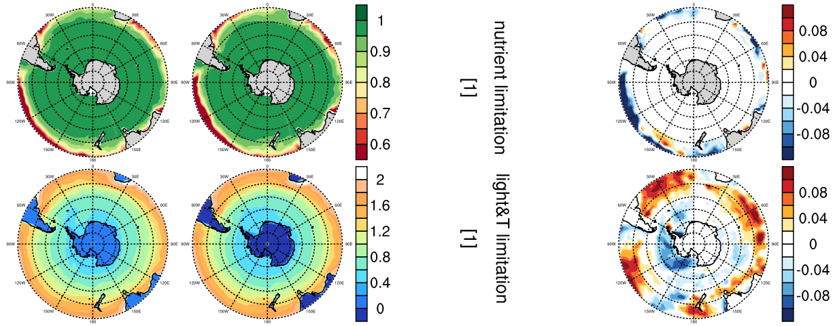
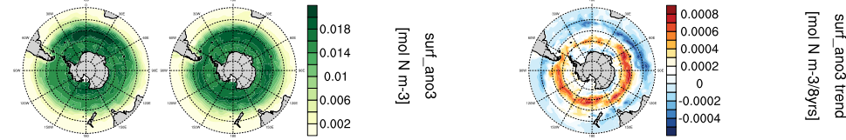
Primary production in the Southern Ocean in HAMOCC is not limited by nutrients, ...
Nutrients increase where less INTPP

Slide 9
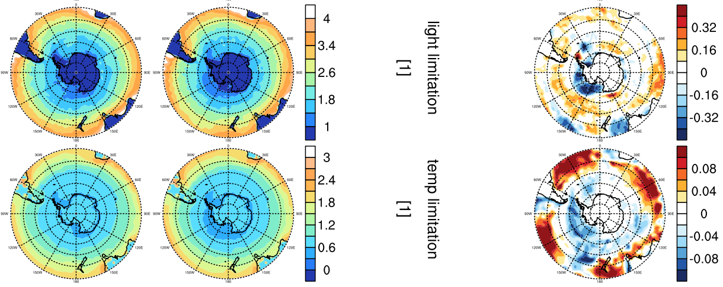
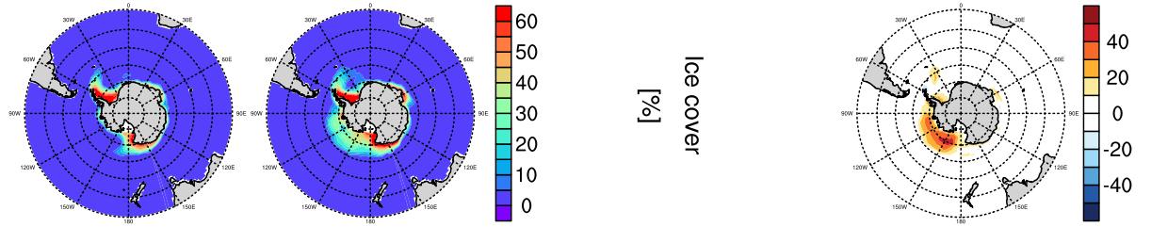
… and not by yearmean trends in light or temperature in 40s-60s°S.
I take trends of yearmean values. Next step: on mm or sm
Ice formed in Ross Sea

Slide 10
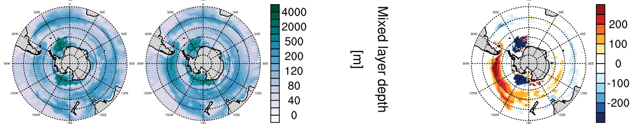
Primary production requires stability of the water column in the euphotic zone (Jöran/Tinka knows). This stability is maintained in 40s°S and reduced in 50s°S.

Slide 11
Primary production decreases S30s because of nutrients, increases S40s because of temperature effect, decreases S50s because of instability.

Slide 12
Conclusion
Anomalous outgassing trends in the Southern Ocean Carbon Sink can be explained by non-thermal direct effects on pco2. Increased upwelling and thermal-enhanced or water-column-instability-reduced primary production

Slide 13
Backup slides raw

Slide 14
Aaron’s vs Landschutzer 2015

Slide 16
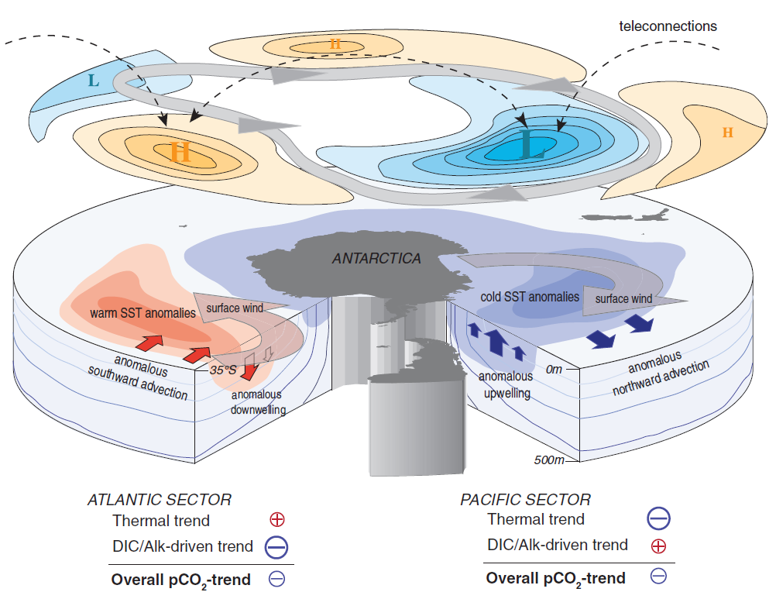
Landschützer et al. 2015

Slide 18
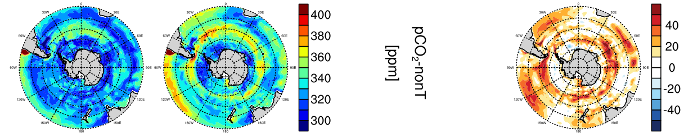
thermal separation nach Jassby and Platt (1976)

Slide 19
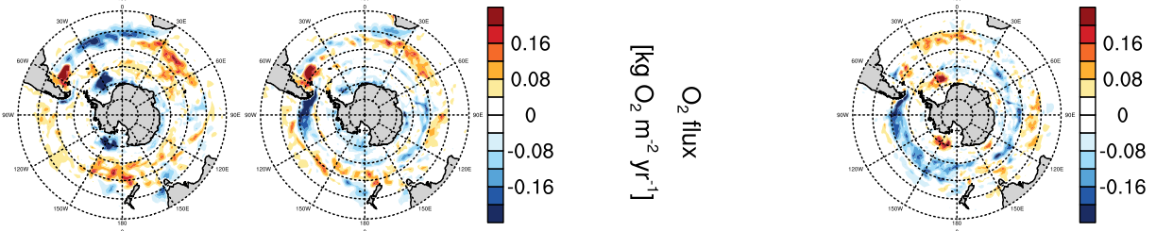

Slide 20
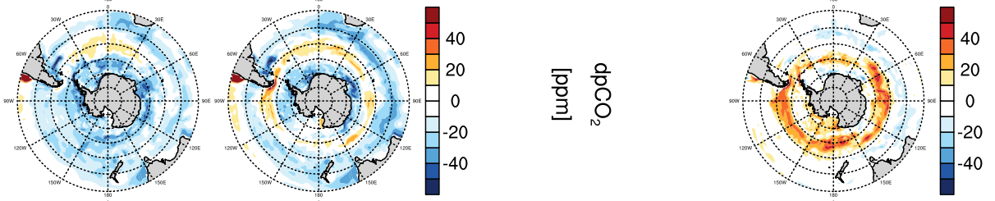
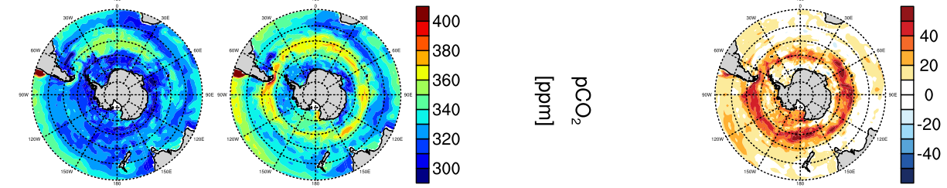

Slide 22
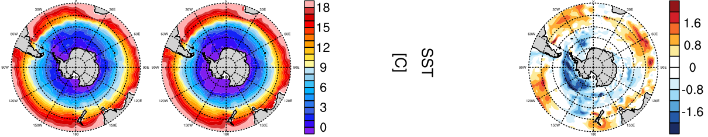

Slide 26


