Slide 1
Aaron‘s storyline

Slide 2
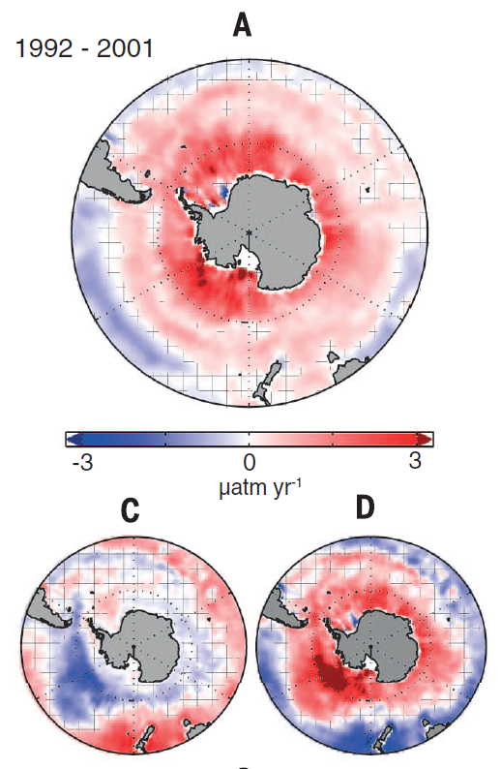

Observations (Landschützer et al. 2015) show anomalous outgassing decadal trend in the Southern Ocean Carbon Sink in the 1990s.

Slide 3
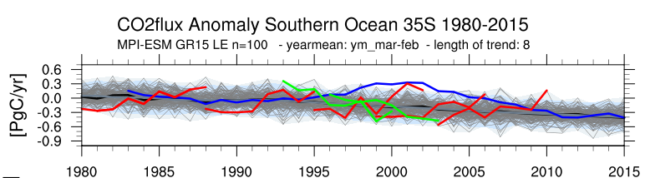
I use initially perturbed large ensemble simulations to assess the variability of the Southern Ocean carbon sink and its underlying processes. I identify similar decadal trends in the MPI-ESM LE.

Slide 4
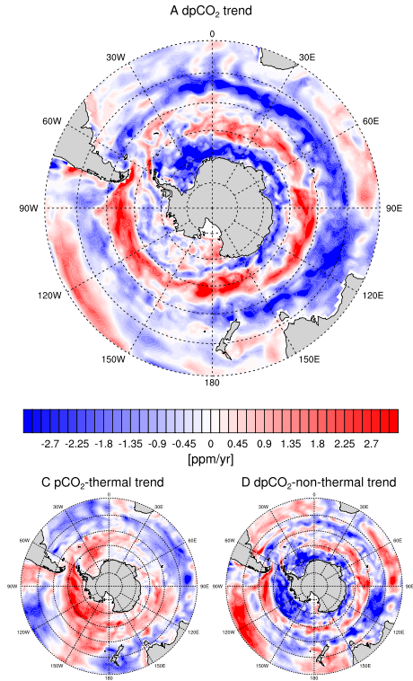
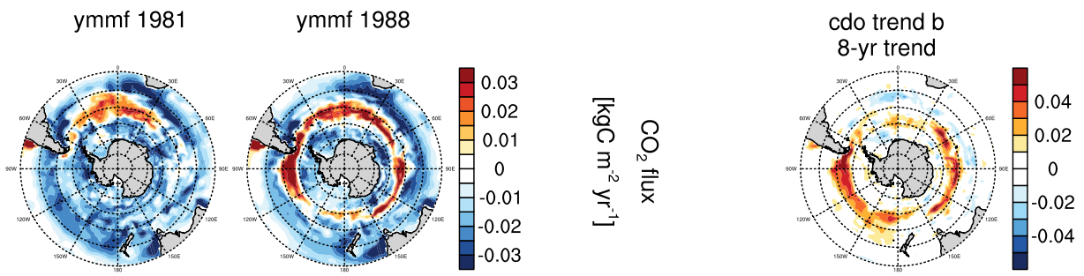
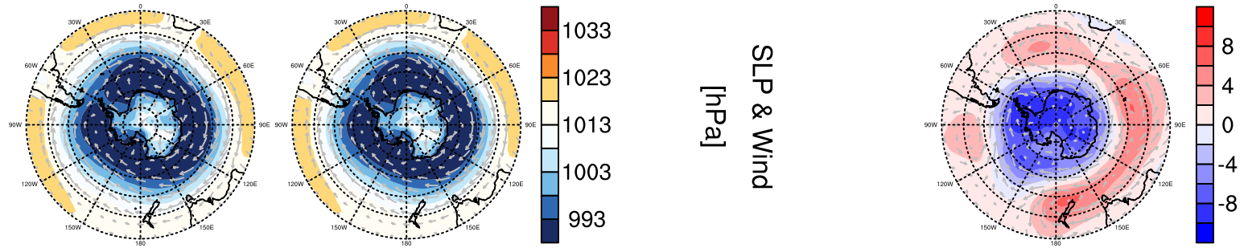
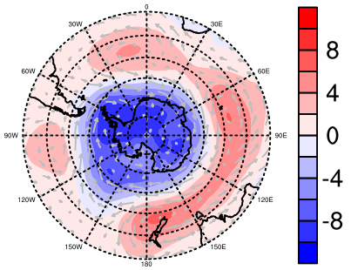
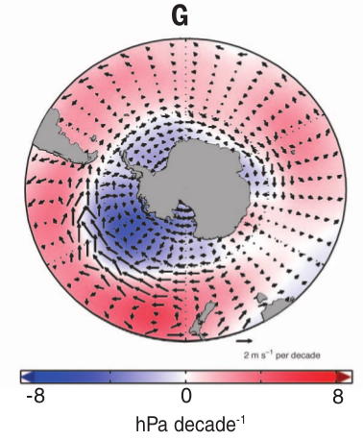
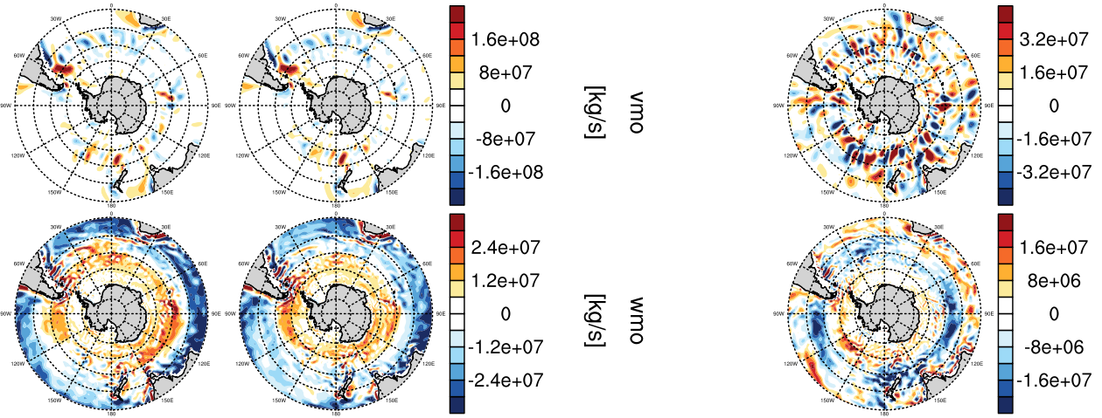
Non-thermal processes dominate. First Explanation: Anomalous outgassing trend is most dominant in 50s°S, where intensified winds increase upwelling.

Slide 5


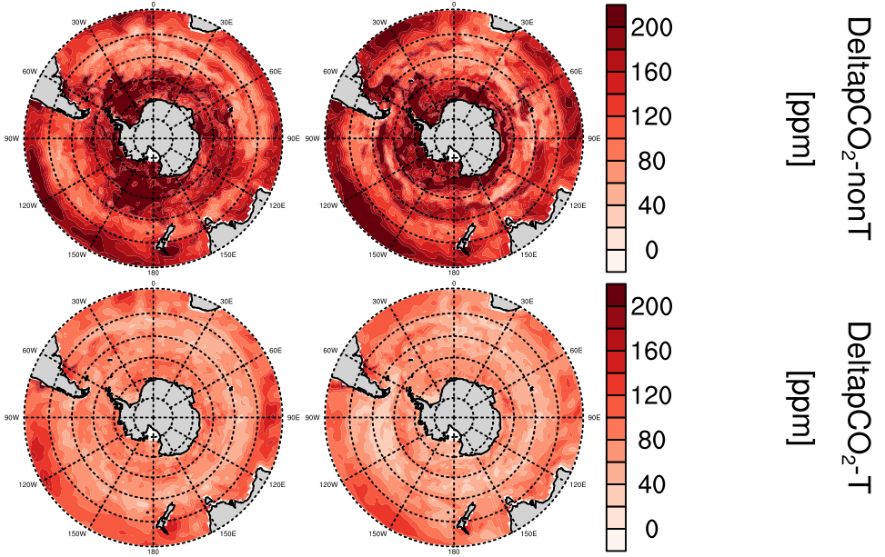
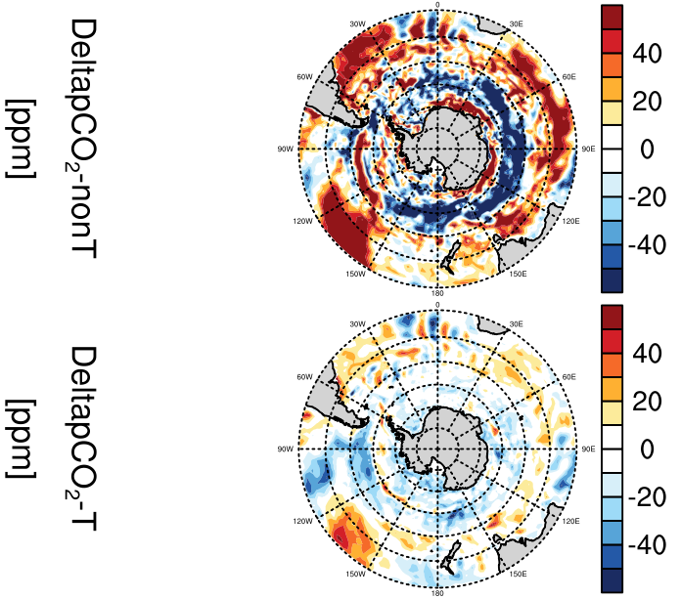


Seasonal cycle might also play a role
Takahashi et al. 2012
dpco2 separation trends
non-
te
temp

Slide 6
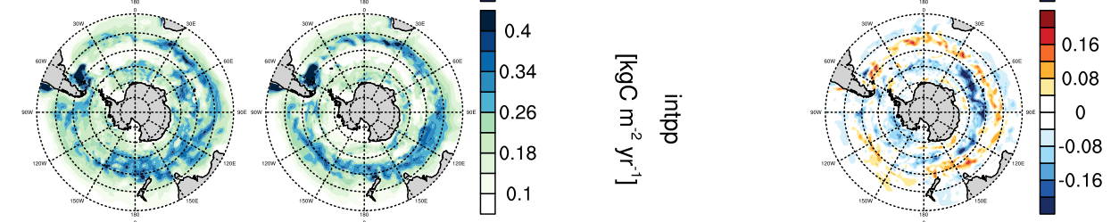
Second explanation: Primary production follows co2flux trend. Why does intpp trend?

Slide 7
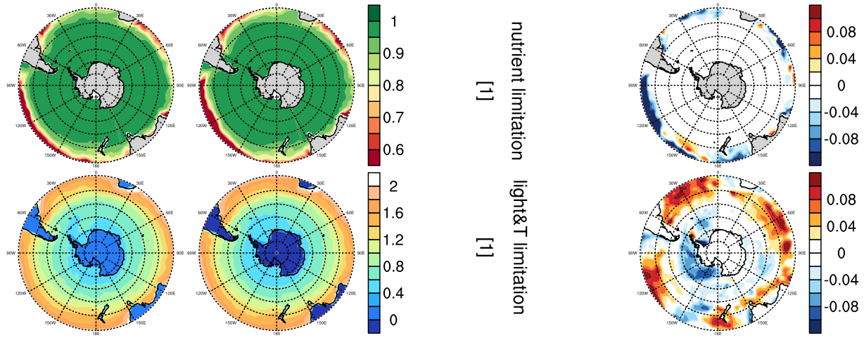
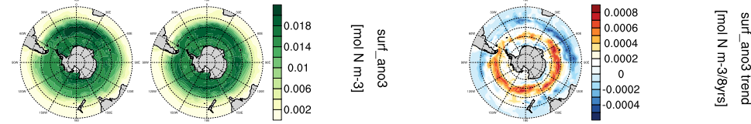
Primary production in the Southern Ocean in HAMOCC is not limited by nutrients, ...
Nutrients increase where less INTPP

Slide 8
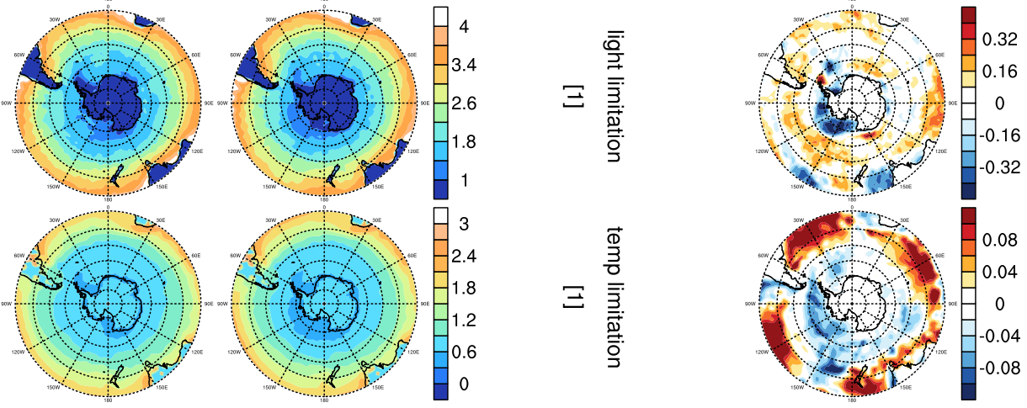
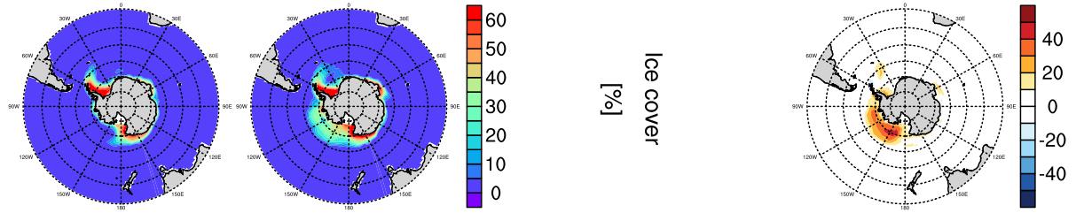
… and not by yearmean trends in light or temperature in 40s-60s°S.
I take trends of yearmean values. Next step: mm or sm
Ice formed in Ross Sea

Slide 9
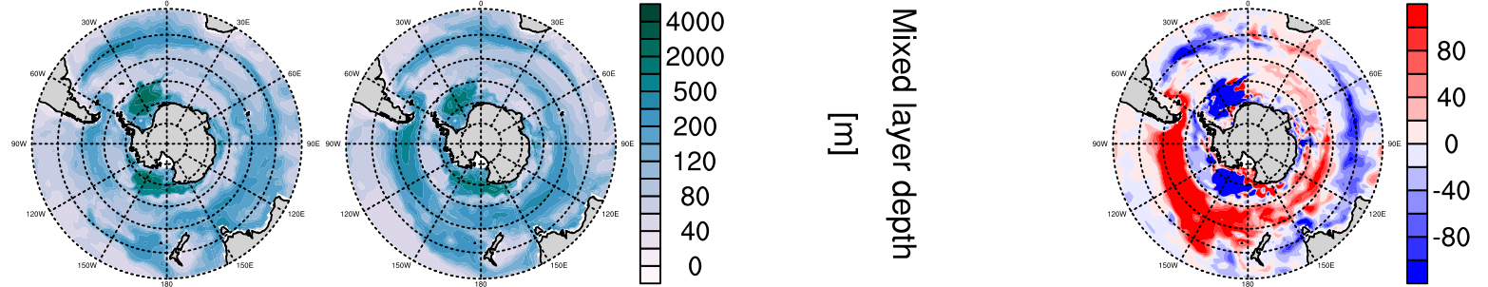
Primary production requires stability of the water column in the euphotic zone (Sverdrup 1953). This stability is maintained in 40s°S and reduced in 50s°S.

Slide 10
Primary production decreases S30s because of nutrients, increases S40s because of temperature effect, decreases S50s because of instability.

Slide 11
Conclusion
Anomalous outgassing trends in the Southern Ocean Carbon Sink can be explained by non-thermal direct effects on pCO2: Increased upwelling and thermal-enhanced or water-column-instability-reduced primary production

Slide 12
Backup slides raw

Slide 13
Aaron’s vs Landschutzer 2015

Slide 15
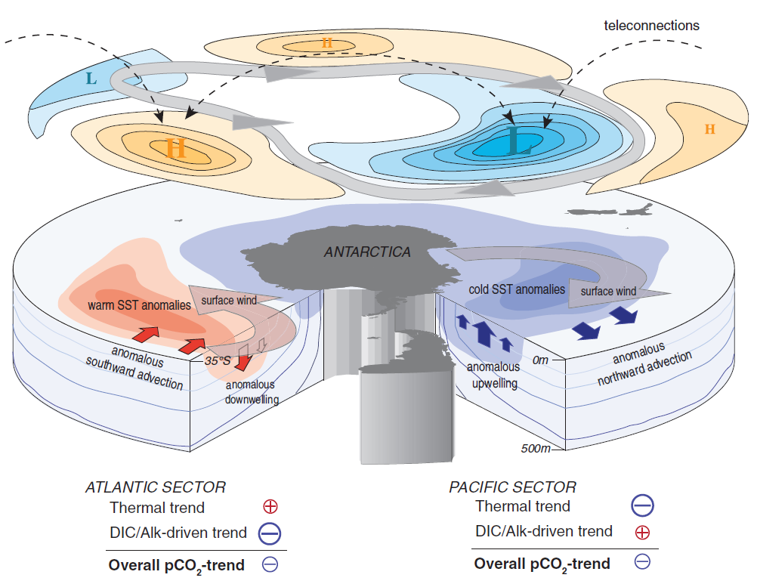
Landschützer et al. 2015

Slide 17
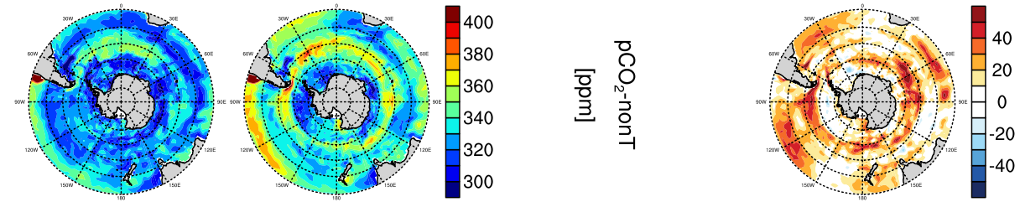
thermal separation nach Jassby and Platt (1976)

Slide 18
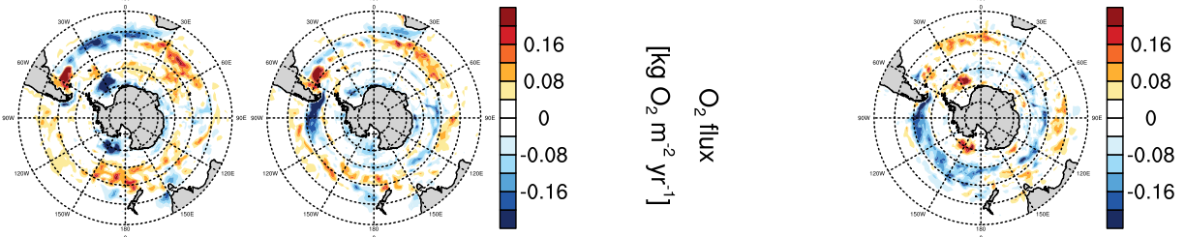

Slide 19
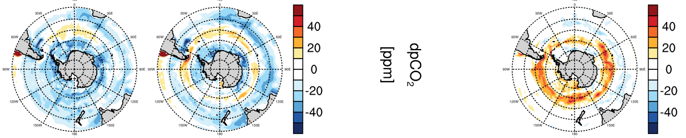
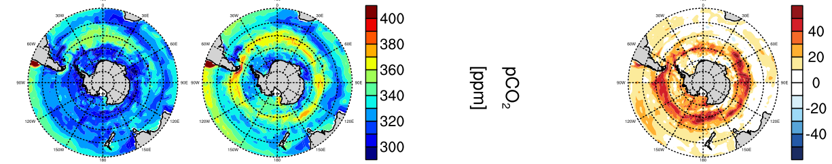

Slide 21
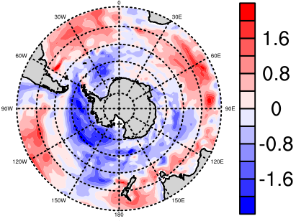
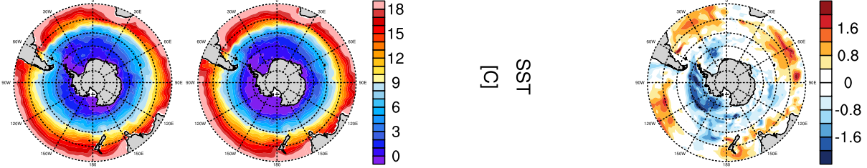

Slide 25
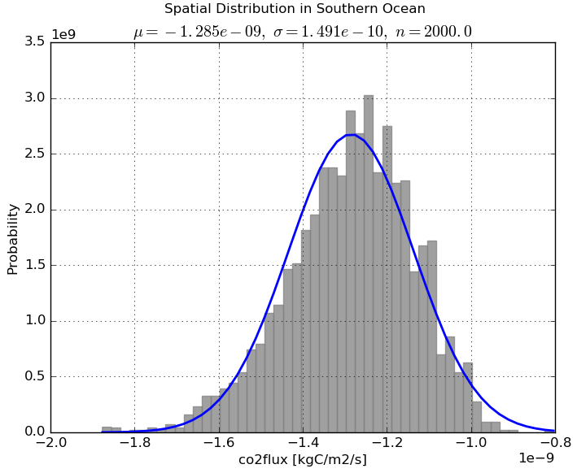
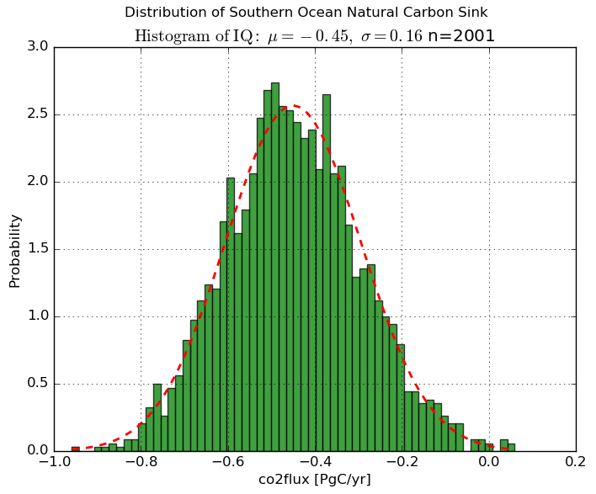

Slide 26
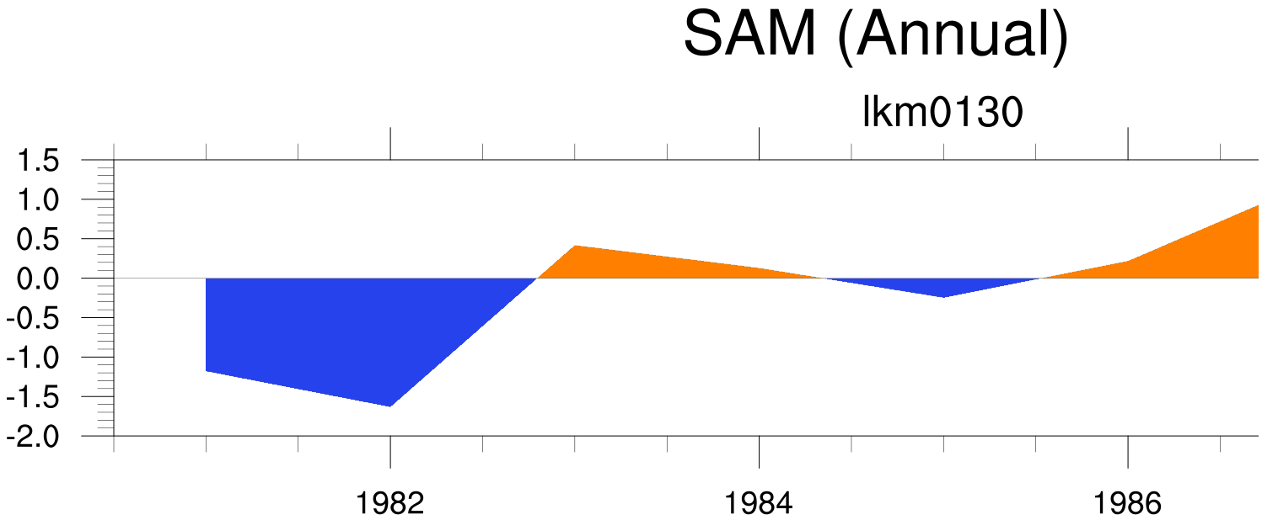
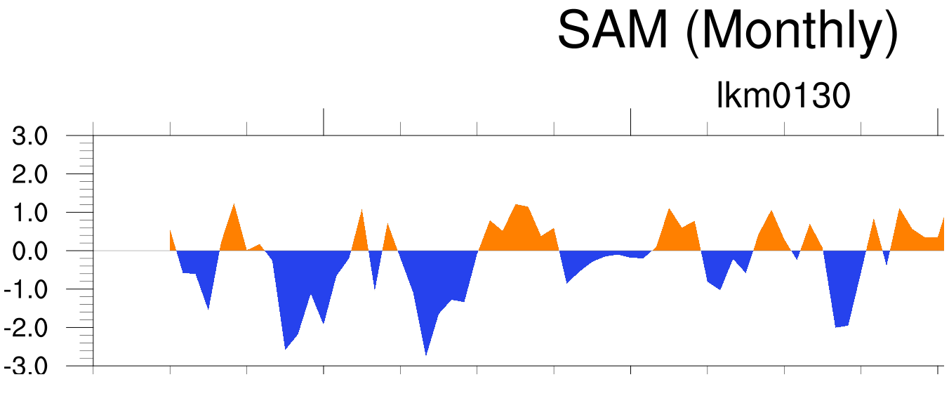

Slide 27
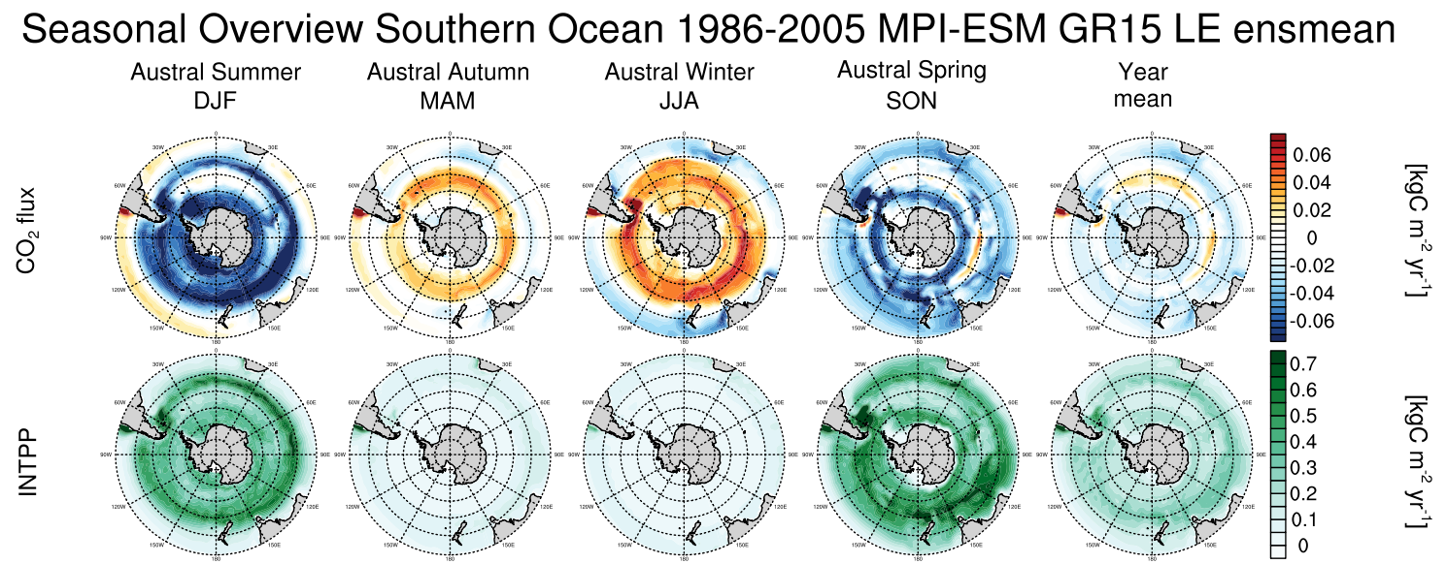
ensmean

Slide 28
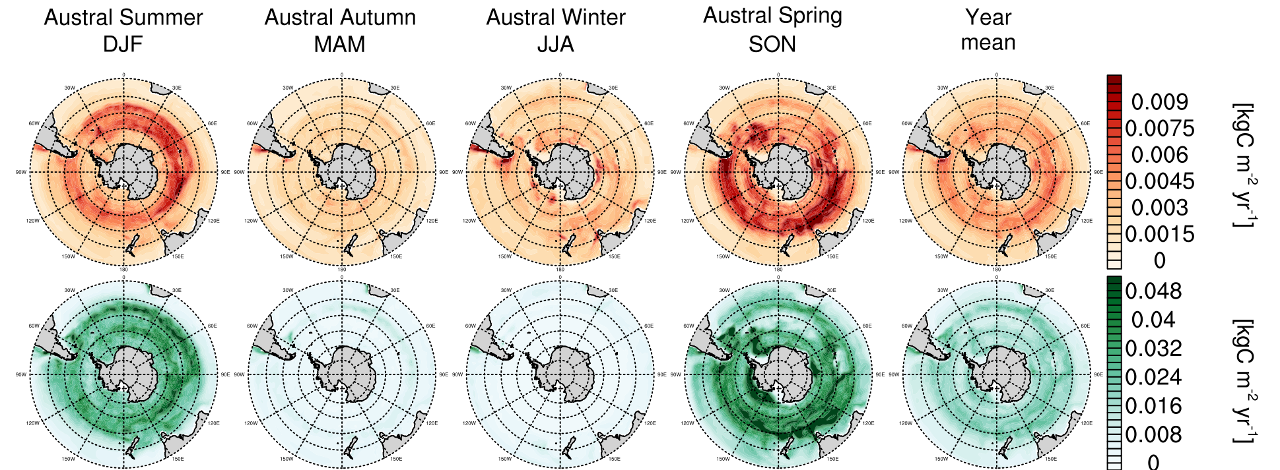
ensstd

