Slide 1
Closing the Southern Ocean Carbon Budget
Aaron Spring

Slide 2
My goal
Budget Analysis in Southern Ocean basin
Calculate northward CO₂ flux to close the budget
two different methods, budget not closed: I want to know what I am missing so far!

Slide 3
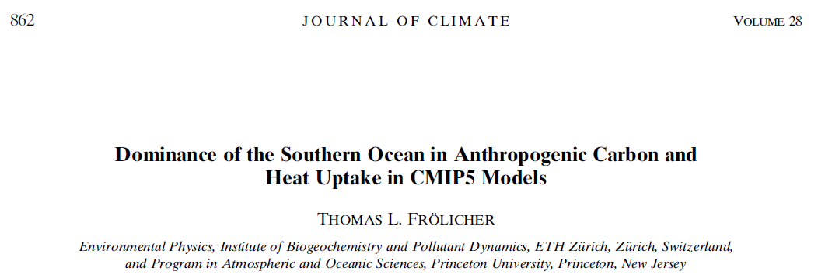
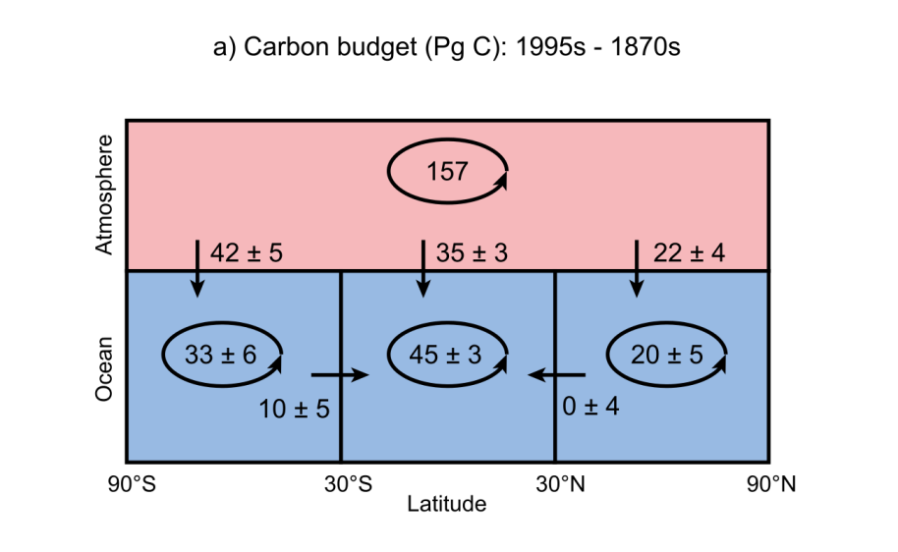
anthropogenic
2 methods:
direct
indirect

Slide 4
Methods: direct and indirect

Slide 5
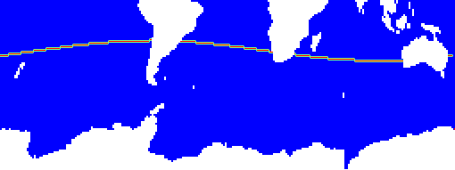
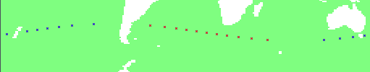
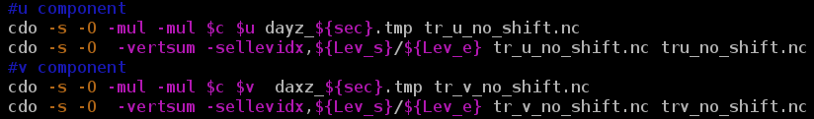
direct northward transport
Ψ_{direct,n} = c[kmol/m³] u[m/s] A[m²]

Slide 6
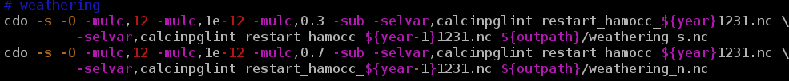
indirect northward transport
Ψ_{n} = weathering_{s} + co2flux_{s} – sediment exchange_{s} – inventory changes_{s}
Ψ_{s} = weathering_{n} + co2flux_{n} – sediment exchange_{n} – inventory changes_{n}
-Ψ_{s} = Ψ_{n} ~ Ψ_{direct}
Inventory (restart: year – year-1): sco212, doc, det, phy, zoo, calc
Sediment (outdata year): prorca, prcaca, sedfludic

Slide 7
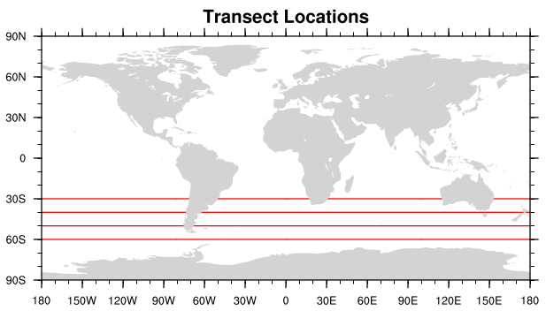
Comparison of results
/home/mpim/m300524/scripts/budget_simple/budget_residual_or_direct.sh
-Ψ_{s} = Ψ_{n} → ~1-2%, max. 5% difference
30S: 1.25* Ψ_{n} ~ Ψ_{direct} → 20-30% difference
40S: 1.15* Ψ_{n} ~ Ψ_{direct} → 0-30% difference
50S: 0.85* Ψ_{n} ~ Ψ_{direct} → -0--100% difference
5 years: lkm200, 1991-1995

Slide 8
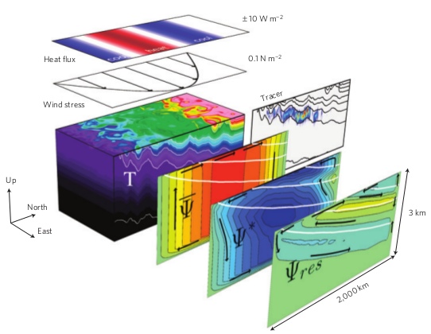

My points
My questions
Direct method takes only advective transport
Difference could be due to diffusion and eddies
  Helmut says: max. 10%
  (Parametrized) Eddies should effect southward transport [Marshall and Speer,2012]
Missing/wrong assumptions/fluxes
Accept 20-25% difference as eddy contribution?

Slide 9
Implementation of correct flow directions
aka. Tinka’s mod
Aaron Spring

Slide 10
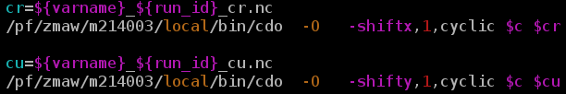
direct northward transport no mod
Ψ_{no_mod} = c[kmol/m³] u[m/s] A[m²] + c v A
What if v > 0 or if u < 0 and c_{m} != c_{r}?
Incorrect at strong gradients!
Takes wrong j in v-transport! (c_{m}*v instead of c_{u}*v if v>0)
c_{m}
c_{r}
u
v
c_{u}
x
y

Slide 11
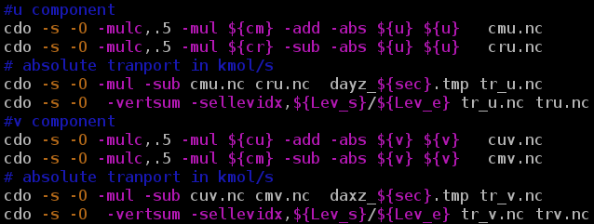
direct northward transport
Ψ_{no_mod} = c[kmol/m³] u[m/s] A[m²] + c v A
Ψ_{Tinkas_mod} = [c_{m}*0.5*(u +|u|)-c_{r}*0.5*(u -|u|)] A +
[c_{u}*0.5*(v +|v|) -c_{m}*0.5*(v -|v|)] A
c_{m}
c_{r}
u
v
c_{u}

Slide 12
Comparison of results
/home/mpim/m300524/scripts/budget_simple/budget_section_transport_shift_no_shift.sh
Ψ_{no_mod} != Ψ_{Tinkas_mod} →sco212 flux changes sign
                doc,det,phy,zoo dont change much as expected!

Slide 13
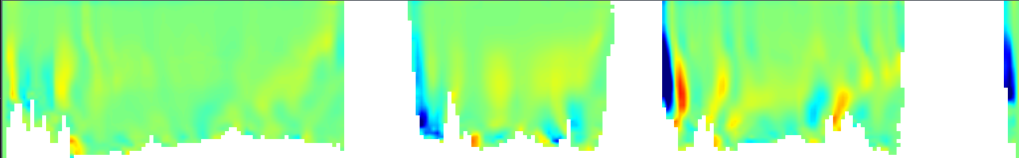

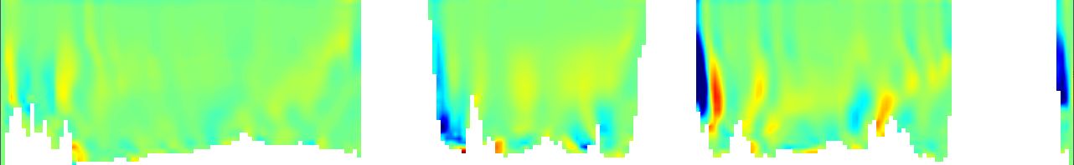

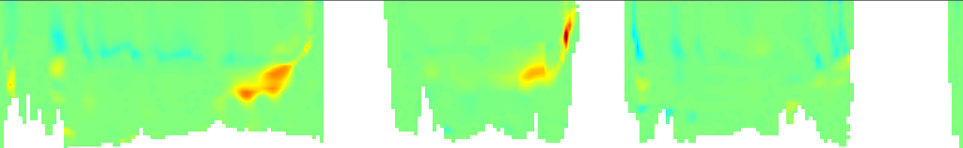


Transsect at 30S: sco212 transport
cdo gridboxsum,1,220
1 year: lkm200, 1993
Ψ_{Tinkas_mod}
Ψ_{no_mod}
Ψ_{v}=39.49 PgC/yr
Ψ_{Tinkas_mod,otal}=-0.61 PgC/yr
Ψ_{u}=-40.10 PgC/yr
South America
Australia
Africa
[kmolC/s]
Ψ_{v}=43.59 PgC/yr
Ψ_{no_mod,total}=1.05 PgC/yr
Ψ_{u}=-42.54 PgC/yr
Ψ_{v}=0.31 PgC
Ψ_{sub}=2.75 PgC
Ψ_{u}=2.44 PgC
Ψ_{Tinkas_mod}-Ψ_{no_mod}
Benguela Current
Namibian coast
900-1900m depth
More missing values of topography!

Slide 14
My questions
What is messing this up?
  sco212 because doc,det,phy,zoo seem to comply
  Topography? Can this be fixed with some cdo?
  Curvilinear grid and lon section? j=const. boundary
  Benguela current: no, also happens for 40S, 3 spots
Missing/wrong assumptions/fluxes

