Slide 1
Closing the Southern Ocean Carbon Budget
Aaron Spring

Slide 2
My goal
Budget Analysis in Southern Ocean basin
Calculate northward CO₂ flux to close the budget
two different methods, budget not closed: I want to know what I am missing so far!

Slide 3
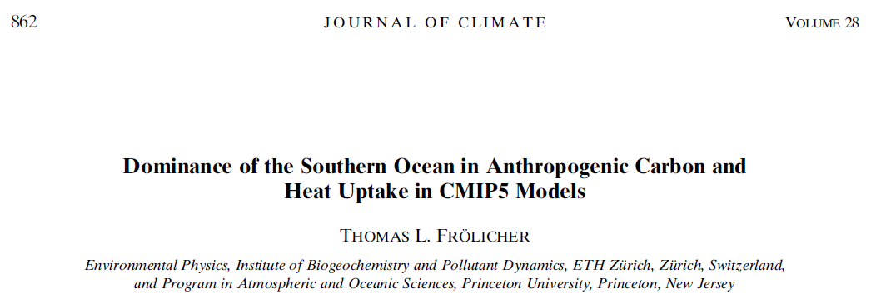
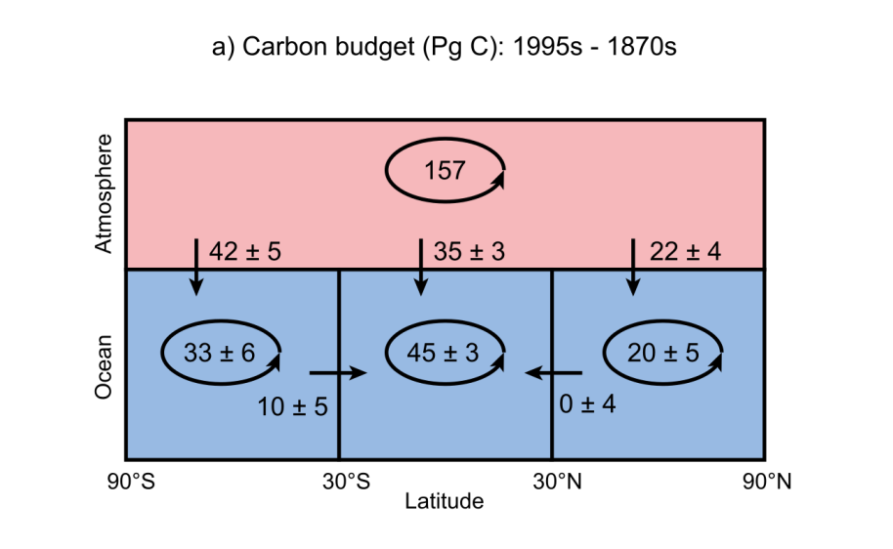
anthropogenic
2 methods:
direct
indirect

Slide 4
Methods: direct and indirect

Slide 5
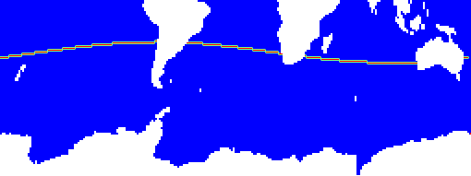
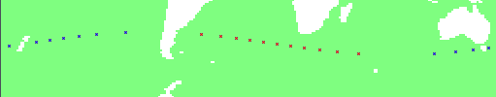
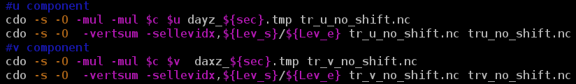
direct northward transport
Ψ_{direct,n} = c[kmol/m³] u[m/s] A[m²]

Slide 6
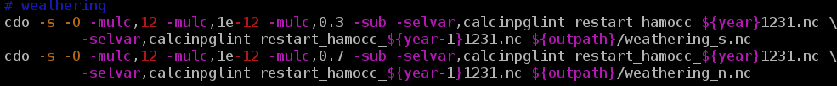
indirect northward transport
Ψ_{n} = weathering_{s} + co2flux_{s} – sediment exchange_{s} – inventory changes_{s}
Ψ_{s} = weathering_{n} + co2flux_{n} – sediment exchange_{n} – inventory changes_{n}
-Ψ_{s} = Ψ_{n} ~ Ψ_{direct}
Inventory (restart: year – year-1): sco212, doc, det, phy, zoo, calc
Sediment (outdata year): prorca, prcaca, sedfludic

Slide 7
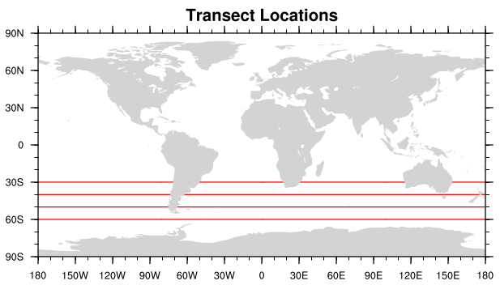
Comparison of results
/home/mpim/m300524/scripts/budget_simple/budget_residual_or_direct.sh
-Ψ_{s} = Ψ_{n} → ~1-2%, max. 5% difference
30S: 1.25* Ψ_{n} ~ Ψ_{direct} → 20-30% difference
40S: 1.15* Ψ_{n} ~ Ψ_{direct} → 0-30% difference
50S: 0.85* Ψ_{n} ~ Ψ_{direct} → -0--100% difference
5 years: lkm200, 1991-1995

Slide 8
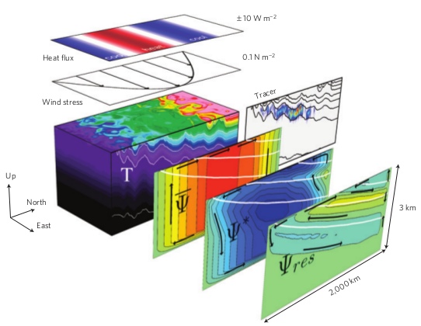

My points
My questions
Direct method takes only advective transport
Difference could be due to diffusion and eddies
  Helmut says: max. 10%
  (Parametrized) Eddies should effect southward transport [Marshall and Speer,2012]
Missing/wrong assumptions/fluxes
Accept 20-25% difference as eddy contribution?

Slide 9
Implementation of correct flow directions
aka. Tinka’s mod
Aaron Spring

Slide 10
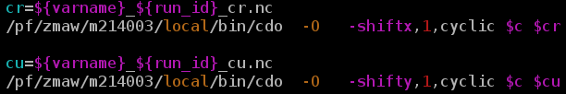
direct northward transport no mod
Ψ_{no_mod} = c[kmol/m³] u[m/s] A[m²] + c v A
What if v > 0 or if u < 0 and c_{m} != c_{r}?
Incorrect at strong gradients!
Takes wrong j in v-transport! (c_{m}*v instead of c_{u}*v if v>0)
c_{m}
c_{r}
u
v
c_{u}
x
y

Slide 11
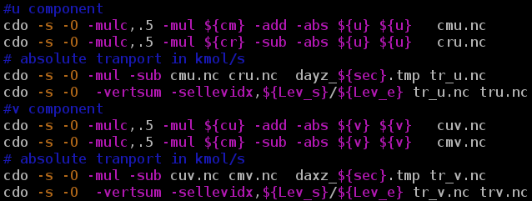
direct northward transport
Ψ_{no_mod} = c[kmol/m³] u[m/s] A[m²] + c v A
Ψ_{Tinkas_mod} = [c_{m}*0.5*(u +|u|)-c_{r}*0.5*(u -|u|)] A +
[c_{u}*0.5*(v +|v|) -c_{m}*0.5*(v -|v|)] A
c_{m}
c_{r}
u
v
c_{u}

Slide 12
Comparison of results
/home/mpim/m300524/scripts/budget_simple/budget_section_transport_shift_no_shift.sh
Ψ_{no_mod} != Ψ_{Tinkas_mod} →sco212 flux changes sign
                doc,det,phy,zoo dont change much as expected!

Slide 13
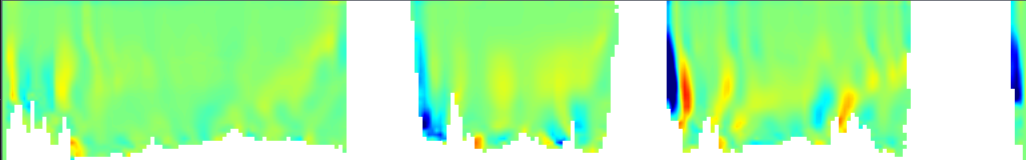

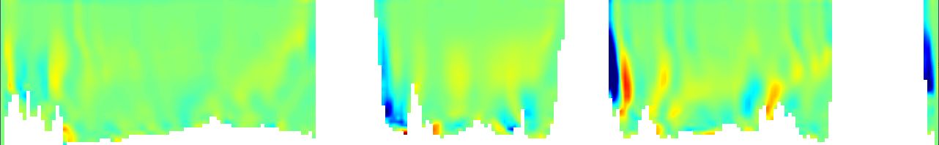

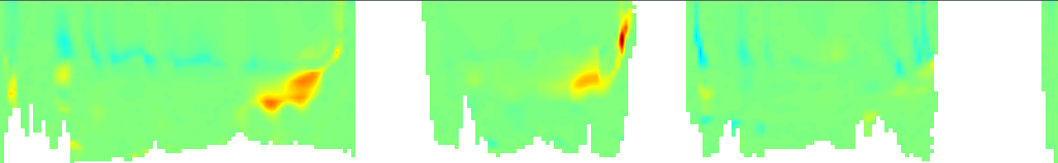


Transsect at 30S: sco212 transport
cdo gridboxsum,1,220
1 year: lkm200, 1993
Ψ_{Tinkas_mod}
Ψ_{no_mod}
Ψ_{v}=39.49 PgC/yr
Ψ_{Tinkas_mod,otal}=-0.61 PgC/yr
Ψ_{u}=-40.10 PgC/yr
South America
Australia
Lev25
Africa
[kmolC/s]
Ψ_{v}=43.59 PgC/yr
Ψ_{no_mod,total}=1.05 PgC/yr
Ψ_{u}=-42.54 PgC/yr
Ψ_{v}=0.31 PgC
Ψ_{sub}=2.75 PgC
Ψ_{u}=2.44 PgC
Ψ_{Tinkas_mod}-Ψ_{no_mod}
Benguela Current
Namibian coast
900-1900m depth
More missing values of topography! - Those make up 4.4 PgC (change_pixel*no_shift)!

Slide 14
My questions
What is messing this up?
  sco212 because doc,det,phy,zoo seem to comply
  Topography? Can this be fixed with some cdo?
  Curvilinear grid and lon section? j=const. boundary
  Benguela current: no, also happens for 40S, 3 spots
Missing/wrong assumptions/fluxes

