Slide 1
We understand air-sea exchange and iron cycle

Slide 2
Subroutines and options
carchm.f90
  l_ctl_co2 : explanation
  lomip : according to new CMIP6 OMIP protocol
  diffat : expl
  l_avflux : expl
ocprod.f90

Slide 3
State of today
Choose between two setups:
  ocean-only: OMIP if lomip
    Schmidt-numbers and Solubility as in OMIP CMIP6 Protocol: Orr et al. (2016) Geosci. Model Dev. Discuss.,
      Schmidt-numbers: Wannikhof 2014 jrnl…
  Coupled: NOT OMIP if not.lomip
    Older references
!!Co2flux atmospheric side or ocean side!!

Slide 4
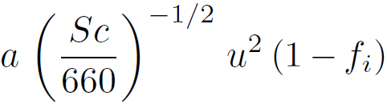
Air-sea exchange
= , , DMS, , concentation in ocean [ppmv]
= Solubility in seawater [?] – Meerwasserlöslichkeit
= transfer velocity [m/s] – Transfergeschwindigkeit
Sc = ~4th order polynomial of T: Schmidt-number
Extension for Sc at high values: Groeger&Mikolajewicz, Ocean Modeling,39,2011 (NOT OMIP)
u: wind velocity, f_i: sea-ice cover, a: conversion factor (new OMIP)

Slide 5
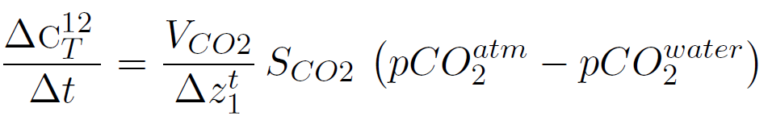
NOT OMIP: Schmidt number after Wanninkhof (1992, J. Geophys. Res., 97, 7373-7382)
OMIP: pressure effect Weiss (1974) ??? L. x, fugacity

Slide 6
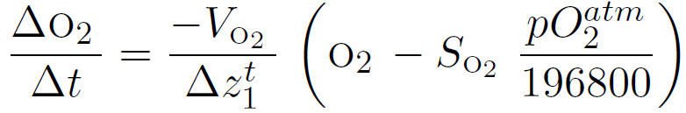
As in Meiner-Reimer et. al, 2005, Eq. 74
NOT OMIP: Schmidt number after Keeling et al. (1998, Global Biogeochem. Cycles, 12, 141-163)
OMIP: Solubility from Weiss (1970)
OMIP: pressure effect Weiss (1974) ??? L. x, fugacity

Slide 7
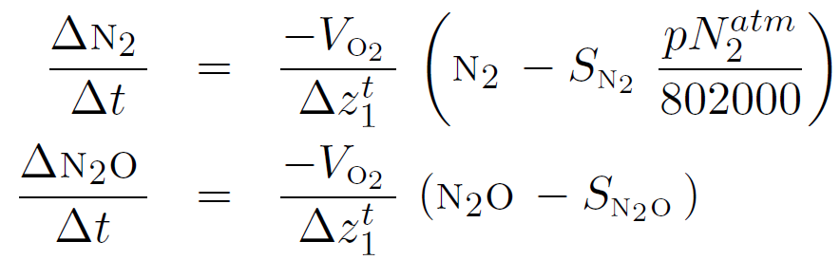
and
same piston velocity as for
Sc and piston velocity are same from and
follows Meiner-Reimer et. al, 2005, Eq. 75
OMIP from Weiss 1974?

Slide 8
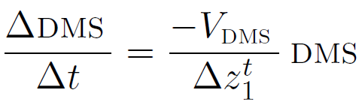
DMS
after (Meiner-Reimer et. al, 2005, Eq. 77)
assumes = 0
NOT OMIP: DMS Schmidt number after Saltzmann et al. (1993, J. Geophys. Res. 98, 16,481-16,486)

Slide 9
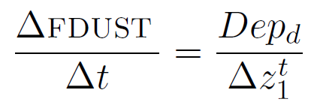
Iron Cycle
Dust deposition () added to surface layer (cite) as FDUST [kg m-3]
  Alternative dust fields possible
Dust particles have same diameter and sinking speed

Slide 10
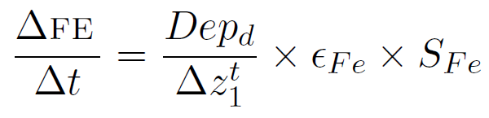
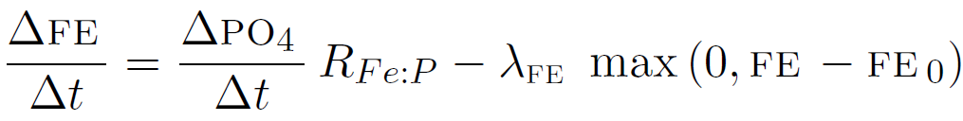
Life of iron
Dissolves (FE) partly () at const. solubility
Chemically inert: only sinks to sediment
FE needed for phytosynthesis, released bz remineralization at fixed Redfield ratio
Relaxation time constant (Johnson et al. 1997)
  Dissolved iron is complexed by strong iron binding ligands, hence lost for bio

Slide 11
Literature cited

