Slide 1
We understand air-sea exchange and iron cycle

Slide 2
Subroutines and options
carchm.f90
l_ctl_co2 : explanation
lomip : according to new CMIP6 OMIP protocol
diffat : expl
l_avflux : expl
ocprod.f90

Slide 3
State of today
Choose between two setups:
ocean-only: OMIP if lomip
Schmidt-numbers and Solubility as in OMIP CMIP6 Protocol: Orr et al. (2016) Geosci. Model Dev. Discuss.,
Schmidt-numbers: Wannikhof 2014 jrnl…
Coupled: NOT OMIP if not.lomip
Older references
!!Co2flux atmospheric side or ocean side!!

Slide 4
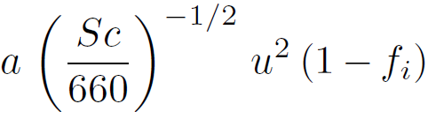
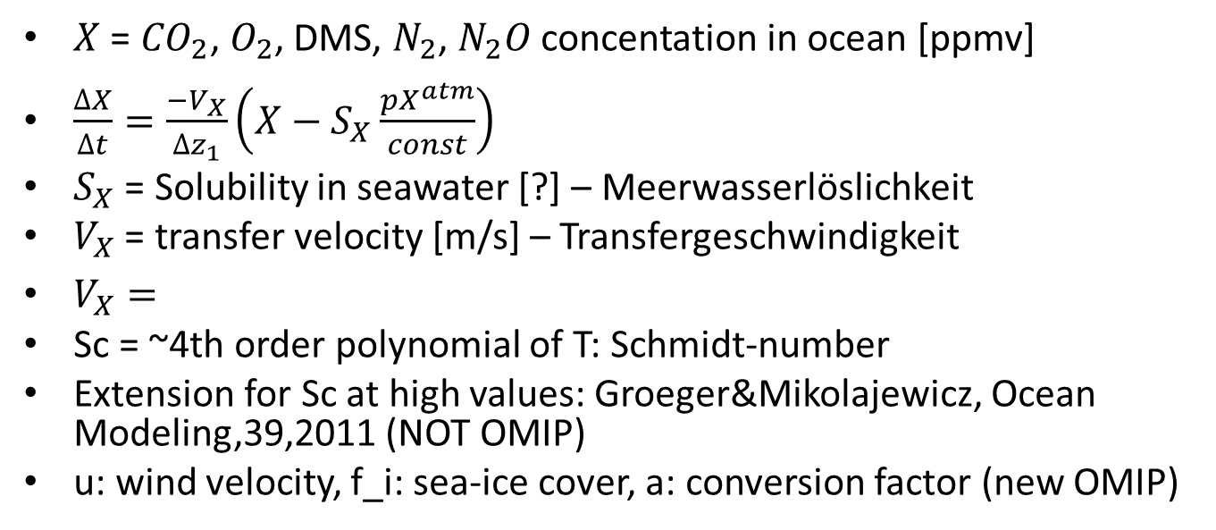
Air-sea exchange
$X$ = ${CO}_{2}$, $O_{2}$, DMS, $N_{2}$, $N_{2}O$ concentation in ocean [ppmv]
$\frac{∆X}{∆t}=\frac{−V_{X}}{∆z_{1}}\left(X−S_{X}\frac{pX^{atm}}{const}\right)$
$S_{X}$ = Solubility in seawater [?] – Meerwasserlöslichkeit
$V_{X}$ = transfer velocity [m/s] – Transfergeschwindigkeit
$V_{X}=$
Sc = ~4th order polynomial of T: Schmidt-number
Extension for Sc at high values: Groeger&Mikolajewicz, Ocean Modeling,39,2011 (NOT OMIP)
u: wind velocity, f_i: sea-ice cover, a: conversion factor (new OMIP)

Slide 5
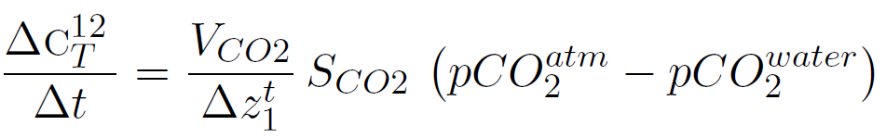
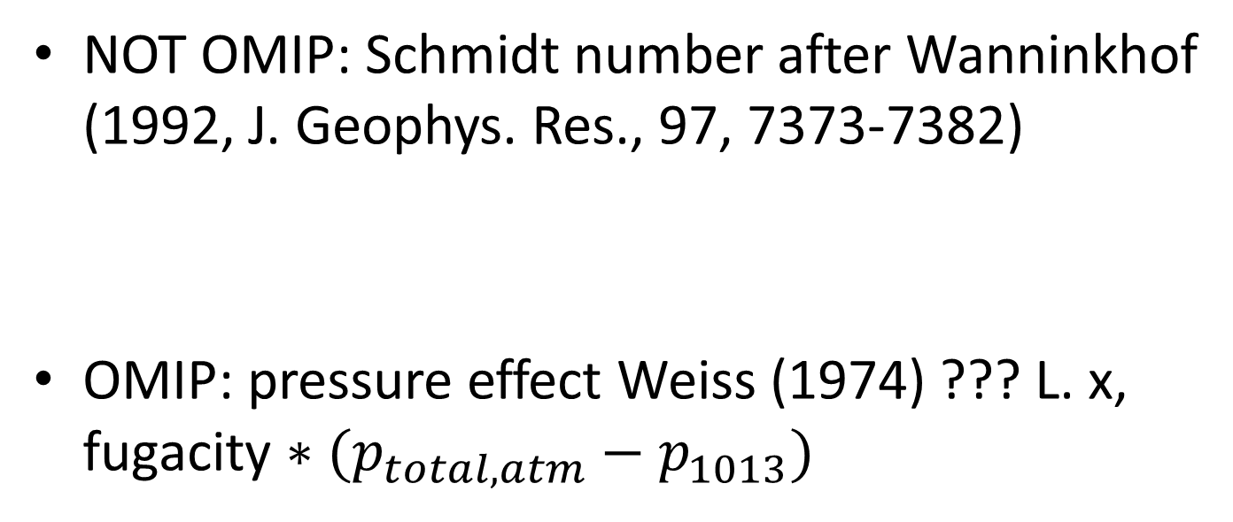

$${CO}_{2}$$
NOT OMIP: Schmidt number after Wanninkhof (1992, J. Geophys. Res., 97, 7373-7382)
OMIP: pressure effect Weiss (1974) ??? L. x, fugacity $∗(p_{total,atm}−p_{1013})$

Slide 6
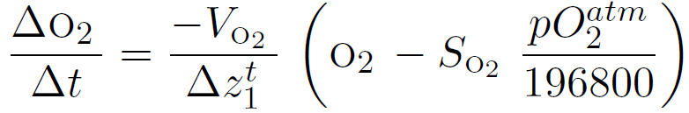
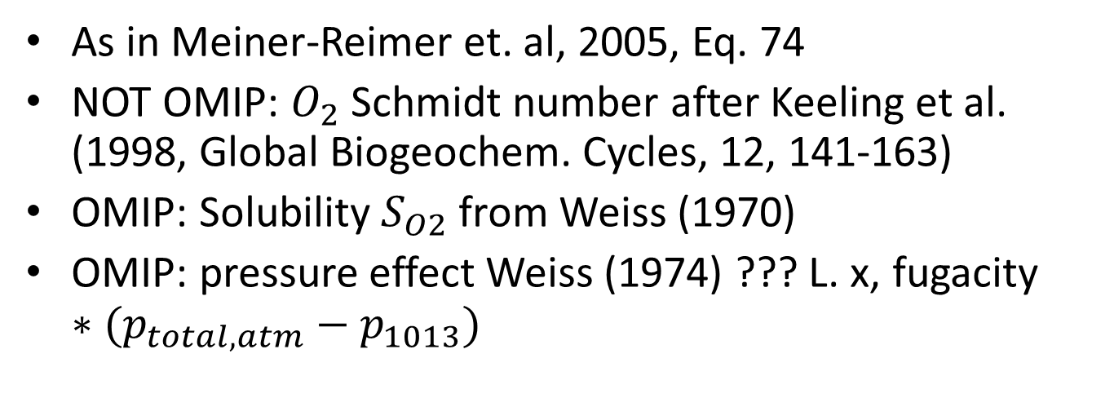

$$O_{2}$$
As in Meiner-Reimer et. al, 2005, Eq. 74
NOT OMIP: $O_{2}$ Schmidt number after Keeling et al. (1998, Global Biogeochem. Cycles, 12, 141-163)
OMIP: Solubility $S_{O2}$ from Weiss (1970)
OMIP: pressure effect Weiss (1974) ??? L. x, fugacity $∗(p_{total,atm}−p_{1013})$

Slide 7
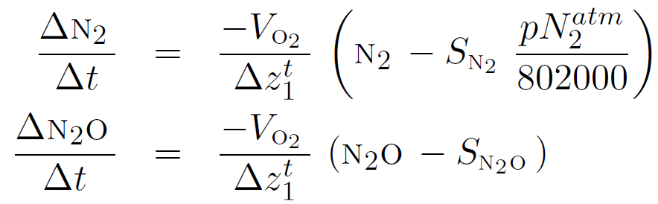
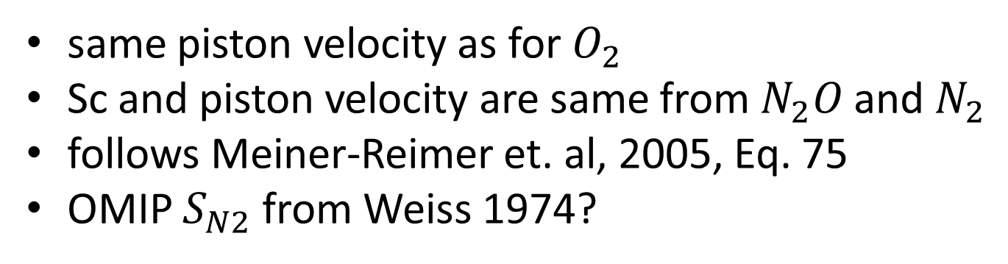

$N_{2}O$and $N_{2}$
same piston velocity as for $O_{2}$
Sc and piston velocity are same from $N_{2}O$and $N_{2}$
follows Meiner-Reimer et. al, 2005, Eq. 75
OMIP $S_{N2}$ from Weiss 1974?

Slide 8
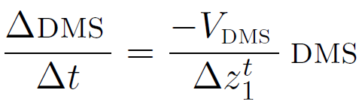
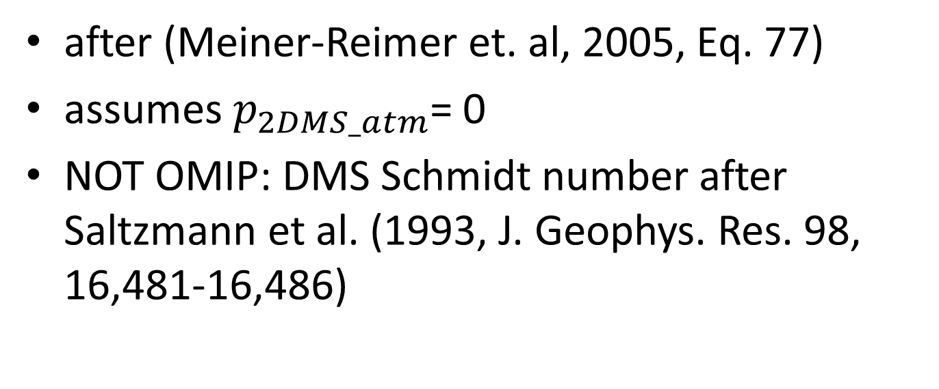
DMS
after (Meiner-Reimer et. al, 2005, Eq. 77)
assumes $p_{2DMS_atm}$= 0
NOT OMIP: DMS Schmidt number after Saltzmann et al. (1993, J. Geophys. Res. 98, 16,481-16,486)

Slide 9
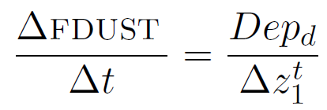
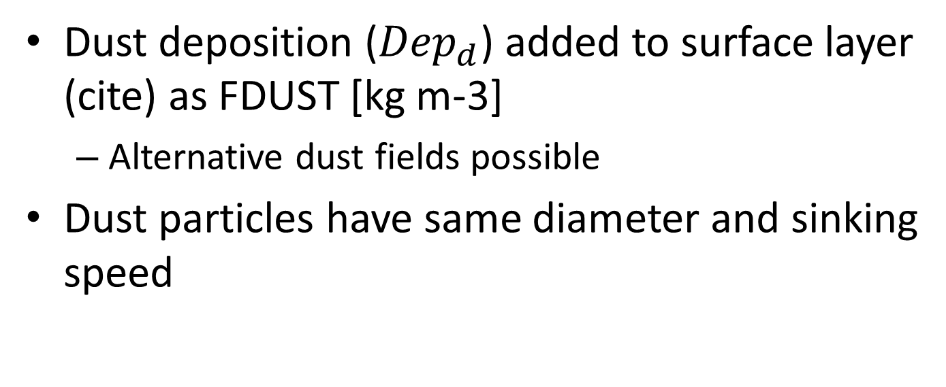
Iron Cycle
Dust deposition (${Dep}_{d}$) added to surface layer (cite) as FDUST [kg m-3]
Alternative dust fields possible
Dust particles have same diameter and sinking speed

Slide 10
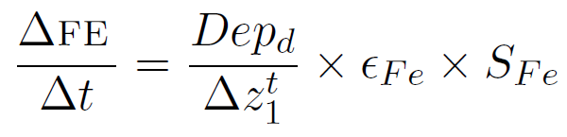
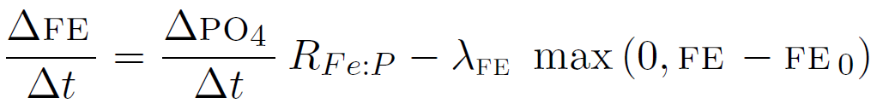
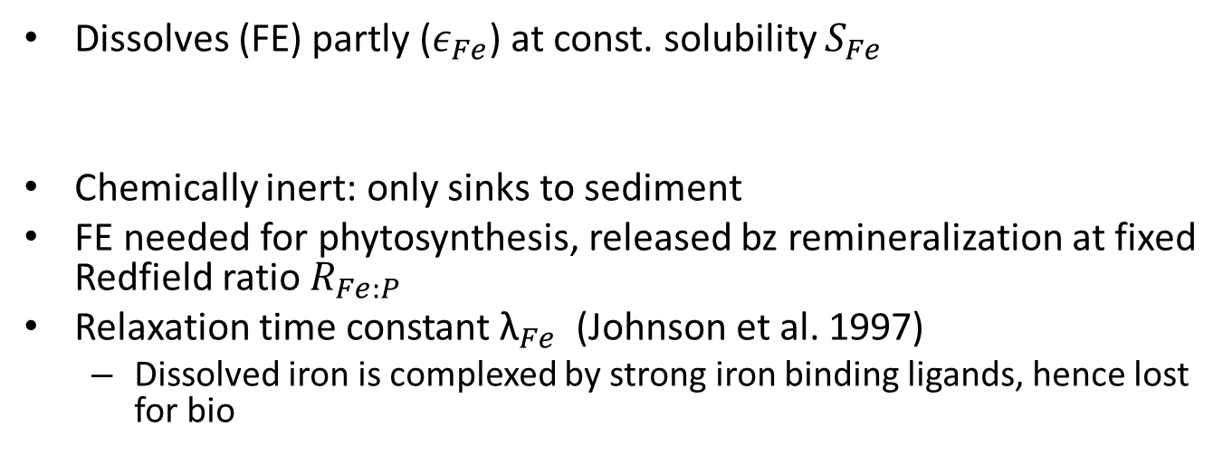
Life of iron
Dissolves (FE) partly ($ε_{Fe}$) at const. solubility $S_{Fe}$
Chemically inert: only sinks to sediment
FE needed for phytosynthesis, released bz remineralization at fixed Redfield ratio $R_{Fe:P}$
Relaxation time constant ${\text{λ}}_{Fe}$ (Johnson et al. 1997)
Dissolved iron is complexed by strong iron binding ligands, hence lost for bio

Slide 11
Literature cited

