Slide 1

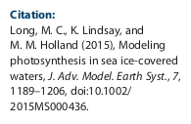
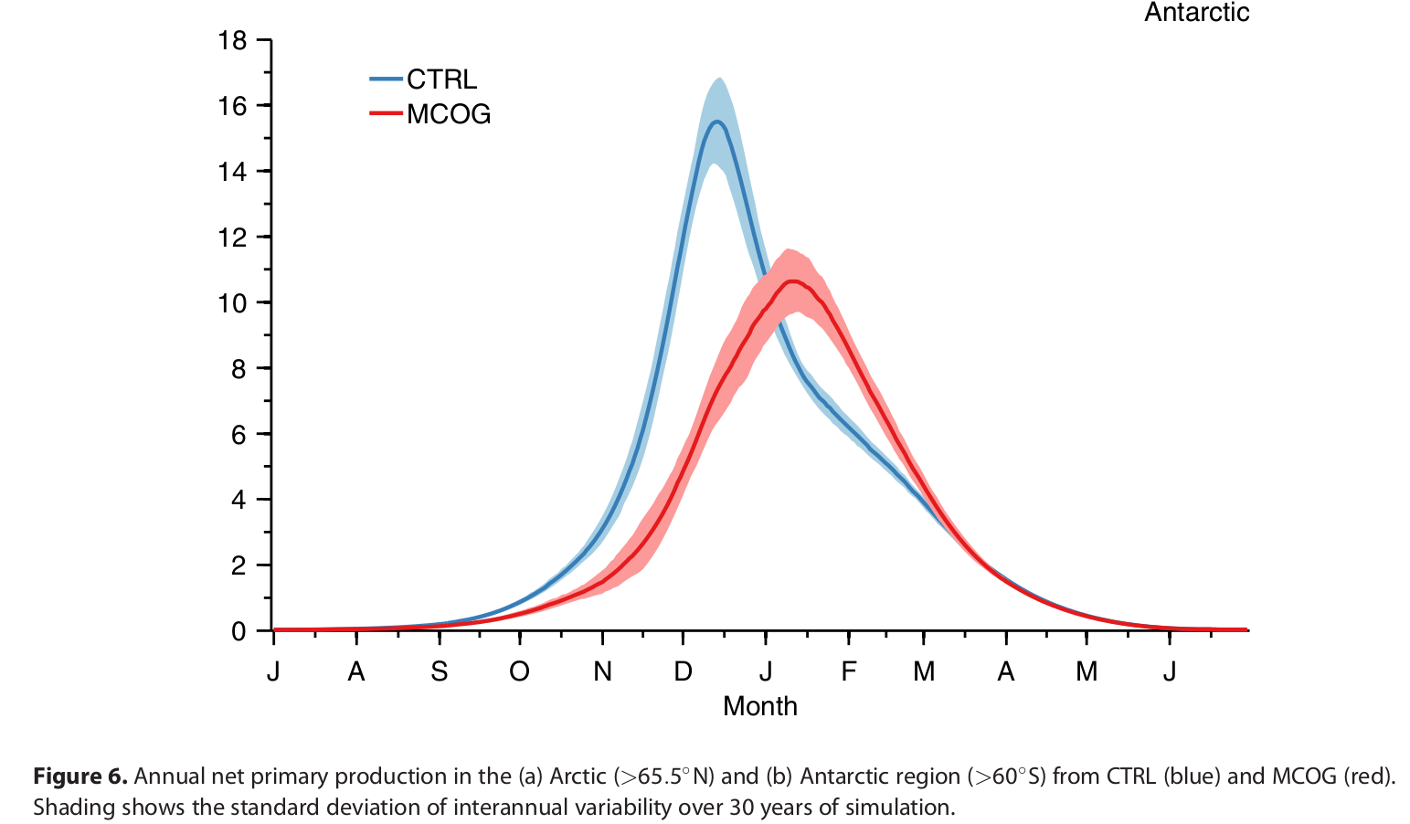
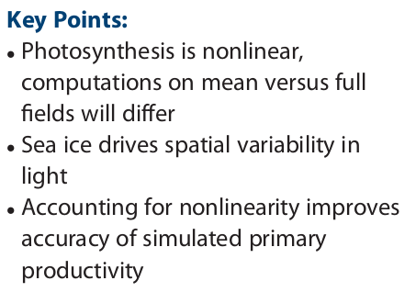
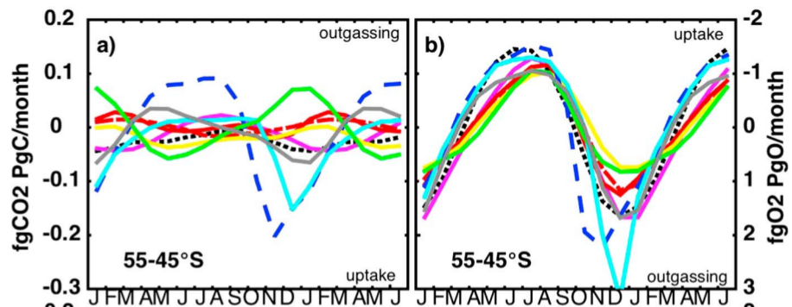
Photosynthesis under partial sea-ice cover
Challenge in HAMOCC: Southern Ocean Seasonality (Nevison et al. 2016)

Slide 2
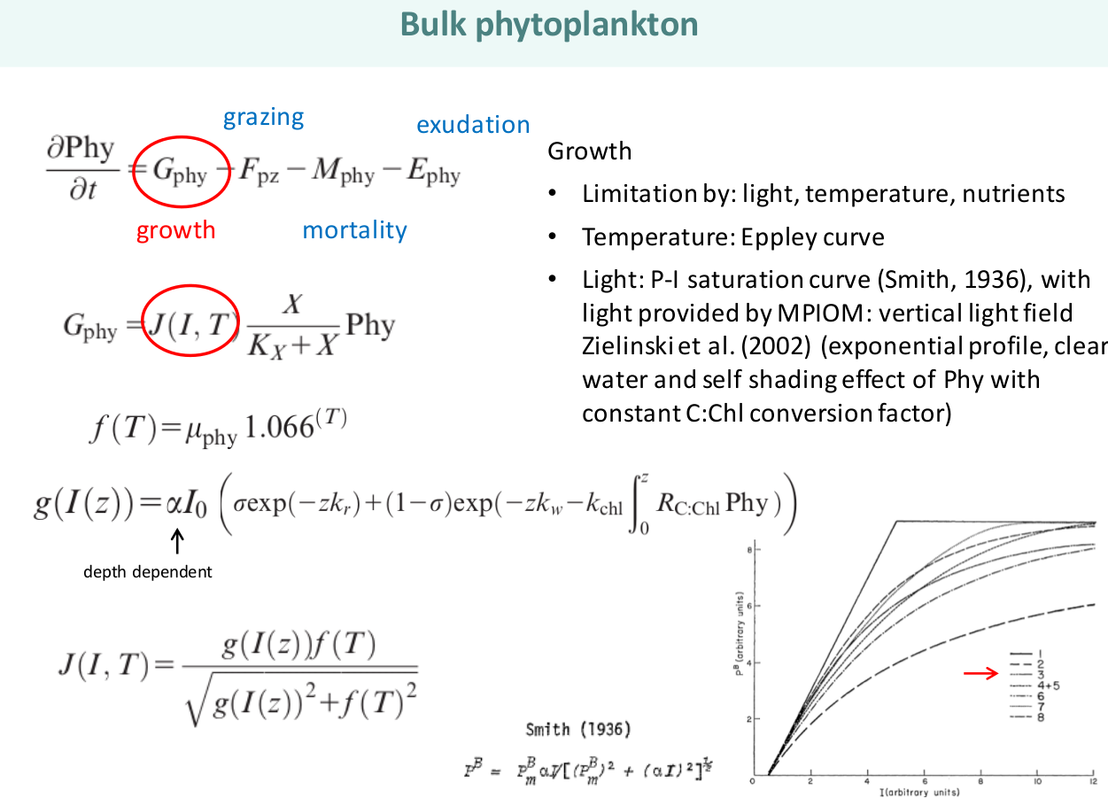

Slide 3
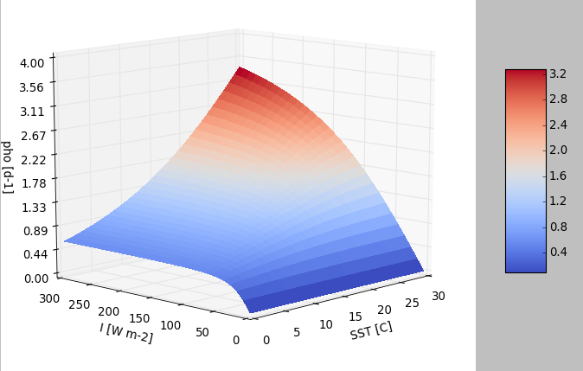
Photosynthesis in HAMOCC
Combined temperature- and light-limitation
Non-linear
For cold waters quickly light-saturated

Slide 4
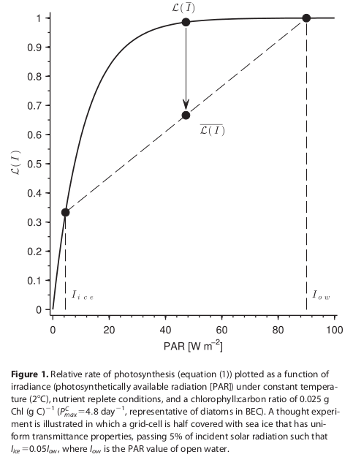
Proposal: Fix for PAR
Now: If grid cell is sea-ice covered, then strahl is attenuated
Proposal: …, then PAR for grid cell is calculated for sea-ice free area (f) and sea-ice covered area (1-f) separately
No change if no ice (f=0)
No change if linear

Slide 5
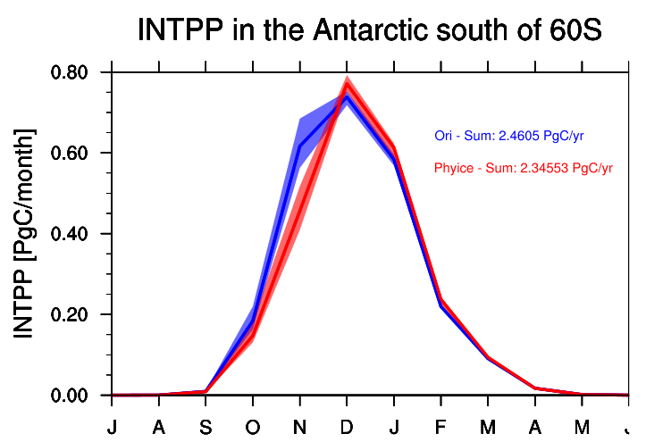
My runs
From Fabrice pre-industrial control restart file
Ori (CTRL) = 30 yrs control run
Phyice (MCOG) = 30 yrs phyice fix
Long 2015

Slide 6
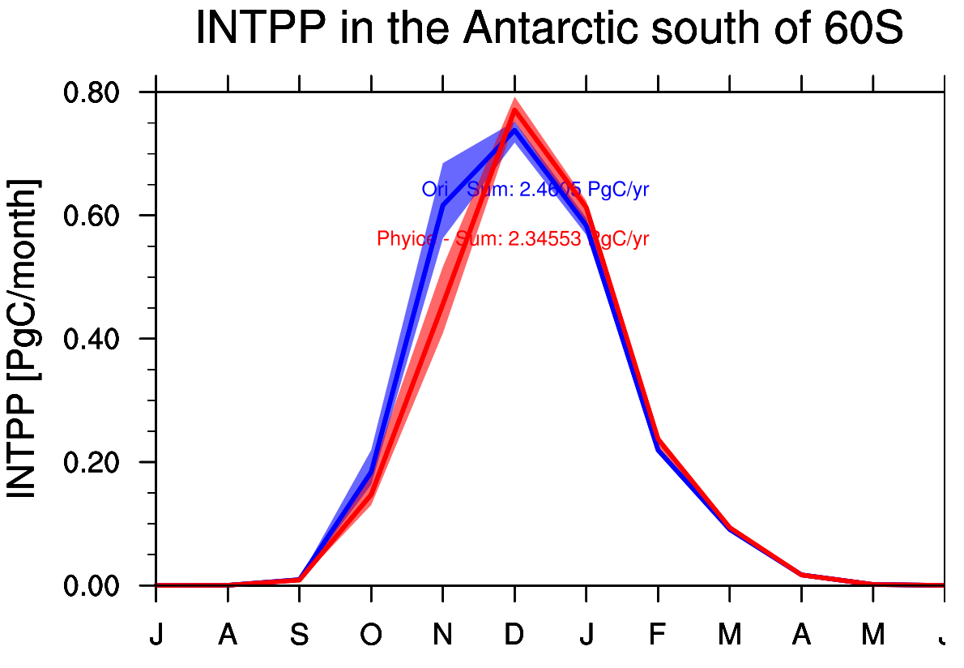

Slide 7
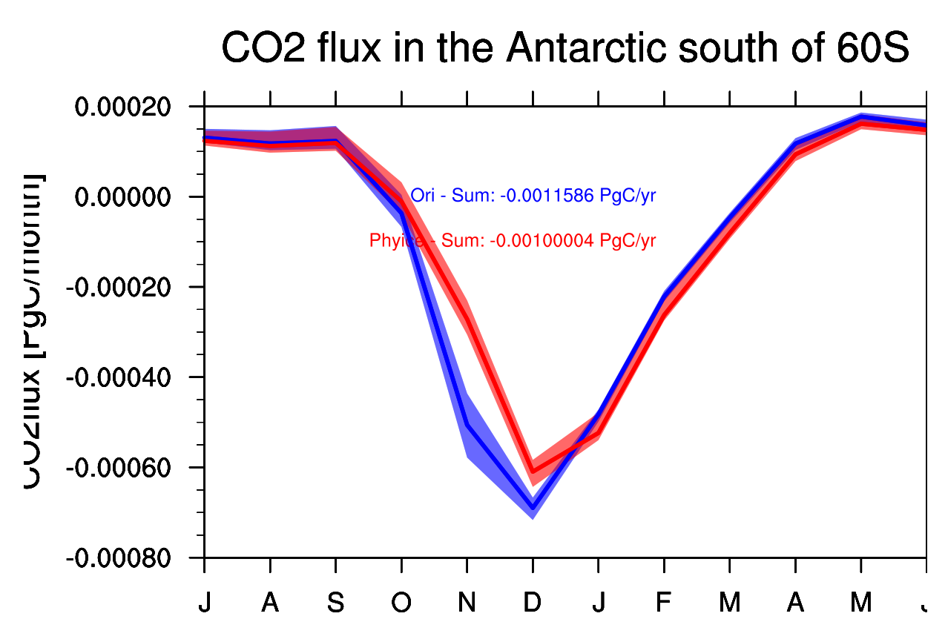

Slide 8
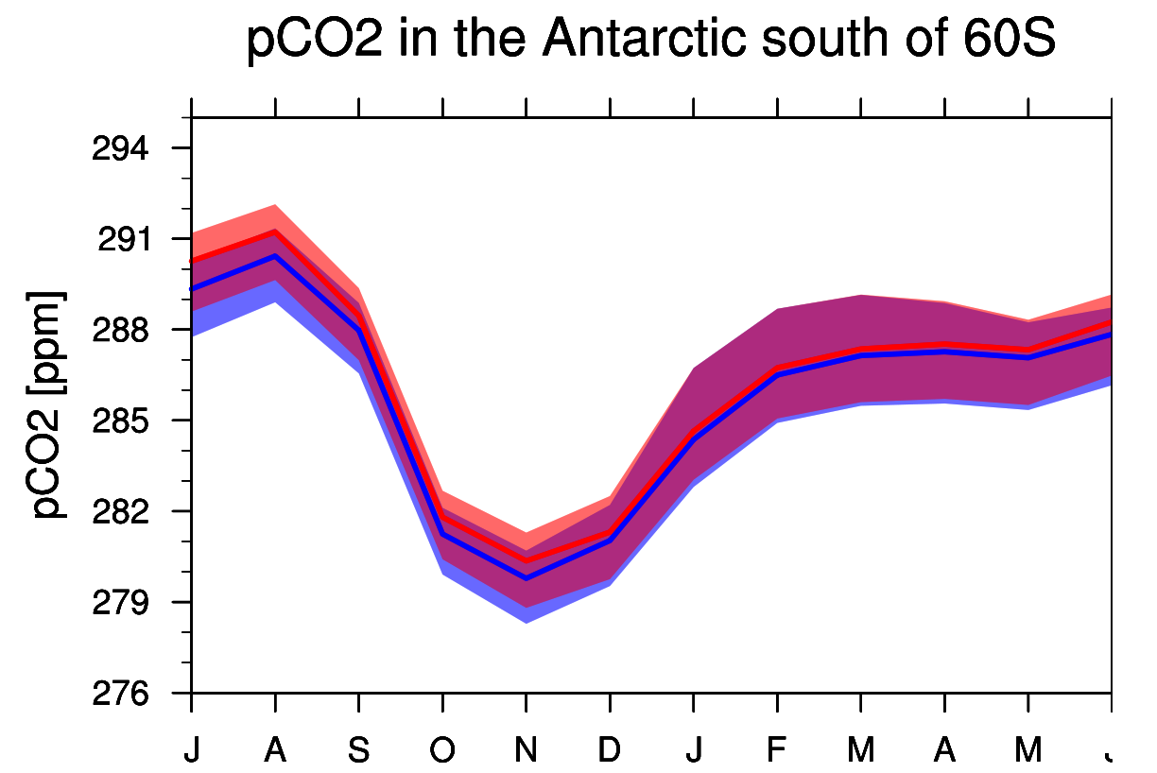

Slide 9
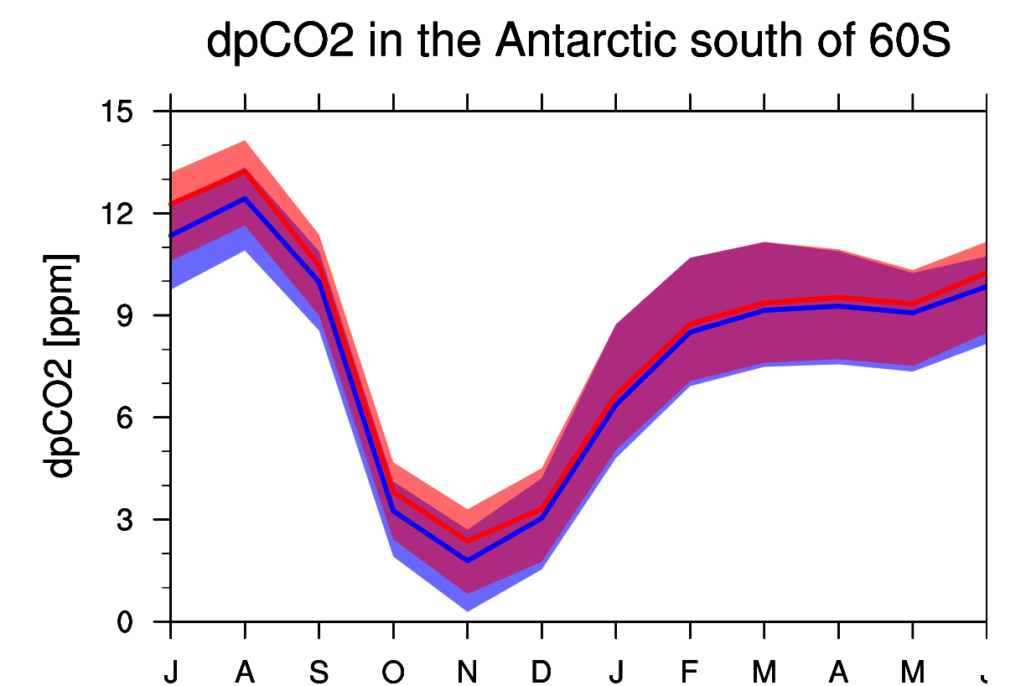

Slide 10
Summary Seasonality

