Slide 1




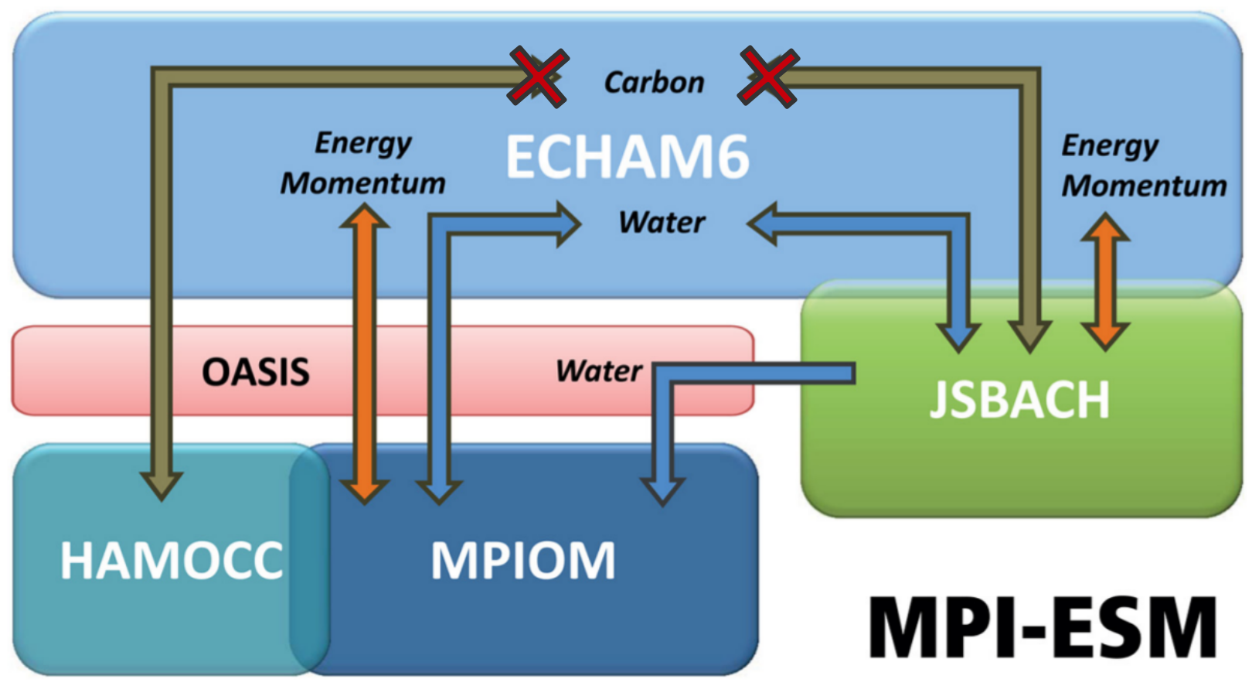
Large ensemble ESM simulations reproduce decadal trends in the Southern Ocean carbon sink
Aaron Spring¹, Hongmei Li¹, Tatiana Ilyina¹
¹Max Planck Institute for Meteorology, Bundesstraße 53, 20146 Hamburg, Germany
Introduction
Observations-based estimates report large decadal variations in the Southern Ocean carbon sink [LeQuere et al. 2007, Landschützer et al. 2015]. Sparse observational data lack the ability to show the dynamics of internally varying processes, which demands for the evaluation with models. Forced ocean models reproduce this internal variability.
However, all coupled earth-system-models fail. By analyzing a historical large ensemble of 100 simulations based on Max Planck Institute’s Earth System Model (MPI-ESM), we assess modeled internal variability of the Southern Ocean carbon sink.
Here we analyze what drives internal variability and focus on negative trends in the Southern Ocean carbon sink which are unforeseen just from atmospheric forcing alone.
Evolution of the Southern Ocean carbon sink
Int decadal variability ±0.4 PgC
Detection of negative decadal carbon sink trends
Winds drive internal variability
Wind on carbon cycle works vice versa for weaker winds.
Opposing response to weaker winds in Trends
area of largest variability 50-60S
Stronger winds drive CO2 outgassing
Weaker winds drive CO2 uptake
Methods
MPI-ESM 1.1
1850-2005 historical
To 2100 RCP4.5
100x with slightly different initial conditions but identical forcing
Prognostic carbon cycle
Trend
Biology
Opposing summer trends in CO2flux and primary production
No change in nutrient limitation
Deeper mixing inhibits primary production
Circulation
Similar to [DeVries et al. 2017]
Intensified upper-ocean overturning circulation
More upwelling of carbon-rich deep waters
More northward transport
Literature: DeVries2017, Landschuetzer2015, Lovenduski2007, LeQuere2007
Summary?
Contact info

