Slide 1





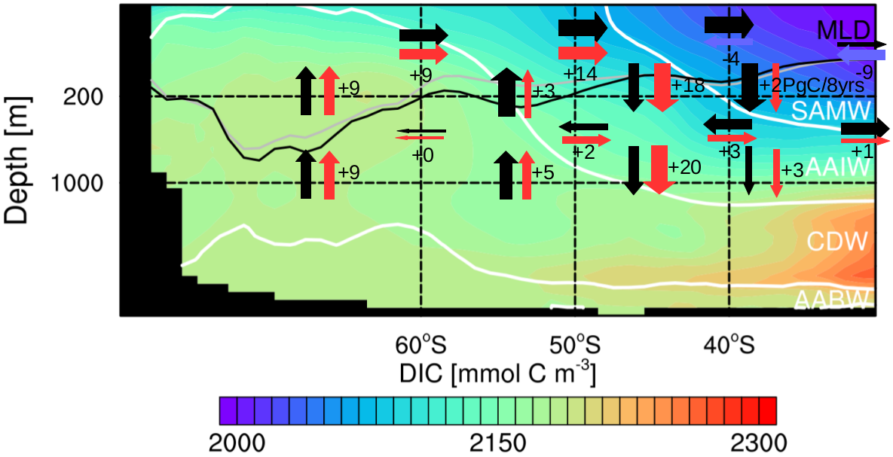

MPI-ESM Large Ensemble simulations reproduce decadal carbon trends in the Southern Ocean
Aaron Spring¹, Hongmei Li¹, Tatiana Ilyina¹
¹Max Planck Institute for Meteorology, Bundesstraße 53, 20146 Hamburg, Germany, aaron.spring@mpimet.mpg.de
Preamble
Observations-based estimates report large decadal variations in the Southern Ocean (SO) carbon sink [LeQuéré et al. 2007, Landschützer et al. 2015]. Sparse observational data lack the ability to show the dynamics of internally varying processes, which demands for the evaluation with models.
Forced ocean models reproduce this internal variability. However, coupled earth-system-models fail. By analyzing a historical large ensemble of 100 simulations based on Max Planck Institute’s Earth System Model (MPI-ESM), we assess modeled internal variability of the Southern Ocean carbon sink.
Here we analyze what drives internal variability and focus on negative carbon sink trends unforeseen just from atmospheric forcing alone.
Internal Variability of the SO carbon sink
Winds drive variability .
Conclusions
Southern Ocean carbon sink variability driven by westerly winds
Decadal carbon sink trends similar to 1990s and 2000s reproducible in coupled ESM
Stronger winds decrease primary production and increase upwelling
Opposing response in biology and circulation to weaker winds
Latitudes of largest variability: 50-60°S
Largest internal variability in outgassing region
Internal decadal (1σ) variability:
±0.4 PgC / decade
Detection of positive and negative decadal carbon sink trends similar to those in the 1990s and 2000s in [Landschützer et al. 2015]
SOM-FFN data range within MPI-ESM LE range
Stronger winds drive CO2 outgassing
Weaker winds drive CO2 uptake
Please get in touch.
Looking for a
PhD position.
Figure 1: Southern Ocean carbon sink; negative CO2 flux values indicate oceanic carbon uptake: (a) CO2 flux climatology in MPI-ESM, (b) internal variability in CO2 flux, (c) evolution of the Southern Ocean carbon sink south of 35°S, green line from SOM-FFN [Landschützer et al. 2015], red line negative carbon sink trend, blue line positive carbon sink trend
Relation of trends between 1980 and 2005 in SAM index and CO2 flux links the carbon sink to wind strength at 50-60°S.
Methods
MPI-ESM1.1 with a prognostic carbon cycle
100 ensemble members have slightly different initial conditions from pre-industrial control run (MPI-ESM LE)
historical forcing from 1850 to 2005 extended under the RCP4.5 scenario to 2100
Ocean biogeochemical model represented by HAMOCC [Ilyina et al. 2013]
Analysis of linear trends of various quantities impacting the carbon cycle
Internal decadal variability
Trends in circulation
Trends in biology
Opposing summer trends in CO2 flux and primary production
No change in nutrient limitation
Deeper mixing inhibits primary production
Intensified upper-ocean overturning circulation
Increased upwelling of carbon-rich deep waters
Increased Ekman northward transport
Increased Ekman subduction
Similar upper-ocean overturning circulation trends as in [DeVries et al. 2017]
Trends in upper-ocean overturning circulation in the zonal Southern Ocean show how increasing westerly winds intensify the overturning which weakens the carbon sink. Black arrows indicate mean advection of carbon, red arrows show intensification in carbon advection, blue arrows show decline, the numbers show the trend over 8 years, white lines are isopycnals separating Southern Ocean water masses
Trends in austral summer in Southern Ocean: (a) CO2flux , (b) vertically integrated primary production, (c) nutrient limitation and (d) mixed-layer depth
References:
Le Quéré et al., 2007, Saturation of the Southern Ocean CO2 Sink Due to Recent Climate Change, Science, 316, 1735-1738
Lovenduski et al., 2007, Enhanced CO2 outgassing in the Southern Ocean from a positive phase of the Southern Annular Mode, Global Biogeochemical Cycles, 21
Landschützer et al., 2015, The reinvigoration of the Southern Ocean carbon sink, Science, 349, 1221-1224
DeVries et al., 2017, Recent increase in oceanic carbon uptake driven by weaker upper-ocean overturning, Nature, 542, 215-218
Ilyina et al., 2013, Global ocean biogeochemistry model HAMOCC: Model architecture and performance as component of the MPI-Earth system model in different CMIP5 experimental realizations Journal of Advances in Modeling Earth Systems, 5, 287-315

