Slide 1

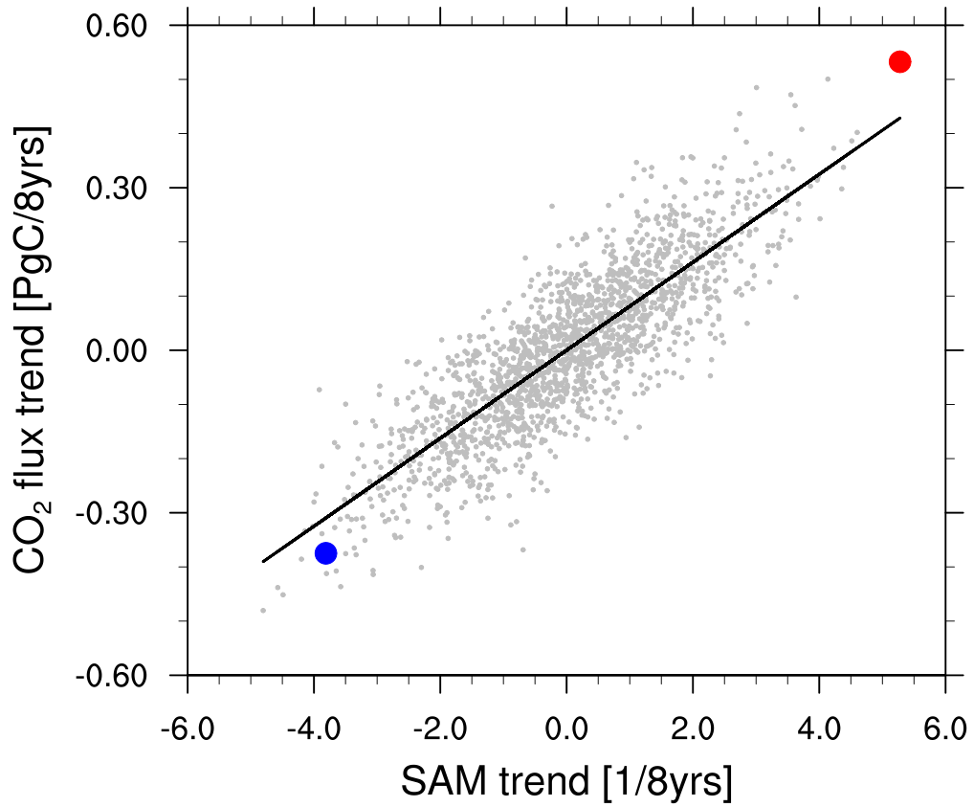
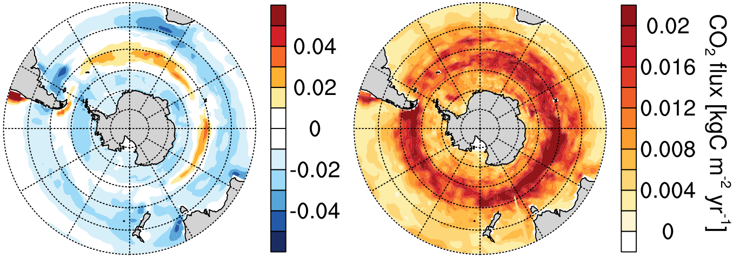
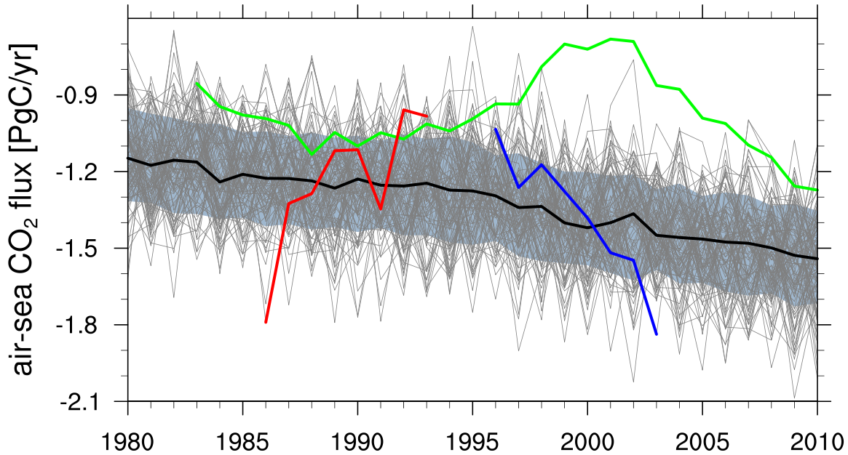

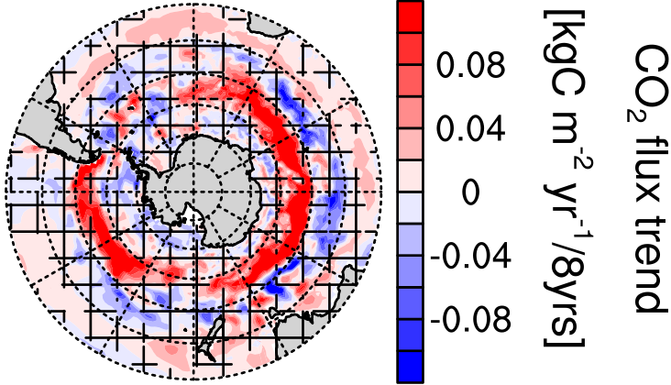
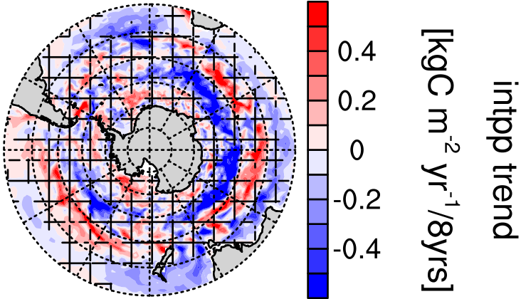
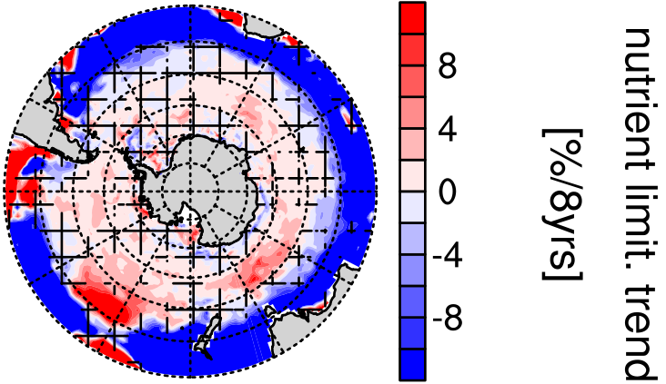
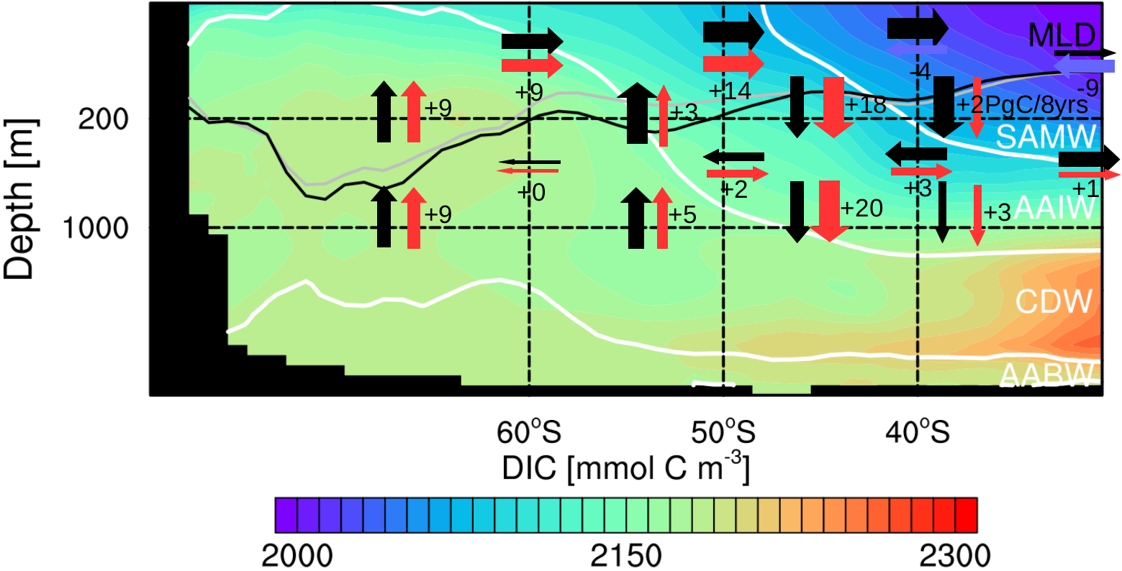
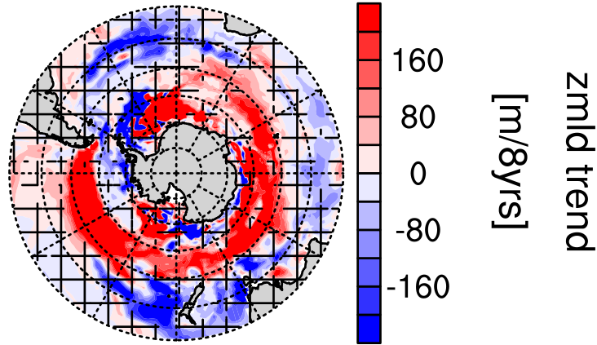
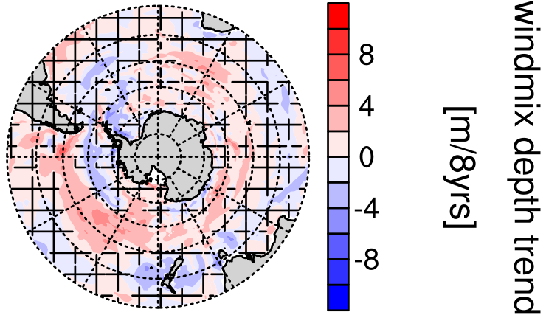
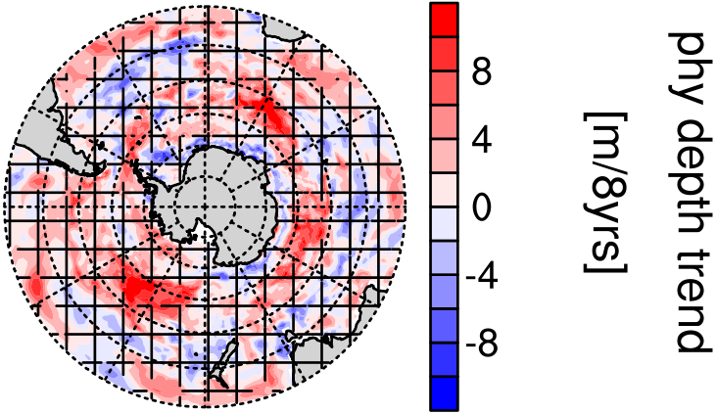
MPI-ESM Large Ensemble simulations reproduce decadal carbon trends in the Southern Ocean
Aaron Spring¹, Hongmei Li¹, Tatiana Ilyina¹
¹Max Planck Institute for Meteorology, Bundesstraße 53, 20146 Hamburg, Germany, aaron.spring@mpimet.mpg.de
1. Preamble
Observations-based estimates report large decadal variations in the Southern Ocean (SO) carbon sink [LeQuéré et al. 2007, Landschützer et al. 2015]. Sparse observational data lack the ability to show the dynamics of internally varying processes, which demands for the evaluation with models.
Forced ocean models reproduce this variability. However, coupled earth-system-models poorly capture climate variability. By analyzing a historical large ensemble of 100 simulations based on Max Planck Institute’s Earth System Model (MPI-ESM), we assess modeled internal variability of the Southern Ocean carbon sink.
Here we analyze what drives internal variability and focus on negative carbon sink trends unforeseen just from atmospheric forcing alone.
3. Internal Variability of the SO carbon sink
4. Winds drive CO₂
7. Conclusions
Latitudes of largest variability: 50-60°S (Fig. 1b)
Decadal carbon sink trends similar to 1990s and 2000s reproducible in coupled ESM (Fig. 1c)
Southern Ocean carbon sink variability driven by westerly winds (Fig. 2)
Stronger winds decrease primary production (Fig. 3), increase upwelling (Fig. 4) and vice versa for weaker winds (Fig. 2)
Largest internal variability in outgassing region
Decadal internal variability: σ = ±0.2 PgC
Detection of positive and negative decadal carbon sink trends similar to those in the 1990s and 2000s in SOM-FFN
Compromise between trend length and signal strength: 8-yr trends
SOM-FFN data range within MPI-ESM large ensemble range
flux variability
Stronger winds lead to CO2
outgassing anomalies
Weaker winds lead to CO2 uptake
anomalies
(a)
(b)
(c)
Please get in touch
with me. Looking for
a PhD position.
Figure 1: The Southern Ocean carbon sink and its variability; negative CO2 flux values indicate oceanic carbon uptake: (a) CO2 flux climatology in MPI-ESM, (b) internal variability in CO2 flux, (c) evolution of the Southern Ocean carbon sink south of 35°S, green line from SOM-FFN [Landschützer et al. 2015], red line is a negative carbon sink trend, blue line is a positive carbon sink trend, gray shading shows the 1σ internal variability
Figure 2: Relation of trends in the SAM index and CO2 flux links the carbon sink at 50-60°S to westerly winds.
2. Methods
MPI-ESM1.1 with a non-interactive carbon cycle
Ocean biogeochemical model represented by HAMOCC [Ilyina et al. 2013]
100 ensemble members with different starting years from pre-industrial control run
historical forcing from 1850 to 2005 extended under the RCP4.5 scenario to 2100
Comparison to observation-based estimate SOM-FFN [Landschützer et al. 2015]
Decadal internal variability:
Analysis of linear trends of various quantities impacting the carbon cycle
5. Response of circulation to stronger winds
6. Response of biology to stronger winds
Opposing summer trends in CO2 flux and primary production
Intensified upper-ocean overturning circulation
Increased upwelling of carbon-rich deep waters, increased Ekman northward transport and increased Ekman subduction
Similar upper-ocean overturning circulation trends as in [DeVries et al. 2017]
No change in nutrient limitation
Deeper mixing due to winds inhibits primary production
(a)
(b)
(c)
Figure 3: Trends in upper-ocean overturning circulation in the zonal Southern Ocean show how increasing westerly winds intensify the overturning which weakens the carbon sink. Black arrows indicate mean advection of carbon, red arrows show intensification in carbon advection, blue arrows show decline, the numbers show the trend over 8 years, gray line, mixed-layer depth in the beginning and the black line at the end of the period, white lines are isopycnals separating Southern Ocean water masses.
(d)
(e)
(f)
Figure 4: Trends in austral summer in Southern Ocean: (a) CO2 flux , (b) vertically integrated primary production, (c) nutrient limitation, (d) mixed-layer depth, (e) vertical diffusivity due to wind and (f) phytoplankton depth
References:
Le Quéré et al., 2007, Saturation of the Southern Ocean CO2 Sink Due to Recent Climate Change, Science, 316, 1735-1738
Lovenduski et al., 2007, Enhanced CO2 outgassing in the Southern Ocean from a positive phase of the Southern Annular Mode, Global Biogeochemical Cycles, 21
Landschützer et al., 2015, The reinvigoration of the Southern Ocean carbon sink, Science, 349, 1221-1224
DeVries et al., 2017, Recent increase in oceanic carbon uptake driven by weaker upper-ocean overturning, Nature, 542, 215-218
Ilyina et al., 2013, Global ocean biogeochemistry model HAMOCC: Model architecture and performance as component of the MPI-Earth system model in different CMIP5 experimental realizations Journal of Advances in Modeling Earth Systems, 5, 287-315

