Slide 1

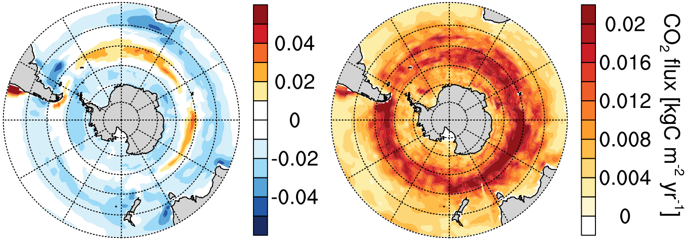
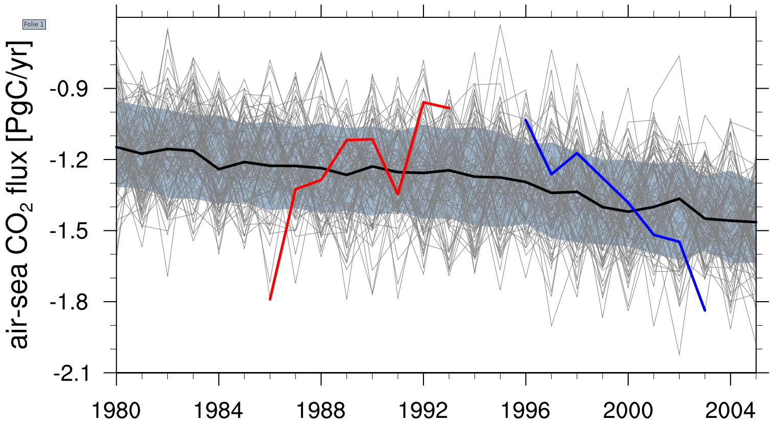
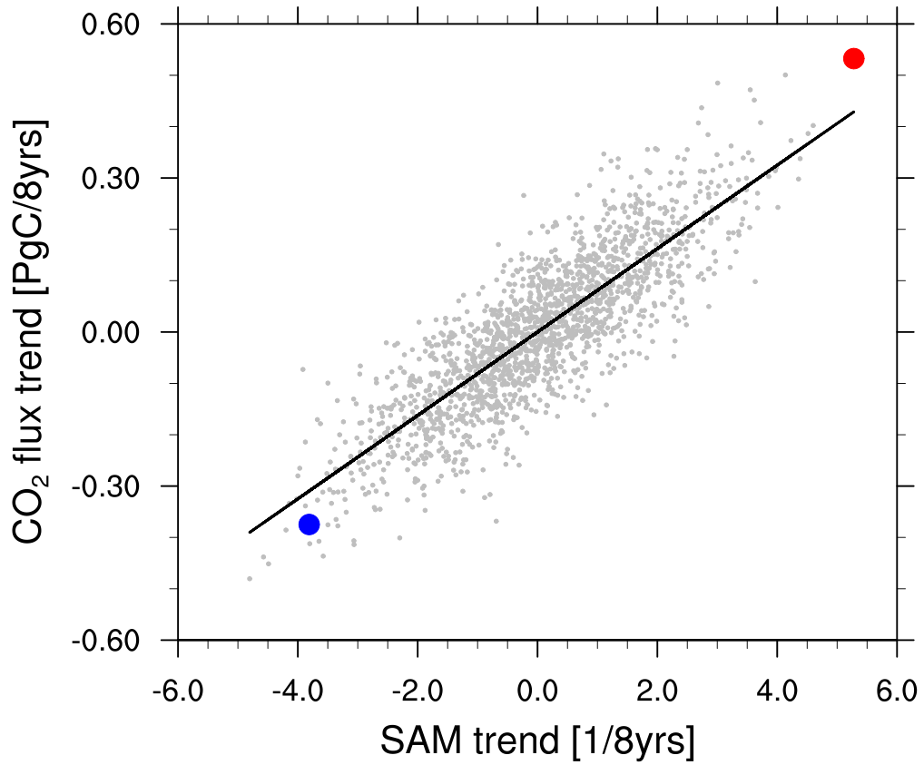

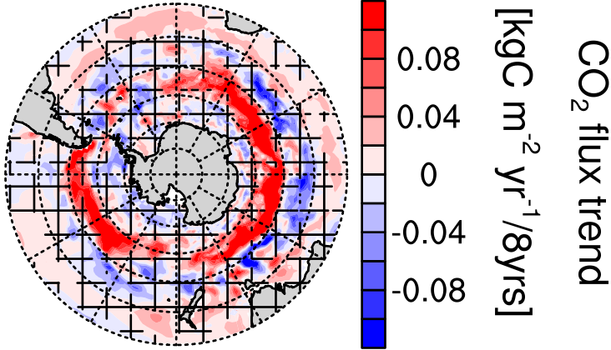
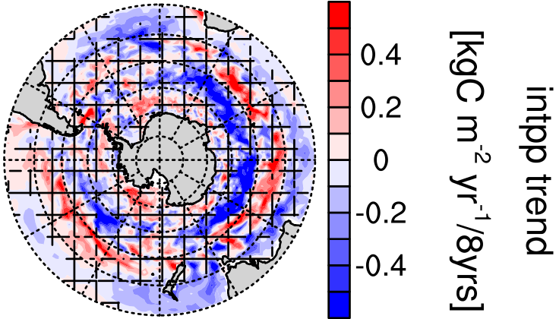
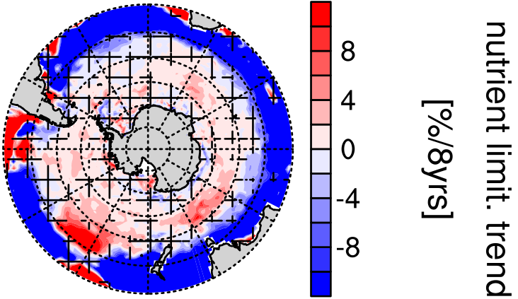
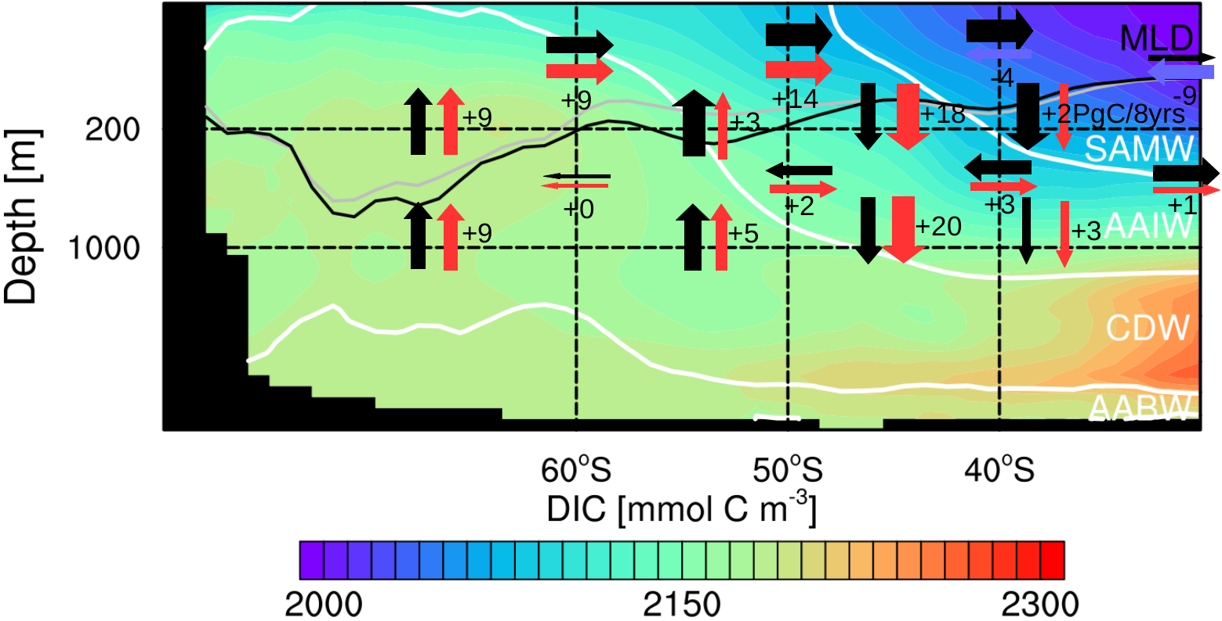
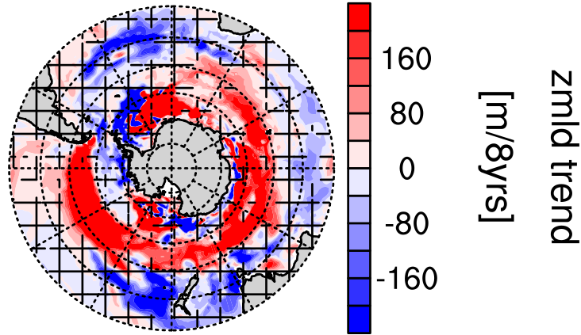
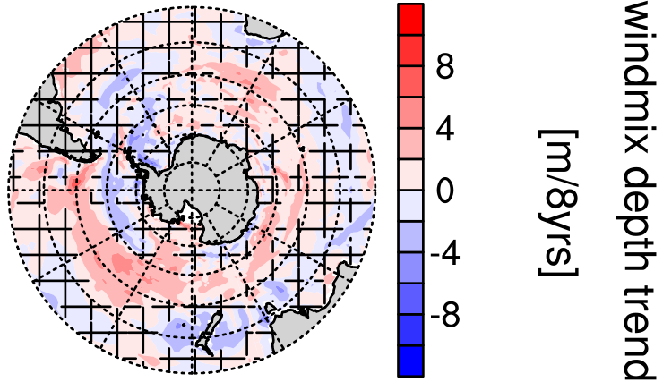
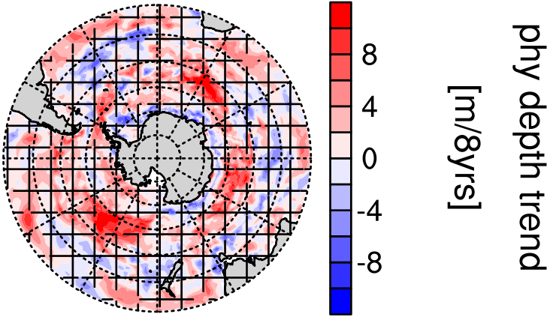
Decadal trends in the Southern Ocean carbon sink in the MPI-ESM grand ensemble
Aaron Spring¹, Hongmei Li¹, Tatiana Ilyina¹
¹Max Planck Institute for Meteorology, Bundesstraße 53, 20146 Hamburg, Germany, aaron.spring@mpimet.mpg.de
1. Preamble
Recent observations suggest pronounced decadal variations in the Southern Ocean (SO) carbon sink [Landschützer et al. 2015]. However, due to the sparse spatial and temporal coverage, it is challenging to discern the dynamics of internally varying processes. Earth-system-models, while being a useful tool to analyze processes that contribute to variability, don’t always capture this variability. By analyzing a historical Large Ensem-ble of 100 simulations based on the Max Planck Institute’s Earth System Model (MPI-ESM), we address the question what are the drivers of inter-nal variability of the Southern Ocean carbon sink? We specifically focus on the negative trends (i.e. weakening of the carbon sink) because those are unforeseen given the ongoing increase in atmospheric CO2 concentrations.
3. Internal Variability of the SO carbon sink
4. Winds drive CO₂
7. Summary
MPI-ESM Large Ensemble captures multi-year positive and negative trends as observations suggest.
We find two wind-depending regimes of the SO carbon sink (Fig.2): Enhanced winds increase upwelling (Fig.3) and decrease primary production (Fig.4); and vice versa for weaker winds. The variability is largest at 50-60°S (Fig. 1b).
Largest internal variability in outgassing area
Modeled decadal internal variability σ = ±0.2 PgC
Identification of positive and negative multi-year CO2 flux trends of similar magnitude of those in SOM-FFN
Compromise between trend length and signal strength: 8-year trends
MPI-ESM Large Ensemble 2σ ~ SOM-FFN decadal variations
flux variability
Relationship between CO2 & SAM sug-gests two regimes in SO carbon sink:
Stronger winds lead to a weakening of the carbon sink (outgassing anomalies)
Weaker winds lead to a stronger carbon sink (ingassing anomalies)
(a)
(b)
(c)
(c)
Figure 1: Air-sea CO2 flux in the Southern Ocean carbon sink and its variability; negative values indicate oceanic carbon uptake: (a) CO2 flux climatology 1980-2005 in MPI-ESM ensemble mean, (b) decadal internal variability σ as decadal anomaly standard deviation, (c) temporal evolution of the Southern Ocean air-sea CO2 flux south of 35°S from 1980 to 2005, gray lines are from 100 ensemble members, the red line is the most extreme positive 8-year CO2 flux trend, the blue line is the most extreme negative CO2 flux trend, the gray shading shows the decadal internal variability σ
Please get in touch
with me. Looking for
a PhD position.
Figure 2: Trends in the SAM index and CO2 flux links the carbon sink at 50-60°S to westerly winds; red/blue dot is the most positive/ negative 8-year CO2 flux trend
2. Methods
MPI-ESM1.1 forced by prescribed pCO concentrations
Ocean biogeochemical model represented by HAMOCC [Ilyina et al. 2013]
perturbed initial conditions ensemble initiated from 100 different starting years from pre-industrial control run
historical forcing from 1850 to 2005
Comparison to observation-based estimate SOM-FFN [Landschützer et al. 2015]
Decadal internal variability σ as standard deviation of decadal anomalies
5. Response of circulation to stronger winds
6. Response of biology to stronger winds
Summer trends in CO2 flux and primary production of opposite direction
2
Intensified upper-ocean overturning circulation (similar to [DeVries et al. 2017])
Increased upwelling of carbon-rich deep waters, increased Ekman northward transport and increased Ekman subduction
Nutrient availability does not decrease
Deeper mixing due to enhanced winds inhibits primary production
(a)
(b)
(c)
Figure 3: Linear trends in upper-ocean overturning circulation in the zonally averaged transect in the Southern Ocean for enhanced westerly winds; black arrows indicate mean advection of carbon, red arrows show intensification in carbon advection, blue arrows show decline, the numbers show the trend over 8 years, gray line, mixed-layer depth in the beginning and the black line at the end of the period, white lines are isopycnals separating Southern Ocean water masses.
(d)
(e)
(f)
Figure 4: Linear trends in austral summer of the most positive CO2 flux trend: (a) CO2 flux, (b) integrated primary production,
(c) nutrient limitation, (d) mixed-layer depth, (e) average depth of vertical diffusivity due to wind and (f) average phytoplankton depth
References:
Landschützer et al., 2015, The reinvigoration of the Southern Ocean carbon sink, Science, 349, 1221-1224
DeVries et al., 2017, Recent increase in oceanic carbon uptake driven by weaker upper-ocean overturning, Nature, 542, 215-218
Ilyina et al., 2013, Global ocean biogeochemistry model HAMOCC: Model architecture and performance as component of the MPI-Earth system model in different CMIP5 experimental realizations Journal of Advances in Modeling Earth Systems, 5, 287-315

