Slide 1






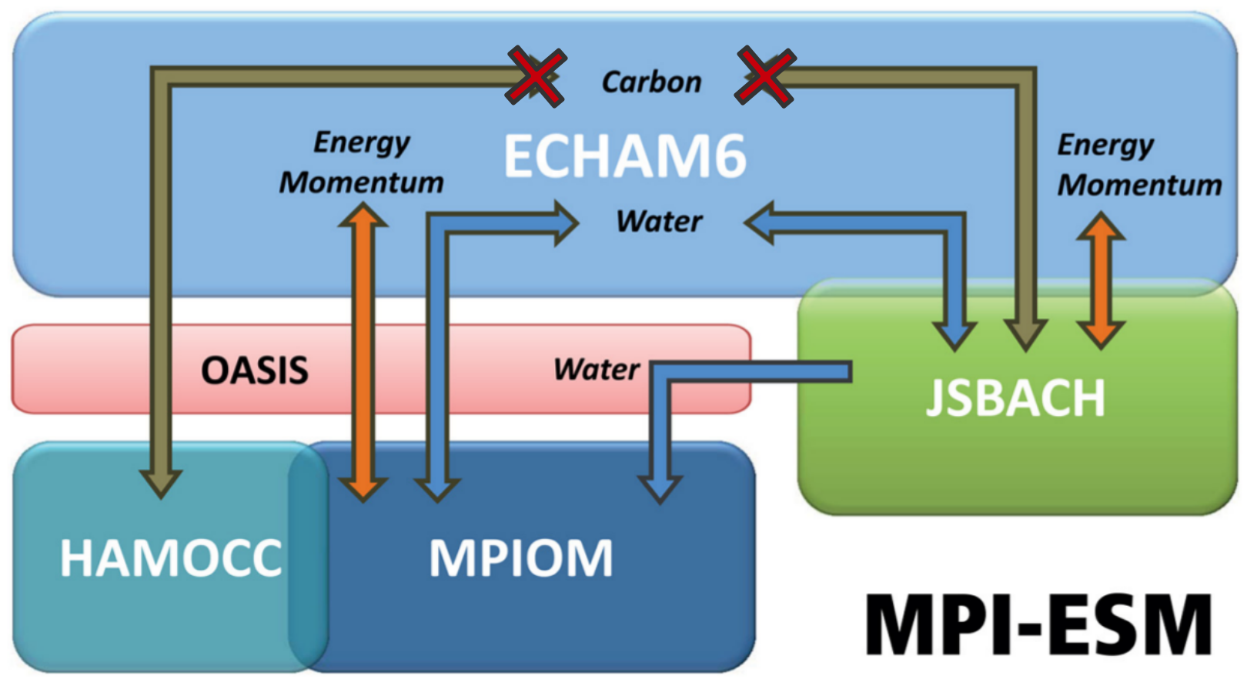
Large ensemble ESM simulations reproduce decadal trends in the Southern Ocean carbon sink
Aaron Spring¹, Hongmei Li¹, Tatiana Ilyina¹
¹Max Planck Institute for Meteorology, Bundesstraße 53, 20146 Hamburg, Germany
Introduction
Observations-based estimates report large decadal variations in the Southern Ocean carbon sink [LeQuere et al. 2007, Landschützer et al. 2015]. Sparse observational data lack the ability to show the dynamics of internally varying processes, which demands for the evaluation with models. Forced ocean models reproduce this internal variability.
However, all coupled earth-system-models fail. By analyzing a historical large ensemble of 100 simulations based on Max Planck Institute’s Earth System Model (MPI-ESM), we assess modeled internal variability of the Southern Ocean carbon sink.
Here we analyze what drives internal variability and focus on negative trends in the Southern Ocean carbon sink which are unforeseen just from atmospheric forcing alone.
Internal Variability of the Southern Ocean carbon sink
Largest internal variability in outgassing area
Internal decadal variability ±0.4 PgC
Detection of negative decadal carbon sink trends similar to [Landschützer et al. 2015]
Winds drive internal variability .
Opposing response to weaker winds in Trends
area of largest variability 50-60S
Stronger winds drive CO2 outgassing
Weaker winds drive CO2 uptake
Conclusions
Southern Ocean carbon sink variability driven by winds
Intensified winds decrease carbon sink via increased upwelling and decreasing primary production due to light limitation from deep mixing
Decadal Southern Ocean carbon sink trends similar to 1990s and 2000s reproducible in coupled ESM
Methods
We use MPI-ESM1.1 with a prognostic carbon cycle. The 100 ensemble members had slightly different initial conditions from the pre-industrial control run and are subject to historical forcing from
1850 to 2005 and extended under the RCP4.5 scenario to 2100.
Trends in biology
Opposing summer trends in CO2flux and primary production
No change in nutrient limitation
Deeper mixing inhibits primary production
Trends in circulation
Similar to [DeVries et al. 2017]
Intensified upper-ocean overturning circulation
More upwelling of carbon-rich deep waters
More northward transport
References:
Le Quéré et al., 2007, Saturation of the Southern Ocean CO2 Sink Due to Recent Climate Change, Science, 316, 1735-1738
Lovenduski et al., 2007, Enhanced CO2 outgassing in the Southern Ocean from a positive phase of the Southern Annular Mode, Global Biogeochemical Cycles, 21
Landschützer et al., 2015, The reinvigoration of the Southern Ocean carbon sink, Science, 349, 1221-1224
DeVries et al., 2017, Recent increase in oceanic carbon uptake driven by weaker upper-ocean overturning, Nature, 542, 215-218

