Slide 2

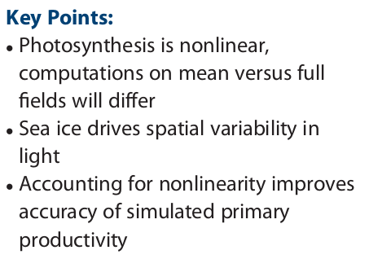
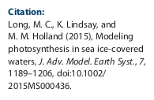
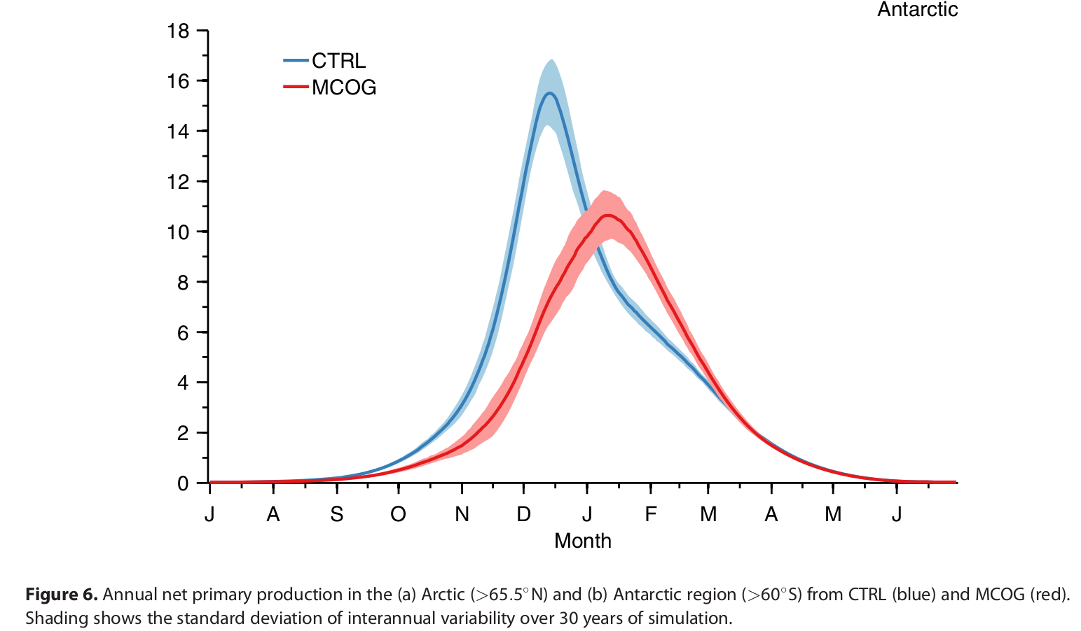
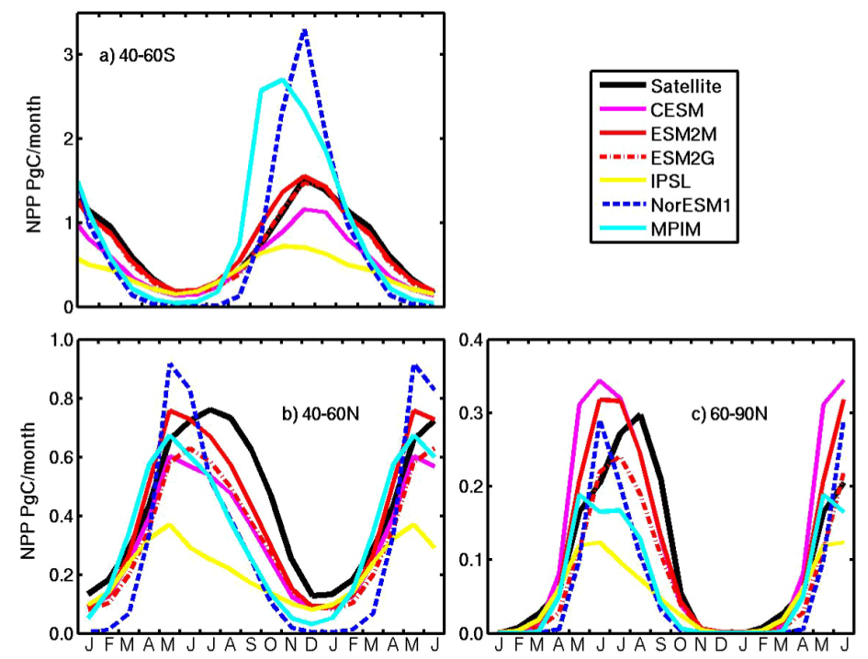
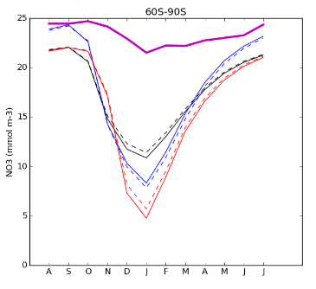
Photosynthesis under partial sea-ice cover
Challenge in HAMOCC: Southern Ocean Seasonality (Nevison et al. 2015)

Slide 3
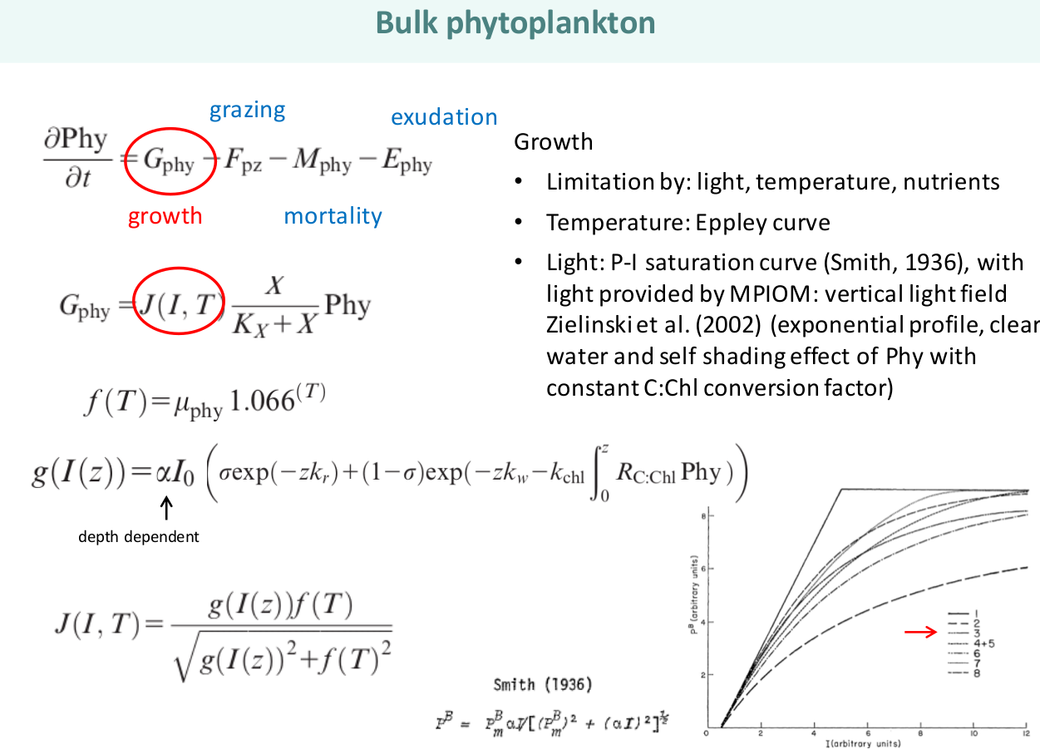

Slide 4
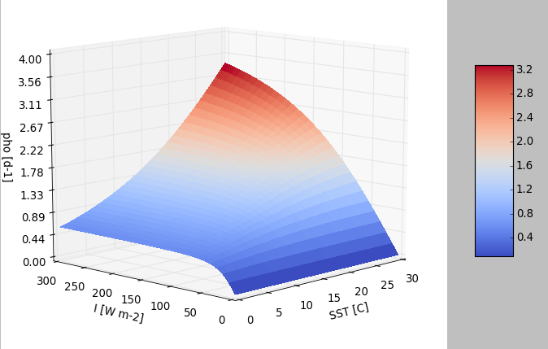
Photosynthesis in HAMOCC
Combined temperature- and light-limitation
Non-linear
For cold waters quickly light-saturated

Slide 5
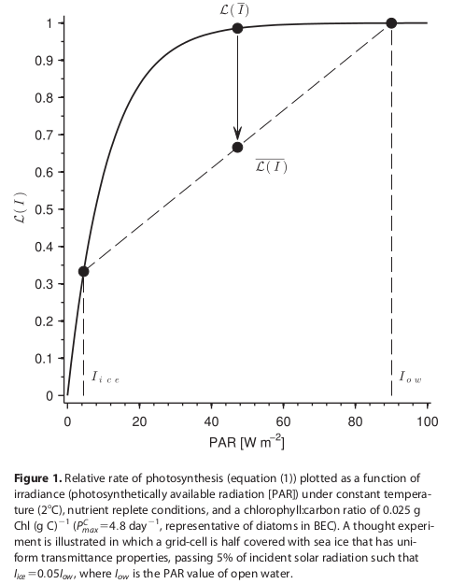
Proposal: Fix for PAR
Now: If grid cell is sea-ice covered, then strahl is attenuated
Proposal: …, then PAR for grid cell is calculated for sea-ice free area (f) and sea-ice covered area (1-f) separately
→ CHANGE IN TIMING
No change if no ice (f=0)
No change if J(I,T) linear

Slide 6
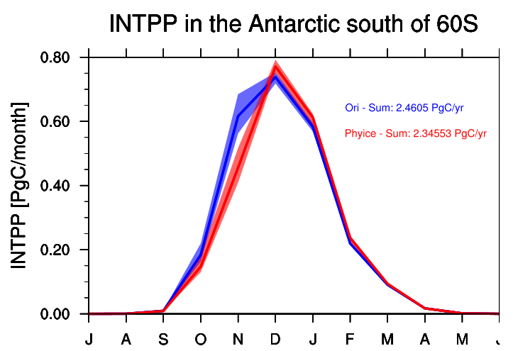
My runs
From Fabrice pre-industrial control restart file
Ori (CTRL) = 30 yrs control run
Phyice (MCOG) = 30 yrs phyice fix
Long 2015

Slide 7
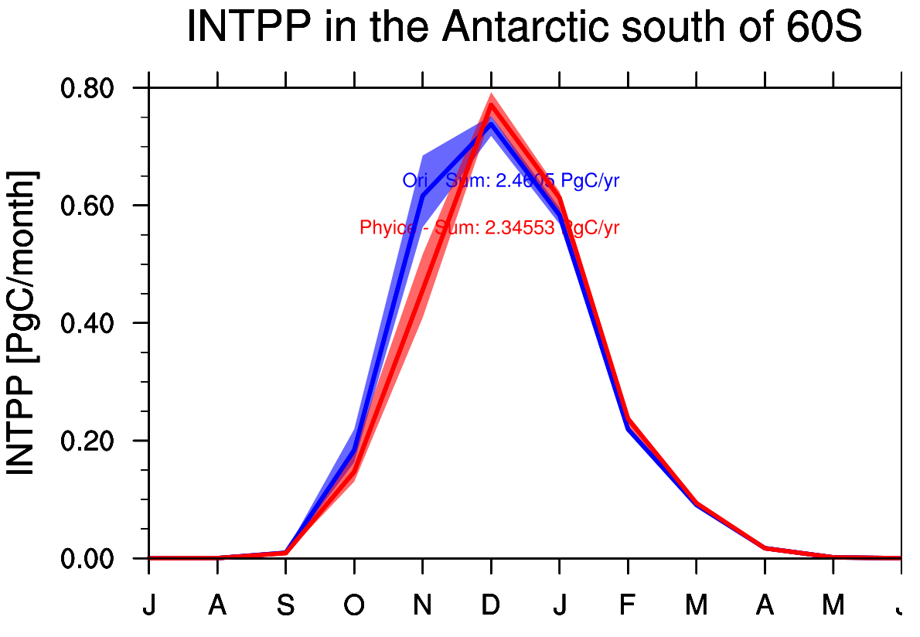

Slide 8
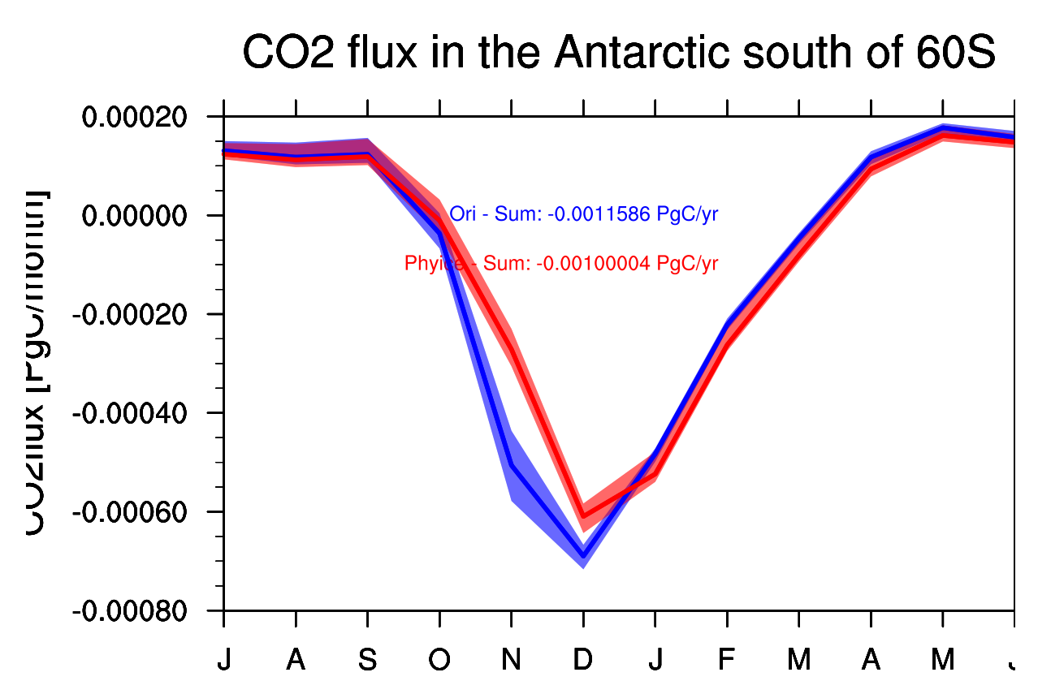

Slide 9
Effects
Little less primary production
Bloom little later
Sea-ice under-estimated in MPIOM
Only checked for 60-90S in pi-control
Adaptable for under-ice phytoplankton growth

Slide 10
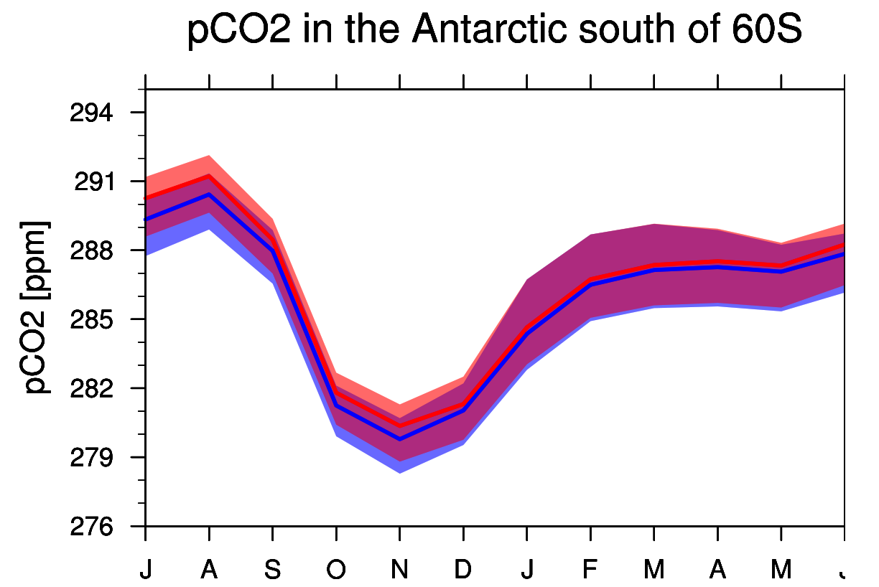

Slide 11
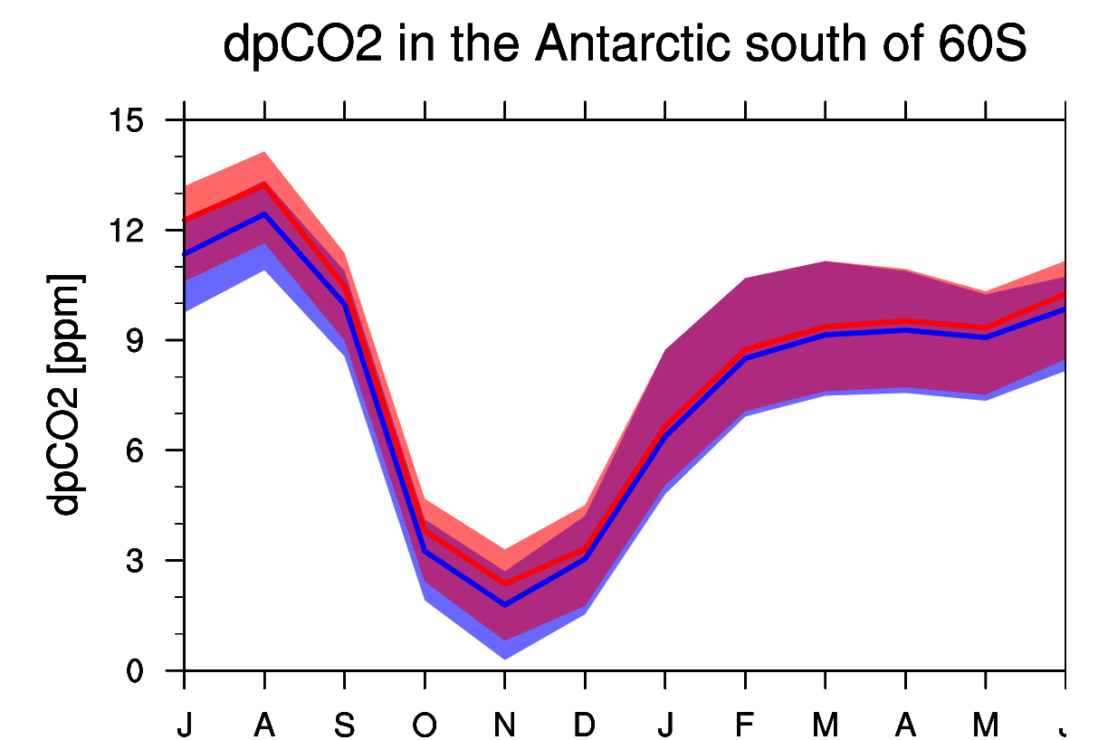

Slide 12
Summary Seasonality

