Slide 1
CO2 separation
Aaron Spring
18.04.2017

Slide 2
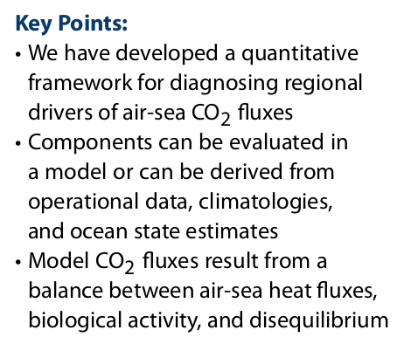
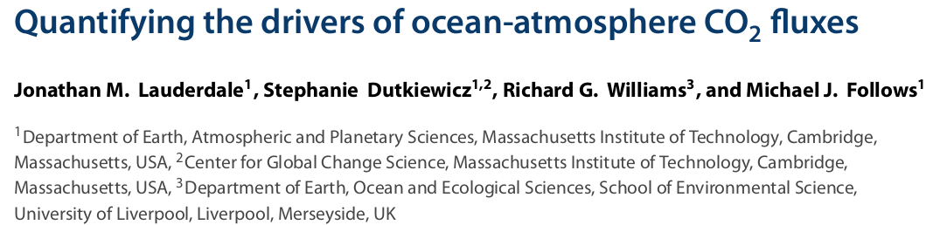
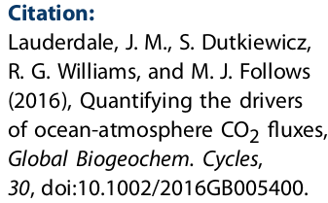
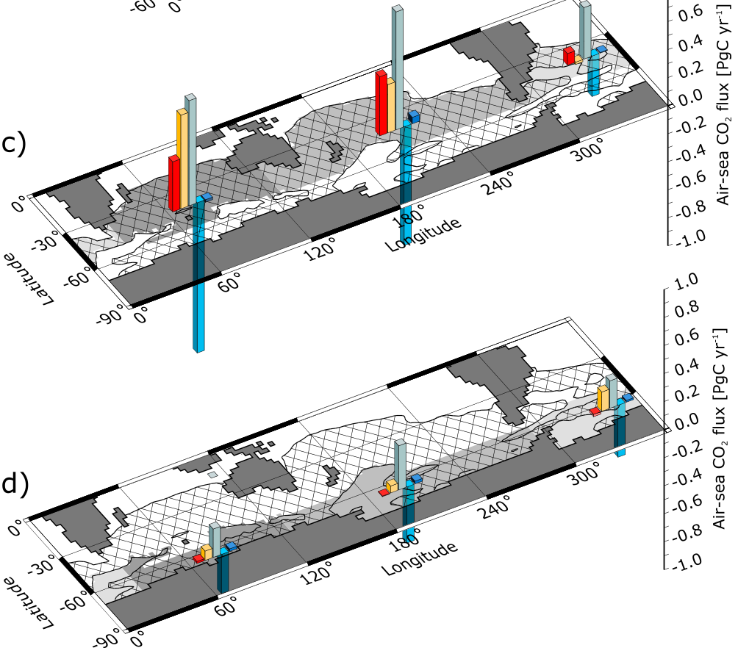
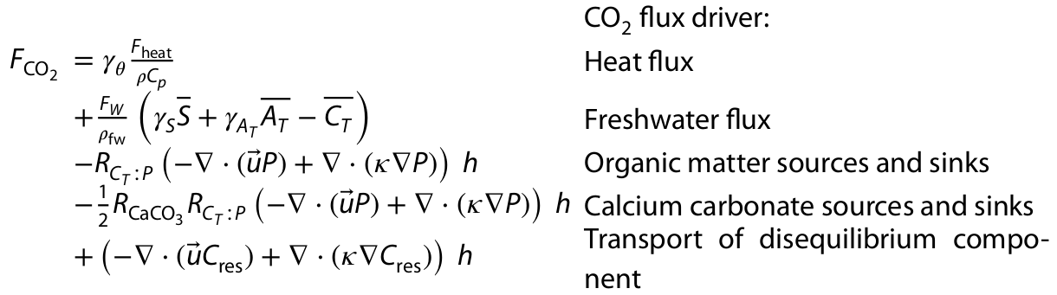
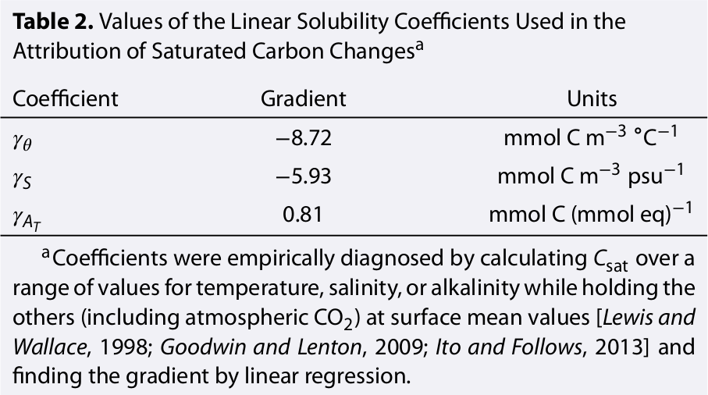
Lauderdale et al. 2016
Assumption: steady state
negative CO2flux = outgassing!

Slide 3
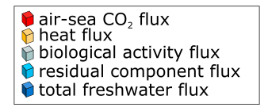
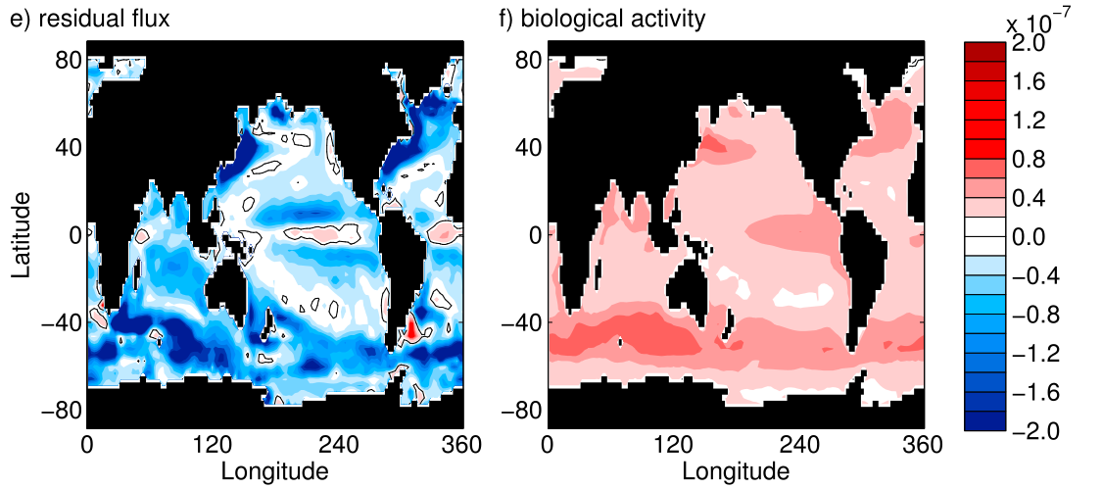
What can we learn from this?
Fresh water: alkalinity flux and dilution flux cancel out
Bio and residual are largest contributors, but depend on each other by definition

Slide 4
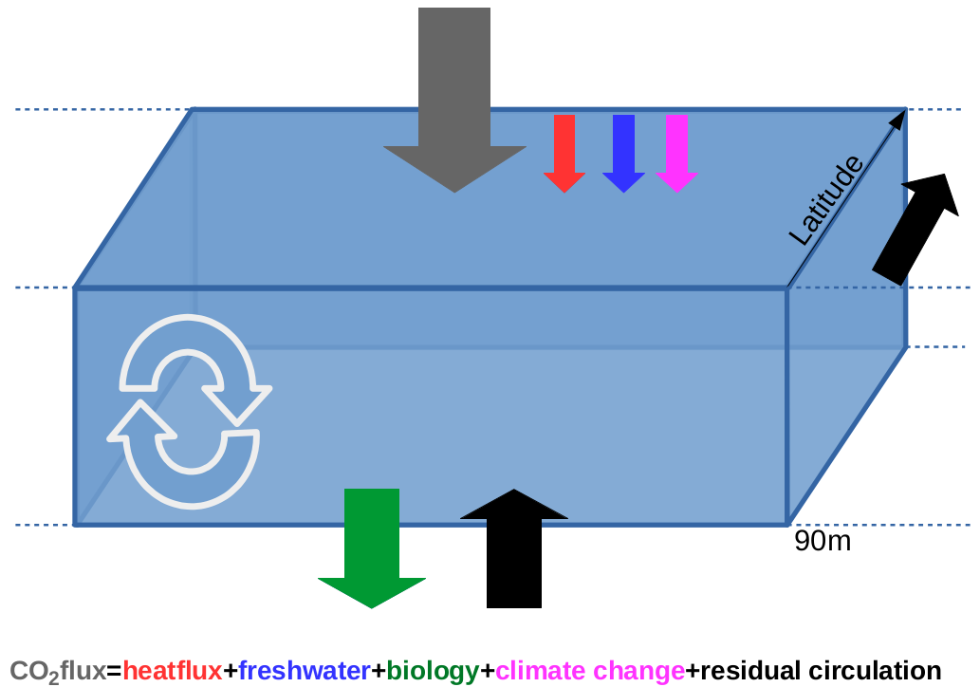
Adaptation to my large ensemble runs
Goal: identify drivers of CO2 variability
- (caex90+coex90) biology
+ change in ensmean co2flux since 1870 climate change
+ residual circulation
positive CO2flux = outgassing!

Slide 5
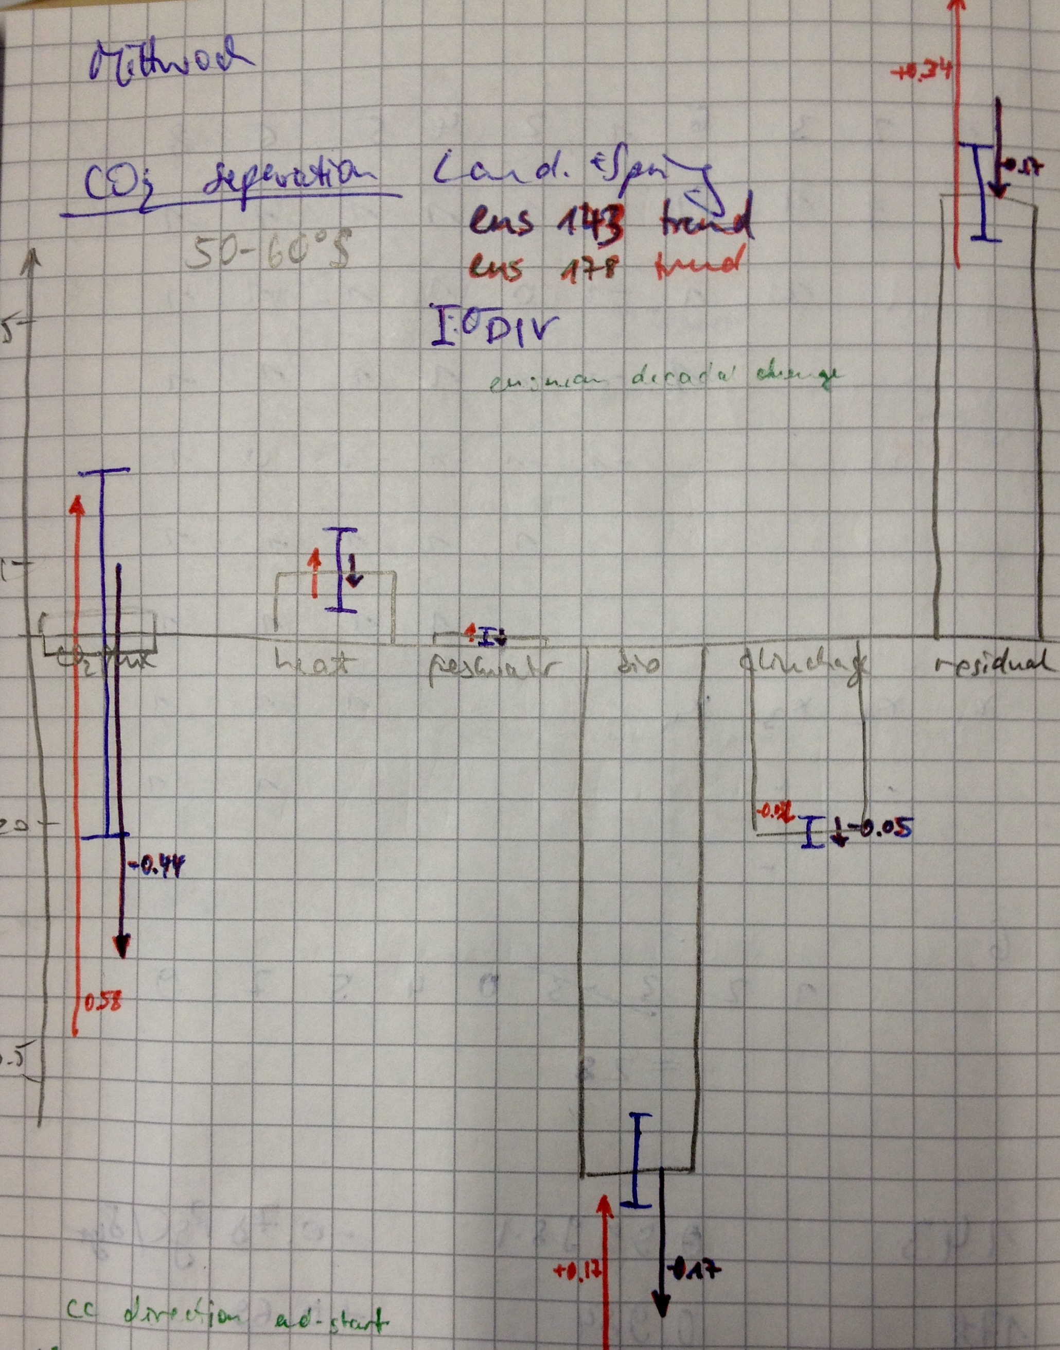
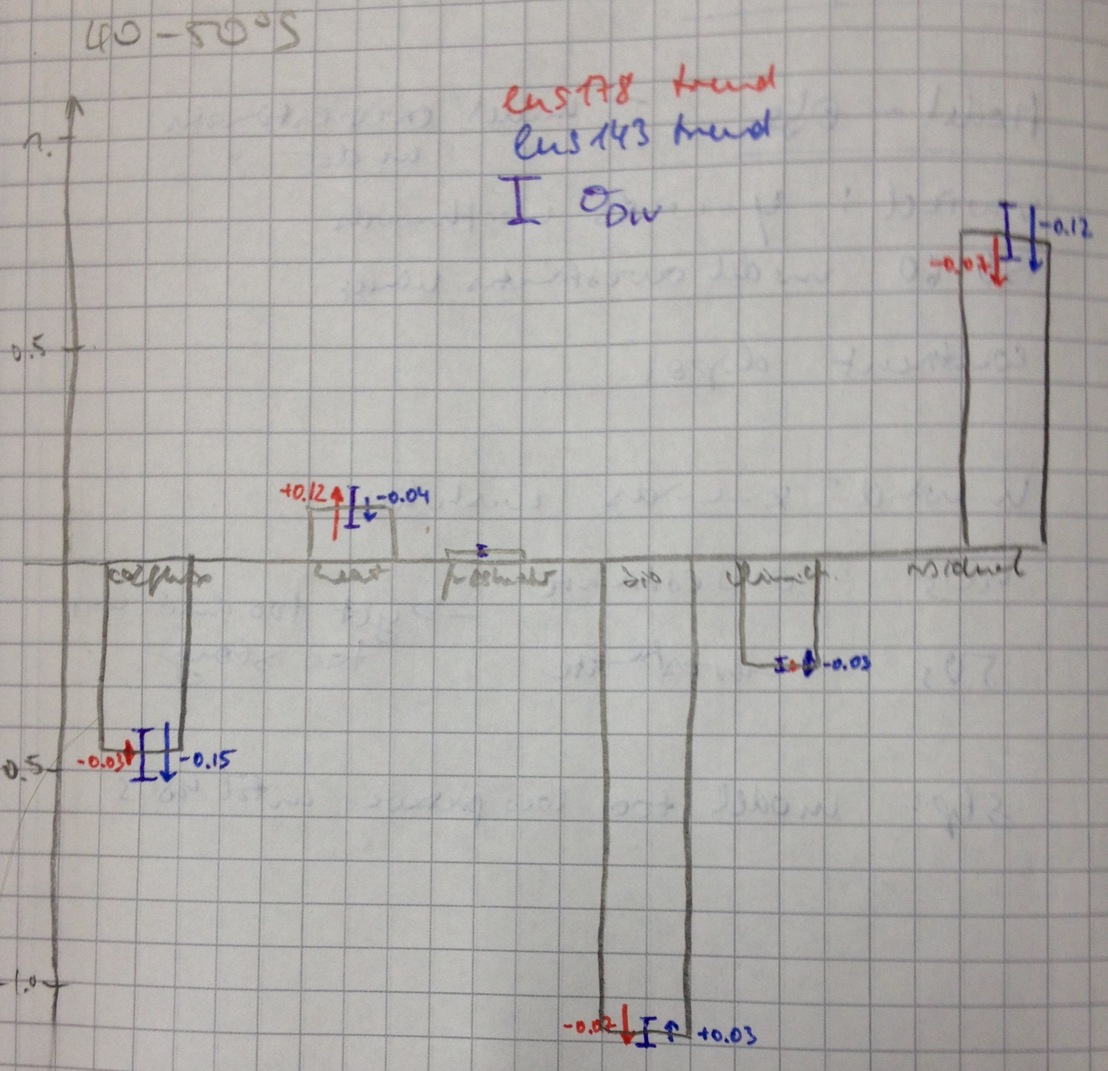
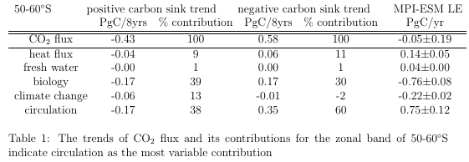
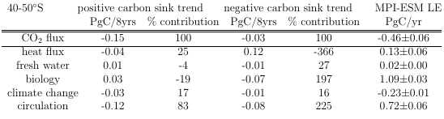
My results 1980-2005 ensmean
Positive carbon sink trend: SST warming
Negative carbon sink trend: SST cooling

Slide 6
Comparing Lauderdale to pi-control

Slide 7
Questions

Slide 8
Lauderdale et al. 2016 input
Text

