Slide 1
CO2 separation
Prep list:
Lauderdale paper
Lauderdale slides
Ncview control timmean
Ncview hist timmean
18.04.2017

Slide 2
CO2 separation
Aaron Spring
18.04.2017

Slide 3
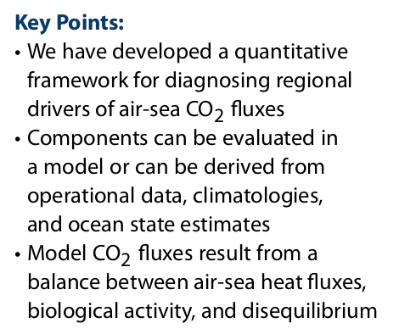
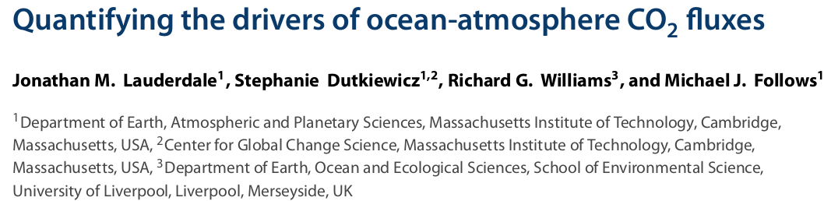
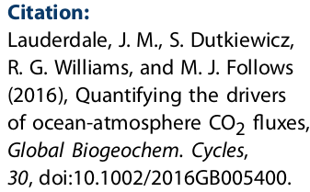
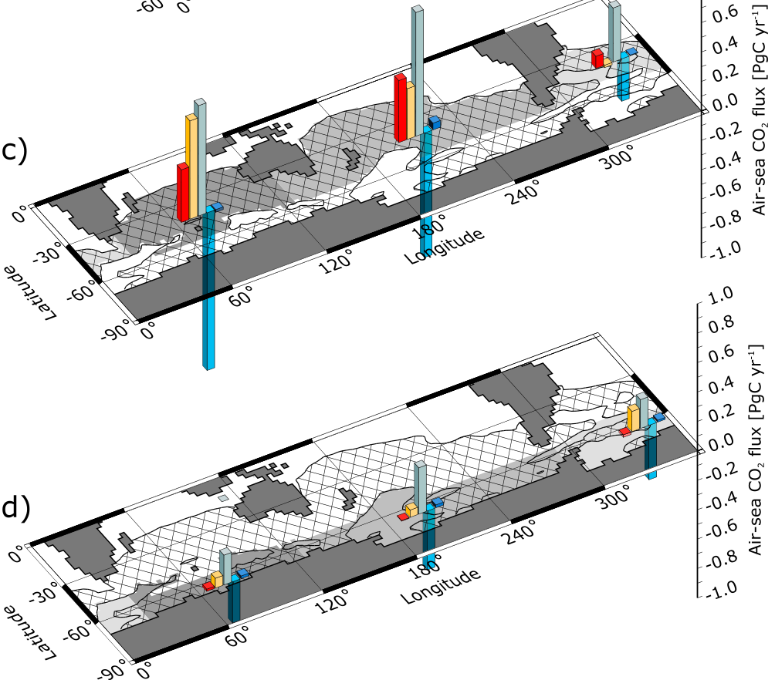
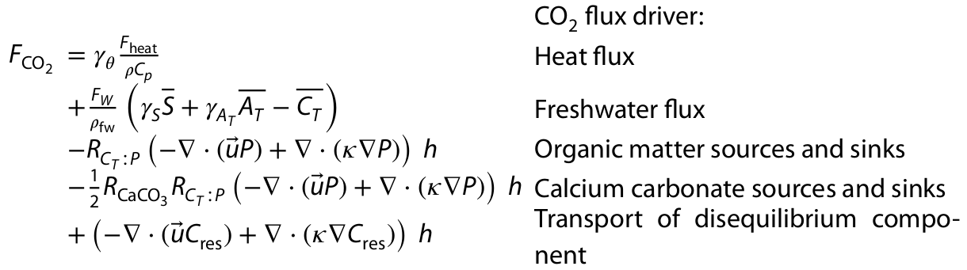
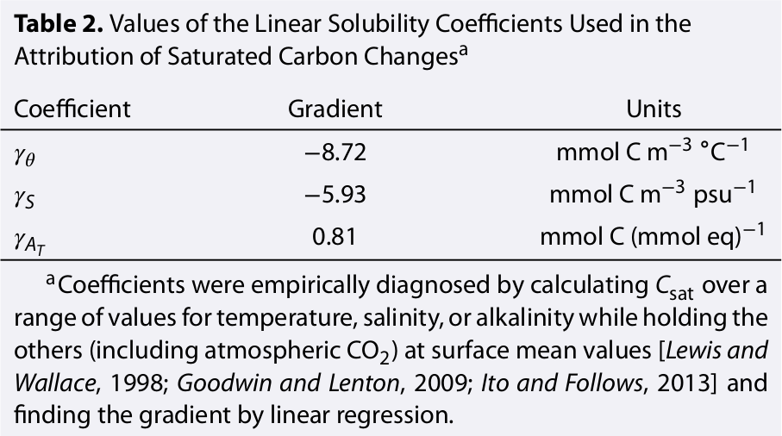
Lauderdale et al. 2016
Assumption: steady state
negative CO2flux = outgassing!

Slide 4
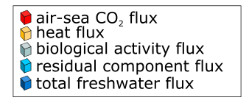
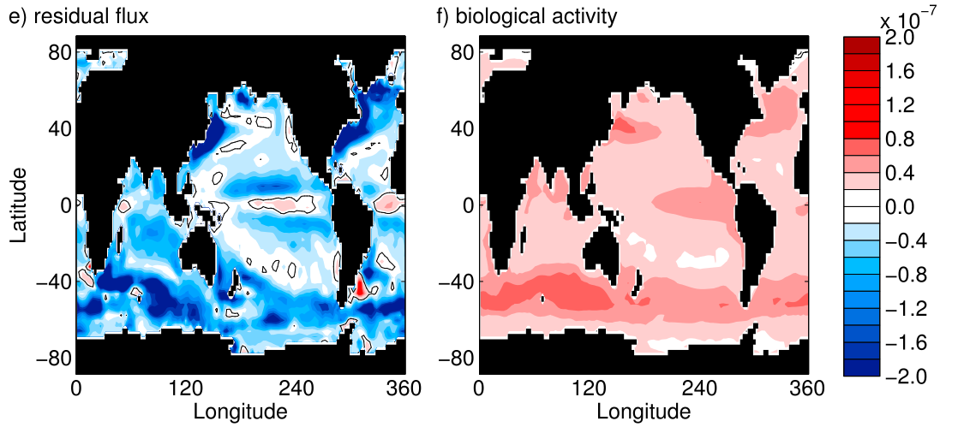
What can we learn from this?
Fresh water: alkalinity flux and dilution flux cancel out
Bio and residual are largest contributors, but depend on each other by definition

Slide 5
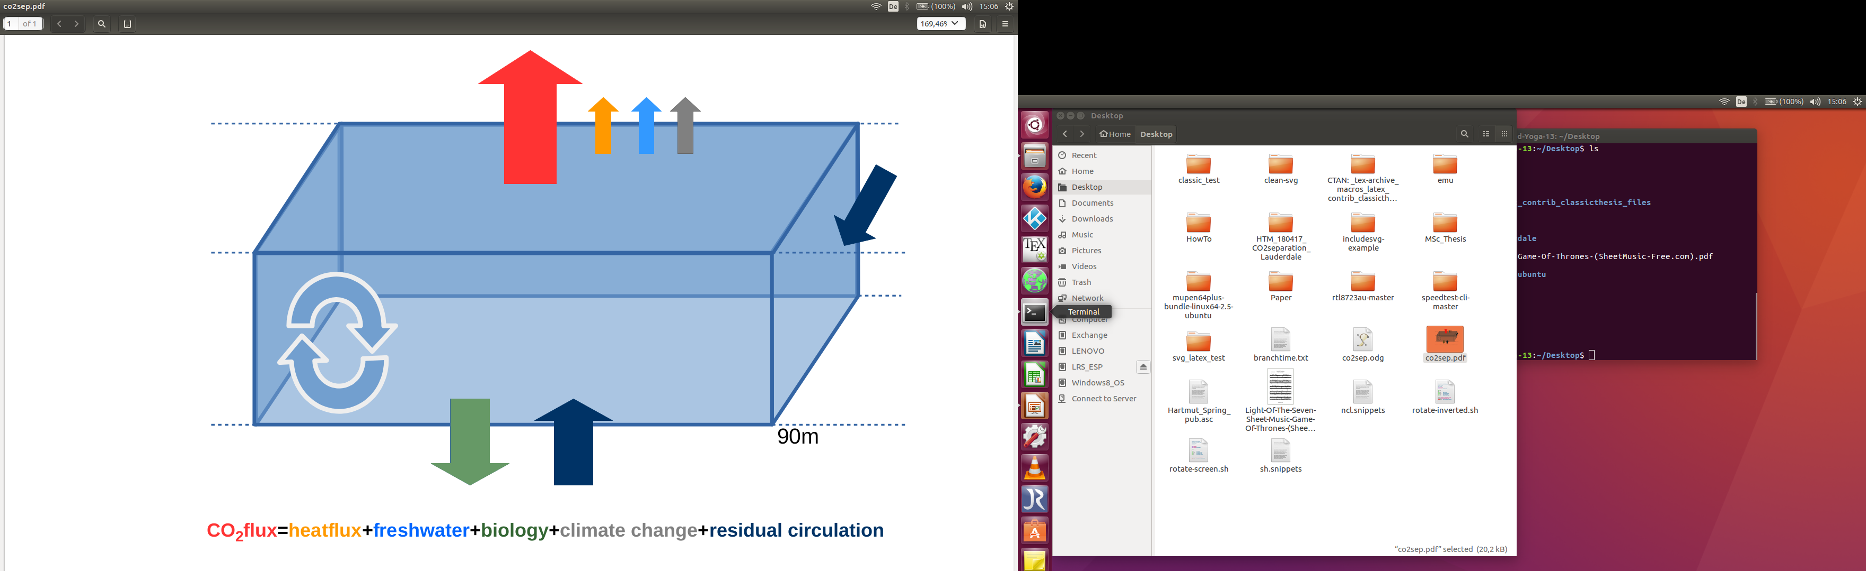
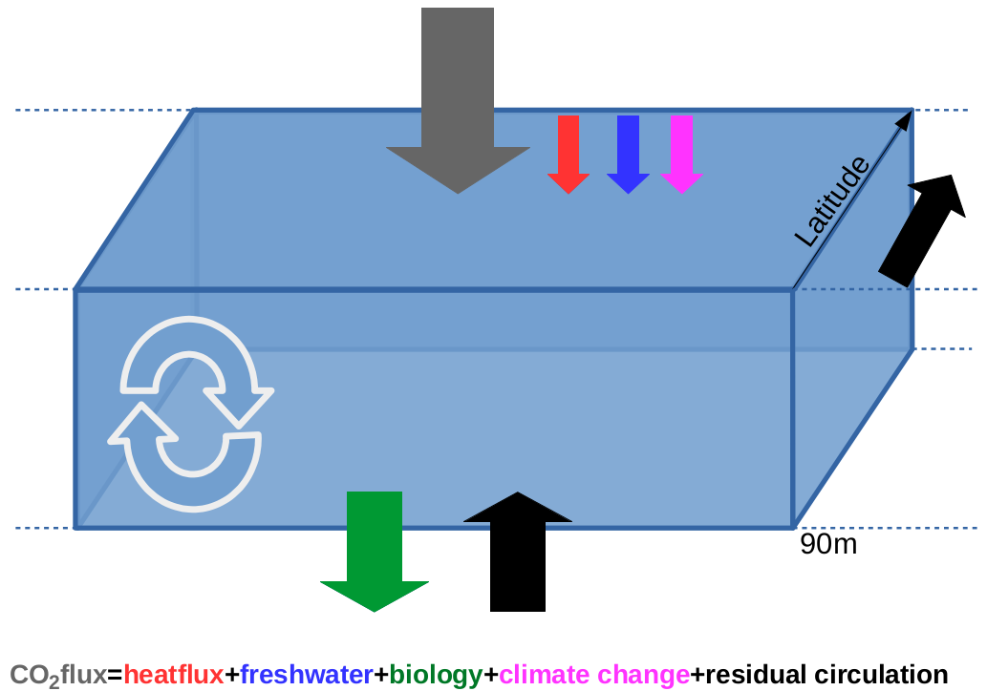
Adaptation to my large ensemble runs
Goal: identify drivers of CO2 variability
aoflnhwo: net heat flux over water
pem: water flux to ocean [m/s]
- (caex90+coex90) biology
+ change in ensmean co2flux since 1870 climate change
+ residual circulation
positive CO2flux = outgassing!

Slide 6
Comparing Lauderdale to pi-control
NCL plots: normal view or ncview live

Slide 7
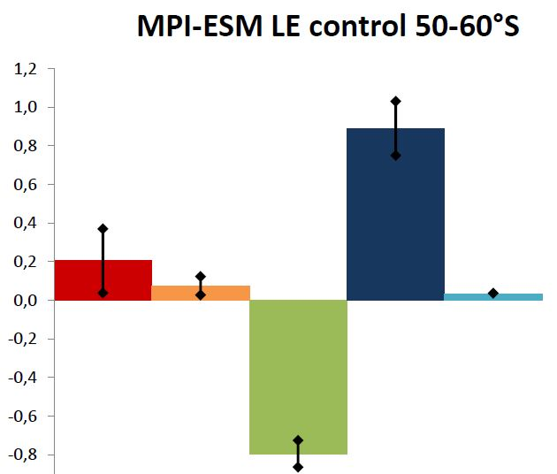
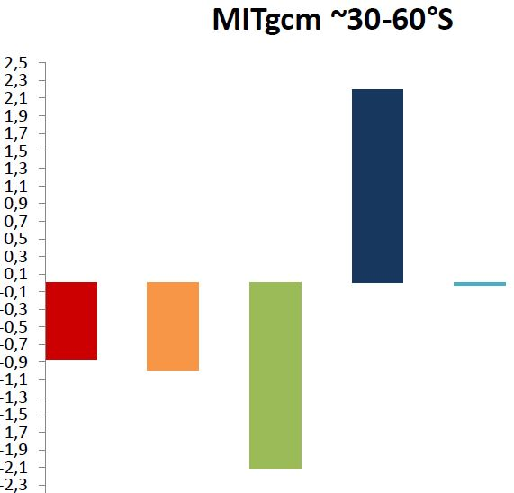
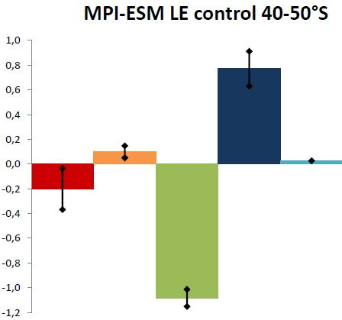
Comparing Lauderdale to pi-control

Slide 8
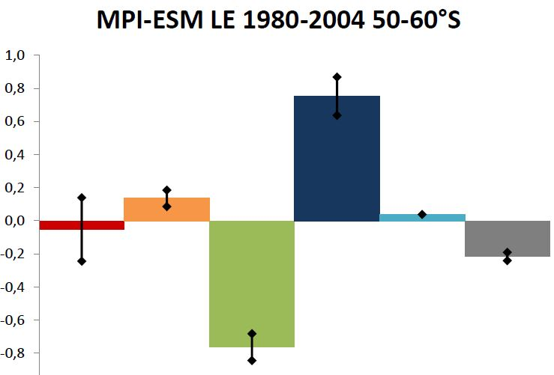
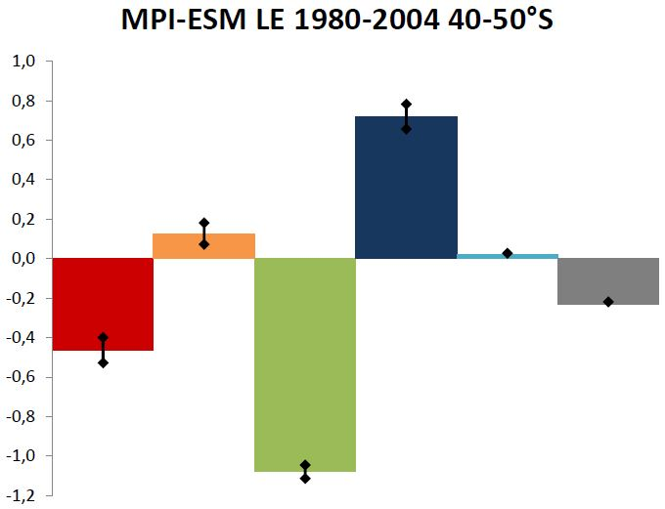
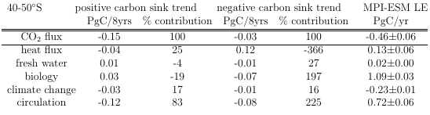
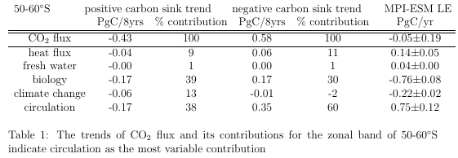
My results 1980-2004

Slide 9
Limitations
Thermal pump via heat flux and not SST
  Cooling SST trends (m178) can have negative trend in CO2 flux contribution due to heat flux, but should be positive (thermal)
I tried bio=fddtdic-co2flux, but too high values

Slide 10
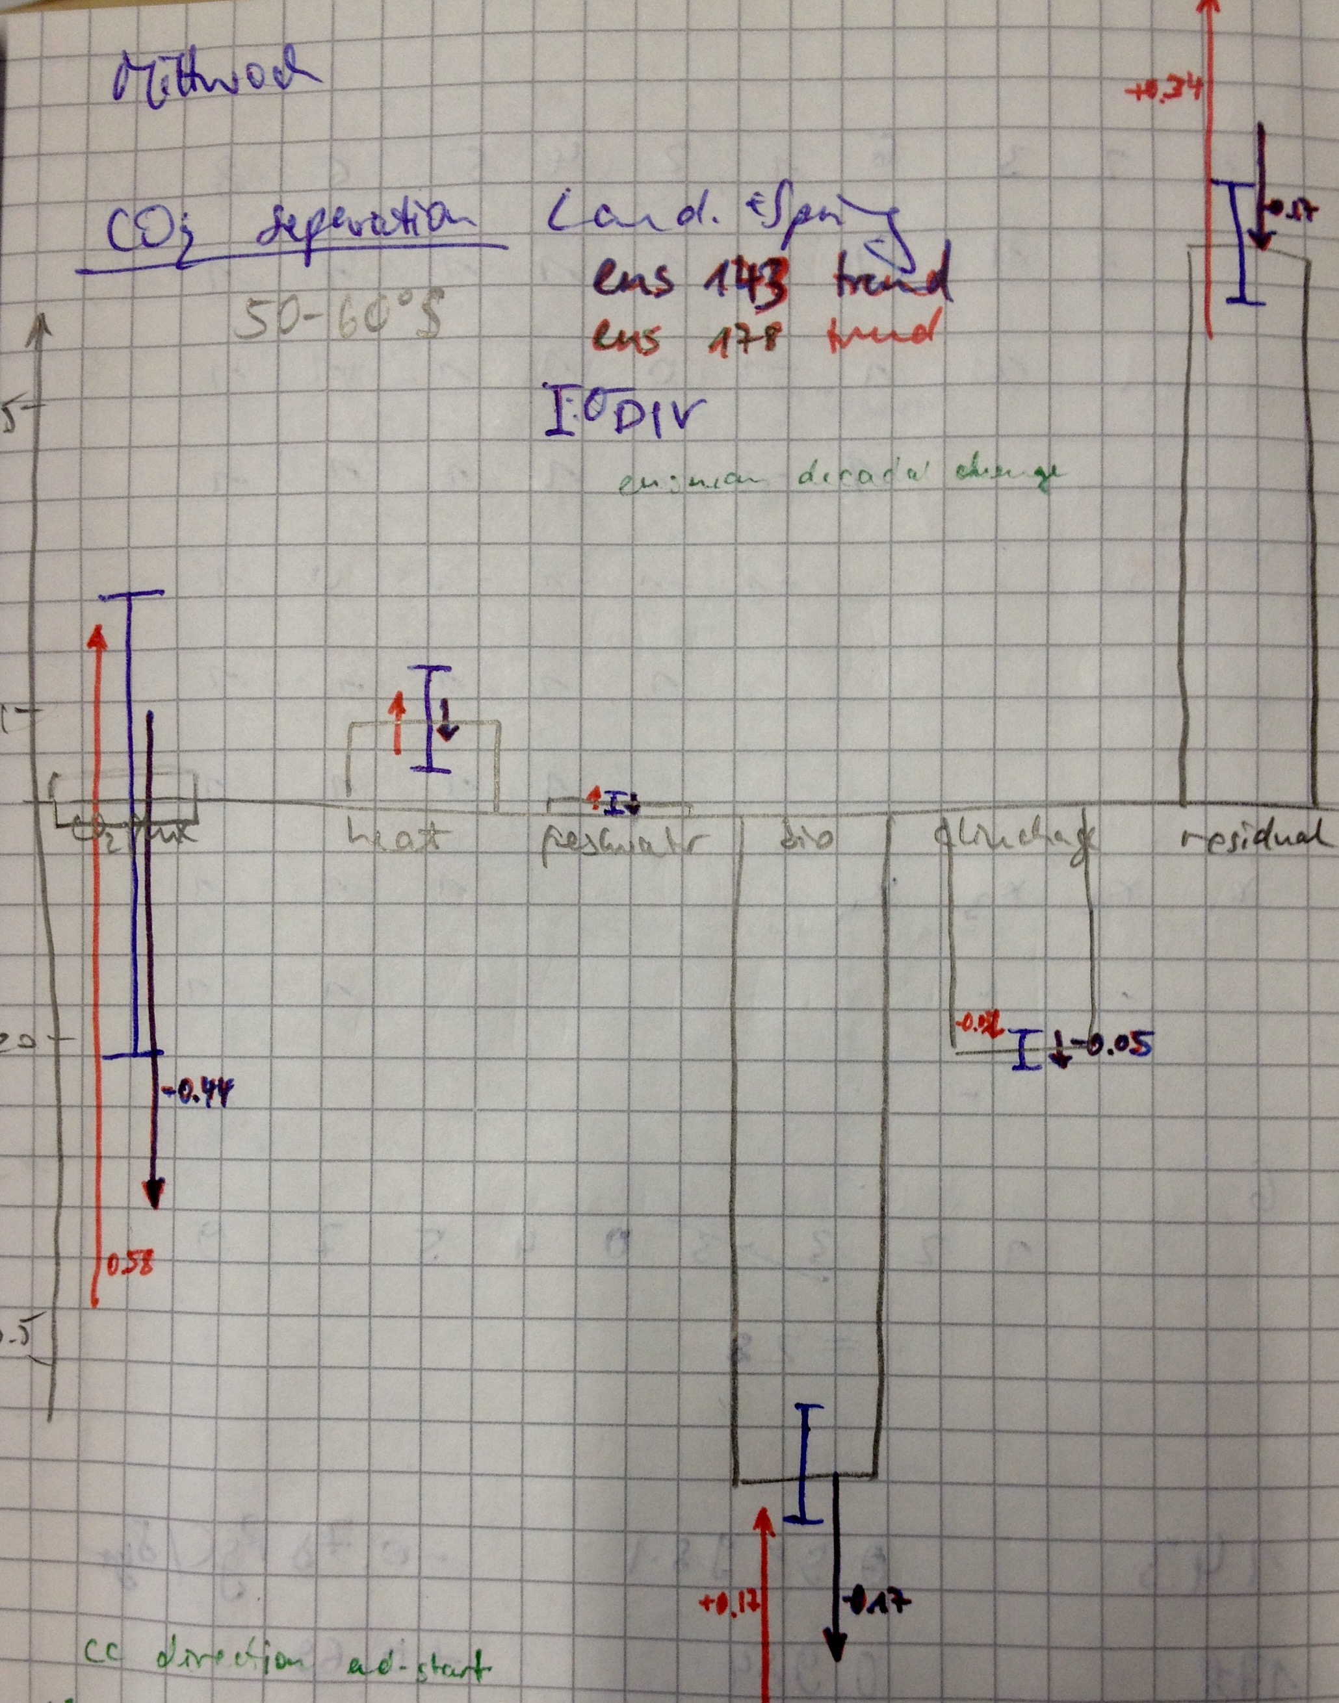
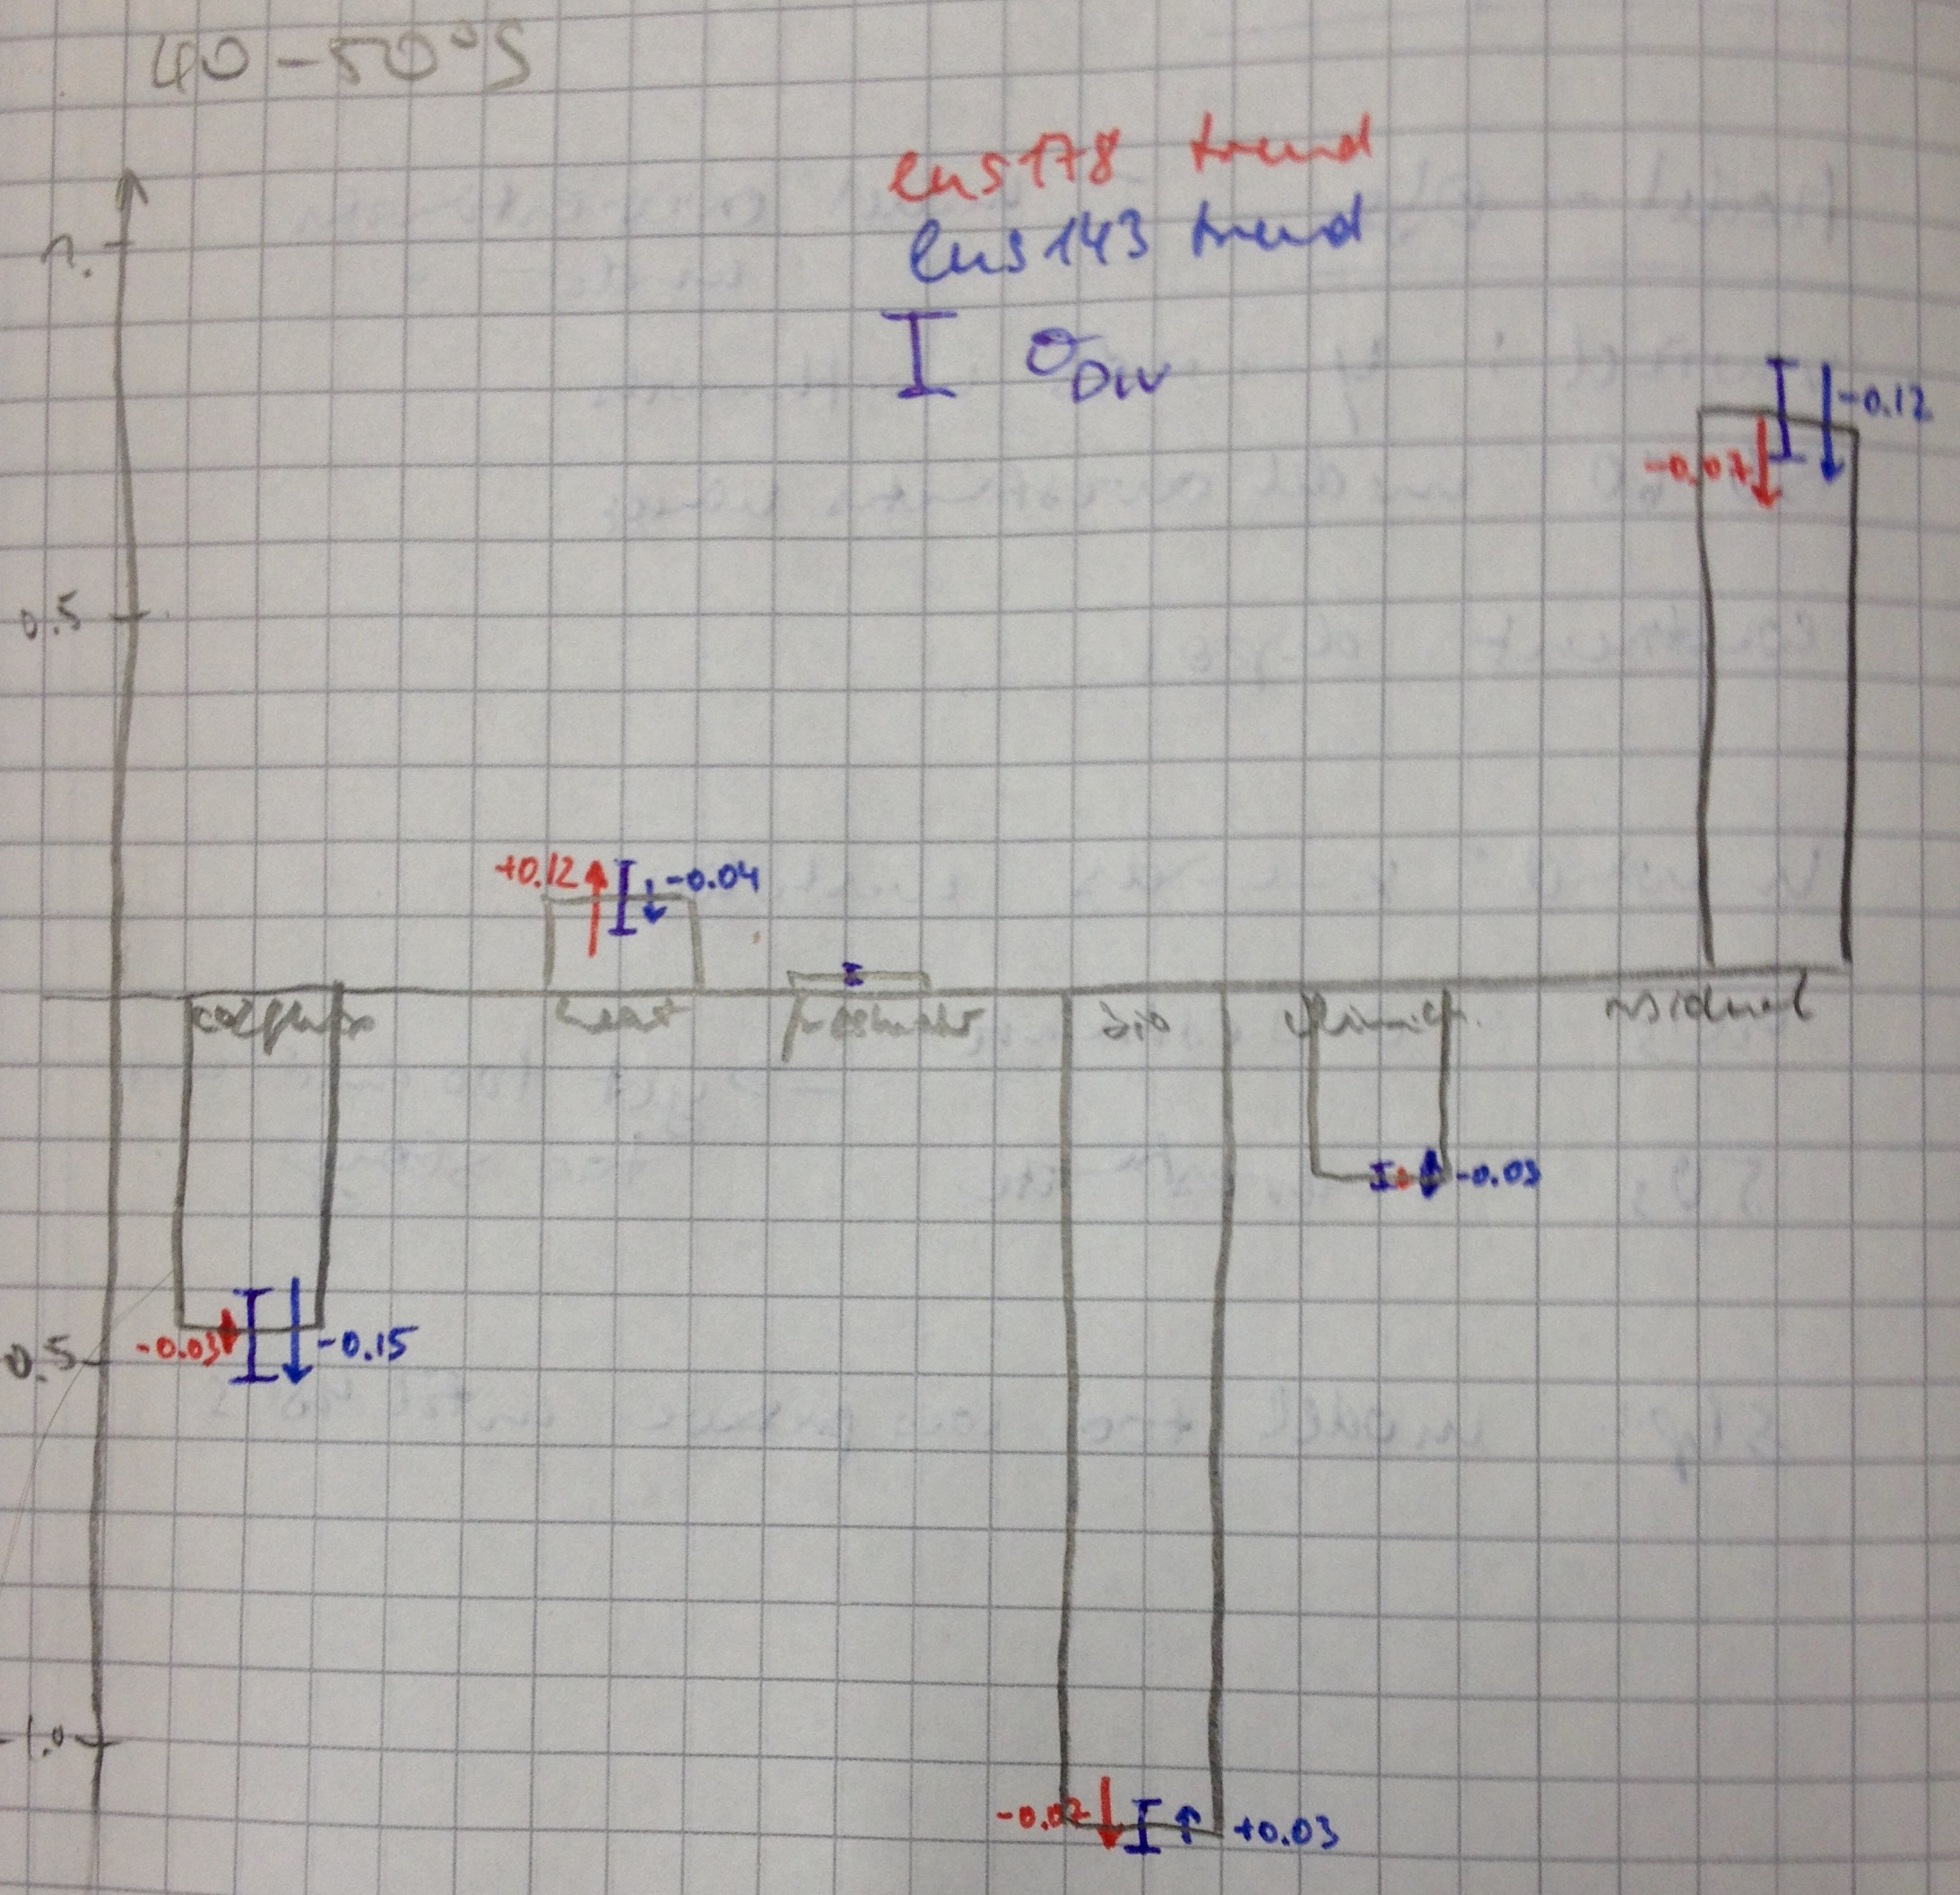

My results 1980-2005 ensmean
Heat refers to net air-sea radiative heat flux:
Positive carbon sink trend: SST warming
Negative carbon sink trend: SST cooling

Slide 11
Lauderdale et al. 2016 input
Text

