Slide 1
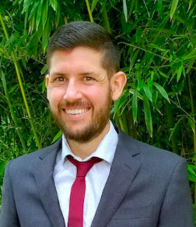

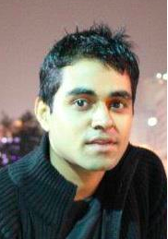
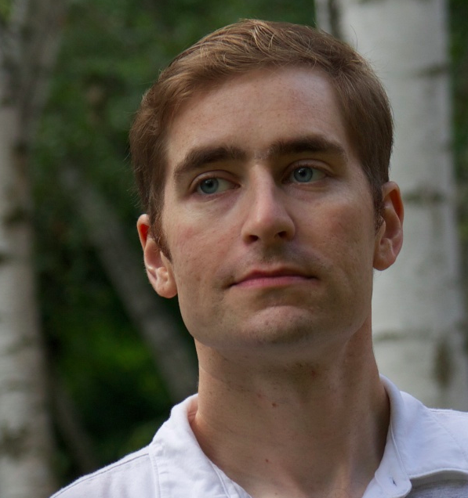
Inference is Everything: Recasting Semantic Resources into a Unified Evaluation Framework
Aaron White (Rochester)
Kevin Duh (JHU)
Pushpendre Rastogi (JHU)
Benjamin Van Durme (JHU)

Slide 2
Have you ever experienced this?
What next?
Amazing
New Model
Accuracy=
76%
e.g. for Recognizing
Textual Entailment (RTE)
e.g. Stanford Natural Language Inference (SNLI) dataset

Slide 3
Ideally… Actionable results
Improve lexical semantics!
Improve anaphora resolution!
Amazing
New Model
Accuracy=
76%

Slide 4
Idea (for RTE)
Existing resources
Amazing
New Model
conversion
76%
55%
99%
Focused Evaluation Datasets
that probe different
linguistic phenomena

Slide 5
Previous work with similar motivations
FraCaS [Cooper et. al. 1996]
Manually constructed test suite to probe a range of semantic phenomena
bAbI [Weston et. al. 2016]
Automatically generated test suite to probe different capabilities needed in question answering
Challenge set for Machine Translation [Isabelle, 2017]
Manually constructed reference set to test subject-verb agreement, noun compounds, question syntax, etc.

Slide 6
Outline
Motivation
Creating focused RTE datasets
Case study: debugging neural models

Slide 7
Recognizing Textual Entailment (RTE)
Dagan et al., 2006, 2013; Bar-Haim et al., 2006; Giampiccolo et al., 2007, 2009; Bentivogli et al., 2009, 2010, 2011
Text
Hypothesis
A couple men are playing soccer
Some men are playing a sport
Relation
Entailed

Slide 8
Stanford Natural Language Inference data (SNLI)
Bowman et al. 2015
Image
Captions
570k hypothesis-text pairs
Mechanical Turk
Flickr30k
Large-scale data enables training sophisticated models.
But maybe not ideal for evaluation: no fine-grain relations.
Young et al. 2014

Slide 9
Our contributions
An evaluation framework based on recasting
existing classification datasets to RTE, e.g.:
Definite Pronoun Resolution (DPR)
FrameNet Plus (FN+)
Semantic Proto-Roles (SPR)
Rahman and Ng 2012
Pavlick et al. 2015
Reisinger et al., 2015

Slide 10
Recasting Definite Pronoun Resolution (DPR) to RTE
Original classification task:
Map pronoun to coreferential element.
A step towards the Winograd Challenge
The bee landed on the flower because...
(a) it wanted pollen. (b) it had pollen.
☑
☒

Slide 11
The bee landed on the flower because...
(a) it wanted pollen. (b) it had pollen.
☑
☒
Text:
correct sentence (a)
Hypothesis:
(a), pronoun resolved
The bee landed on the flower because
it wanted pollen.
The bee landed on the flower because
the bee wanted pollen.
Relation
Entailed.

Slide 12
The bee landed on the flower because...
(a) it wanted pollen. (b) it had pollen.
☑
☒
Text:
correct sentence (a)
Hypothesis:
(b), pronoun resolved
The bee landed on the flower because
it wanted pollen.
The bee landed on the flower because
the bee had pollen.
Relation
Not Entailed.

Slide 13
Recasting FrameNet Plus (FN+) to RTE
Original data:
- Applied paraphrase to FrameNet triggers
- Turker judged on 5-point scale how much meaning was retained
So our work must continue.
So our labor must continue.
Paraphrase rating = 4
1-3 rating
Not entailed
4-5 rating
Entailed

Slide 14
So our work must continue.
So our labor must continue.
Paraphrase rating = 4
Text
Hypothesis
So our work
must continue.
So our labor
must continue.
Relation
Entailed.

Slide 15
So our work must continue.
So our occupation must continue.
Paraphrase rating = 1
Text
Hypothesis
So our work
must continue.
So our occupation
must continue.
Relation
Not Entailed.

Slide 16
Recasting Semantic Proto-Roles (SPR) to RTE
5-point scale likelihood ratings for property
The network must refund money to the advertisers and loses considerable revenue and prestige.
How likely is it that the network was altered or somehow changed during or by the end of the losing.
The network must refund money to the advertisers and loses considerable revenue and prestige.
Likelihood rating = 4
1-3 rating
Not entailed
4-5 rating
Entailed

Slide 17
Recasting Semantic Proto-Roles (SPR) to RTE
EXAMPLES:
T: I heard parts of the building above my head cracking
H: I was aware of being involved in the hearing
T: UNESCO converted the founding U.N. ideals of individual rights and liberty into peoples’ rights
H: UNESCO existed after the converting stopped
T: THE IRS delays several deadlines for Hugo's victims
H: THE IRS caused the delaying to happen.

Slide 18
Semantic Proto-Roles
What’s the number and character of thematic roles in the syntax/semantics interface?
AGENT and PATIENT
BENEFICIARY? RECIPIENT? Fuzzy boundaries?
Dowty (1991) introduced Proto-Agent, Proto-Patient fine-grained properties
Did the argument change state?
Did the argument have volition in the change?
Stable vs unstable predicate
Stable - “kill”: KILLER=subject, VICTIM=object
Unstable - “buy”/“sell”: SOURCE/GOAL similar in proto-agent property so compete equally for subject position

Slide 19
Semantic Proto-Roles
What’s the number and character of thematic roles in the syntax/semantics interface?
AGENT and PATIENT
BENEFICIARY? RECIPIENT? Fuzzy boundaries?
Dowty (1991) introduced Proto-Agent, Proto-Patient fine-grained properties
Did the argument change state?
Did the argument have volition in the change?

Slide 20
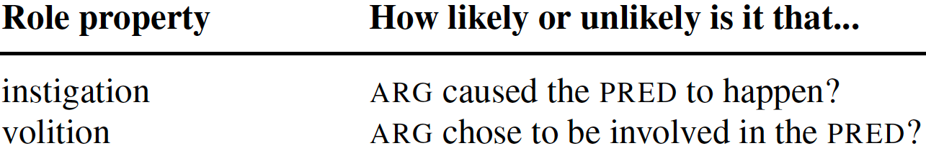
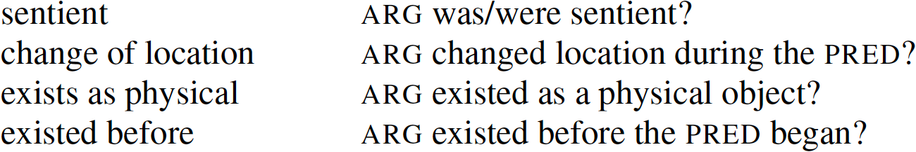
Example Semantic Proto-Role Properties

Slide 21
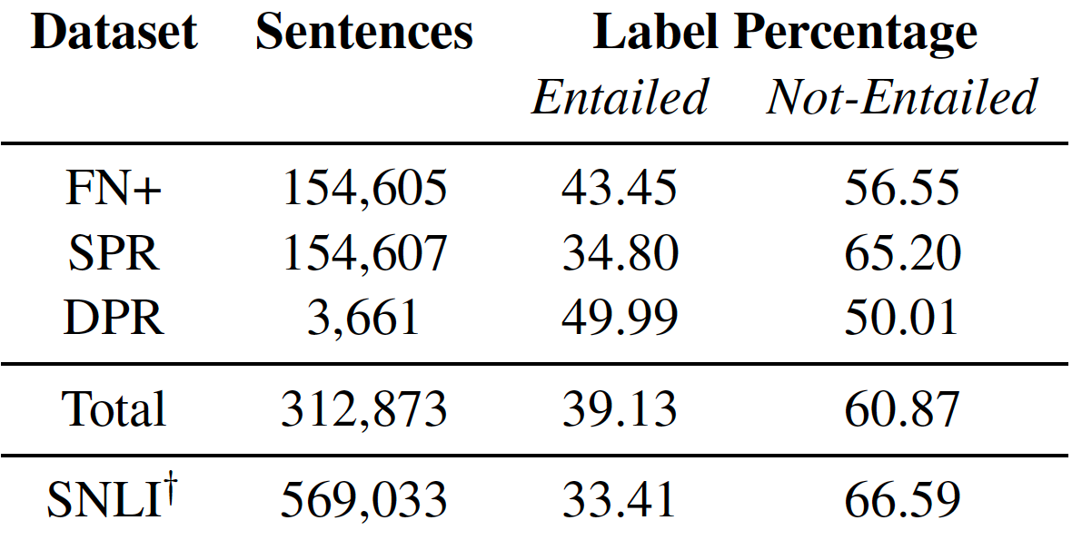
Focused RTE Dataset characteristics

Slide 22
Outline
Motivation
Creating focused RTE datasets
Case study: debugging neural models

Slide 23
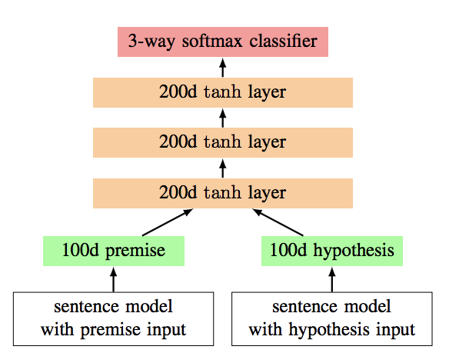
Train on SNLI
2-way entailed vs. not classifier
Evaluated on recasted focused RTE datasets:
Definite Pronoun Resolution (DPR)
FrameNet Plus (FN+)
Semantic Proto-Roles (SPR)

Slide 24
Train on SNLI
2-way entailed vs. not classifier
85%
Fails in pronouns.
Better in paraphrase.
Generally, difficult tasks
Evaluated on recasted focused RTE datasets:
49%
62%
58%
Definite Pronoun Resolution (DPR)
FrameNet Plus (FN+)
Semantic Proto-Roles (SPR)

Slide 25
Train on DPR
Eval on DPR
Train on FN+
Eval on FN+
Train on SPR
Eval on SPR
50%
81%
81%
Still fails at pronouns
Failure to generalize from SNLI training
Train on SNLI
Evaluated on recasted focused RTE datasets:
49%
62%
58%
Definite Pronoun Resolution (DPR)
FrameNet Plus (FN+)
Semantic Proto-Roles (SPR)

Slide 26
Summary
Actionable Results?
Amazing
New Model
Accuracy=
76%
e.g. for Recognizing
Textual Entailment (RTE)
e.g. Stanford Natural Language Inference (SNLI) dataset

Slide 27
Summary
Existing resources
Amazing
New Model
conversion
76%
55%
99%
Focused Evaluation Datasets
that probe different
semantic phenomena
(Data available at http://decomp.net)
.

Slide 29
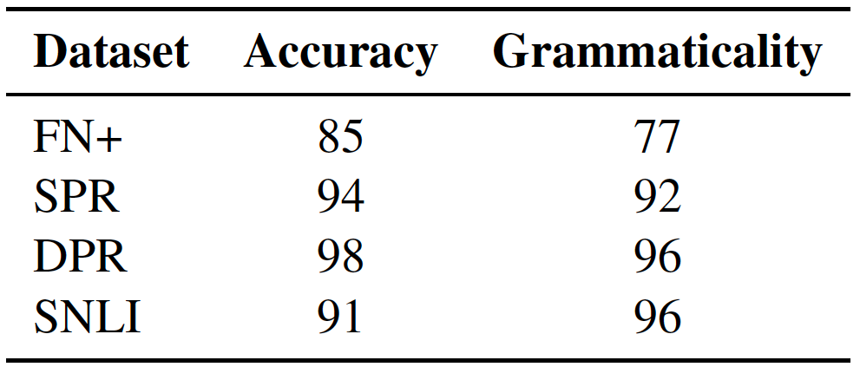
Data Validation
Manual check of 100 pairs per dataset

