Slide 1
DIGITAL DOJO
Logo goes here
Digital Technology Solutions

Slide 2
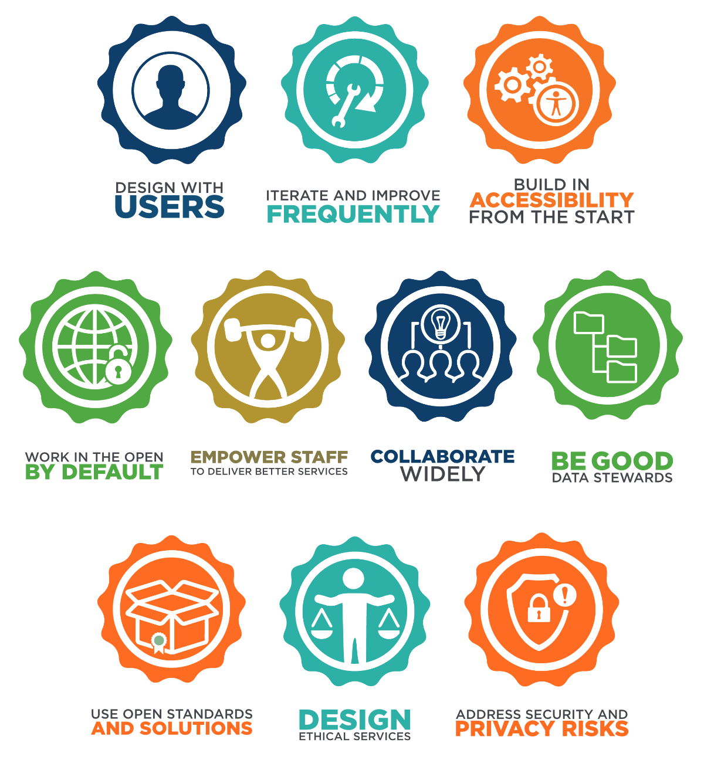
Modernizing is hard
The Technical debt remediation team identified over 140 IITB systems, including 25 mission critical systems, that require immediate attention.
We need teams taking on these projects to follow TBS Digital Standards.
Teams can feel overwhelmed, and unprepared to deliver in new ways.
Notes:
Add more specifics about Agile, DevOps, etc. Either talking points or another slide. Hint to our service catalog?

Slide 3


We want to help
Logo goes here
A Dojo is a Japanese word for a space for immersive learning or meditation. The Digital Dojo aims to provide a space where product teams learn new skills and new ways to solve problems.
Our goal is to introduce you to the tools and strategies to be able to continue your Digital journey.

Slide 4




What a Dojo isn’t vs. What a Dojo is
What a Dojo isn’t
What a Dojo is
Classroom training
Practical & immersive experience
A center of expertise
Experts work directly with your team
Abstract or high-level theoretical
Work on your real product
Exercises with predefined answers
Customized to your objectives

Slide 5



Why our Dojo?
Team-based experience
Government of Canada focus
Virtual learning
We are designing the dojo with Virtual learning in mind. We will also help teams learn how to work together more effective in this new world.
We don’t focus on individual skills; we want to upskill the entire team together. Business and IT, working together.
We cater our experience to the reality of Government IT; we have a shared vocabulary, standards, and our team has experienced the unique blockers.

Slide 6
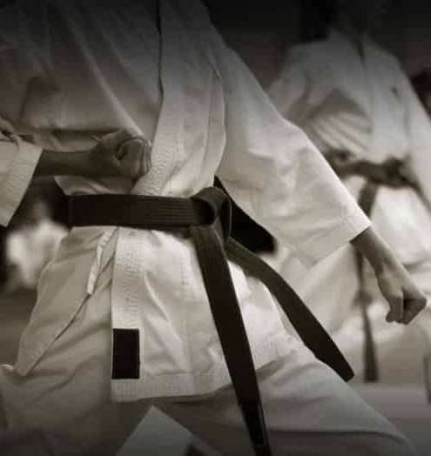
Who should consider the Dojo?
We will focus on teams that are ready to take the next step but need a safe place to experiment.
As much as we want to, we won’t be able to help everyone.
We do not want to change what is already working, or force change on people that really aren’t ready.

Slide 7




The Digital Dojo Experience
DISCOVERY
PREPARATION
PRACTICE
CLOSEOUT
Assemble the team
Solidify the objective
Pre-Dojo training
6 week of hands-on work towards objective
Take the team from crawl to run
Spaced repetition and opportunity for repeated practice
Safe-to-fail learning
Receive recommendations on the way forward
Share our products, experiences and resources in the open
The Dojo practice never ends, it can continue and be used into everyday use

Slide 8
The Digital Dojo Experience - Discovery
Objective: Determine if the client/problem is a good fit for the dojo
Verify prerequisites
Understand our goals
Maturity Assessments

Slide 9
The Digital Dojo Experience - Preparation
Objective: Get everyone ready to run on Day 1 of the Dojo experience
Assemble the team
Solidify the objective
Pre-Dojo training

Slide 10
The Digital Dojo Experience - Practice
Objective: Immersive learning through hands on practice towards defined Objective
Expert led Sprint
Collaboration Sprint
Client led Sprint

Slide 11
The Digital Dojo Experience - Closeout
Objective: Safely exit the dojo, and share our experiences
Collaborate a path forward
Share knowledge in the open
Aftercare & Check-ins

Slide 12
The bigger, GC wide vision
Form mutually beneficial partnerships across ESDC, and the GC
Make the creation of our Dojo replicable, and shareable
Avoid reinventing the wheel
CSPS Digital Academy , Canadian Digital Service, GC DevOps League, GC Agile Community of Enablement, TBS OCIO, Interdepartmental Working Groups, MORE?!

Slide 13
Related Initiatives within ESDC
Cloud CoE
?
?

Slide 14




Where we are now
The Dojo team is currently doing service design, and we need your help
Pathfinding
Soft Launch
Grand Opening
Building fundamentals
Planning the soft launch
Customer research
Determine ideal 1st clients
Test and adjust with our first client
Learn as we go
Validate our hypothesis
Accept requests from across ESDC
Continue to adjust and adapt with changing landscapes
WE ARE HERE

Slide 15




Get in touch, please!
“There are no secrets to success. It is the result of preparation, hard work, and learning from failure.”
- Colin Powell
Questions? Interesting in helping? We’d love to hear from you. Here’s how you can contact us:

