Slide 1
Tbrain X 玉山銀行
信用卡盜刷偵測
隊伍名稱： 阿罵我要吃糖果

Slide 2


Infographic Style
Teams
Aaron
Max
香港中文大學統計系
金融業-資料科學家
工研院量測中心
友達光電韌體/資料工程師
Peter
Sandra
香港中文大學工程系
軟件工程師
成功大學製造資訊與系統研究所
博士研究生

Slide 3

Infographic Style
Agenda
Define eval_metric
Model Explanation
Feature Engineering
Summary
Model Specification

Slide 4
Infographic Style
Define eval_metric
Aim
Criteria for early stopping (Boosting, NN)
Assessment for model performance
(Feature Selection)

Slide 5
Define eval_metric
Problem of F1-Score
Good performance in training but bad result in validation
Easy to overfit

Slide 6
Define eval_metric
Average Precision Score
Summarize a precision-recall curve

Slide 7
Define eval_metric
Problem of Average Precision Score
The average precision score increases but maximum F1 Score decrease

Slide 8
Define eval_metric
Solution
Using average precision score for early stopping
Using maximum F1 Score for assessment of model performance

Slide 9
Infographic Style
Model Explanation
Total: 5 models(1 Base, 4 Special)
20 raw features, 13 preprocessed features, 4 special features
Base model: raw features and preprocessed features.
Special model : Base features plus one special feature.

Slide 10
Feature Engineering
Transaction Frequency Features
The number of times of transaction during the period(30 days)
The number of times of transaction during the day(locdt)
The number of times of transaction for the merchant(mchno) during the period(30 days)

Slide 11
Feature Engineering
Time Features
The time(loctm) difference between the transaction and previous/next transaction
The standard deviation of the transaction time(loctm) during the day(locdt)

Slide 12
Feature Engineering
Transaction Amount Features
The minimum/maximum amount(conam) of transaction of the card(cano) during the day(locdt)
The time(loctm) difference between the transaction and the transaction with zero amount(conam)(if exist)

Slide 13
Feature Engineering
Merchant(mchno) Features
The days(locdt) difference between the first and last transaction with same card(cano) and merchant(mchno)
The n-th transaction with same card(cano) and merchant(mchno)

Slide 14
Feature Engineering
Changing Card Features
The days(locdt) difference between the transaction and the last transaction with same card(cano)
The days(locdt) difference between cardA(canoA) and cardB(canoB) with same user(bacno)

Slide 15
Feature Engineering
Special Features
Whitelist/Blacklist of merchant(mchno) with same user(bacno)
Blacklist of transaction amount(cano) with same card(cano)
The days(locdt) difference between the transaction and the first fraudulent transaction(if exist)

Slide 16
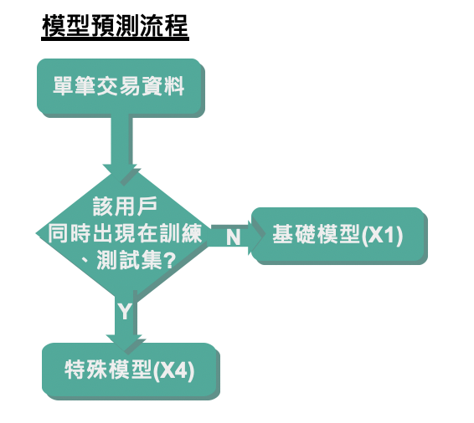
Summary
Some users(bacno) in both training and testing set.
Capture the information of the label
Note: May not work in real world

Slide 17
Model Specification
Simplified Model
  Apply limited number of new features
  Prevent overfitting
  Implement quickly
  Low Maintenance cost

Slide 18
Model Specification
Focus Learning
  Replace the value of categorical features of training set with NA if the value is not in testing set
  Reduce to learn something useless when apply in testing set

Slide 19
Model Specification
Using GroupKfold
  Use early stopping and split the training set by GroupKFold(bacno)
  Stop training once the model performance stops improving on a hold out validation dataset
  Model stop earlier (prevent overfitting)

Slide 20
Model Specification
Drop extreme cases
  Some of the predictions of testing set are very extreme between folds
  Drop if it is out of 1 standard deviation boundary
  Exclude the extreme cases
  Details: https://github.com/aarontong95/TBrain_Credit_Card

Slide 21
Thank You!

