Slide 1


What is this?

Slide 2
What is this?
This is a DOG.

Slide 3
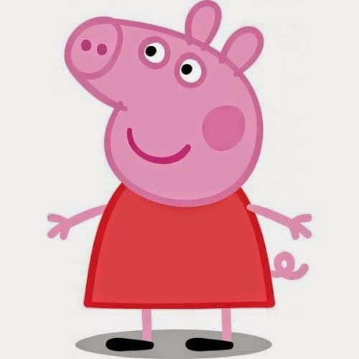
What is this?

Slide 4
What is this?
This is a PIG.

Slide 5

What is this?

Slide 6
What is this?
This is a FISH.

Slide 7
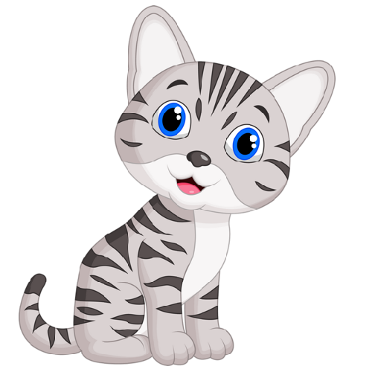
What is this?

Slide 8
What is this?
This is a CAT.

Slide 9
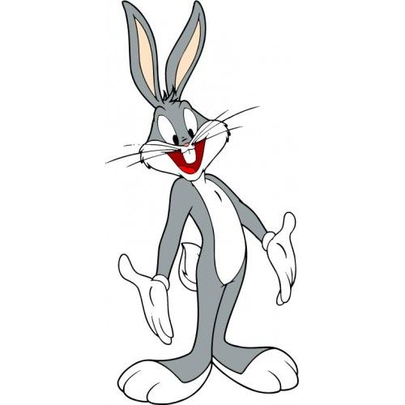
What is this?

Slide 10
What is this?
This is a RABBIT.

Slide 11
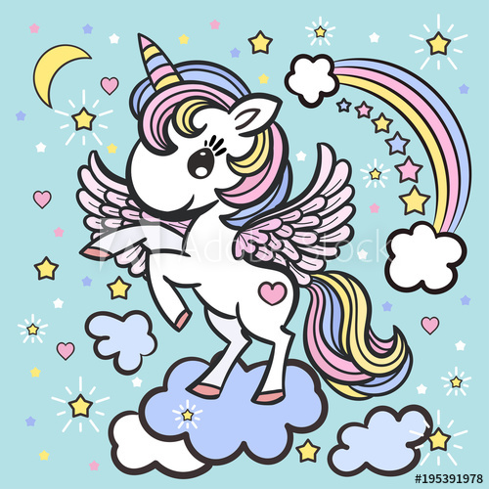
What is this?

Slide 12
What is this?
This is a UNICORN.

Slide 13
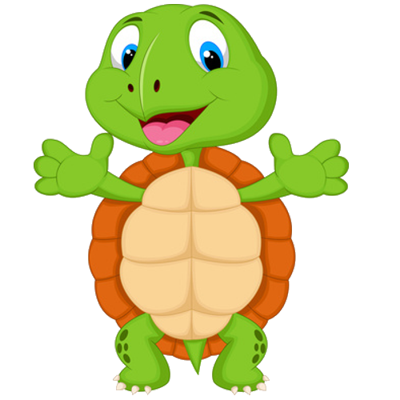
What is this?

Slide 14
What is this?
This is a TURTLE.

Slide 15
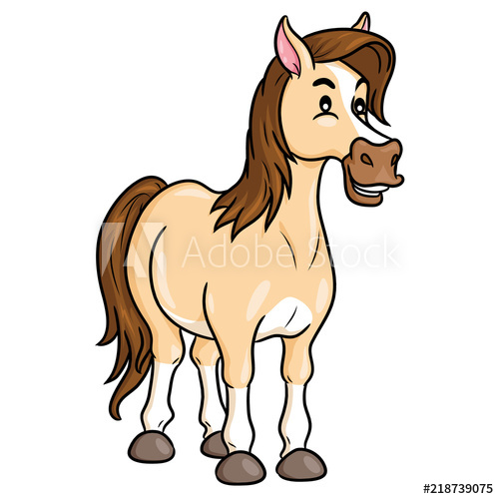
What is this?

Slide 16
What is this?
This is a HORSE.
This is a HORSE.

Slide 17
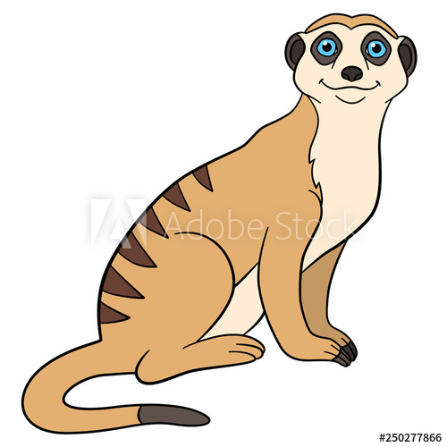
What is this?

Slide 18
What is this?
This is a MEERKAT.

Slide 19
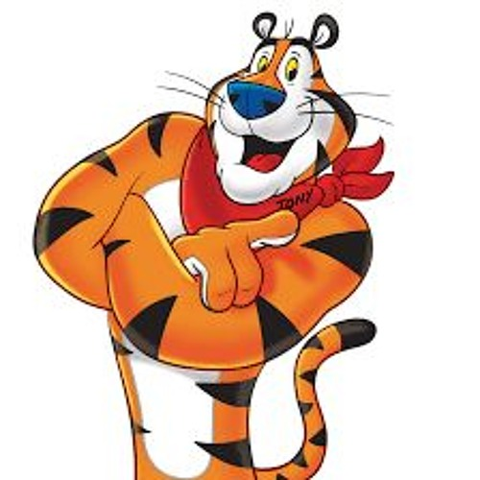
What is this?

Slide 20
What is this?
This is a TIGER.

