Slide 1
Figures in Our Paper

Slide 2













$$c_{1}$$
Execution Times of the modes
$$c_{2}$$
$$c_{3}$$
$$c_{4}$$
$$c_{5}$$
$$c_{m}$$
$$ω_{{rb}_{0}}$$
$$ω_{{rb}_{1}}$$
$$ω_{{rb}_{2}}$$
$$ω_{{rb}_{3}}$$
$$ω_{{rb}_{4}}$$
$$ω_{{rb}_{5}}$$
$$ω_{{rb}_{m}}$$
Speeds

Slide 3

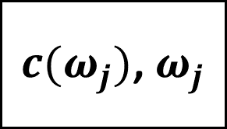
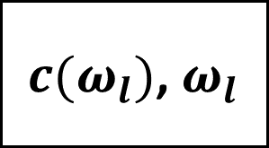



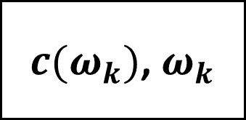

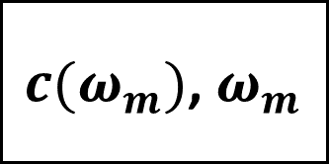

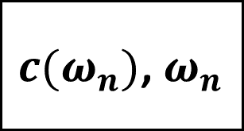


$$\tilde{T}(ω_{l},ω_{m})$$
$$\tilde{T}(ω_{n},ω_{o})$$
$$\tilde{T}(ω_{m},ω_{n})$$
$$\tilde{T}(ω_{k},ω_{l})$$
$c(ω_{l})$, $ω_{l}$
$c(ω_{n})$, $ω_{n}$
$c(ω_{m})$, $ω_{m}$
$c(ω_{k})$, $ω_{k}$
$$\tilde{T}(ω_{j},ω_{j})$$
$c(ω_{j})$, $ω_{j}$
$$j→k→l→m→n→o$$
$$\tilde{T}(ω_{j},ω_{j})$$
$c(ω_{j})$, $ω_{j}$
Time Interval = Size of the Knapsack

Slide 4
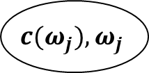


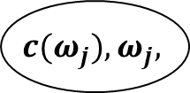

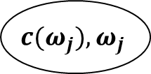
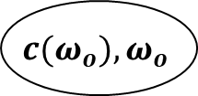

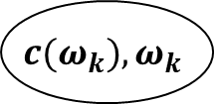


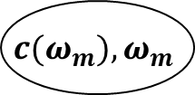



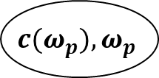


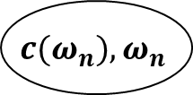


$$c(ω_{j}),ω_{j}$$
$\tilde{T}$($ω_{j}$, $ω_{j}$)
$\tilde{T}$($ω_{k}$, $ω_{j}$)
$$c(ω_{j}),ω_{j}$$
$$c(ω_{k}),ω_{k}$$
$\tilde{T}$($ω_{j}$, $ω_{j}$)
$\tilde{T}$($ω_{l}$, $ω_{k}$)
$$c(ω_{j}),ω_{j},$$
$$c(ω_{l}),ω_{l}$$
$\tilde{T}$($ω_{k}$, $ω_{j}$)
$\tilde{T}$($ω_{m}$, $ω_{l}$)
$$c(ω_{k}),ω_{k}$$
$$c(ω_{m}),ω_{m}$$
$\tilde{T}$($ω_{n}$, $ω_{m}$)
$$c(ω_{n}),ω_{n}$$
$\tilde{T}$($ω_{o}$, $ω_{n}$)
$\tilde{T}$($ω_{p}$, $ω_{n}$)
$$c(ω_{o}),ω_{o}$$
$$c(ω_{p}),ω_{p}$$
$\tilde{T}$($ω_{o}$, $ω_{o}$)
$$c(ω_{o}),ω_{o}$$

